Slide 1
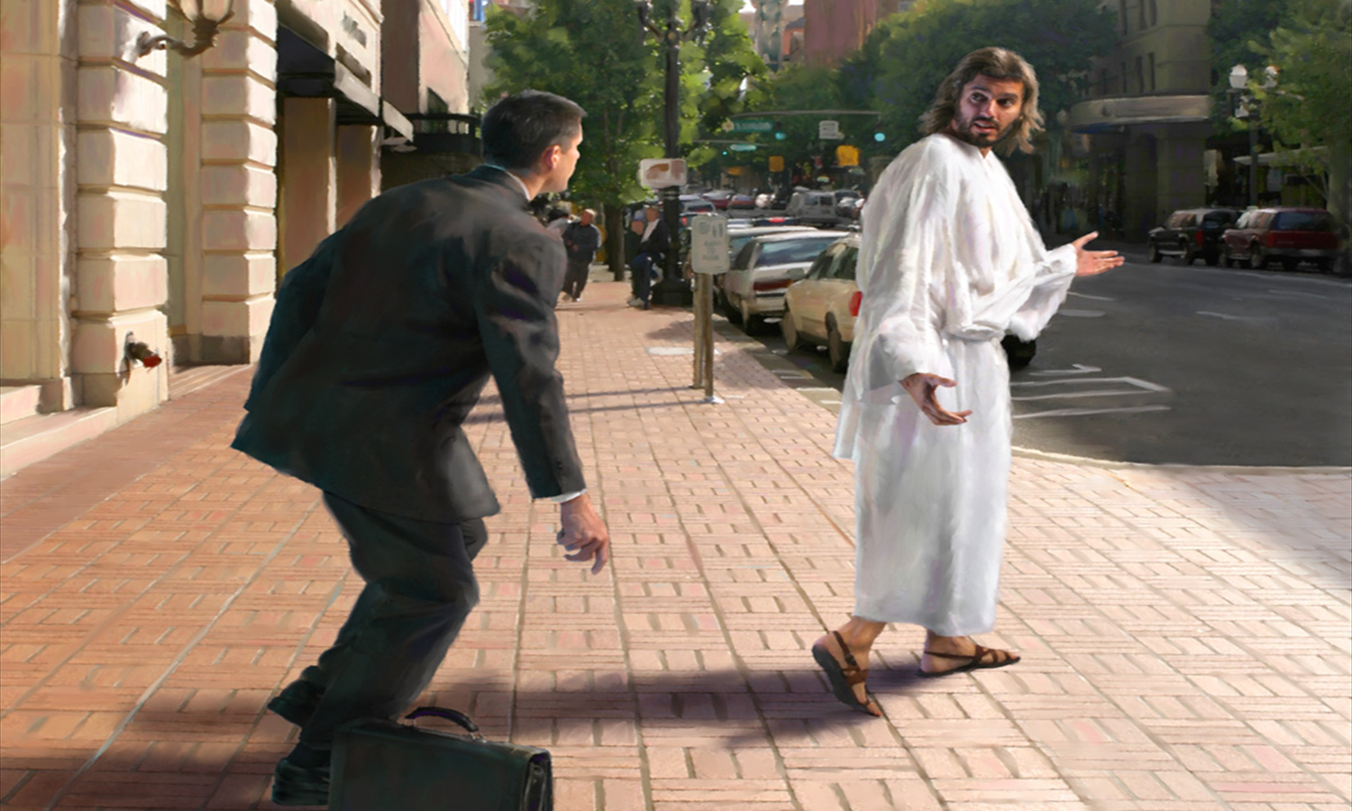
Is Jesus Lord of My Life?
Theme : Lessons on Christian Living -
Chapter 1 - Putting Christ First
Key verse: Matthew 6:33
Date : 4 June 2017

Slide 2
But seek first the Kingdom of God and His righteousness, and all these things shall be added to you. Matthew 6:33

Slide 3
Introduction
How do we live out the Lordship of Jesus? What does this journey of Christ’s Lordship look like?
Kingdom of God = the rule/authority of God (not a place)
Seek God’s righteousness = to seek the rule of God in my inner character

Slide 4
Is Jesus Lord of my life?
1. Why is Jesus the Rightful Lord of my life?
2. How I perform in my Lordship test depends on the choice I make ahead of time.
3. Can I predict how I will perform in my Lordship test?

Slide 5
1 Why is Jesus the Rightful Lord of my life?
Because of who He is
My Creator. Genesis 2:4. Genesis 1
My Provider. Genesis 1:29, 2:16, 17
My Sin-bearer and Deliverer. Luke 1:74, 75
My Judge. John 5:22

Slide 6
1 Why is Jesus the Rightful Lord of my life?
B) Because without making Him Lord, our spiritual journey with God cannot begin.
Abraham: God spoke to him only after he obeyed and left Us
Moses: God was angry when Moses took His command casually at the beginning but called him friend only later in life when he was obedient Exodus 4:14, 33:11

Slide 7
Why is Jesus the Rightful Lord of my life?
b. Because without making Him Lord, our spiritual journey with God cannot begin.
Paul: Jesus called Paul, who replied... ”Who are you, Lord?” Acts 9:5
Our own salvation requires us to confess Jesus is Lord Romans 10:9

Slide 8
Why is Jesus the Rightful Lord of my life?
c. Because without making Him Lord, this spiritual journey on earth cannot work.
In relating with others, we would choose man’s applause instead of God’s approval. Result: we become hypocrites (actors) in giving, praying and are unforgiving. Matthew 6:1-15

Slide 9
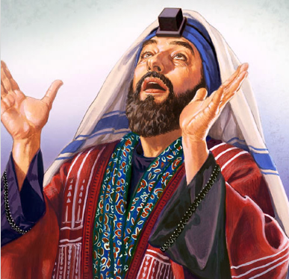
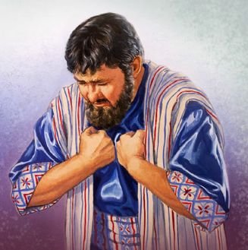
Why is Jesus the Rightful Lord of my life?
c. Because without making Him Lord, this spiritual journey on earth cannot work.
In relating To God, we would choose to be showy instead of cultivating our inner life. Result: we fast to be seen by others. Matthew 6:16-18

Slide 10
Why is Jesus the Rightful Lord of my life?
c. Because without making Him Lord, this spiritual journey on earth cannot work.
In relating to our daily needs, we would choose to accumulate treasures on earth instead of treasures in heaven. Result: what we treasure in our hearts. Matthew 6:19-21, darkens our spirit v22-23 and enslaves our will v24.

Slide 11
2 How I perform in my Lordship test depends on the choice I make ahead of time.
Do good people do bad things? Some examples of those who were tested:
King Saul failed the test of waiting and acted foolishly out of disobedience. 1 Samuel 13:1-13
King David failed when tempted with forbidden pleasure. 2 Samuel 12:7-10
“I have sinned against the Lord.” 2 Samuel 12:13
Job was tested in sufferings.
He did not blame God but said, “I repent in dust and ashes”...Job 42:6
KING SAUL
KING DAVID
JACOB

Slide 12
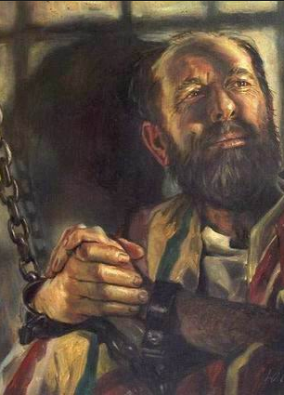
2 How I perform in my Lordship test depends on the choice I make ahead of time.
Paul was tested by
Imprisonment. Philippians 1:12-14
possible death. Philippians 1:21-23
enemies in the church. Philippians. 3:18-21
disagreements among church members. Philippians 4:2-3
yet he said, “I have learned to be content whatever the circumstances”. Philippians 4:11-13

Slide 13
Application:
Can I predict how I will perform in my Lordship test?
Yes, by evaluating the depth of my relationship with the Lord Jesus through:
a) Choices - daily to exalt the Lord
b) Sacrifices - I make to obey
c) Time - spent in meditating His Word and prayer.
Choose one to apply this week.

