Slide 1
How to have an Encounter with GOD
Pre-Encounter
Session 1

Slide 2
1. What is Encounter?

Slide 3
1. What is an Encounter?
EYE SEE IT NOW

Slide 5
See
Oh I See!

Slide 6
Personal
MY Personal Encounter!

Slide 7
Experience
Touched
Love
Forgiven
Joy
Miracles
Peace
Vision
Word
Warm

Slide 8
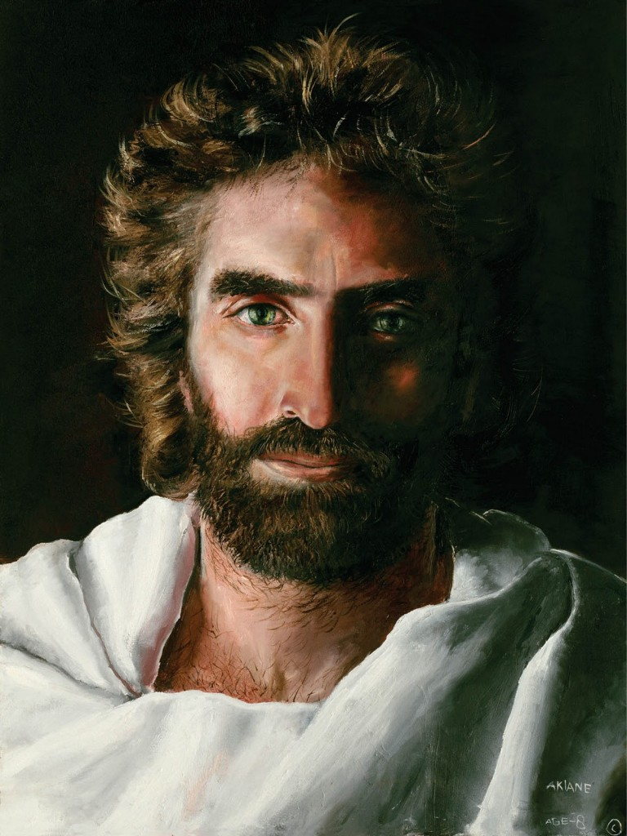
1. What is Encounter?
See
Personal
Experience

Slide 9
2. Why should you Encounter GOD?
Life Renewed
Life Transformed
Life Fulfilled
“I’ve come to seek and to save what is lost”
Luke 19:10

Slide 10
Life Renewed
Jesus accepted him

Slide 11
Life Transformed
Jesus changed his life

Slide 12
Life Fulfilled
Jesus with him

Slide 13
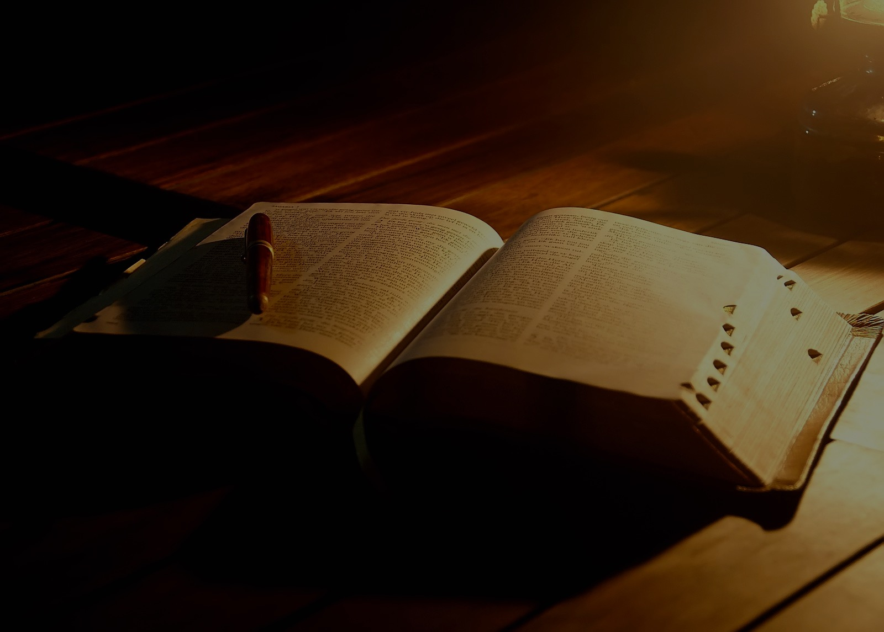
You will seek me and find me when you seek me with all your heart
Jeremiah 29:13

Slide 14
"For I know the plans I have for you," declares the LORD, "plans to prosper you and not to harm you, plans to give you hope and a future."
Jeremiah 29:11

Slide 16
2. Why should you Encounter GOD?
Life Renewed
Life Transformed
Life Fulfilled
“I have plans to prosper you and to
give you hope and a future.” – Jeremiah 29:11

Slide 17
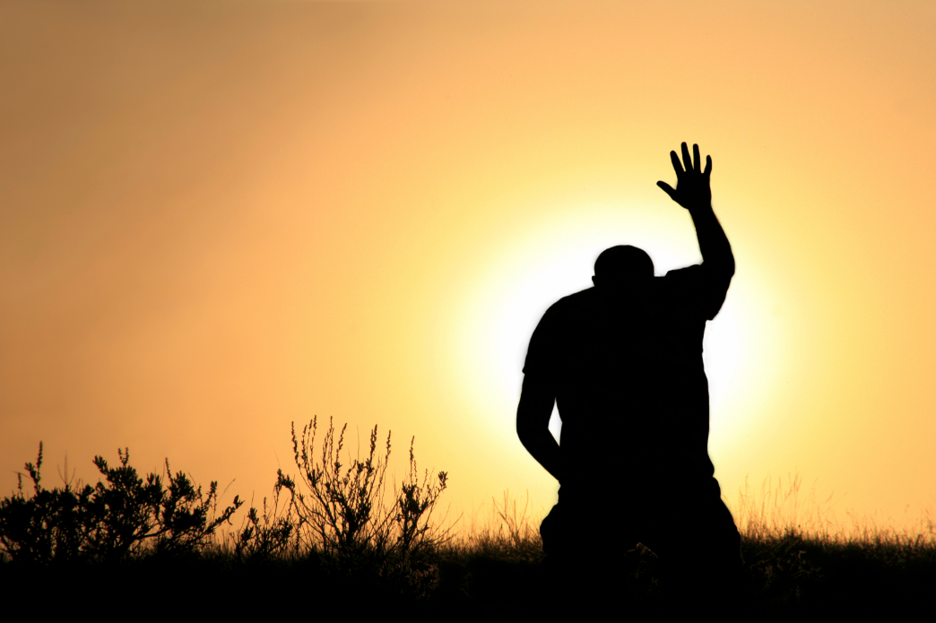
3. How you can have an Encounter with GOD?
Heart
Faith
Change
I want!

Slide 18
Heart
I want to see

Slide 19
Faith
I will take action

Slide 20
Change
I want to change

Slide 21
3. How you can have an Encounter with GOD?
Heart
Faith
Change
I want to see
I will take action
I want to change
LORD I want!

Slide 22
Invitation is OPEN! Encounter GOD

