Slide 1


Slide 2
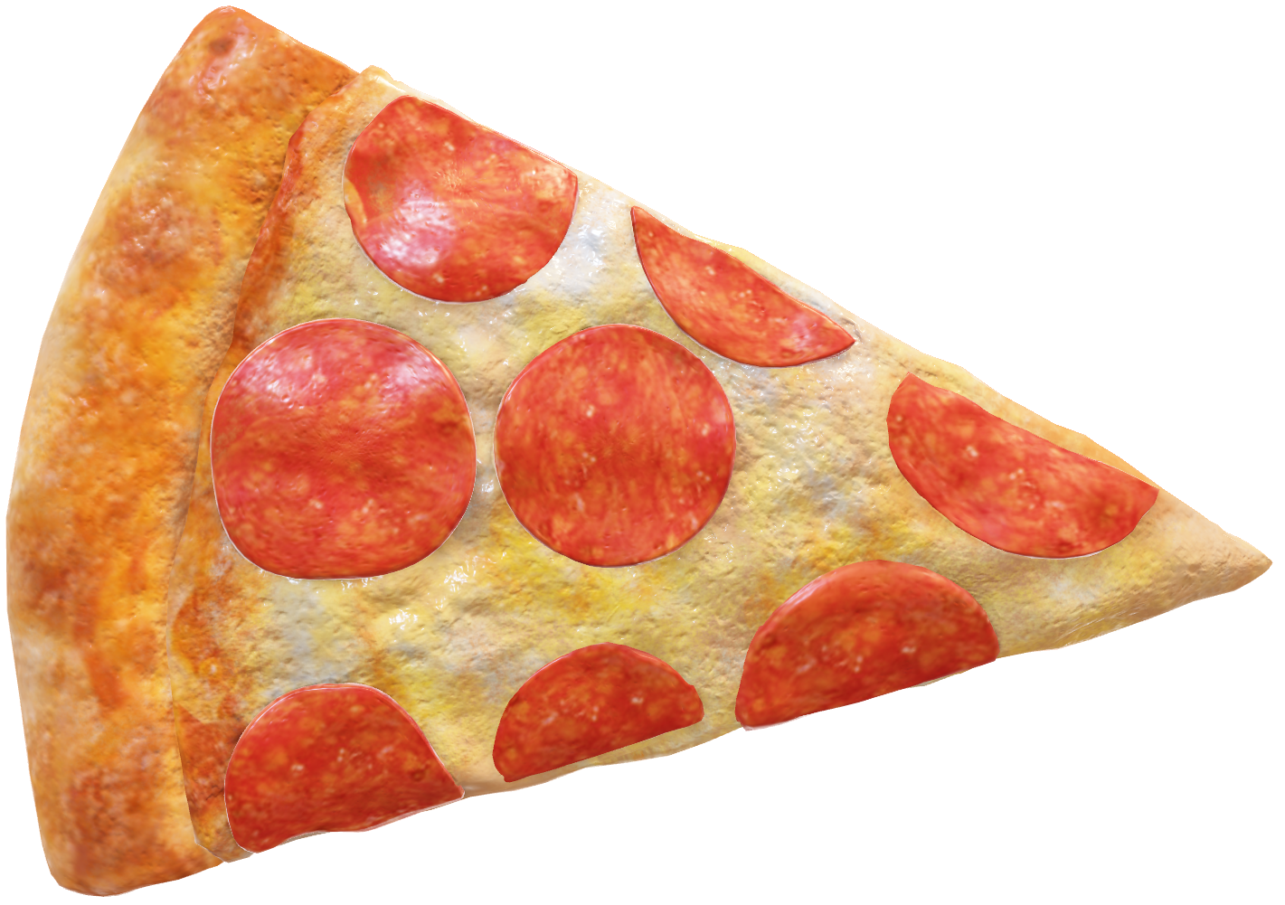
Pizza

Slide 3
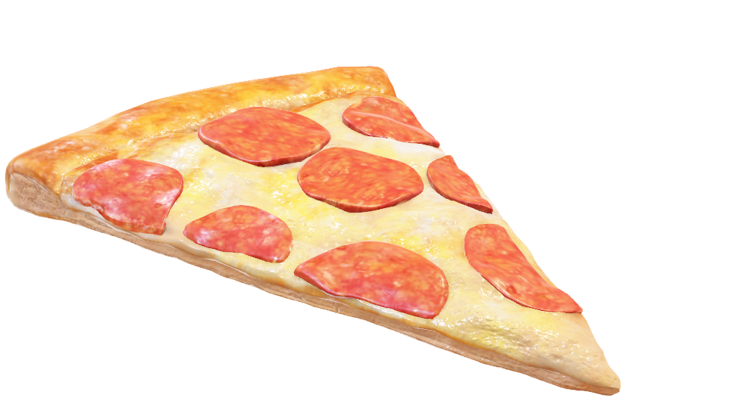
Pizza

Slide 4


Slide 5


