Slide 1
T-SQL Programming Best Practices for Developers
Copyright © 2016 Madeira Ltd
All Rights Reserved
Full rights, including copyrights, belong exclusively to Madeira Ltd
No use of the materials, in any form, is allowed,
unless receiving a prior written permission from Madeira Ltd.

Slide 2
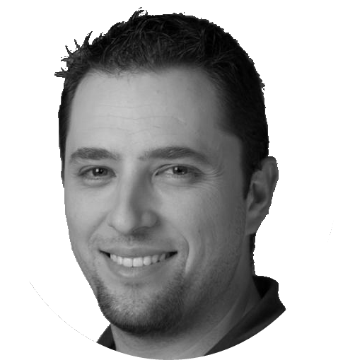
About Me
Email Address: eitan@madeiradata.com
Twitter: @EitanBlumin
Blog: www.madeiradata.com/author/eitan
Eitan Blumin
Senior Consultant

Slide 3
Course Objectives
Familiarize with common mistakes and pit falls in TSQL
Learn about best practices for how to avoid and fix these mistakes and pit falls

Slide 4
Prerequisites
Experience in Writing Transact-SQL Code
Experience in Writing SQL Queries
Familiarity with SQL Server Client Tools

Slide 5
Course Outline
Course Introduction
Variables
Local Variables
Table Variables
Functions
Cursors
Other Common Pit Falls

