Slide 1
INTRODUCTION TO
ISLAMIC FINANCE AND BANKING
110 CODE

Slide 2
Learning Objectives
Upon the completion of this chapter, the reader should be able to:
1. Describe the conceptual basis of the modern practice of Islamic banking and finance;
2. Explain the historical development and conceptual arguments of Islamic banking and finance;
3. Understand the components and operating structure of the Islamic banking and finance industry as well as the process of development of Islamic finance products;
4. Describe the current size and worldwide spread if Islamic banking and finance.

Slide 3
Learning Objective 1.1
Describe the conceptual basis of the modern practice of Islamic banking and finance.
Basis of Islamic Banking and Finance
The basis of Islamic finance is Islamic law, which is also known as the Shari’ah
The central ruling body is the International Islamic Fiqh Academy (IIFA)
The underlying principles of the modern Islamic banking and finance industry include:
      The prohibition of interest and excessive risk
      The permissibility of lawful sales
      Islamic entrepreneurship

Slide 4
Learning Objective 1.1
Describe the conceptual basis of the modern practice of Islamic banking and finance.
Basis of Islamic Banking and Finance
The Shari’ah
Defines man-to-God and man-to-man relationships
Shari’ah is the Devine prescriptions in the form of faith and belief, laws and moral norms broadly classified into two strands:
    ibadah (worship and devotional practices)
    muamalat (civil transactions)
The primary sources of the Shari’ah are the Qur’an and Sunnah

Slide 5
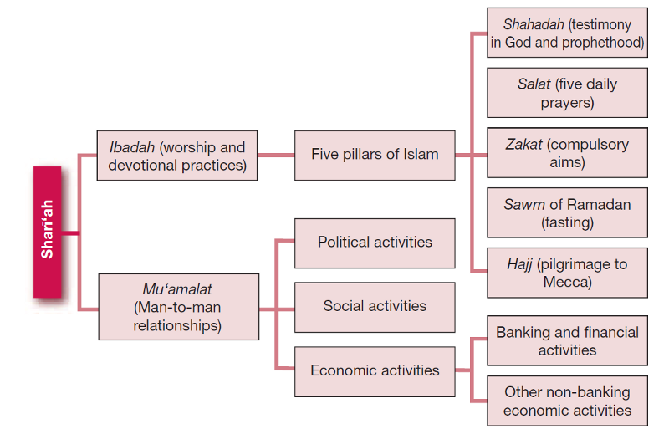
Learning Objective 1.1
Describe the conceptual basis of the modern practice of Islamic banking and finance.
Basis of Islamic Banking and Finance
Figure 1.1: Shari’ah as the Basis of Islamic Banking and Finance

Slide 6
Learning Objective 1.1
Describe the conceptual basis of the modern practice of Islamic banking and finance.
Basis of Islamic Banking and Finance
The Qur’an
The first source of the Shari’ah
General and specific rules on religious, commercial, political, economic, legal and social norms
Emphasis on mutual consent and consensus among consenting parties
Prohibits exploitative measures:
    Excessive risk or uncertaintly (gharar)
    Usary or interest (riba)
Prohibits cheating and corrupt practices in the management of funds
Does not allow dealings in prohibited products

Slide 7
Learning Objective 1.1
Describe the conceptual basis of the modern practice of Islamic banking and finance.
Basis of Islamic Banking and Finance
The Sunnah
The second primary source of the Shari’ah
Comprises the sayings, practices and tacit approvals of the Prophet Muhammad (PBUH)
Meant to further explain the injunctions of the Qur’an
For example, there are many prophetic traditions that deal with riba that highlight the affirmative evidence of the prohibition of riba already mentioned in the Qur’an

Slide 8
Learning Objective 1.2
Explain the historical development and conceptual arguments of Islamic banking and finance
Origins and Historical Overview of Islamic Banking and Finance
The history of Islamic finance is divided into two general aspects:
  The early days transactions
  The modern-day experiments

Slide 9
Learning Objective 1.2
Explain the historical development and conceptual arguments of Islamic banking and finance
Origins and Historical Overview of Islamic Banking and Finance
The early days transactions
The Era of the Prophet
The Period of Orthodox Caliphate (632 – 661 C.E.)
Period of the Noble Companions and the Succeeding Generations
The Umayyad and Abbasid Eras
Notes:
<number>

Slide 10
Learning Objective 1.2
Explain the historical development and conceptual arguments of Islamic banking and finance
Origins and Historical Overview of Islamic Banking and Finance
The Era of the Prophet
The prevailing modes of transactions during this era include:
Shirkah (partnership) based on profit-and-loss sharing (PLS)
Al qard Al hasan (benevolent loan)
Salam (Forward) contract
Sarf (exchange of money), i.e. gold for gold and silver for silver at the same sitting
Ijarah (leasing)
Trans-regional trade involved trade caravans from Mecca to Syria and vice versa

Slide 11
Learning Objective 1.2
Explain the historical development and conceptual arguments of Islamic banking and finance
Origins and Historical Overview of Islamic Banking and Finance
The Period of Orthodox four rightly-guided Caliphs: (632 – 661 C.E.)
Abu Bakr Assidique (632 – 634)
Failure of a segment of the Islamic state to pay the compulsory alms known as zakat.
Umar ibn Al-Khattab (634 – 644)
- Dramatic reforms in the economic policy of the state.
- The introduction of a centralized and permanent Bait al-mal (the Treasury House)
Uthman ibn Affan (644 – 656)
The introduction of the first Muslim coins
Ali ibn Abi Talib (656 – 661)

Slide 12
Learning Objective 1.2
Explain the historical development and conceptual arguments of Islamic banking and finance
Origins and Historical Overview of
Islamic Banking and Finance
Period of the Noble Companions and the Succeeding Generations marked by:
Building on the reforms introduced by the Prophet (PBUH)
Tremendous increase in commercial interaction between merchants in the Islamic state and elsewhere
Further development of fiqh (Islamic jurisprudence)
Advanced economic reforms based on self-exerted judgment (ijtihad)

Slide 13
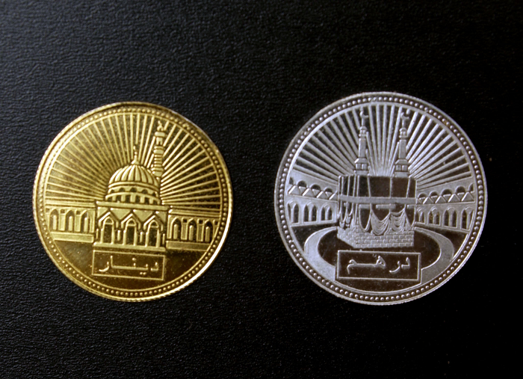
Learning Objective 1.2
Explain the historical development and conceptual arguments of Islamic banking and finance
Origins and Historical Overview of
Islamic Banking and Finance
The Umayyad and Abbasid Eras
Issuance of the first Islamic dirham (containing the crescent, the star, and bismillah)
Shifting of the Treasury House to Damascus, capital
of the Umayyad, where a
bigger building was designated
as Bait al-Mal
The Treasury House still
significant during the Abbasid
period and Mamluk era
The dinar and dirham still
used as mediums of exchange

Slide 14
Learning Objective 1.2
Explain the historical development and conceptual arguments of Islamic banking and finance
Origins and Historical Overview of
Islamic Banking and Finance
Modern-Day Experiments of Islamic Finance marked by:
The Ottoman Empire’s fall resulting in fragmentation of Muslim nation into different countries
Prevalence of interest-based banking and finance system
Lack of awareness among Muslim communities across nations on whether to return to Islamic roots
Experiments in Islamic finance in Egypt, Malaysia, and Pakistan: the basis of modern Islamic banking and finance

Slide 15

Learning Objective 1.2
Explain the historical development and conceptual arguments of Islamic banking and finance
Origins and Historical Overview of
Islamic Banking and Finance
Timeline of Modern-day Experiments of
Islamic Banking and Finance from 1962 to 1975
Initial Reforms in the Banking Industry in Pakistan in 1962
Mit Ghamr Local Savings Bank in Egypt of 1963 (“the first modern-day trial of Islamic baking”)
The Malaysian Pilgrims Savings
Board, Tabung Haji of 1969
(managing savings of prospective
pilgrims by investing in Sharī’ah-
compliant investments)
The Founding of the Islamic
Development Bank (IDB) in 1975

Slide 16
Learning Objective 1.2
Explain the historical development and conceptual arguments of Islamic banking and finance
Origins and Historical Overview of
Islamic Banking and Finance
The functions of the IDB are:
To participate in equity capital and to grant loans
To provide financial assistance to member countries
To establish and operate special funds for specific purposes
To accept deposits and to mobilize financial resources through Sharī’ah compatible modes
To promote foreign trade, especially in capital goods, among member countries

Slide 17
Learning Objective 1.2
Explain the historical development and conceptual arguments of Islamic banking and finance
Origins and Historical Overview of
Islamic Banking and Finance
Dubai Islamic Bank (DIB)
The first fully-fledged Islamic world commercial bank in 1975. Operates five main business groups:
Retail banking
Corporate banking
Real estate
Investment banking
Proprietary trading investments

Slide 18
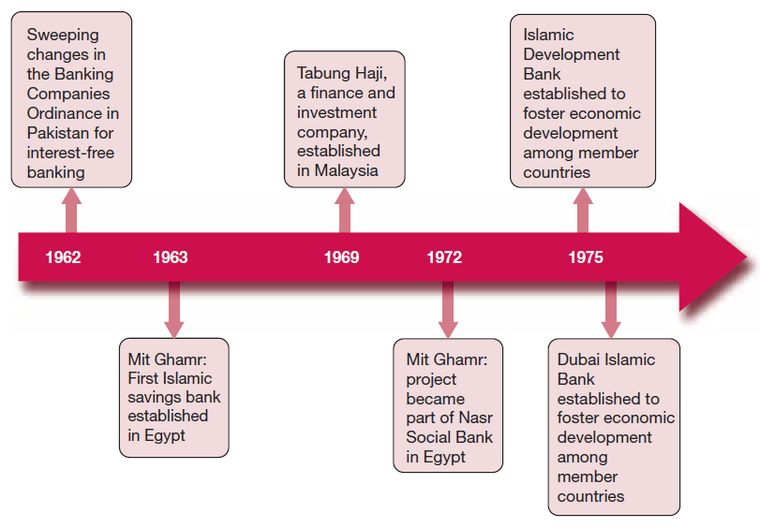
Learning Objective 1.2
Explain the historical development and conceptual arguments of Islamic banking and finance
Origins and Historical Overview of
Islamic Banking and Finance
Timeline of Modern-day Experiments of Islamic banking and finance from 1962 – 1975
Figure 1.2: Timeline of Modern-day Experiments of Islamic banking and finance from 1962 to 1975

Slide 19
Learning Objective 1.2
Explain the historical development and conceptual arguments of Islamic banking and finance
Conceptual Arguments for Islamic
Banking and Finance
The fundamentals of Islamic banking and finance business are:
Interest-free
Ethical
Asset-based and asset-backed
Partnership investment based on profit and loss sharing (PLS) between financer and entrepreneur

Slide 20
Learning Objective 1.2
Explain the historical development and conceptual arguments of Islamic banking and finance
The Development of Islamic Banking
and Finance Industry
Emergence of the modern Islamic banking and finance industry in the 1960s
Gradual expansion of the Asian markets between the 1980s and ‘90s
Introduction of Islamic insurance (takaful)
Introduction of project financing with the support of the IDB
Introduction of sukuk (Islamic bonds) and equities markets in the 1990s
Internationalization of Islamic banking and finance from the early 2000s

Slide 21
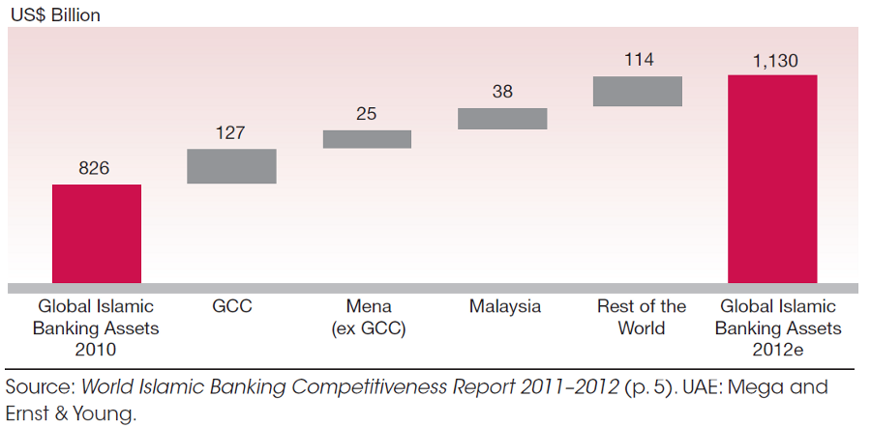
Learning Objective 1.2
Explain the historical development and conceptual arguments of Islamic banking and finance
The Development of Islamic Banking
and Finance Industry
Figure 1.3: Total Global Islamic Banking Assets Growth 2012

Slide 22
Learning Objective 1.3
Understand the components and operating structures of the Islamic banking and finance industry as well as the process of development of Islamic finance products.
Components of Islamic Banking and
Finance Industry
The four major components of the Islamic banking and finance industry are:
Islamic banking
Takaful
Islamic capital markets
Islamic non-bank financial institutions
These form the Islamic financial architecture and infrastructure

Slide 23
Learning Objective 1.3
Understand the components and operating structures of the Islamic banking and finance industry as well as the process of development of Islamic finance products.
Components of Islamic Banking and
Finance Industry
Islamic Banking
The Islamic banking component:
Deposit-taking and finance of institutions to meet needs of Muslim customers and investors
May be:
- Fully fledged Islamic banks
- Islamic subsidiaries or
- ‘Windows’ of conventional banks

Slide 24
Learning Objective 1.3
Understand the components and operating structures of the Islamic banking and finance industry as well as the process of development of Islamic finance products.
Components of Islamic Banking and
Finance Industry
Takaful (Islamic Insurance)
Takaful based on mutual cooperation, common welfare and general good of society
Development of modern takaful began with debates about legality of conventional insurance schemes
Controversy resolved by the Islamic Fiqh Academy in Resolution No. 9 of 1985
Takaful and retakaful significant in managing and mitigating risks in Islamic banking and finance

Slide 25
Learning Objective 1.3
Understand the components and operating structures of the Islamic banking and finance industry as well as the process of development of Islamic finance products.
Components of Islamic Banking and
Finance Industry
The Islamic Capital Markets (ICM)
ICM is a special market where investment activities do not contradict the principles of the Sharī‘ah
The Islamic Capital Market is free riba, gharar and maysir
The market players include:
- Brokerage houses
- Investment banks
- Fund management institutions
- Islamic asset management institutions

Slide 26
Learning Objective 1.3
Understand the components and operating structures of the Islamic banking and finance industry as well as the process of development of Islamic finance products.
The Islamic Capital Markets (ICM)
Various international bodies established to study, promote, develop and set standards for Islamic finance products include:
- International Islamic Financial Market (IIFM)
- Islamic Financial Services Board (IFSB)
- Accounting and Auditing Organization for Islamic Financial Institutions (AAOIFI).

Slide 27
Learning Objective 1.3
Understand the components and operating structures of the Islamic banking and finance industry as well as the process of development of Islamic finance products.
Components of Islamic Banking and
Finance Industry
Islamic non-bank financial institutions
Islamic financial institutions that play a facilitative role in Islamic society ensuring economic development through non-bank financing
They support liquidity needs of major agents in the economy
They include: finance companies, Islamic housing cooperatives, Islamic microfinance institutions, waqf management institutions, private equity /venture capital firms, hajj and zakat management bodies

Slide 28
Components of Islamic Banking and
Finance Industry
Learning Objective 1.3
Understand the components and operating structures of the Islamic banking and finance industry as well as the process of development of Islamic finance products.
Islamic financial architecture and
infrastructure
Crucial support for Islamic financial services:
payment-settlement, legal institutions and framework
safety net
liquidity support providers
corporate governance e.g Sharī‘ah governance structure
standard setters for financial supervision and infrastructure
rating and external credit assessment institutions
financial statistics and information providers
knowledge management/HR development institutions
research and development institutions.

Slide 29
Learning Objective 1.3
Understand the components and operating structures of the Islamic banking and finance industry as well as the process of development of Islamic finance products.
Operating Structures of Islamic
Banking and Finance Industry
Key operating mechanisms of Islamic banking and finance industry include:
Fund mobilization
Fund utilization
- Sharing modes
- Sale modes
- Leasing modes

Slide 30
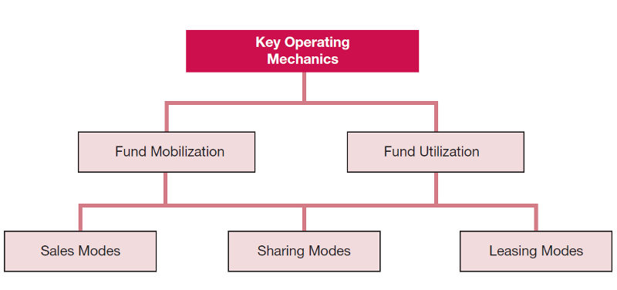
Learning Objective 1.3
Understand the components and operating structures of the Islamic banking and finance industry as well as the process of development of Islamic finance products.
Key Operating Mechanisms of
Islamic Banking and Finance
Figure 1.4: Key Operating Mechanisms of Islamic Banking and Finance

Slide 31
Learning Objective 1.3
Understand the components and operating structures of the Islamic banking and finance industry as well as the process of development of Islamic finance products.
Key Operating Mechanisms of
Islamic Banking and Finance
Fund mobilization
The process of raising funds to establish a viable financial
institution through the sale of shares to investors and
receiving funds from depositors. Features include:
An ethical manner
Net equities owned by shareholders
Investment deposits
Demand deposits

Slide 32
Learning Objective 1.3
Understand the components and operating structures of the Islamic banking and finance industry as well as the process of development of Islamic finance products.
Key Operating Mechanisms of
Islamic Banking and Finance
Fund utilization
The process of using the funds realized in Sharī'ah-compliant
business:
Sharing modes - Partnership where funds initially mobilized are invested in Sharī'ah-compliant business; parties share profits or loss
Sale modes – The bank purchases an item on behalf the client and resells it to them on a deferred basis or immediately
Leasing modes - The rent of an asset or hire purchase where a rental fee is paid for a stipulated period of time mutually agreed by the parties

Slide 33
Learning Objective 1.3
Understand the components and operating structures of the Islamic banking and finance industry as well as the process of development of Islamic finance products.
The Development of Islamic Banking
Products
Islamic banking products - financial tools through which the financial institutions carry out business
Designed to suit conventional market needs while retaining the true nature of Islamic financial transactions
Involve profitable and non-profitable dealings such as:
- zakat (alms)
  - waqf (charitable endowment)
- tabaru‘at (gratuitous contracts)

Slide 34
Learning Objective 1.3
Understand the components and operating structures of the Islamic banking and finance industry as well as the process of development of Islamic finance products.
The Development of Islamic
Banking Products
Islamic banking products initially based on ideas of equity partnership or partnership modalities
Early jurists employed ijtihad in developing Sharī‘ah-compliant products
Emphasis should be on developing Sharī‘ah-based
rather than Sharī‘ah-compliant financial products

Slide 35
Learning Objective 1.4
Describe the current size and worldwide spread of Islamic banking and finance.
The Growth of Islamic Banking
and Finance
Islamic banking and finance being integrated into the global economy
The practice of Islamic banking and finance has now been accepted as an alternative to conventional financial systems
Acceptance attracts new non-Muslim experts, professionals and financial institutions

Slide 36
Learning Objective 1.4
Describe the current size and worldwide spread of Islamic banking and finance.
Islamic Banking Today: The Size of
the Industry
The industry has more than doubled in size since 2006
Sharī‘ah-complaint assets rose by 8.85% from US$ 822 billion in 2009 to US$ 895 billion in 2010
By end of 2011, total estimate of Sharī'ah-compliant assets was US $1.3 trillion
Rapid growth experienced in the Gulf Cooperation Council (GCC) countries over the last decade
Growth and expansion of Islamic finance industry continued at the time of global financial crisis

Slide 37
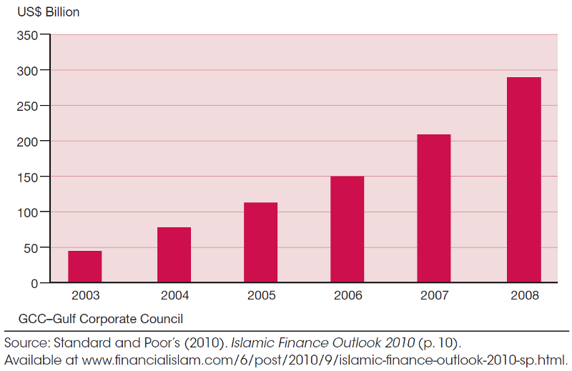
Learning Objective 1.4
Describe the current size and worldwide spread of Islamic banking and finance.
Total Assets of Islamic Banks
in the GCC Region
Figure 1.5: Total Assets of Islamic Banks in the GCC Region

Slide 38
Learning Objective 1.4
Describe the current size and worldwide spread of Islamic banking and finance.
The World-wide Spread of Islamic
Banking
Islamic commercial banking experiencing a huge expansion in products and areas of influence across the world.
2010 estimates show Islamic banks and financial institutions number 430 across over 75 countries.
Islamic banking spans the Middle East, North Africa, South-East and central Asia, sub-Saharan Africa, and western Europe.
More than 191 leading conventional banks in Europe and America have opened Islamic banking windows or subsidiaries such as Standard Chartered Bank, Citibank, HSBC, ABN AMRO, and UBS.
Notes:
<number>

Slide 39
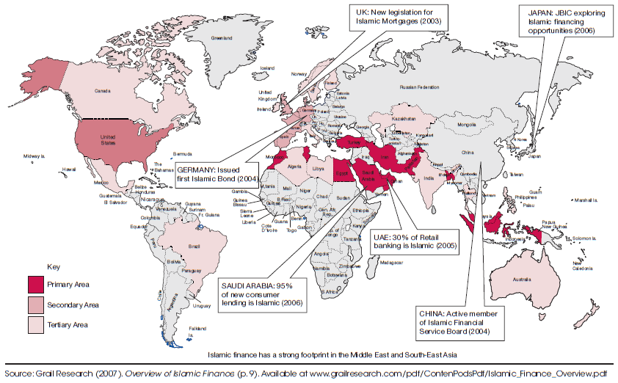
Learning Objective 1.4
Describe the current size and worldwide spread of Islamic banking and finance.
Global Coverage of Islamic Finance
Figure 1.6: Global Coverage of Islamic Finance

Slide 40
Learning Objective 1.4
Describe the current size and worldwide spread of Islamic banking and finance.
Multinational Islamic Banks
The main multinational Islamic banks are:
Jordan Islamic Bank – 1978/1979
Faisal Islamic Banks in Egypt and in Sudan – 1977/1978
Kuwait Finance House - 1977
Al Rajhi Bank - 1987
Islamic Development Bank (IDB) - 1975

Slide 41
Learning Objective 1.4
Describe the current size and worldwide spread of Islamic banking and finance.
Future of Islamic Finance Industry
Islamic finance set to continue significant growth path
Legal and regulatory challenges still face the emerging Islamic financial industry
Islamic finance has the potential of being an alternative mode of finance
Islamic finance assets expected to grow consistently at 15% per annum and exceed USD 1 trillion by 2016
Global spread of Islamic finance products likely to soon engulf Latin America and elsewhere

Slide 42
Key Terms
Bay al-salam
Fund mobilization
Fund utilization
Gharar
Hajj
Ijtihad
Leasing modes
Maysir
Mudarabah
Qard hasan
Retakaful
Riba
Sale modes
Sharing modes
Sukuk
Sunnah
Tabaru‘at
Takaful
Waqf
Zakat

