Slide 1
SOCIAL MEDIA Design Toolkit

Slide 2
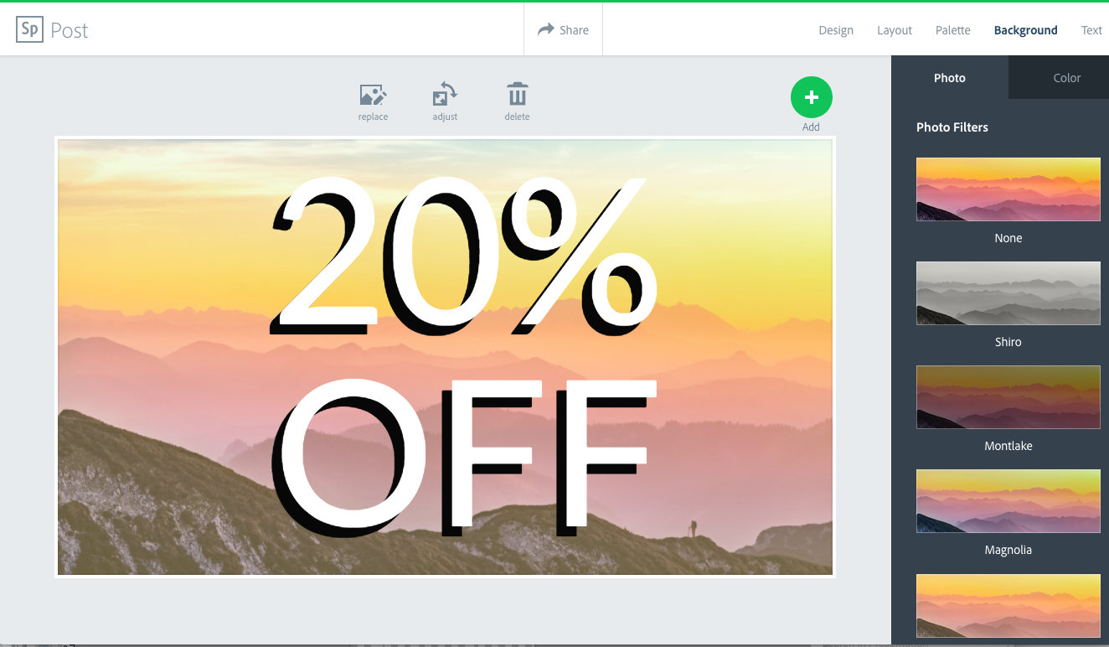
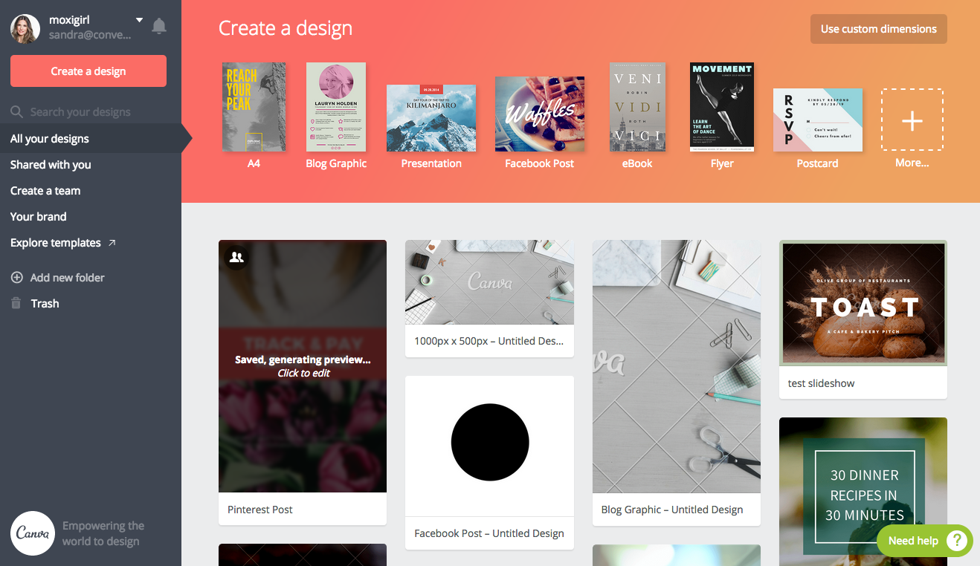
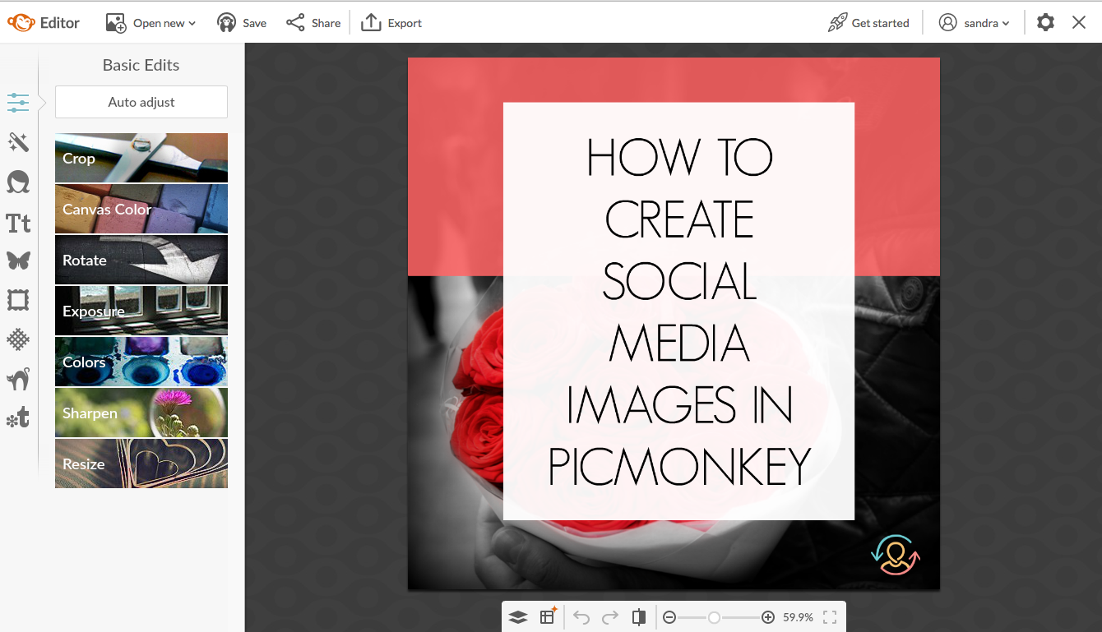
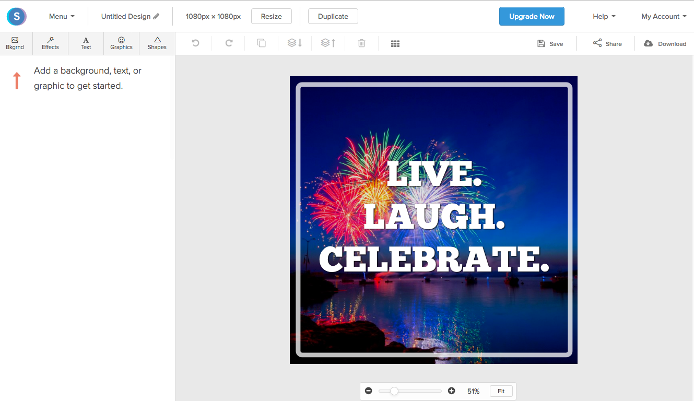
Tools to Design Social Media Images
Canva
PicMonkey
RelayThat
DesignBold
Snappa
Photoshop

Slide 3
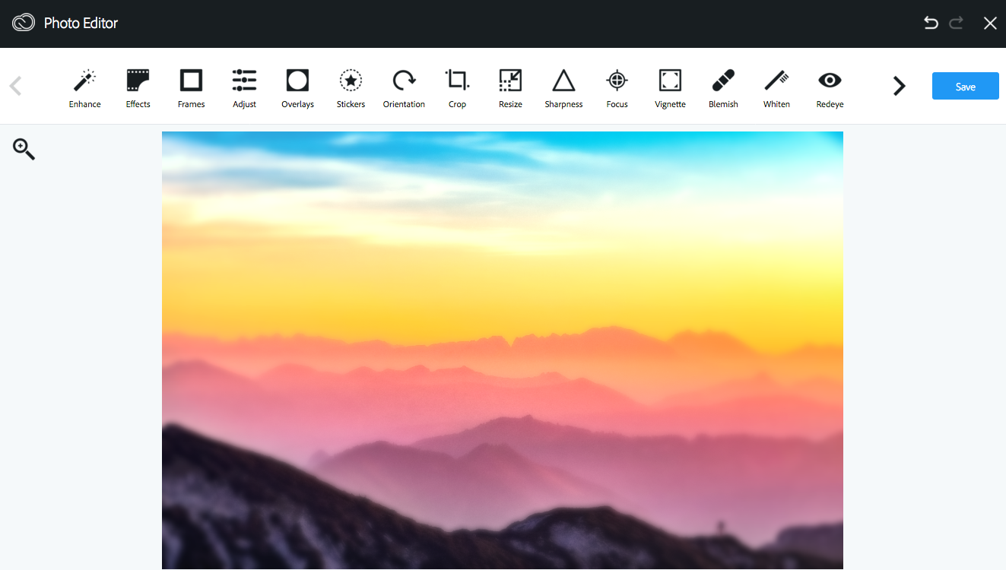
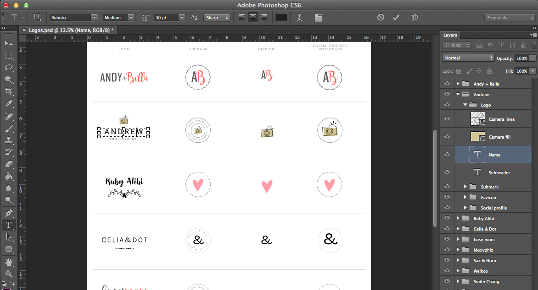
Other Helpful Graphic Tools
Tools to Edit Photos:
PicMonkey
Photoshop
Aviary
Tools to Design Infographics
Canva
PicMonkey
Photoshop
Piktochart
Infogram

Slide 4
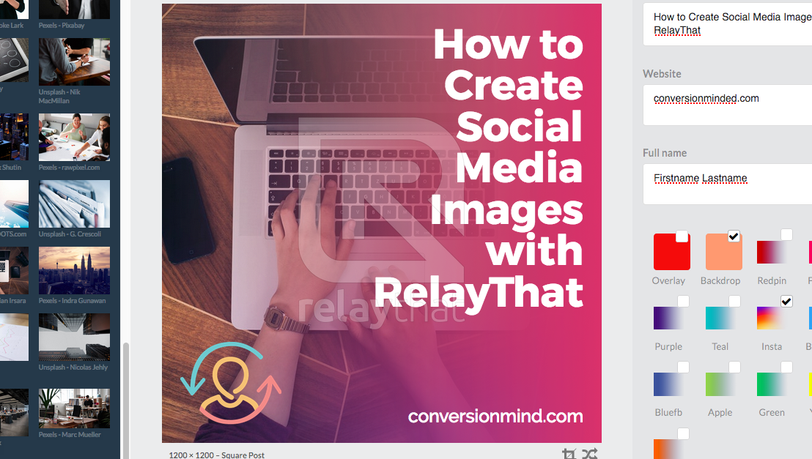
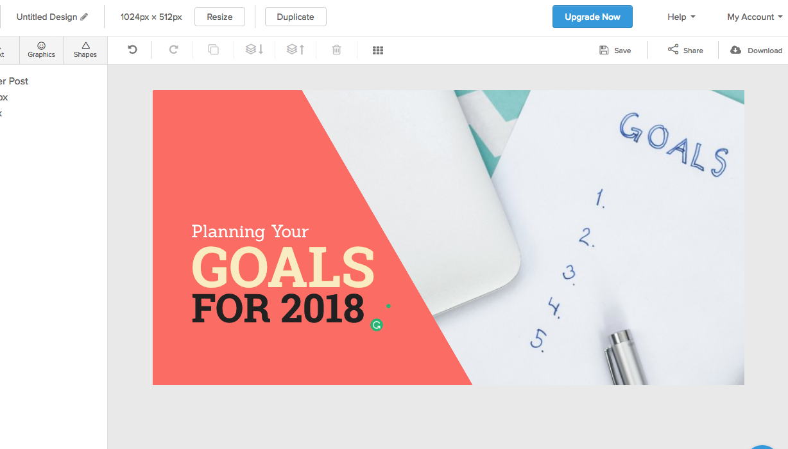
Best overall graphics tools for non-designers…
Canva
PicMonkey
RelayThat
Snappa

Slide 5
Photoshop vs Canva / PicMonkey Throwdown
Photoshop
Canva + PicMonkey
Must create custom templates
More creativity and flexibility
All-in-one graphic tool
Easy to change the color of icons
Not as hard to use as you might think
Pre-made templates
Design limitations
Easy to use out of the box
••Canva allows you to save brand colors, logo + fonts

Slide 6
Here’s Why I Love Photoshop…
Photoshop is the best graphics tool to create blog and social media images, and it’s not as hard as you might think!
You can shift the placement of your background image to accommodate text, so your text isn’t competing with the image.
You can easily resize the background image on the canvas.
Ghost out sections of your image to make text more legible
Edit your photos with many different filters + adjustments (hue, tone, color levels, balance).
Customize the colors of Flaticon and Freepik icons
Create any type of graphic (infographic, Pinterest, Instagram, etc)

