Slide 1
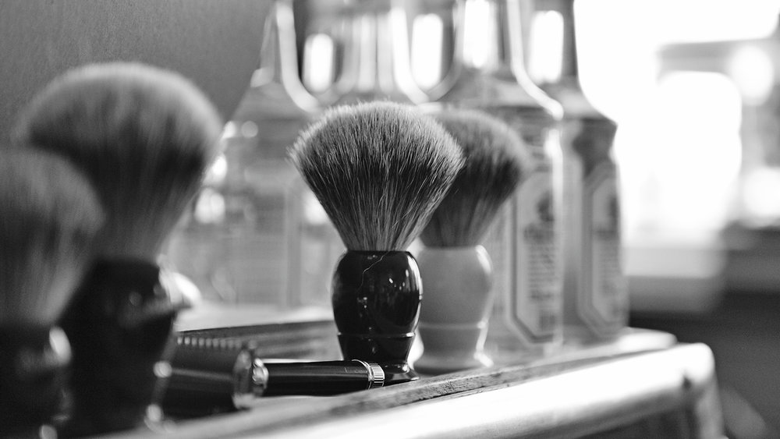
The history of barbering

Slide 2
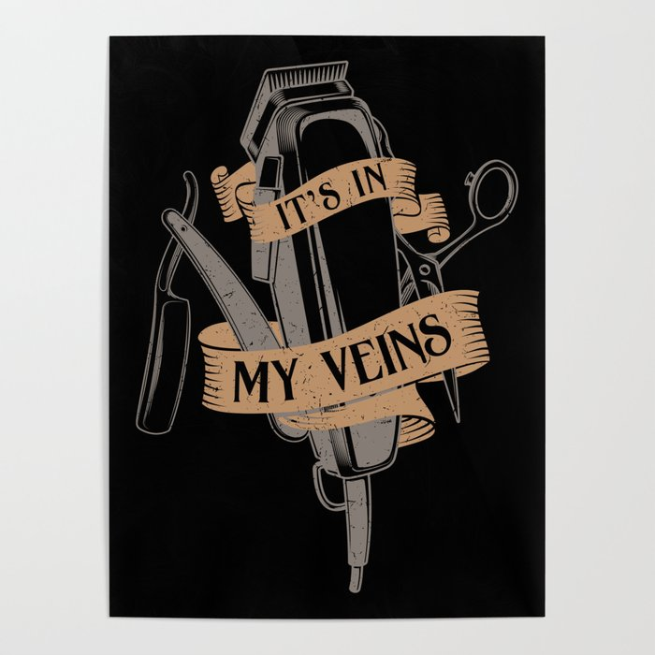
What is barbering?
The best profession in the world!!! Duh!! ☺ and also one of the oldest
All early cultures practiced some form of beautification and adornment
Archaeological evidence was found in painted pottery, early sculptures, and burial mounds.

Slide 3
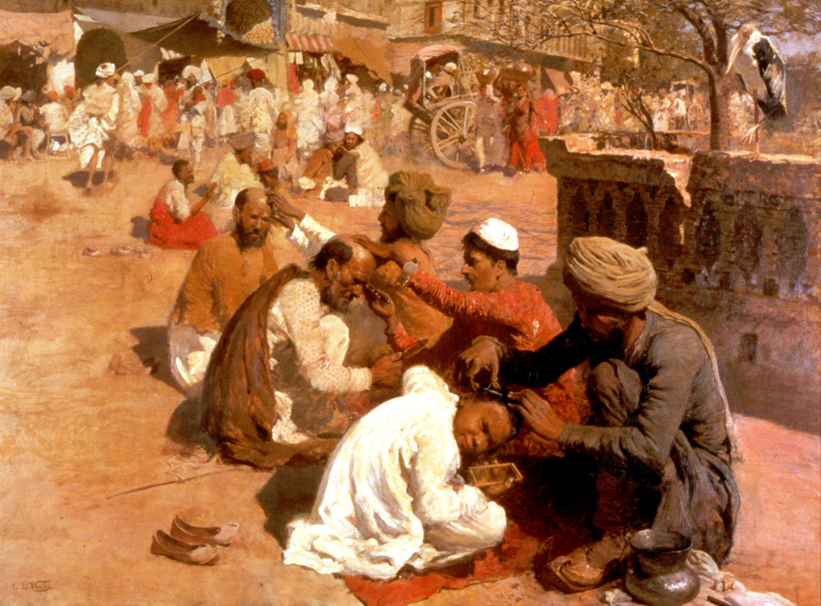
Why study the history?
Understanding its evolution can provide you with an appreciation of the prominent role it achieved in different cultures throughout the ages.
It will help you predict and understand upcoming trends
Having a clear picture of organizations and regultions developed will help you have a better idea of where you fit into in this profession.

Slide 4
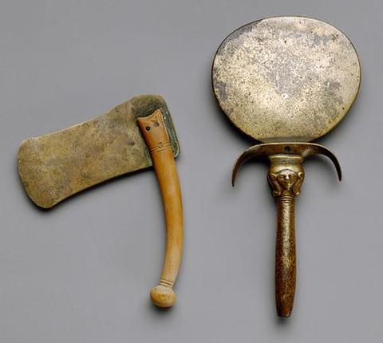
Ancient cultures
Haircutting and hairstyling were practiced as early as the Glacial age.
The implements used then were sharpened flints, oyster shells, or bone.
Animal sinew or strips of hide were used to tie hair back
Primative cultures maintained a connection between the body, mind, and spirit.
Superstitions and beliefs merged spirituality, religious rituals, and medical practices together.
Belief systems elevated tribal babers to positions of importance such as medicine men, shamans, or priest.
Barber is derived from the latin word barba, meaning “beard”.
Tonsorial comes from the latin word “tondere” meaning “to shear”
Tonsorial means the cutting, clipping, or trimming of hair with shears or a razor

Slide 5
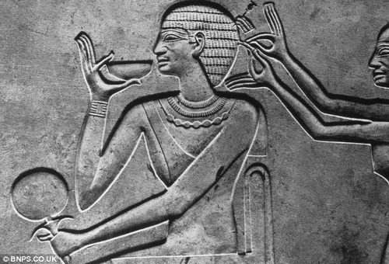
Egyptian culture
Egyptians are credited with being the first people to cultivate beauty in an extravagent fashion.
Combs, brushes, mirrors, cosmetics, scissors, and razors were made of tempered copper and bronze
They used berries, bark, minerals, and other natural materials to color there hair and nails.
Using henna as a coloring agaent was first recorded in 1500 b.c.
Every 3rd day the barbers shaved the priest entire body to ensure their purity before entering the temple.
Meryma’at was a barber held in high esteem, and his image was sculpted for posterity.

Slide 6
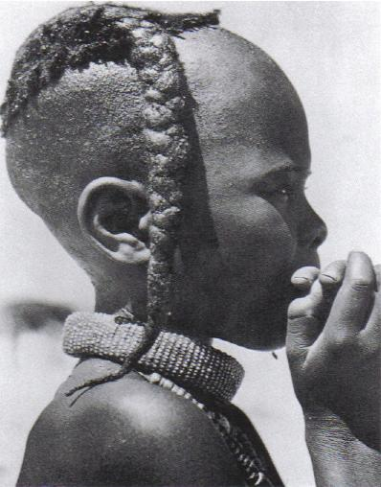
African culture
Hair was groomed with intricately carved combs and decorated with beads, clay, and colored bands.
Braiding was used extensively, w/ intricate patterns frequently denoting status in the tribe.

Slide 7
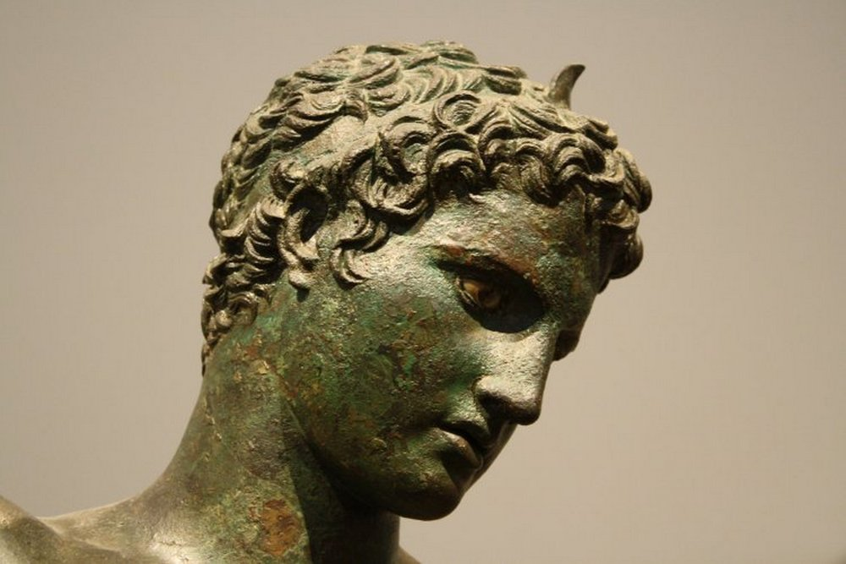
Greek culture
Greek barbers from sicily introduced shears to rome between 800 and 700 bc
In greece during its golden age (500 to 300 bc) is where barbering became a highly developed art.
Alexander the great issued a decree that all soliders be cleaned shaven b/c the pershians kept grabbing the troops by their beards, pulling them to the floor and beheading them.
Ticinius mena brought shaving and barbering services to rome in 296 bc.
Emperor hadrian grew his beard to hide his facial scars.
Greek philosopher and mathematician pythagoras, believed the hair was the source of the brains inspiration, and cutting it decreased an individuals intellectual capacity.

Slide 8
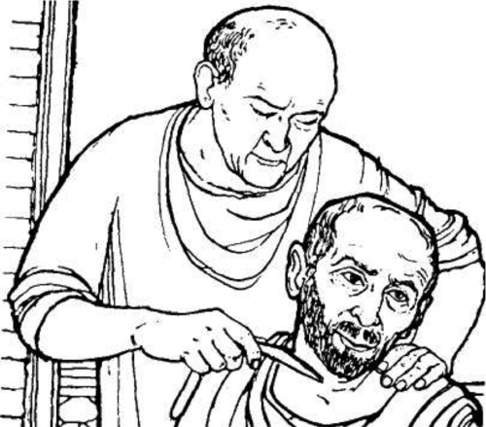
Customs and traditions
Many believed that hair clippings could bewitch an individual hence, haircutting was reserved for the priest, medicine man, or spiritual leader of the tribe.
In almost every culture, hairstyles indicated social status.
Greek boys would cut their hair entering adolescence
Hindus shaved their heads
Chinese men adopted the queue as a mark of dignity and manhood
In Rome the color of a woman's hair indicated her class rank.
Noble woman tinted their hair red, middle class blonde, and poor was tinted black.
Clergymen of the middle ages were distinguished by the tonsure (a shaved patch on the top of the head) in 1972 it was abolished.

Slide 9
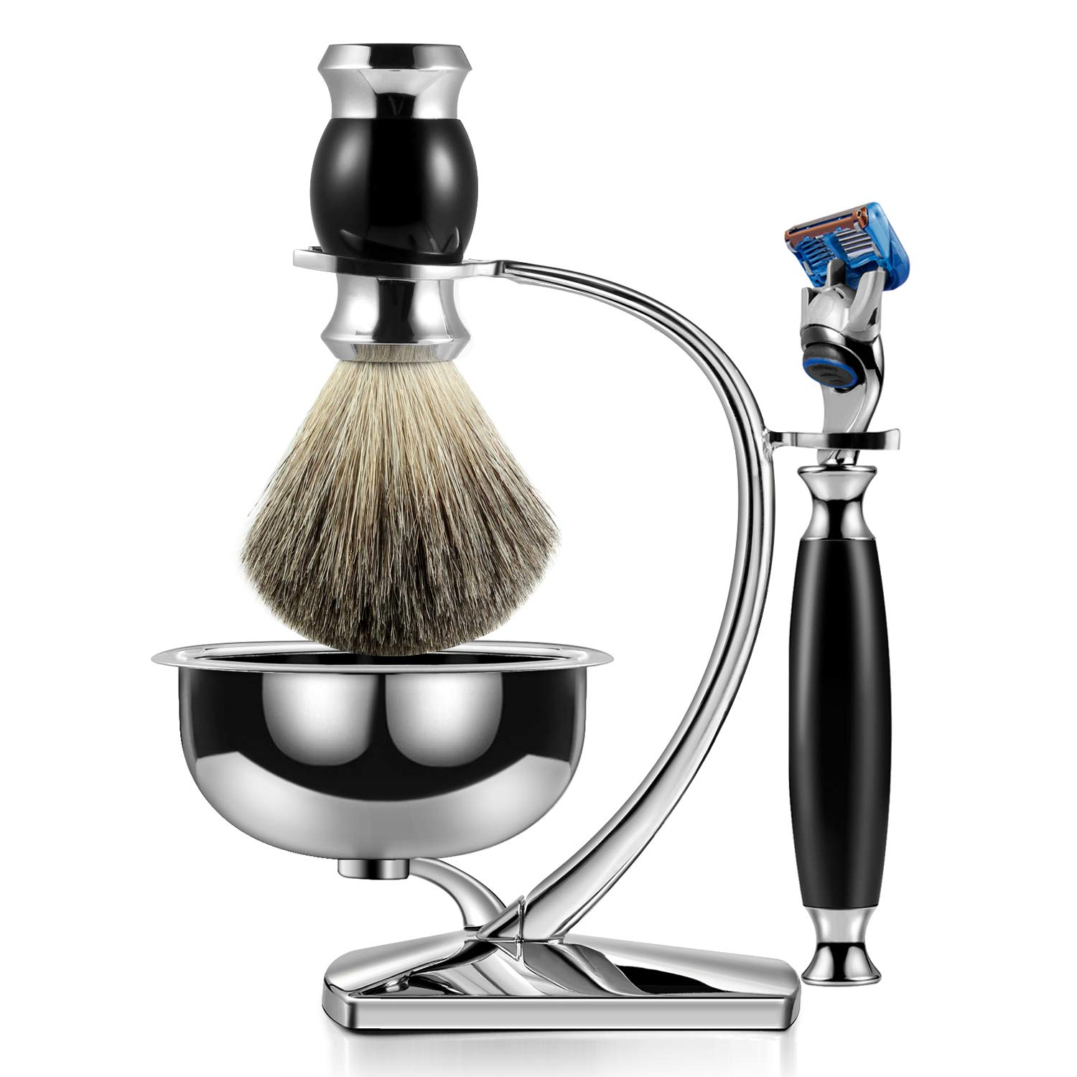
Beard and shaving
It is unknown when this form of hair removal began.
Stone razors and scrapes from the upper paleolithic period indicate that early man used these tools for hair removal.
Flint-bladed razors were used by ruling classes to shave their heads and faces.
Mesopotamians of 300 bc shaved with obsidian blades
Most groups considered the beard a sign of wisdom, strength, or manhood.
In some cultures the beard is a sacred symbol.
For orthodox jews the beard is a sign of religious devotion.

Slide 10
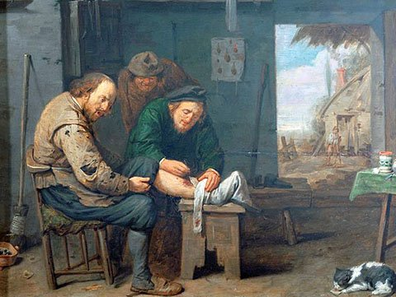
Barber-surgeons
Barbers not only provided tonsorial services but also entered the world of medicine.
One of the most common treatments for curing a variety of illnesses was blood-letting
Barbers continued the practices of bloodletting, minor surgey, herbal remedies, and tooth pulling.
For centuries dentistry was performed only by barbers, and for more than 1000yrs barbers were known as barber-surgeons.
Ambroise pare was the father of modern surgery.

Slide 11
The barber pole
The symbol of the barber pole evolved from the procedure of bloodletting .
The pole is compared to a staff that the patient would hold tightly in order for the veins to stand out during bloodletting.
The bottom end-cap represents the basin that was used as a vessel to catch the blood.
The white stripes represent the bandages that were used to stop the bleeding and were hung on the staff to dry.
The stained bandages would twist around the pole in the brezze forming the red and white pattern.

Slide 12
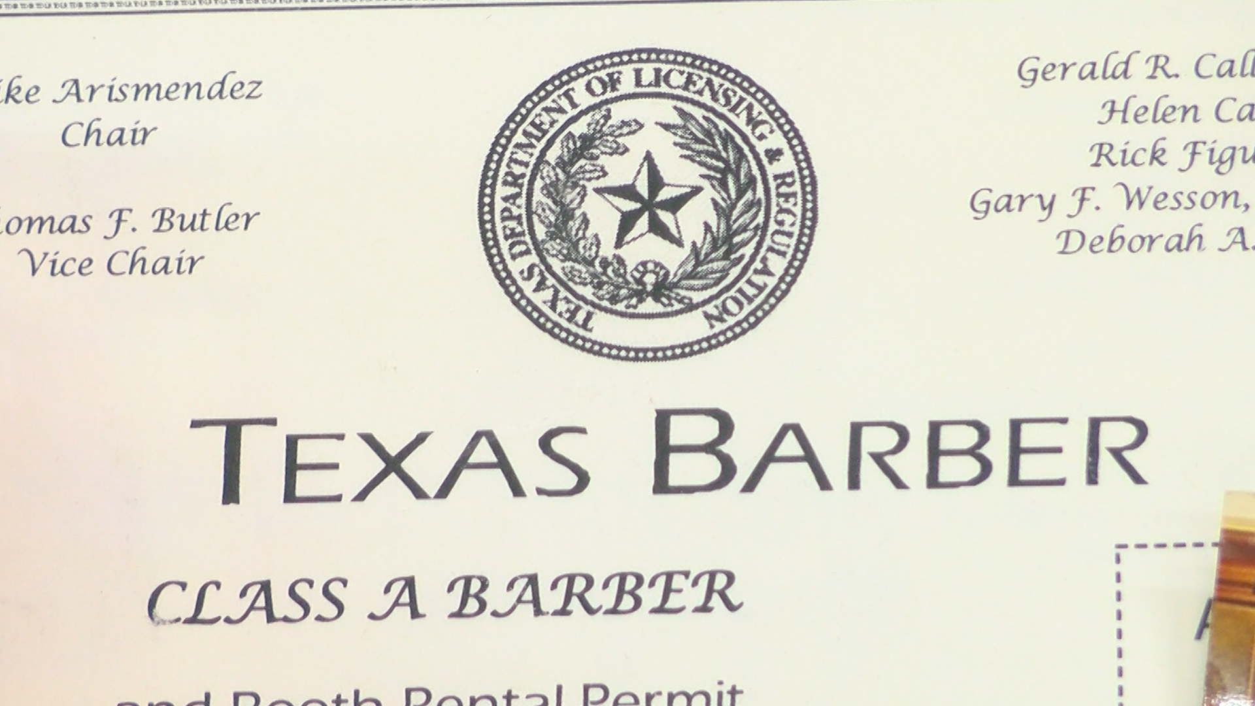
Organizations and state board
By the end of the 19th century, barbering seperated from religion and medicine, becoming its own profession.
“Employer” organizations are known as master barber groups
“employee” organizations are known as journrymen barber groups.
Members of employer organiztions are apprentice barbers
Minnesota passed the 1st barber law in 1897 to set standards for sanitation, minimum education, and licensing requirements
St. paul, minnesota was also where the 1st barber school was located.
In 1983 a.b. moler established americas 1st journeymen barbers.
The associated masters barbers of america was established in chicagpo in 1924
Ambba stands for associated master barbers and beauticians of america.
The ambba adopted the barber code of ethics in 1929 to promote professional responsibility in the trade.

