Slide 1
Systems of Power and intersectionality
The Conscious Lee MEd, Mhr
Theconsciouslee.com

Slide 2
Learning objectives
1. Define and Explore Intersectionality
2. Discuss different systems of power
3. Develop methods and Strategies to navigate systems of power
4. Understand systems of power in the workplace

Slide 3
What is power?

Slide 4
Its always about power
Race, class, gender, and sexuality are historically and globally specific, socially constructed power relations that simultaneously operate at both the macro (societal)and micro (individual) levels of society.

Slide 5
Systems of power understood
In social science and politics, power is the capacity of an individual to influence the conduct (behaviour) of others. The term "authority" is often used for power that is perceived as legitimate by the social structure.
Power can be seen as evil or unjust. This sort of primitive exercise of power is historically endemic to humans; however, as social beings, the same concept is seen as good and as something inherited or given for exercising humanistic objectives that will help, move, and empower others as well.

Slide 6
We are given little guidance about what constitutes a race, class, gender, and sexuality
The strength of these anthologies is that they demonstrate the significance of race, class, gender, and sexuality by presenting a wide array of diverse human experiences and analyses across these dimensions.
Students are encouraged to move beyond thinking about major social and personal issues solely from their own viewpoints or from dominant group perspectives. The major limitation is that anthologies provide little direction in identifying the themes and assumptions that pull these diverse perspectives together.

Slide 7
The beginning of intersecting systems of power
It is in Women’s Studies-not in racial or ethnic studies, not in social stratification (class) studies in sociology, not in psychology or in other traditional disciplines-that race, class, gender, and sexuality studies first emerged.’
Because of its critical stance toward knowledge in the traditional disciplines, its interdisciplinary approach, and its orientation toward social change and social betterment, Women’s Studies has been most open to self-critique for its exclusion of multiply oppressed groups, such as women of color, working-class women, and lesbians.

Slide 8
Women of Color
In the 1970s and 198Os, women of color, the majority of whom were poor or working class, were especially vehement in voicing their opposition to theories of and perspectives on social reality that focused on a single dimension-especially on gender, but also on race, class, or sexuality.
They argued that the multidimensionality and interconnected nature of race class, gender, and sexuality hierarchies are especially visible to those who face oppression along more than one dimension of inequality.

Slide 9
Black feminism
Patricia Hill Collins (1990), author of Black Feminist Thought, identifies the “interlocking nature of oppression” as one of three recurring themes in the work of Black feminists.
When Black women began to critique recent gender scholarship for its exclusionary practices, they focused on conducting analyses that began from the experiences of Black women, putting them at center stage

Slide 10
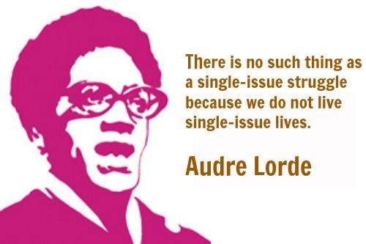
Intersectionality
The irony of ignoring groups whose experiences typically reflected the confluence of multiple major dimensions of inequality was captured in the often- cited title of one of the first anthologies in Black Women’s Studies: All the Women Were White, A11 the Blacks Were Men, But Some of UsAre Brazje: Black Women’s Studies (Hull, Scott, & Smith, 1982).

Slide 11
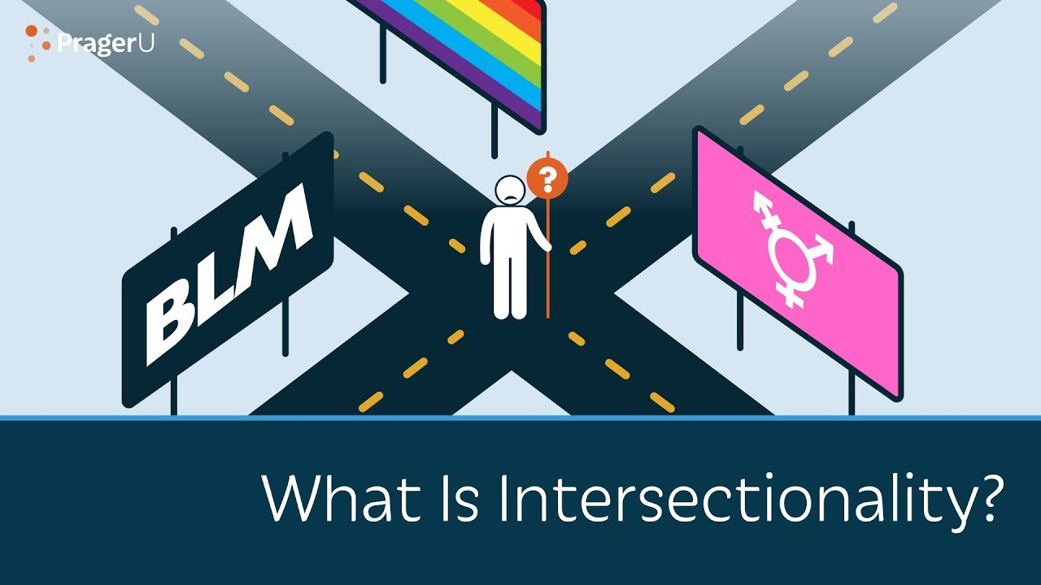
Intersectionality Explained
“Intersectionality is a lens through which you can see where power comes and collides, where it interlocks and intersects. It’s not simply that there’s a race problem here, a gender problem here, and a class or LBGTQ problem there. Many times that framework erases what happens to people who are subject to all of these things.”
-Kimberlé Crenshaw

Slide 12
Interlocking systems of power
Since that time, the critique of the White middle-class bias in Women’s Studies has been joined by a critique of the male bias in racial ethnic studies, harkening back to the words of Sojourner Truth.
The study of race, class, gender, and sexuality has been expanded by studies of other groups of women of color of other oppressed groups, such as gays and lesbians and, more recently, of privilege itself: for example, studies of the social construction of whiteness or of masculinity.

Slide 13
Power and perspective
Seeing the world through the eyes of oppressed groups raises new questions about our preconceived notions of many aspects of social reality-from the social relations of domestic work to what it takes to be a “good” mother to the American Dream that talent and hard work will produce material success.
At the same time that it questions traditional scholarship and interpretations of the lives of oppressed as well as dominant groups, the scholarship on race, class, gender, and sexuality also tends to avoid grand theorizing about the essential natures of these hierarchies.

Slide 14
Context is key
Race, class, gender, and sexuality are contextual. Although they persist throughout history, race, class, gender, and sexuality hierarchies are never static and fixed, but constantly undergo change as part of new economic, political, and ideological processes, trends, and events. Their meanings vary not only across historical time periods, but also across nations and regions during the same period.
Because race, class, gender, and sexuality must always be understood within a specific historical and global context, research tends to avoid the search for common meanings that would apply to all times and all places.

Slide 15
For example
In the post-Civil Rights era in the United States, the racial signifiers “Latino/a,”“Asian American,”“People of Color,” and “Native American” developed when people from different cultures, tribes, and national origins were treated as a single racial group by a dominant culture that failed to recognize differences among “racial” ethnic groups.
Many members of these groups subsequently organized politically to resist their joint oppressions, and out of those political movements new racial identities were forged These labels did not exist before the 1960s, and even today some people identify with them and others do not, signifying the fluid, political, historically specific, and social meaning of race.

Slide 16
Socially constructed
Race, class, gender, and sexuality are social constructs whose meaning develops out of group struggles over socially valued resources. The dominant culture defines the categories within race, gender, and sexuality as polar opposites-White and Black (or non-White), men and women, heterosexual and homosexual-to create social rankings: good and bad, worthy and unworthy, right and wrong.

Slide 17
Social constructs continued
It also links these concepts to biology to imply that the rankings are refuted, permanent, and embedded in nature. That is, dominant groups define race, gender, and sexuality as ranked dichotomies, where Whites, men, and heterosexuals are deemed superior. Dominant groups justify these hierarchies by claiming that the rankings are a part of the design of nature-not the design of those in power. Subordinate groups resist the binary categories, the rankings associated with them, and the biological rationales used to justify them.

Slide 18
The binary nature of systems
Powerful vs Powerless
Gay vs Straight
White vs Black
Men vs Women
Rich vs Poor
Able Bodied vs Disability

Slide 19
The dominant culture is made up of many systems of power
The dominant culture defines the categories within race, gender, and sexuality as polar opposites-White and Black (or non-White), men and women, heterosexual and homosexual-to create social rankings: good and bad, worthy and unworthy, right and wrong (Lorber, 1994). It also links these concepts to biology to imply that the rankings are fixed permanent, and embedded in nature.

Slide 20
Power and intersectionality
When race, gender, and sexuality are treated as discrete variables, individuals are typically assigned a single location along each dimension, which is defined by a set of presumably mutually exclusive and exhaustive categories. This practice reinforces the view of race, gender, and sexuality a. permanent characteristics of individuals, as unchangeable, and as polarities-people can belong to one and only one category.

Slide 21
Critical examination
That is, dominant groups define race, gender, and sexuality as ranked dichotomies, where Whites, men, and heterosexuals are deemed superior. Dominant groups justify these hierarchies by claiming that the rankings are a part of the design of nature-not the design of those in power.

Slide 22
Think about it
When we say that race, gender, and sexuality are social constructs, not fixed biological traits, we also mean that we cannot fully capture their meaning in everyday life in the way that social scientists often attempt to do by employing them as variables in traditional quantitative research.

Slide 23
WORKS CITIED
Global Political Economy and Political Economy Components by: Bogusław Szczepański Department of Economics Poznan University of Economics
INTRODUCTION TO SOCIOLOGY – 2ND CANADIAN EDITION, Chapter 12. Gender, Sex, and Sexuality, W. Little
Readings in Multicultural Practice edited by Glenn C. Gamst, Aghop Der-Karabetian, Richard H. Dana
A CONCEPTUAL FRAMEWORK FOR UNDERSTANDING RACE, CLASS, GENDER, AND SEXUALITY, by Lynn Weber

