Slide 1
ENERGY

Slide 2
What is Energy?
Ability to do work.

Slide 3
Without Energy, we cannot do the work.

Slide 4
Three Forms Of Energy
light energy
heat energy
sound energy

Slide 5
Light Energy
Is a form of energy that helps us to see the things around us.

Slide 6
Without light, we can’t see the things around us.

Slide 7
Two Types of Light Energy
Natural – made by God
Artificial – made by people

Slide 8
Natural Light

Slide 9
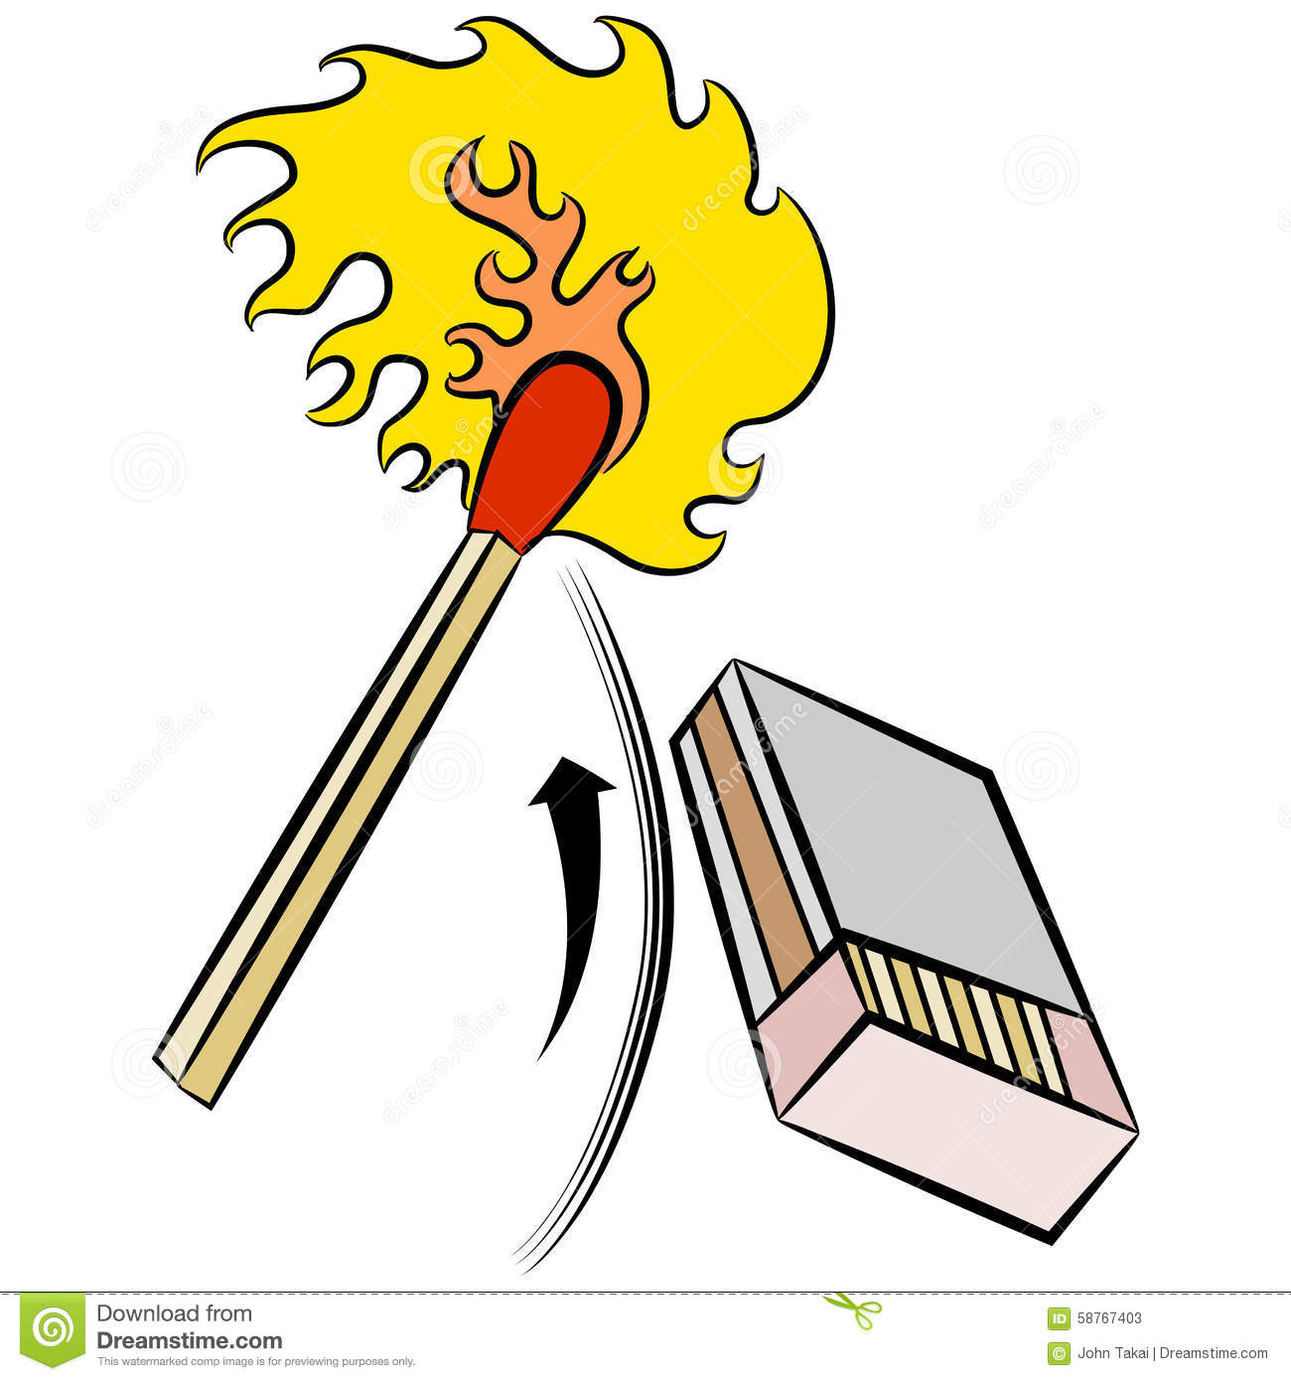
Artificial Light

Slide 10
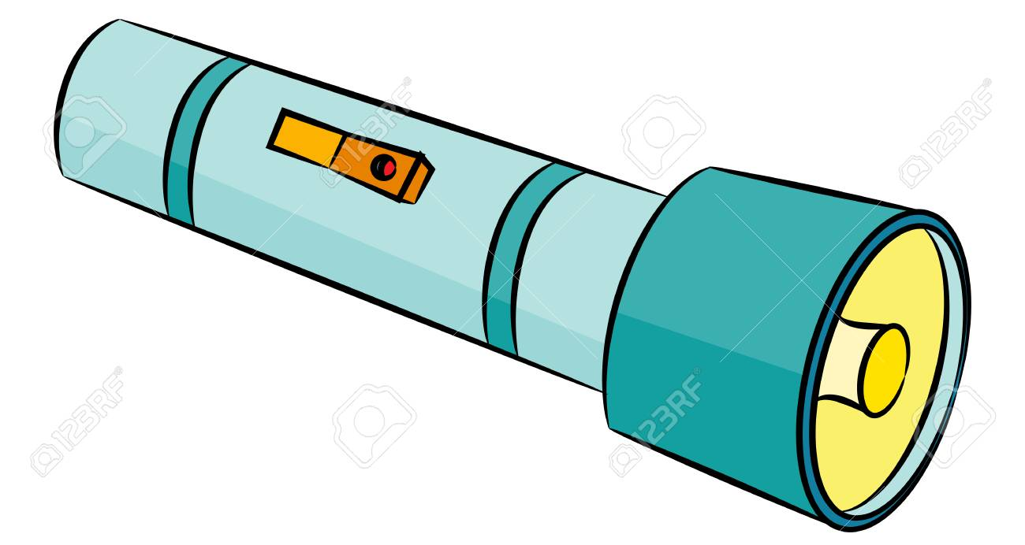
Artificial Light

Slide 11
Heat Energy
Gives heat and makes us feel warm.

Slide 12
sun

Slide 13
fire

Slide 14
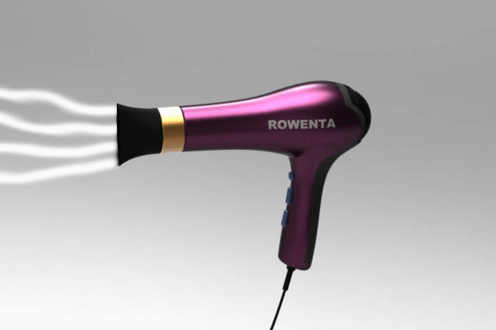
hairdryer

Slide 16
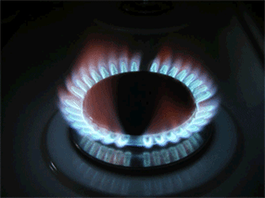
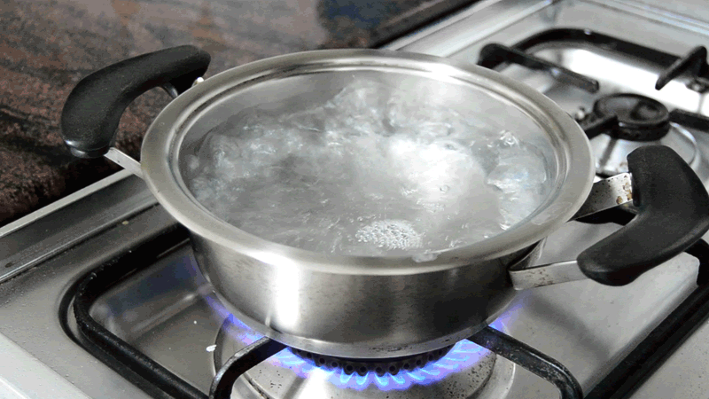
Gas stove

Slide 17
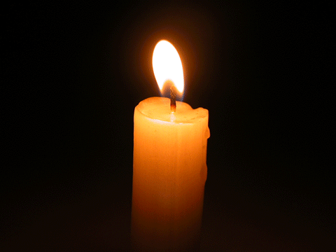
Candle

Slide 18
Light
bulb

Slide 20
Importance Of Heat

Slide 21
Heat energy is very useful.

Slide 22
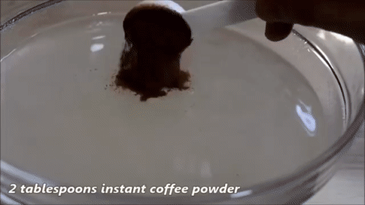
Hot water can dissolve powdered coffee , milk and sugar.

Slide 23
Heat helps our clothes dry.

Slide 24
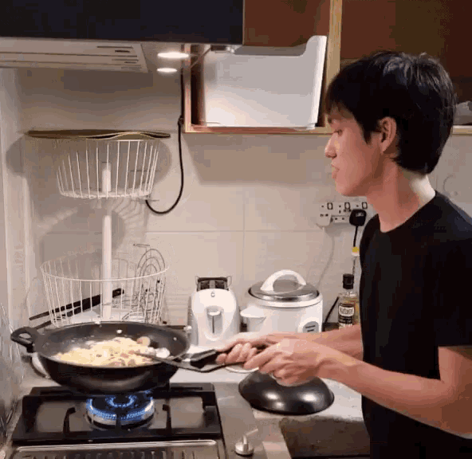
Heat is also use for cooking.

Slide 25
Heat can be harmful too.

Slide 26
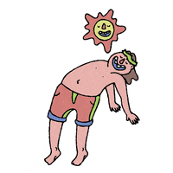

Slide 29
Sound Energy
Is made from the vibration things which makes a sound.

Slide 31
Volume
Is loudness or softness of a sound.

Slide 32
Soft Sound

Slide 33
Tweeting birds

Slide 34
Whispering to someone

Slide 35
Singing choir

Slide 36
Shouting

Slide 37
Flying airplane

Slide 38
Noise
A loud sound that is made by anything or anyone.

Slide 39
A loud sound can harm your ears. It can be painful and damage your eardrums.

Slide 42
Let’s Review!

Slide 43
What are the three Forms Of Energy ?
light energy
heat energy
sound energy

Slide 44
What are the Two Types of Light Energy ?
Natural light – made by God
Artificial light – made by people

Slide 45
It gives heat and makes us feel warm.
Heat Energy

Slide 46
It is made from the vibration things which makes a sound.
Sound Energy

Slide 47
It is a form of energy that helps us to see the things around us.
Light Energy

Slide 48
Identify the types of energy
light energy
heat energy
sound energy

Slide 49
Heat energy
light energy

Slide 50
sound energy

Slide 51
Light energy

Slide 52
Light energy

Slide 53
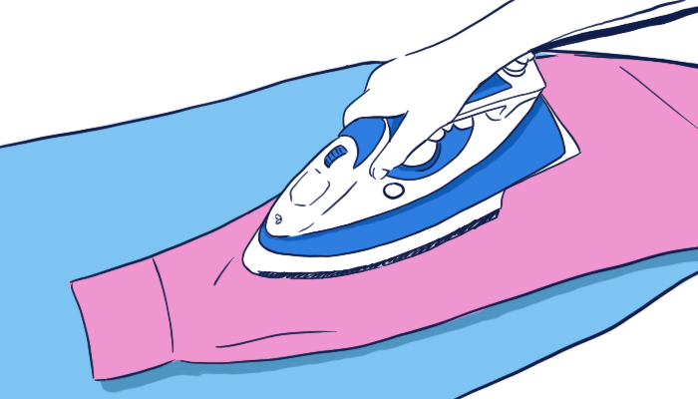
heat energy

