Slide 1
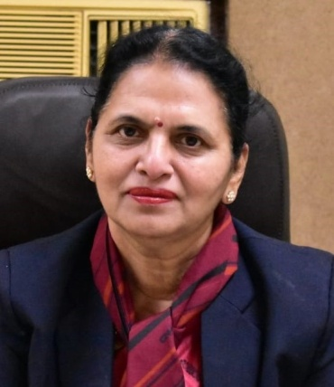
Short Term Certificate Course on Social Business
Overview of
Social Business
Presentation by
Dr. Charanjit Kaur
Principal,
Career College, Bhopal
Director, YSBC, Career College, Bhopal.

Slide 2
Prof. Muhammad Yunus, Winner of Nobel Peace Prize in 2006 and founder of Grameen Bank, Bangladesh

Slide 3
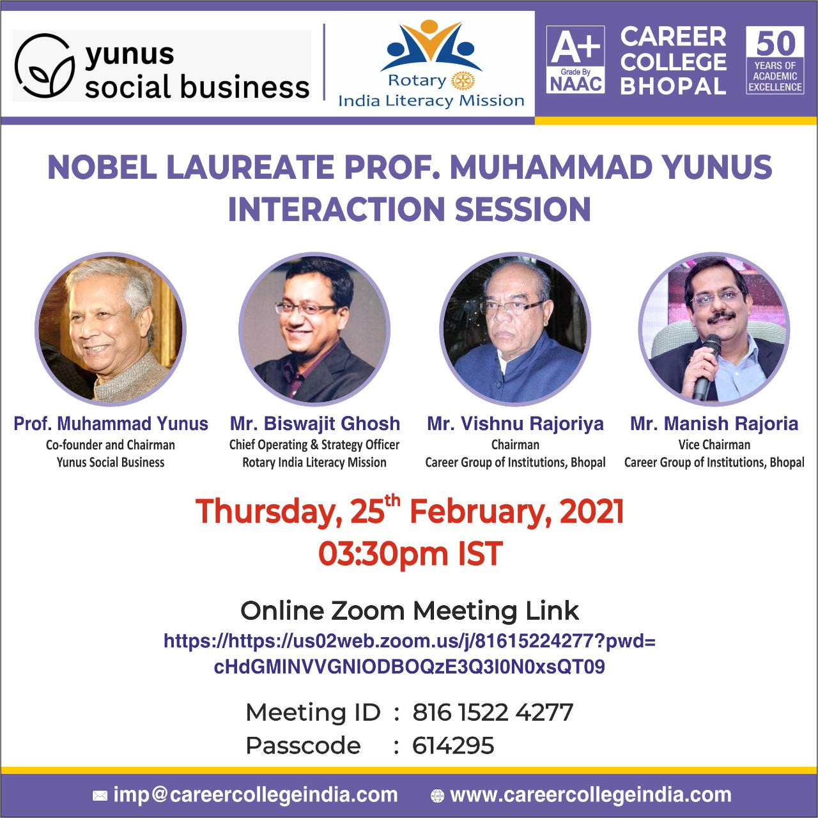

Slide 5
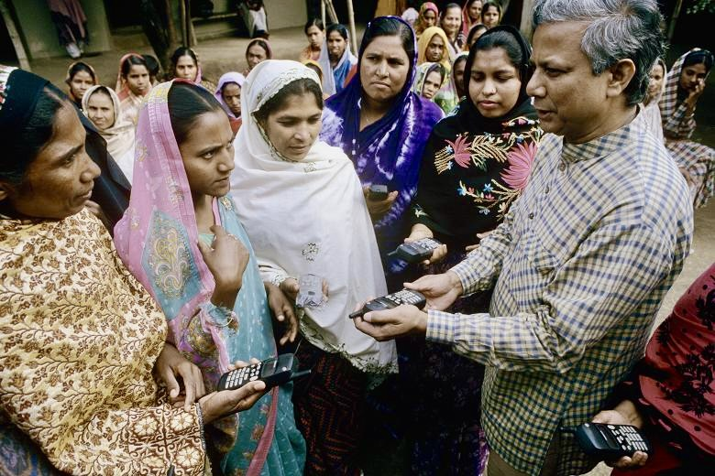
Prof. Mohd. Yunus

Slide 6
Multidimensional Personality or Robot Person
“If you can have a selfish business, you can also have a business based on selflessness where you are not interested in personal benefit but a collective benefit for the world.
The conventional banking system had been reluctant to give credit to those who were too poor to provide any form of guarantee.
The first loans he issued had a value of $27 (£14.50) (Rs. 2000 - 2500/). Their recipients were 42 women from the village of Jobra, near the university.

Slide 9
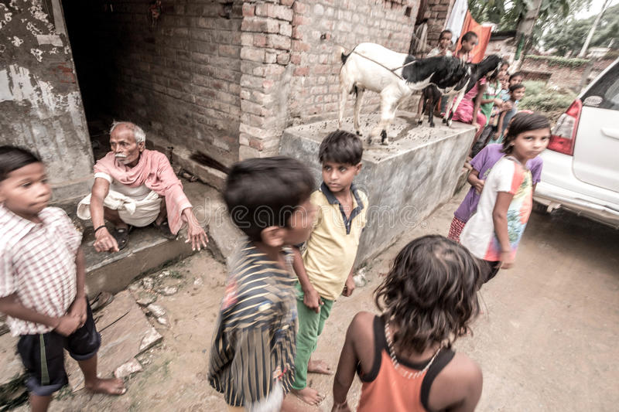
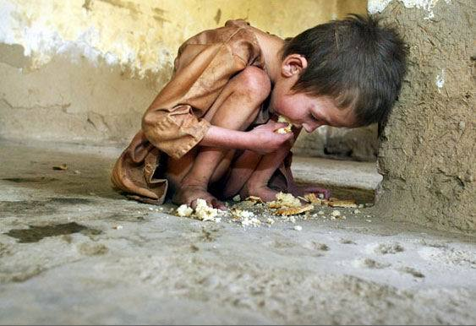

Slide 11
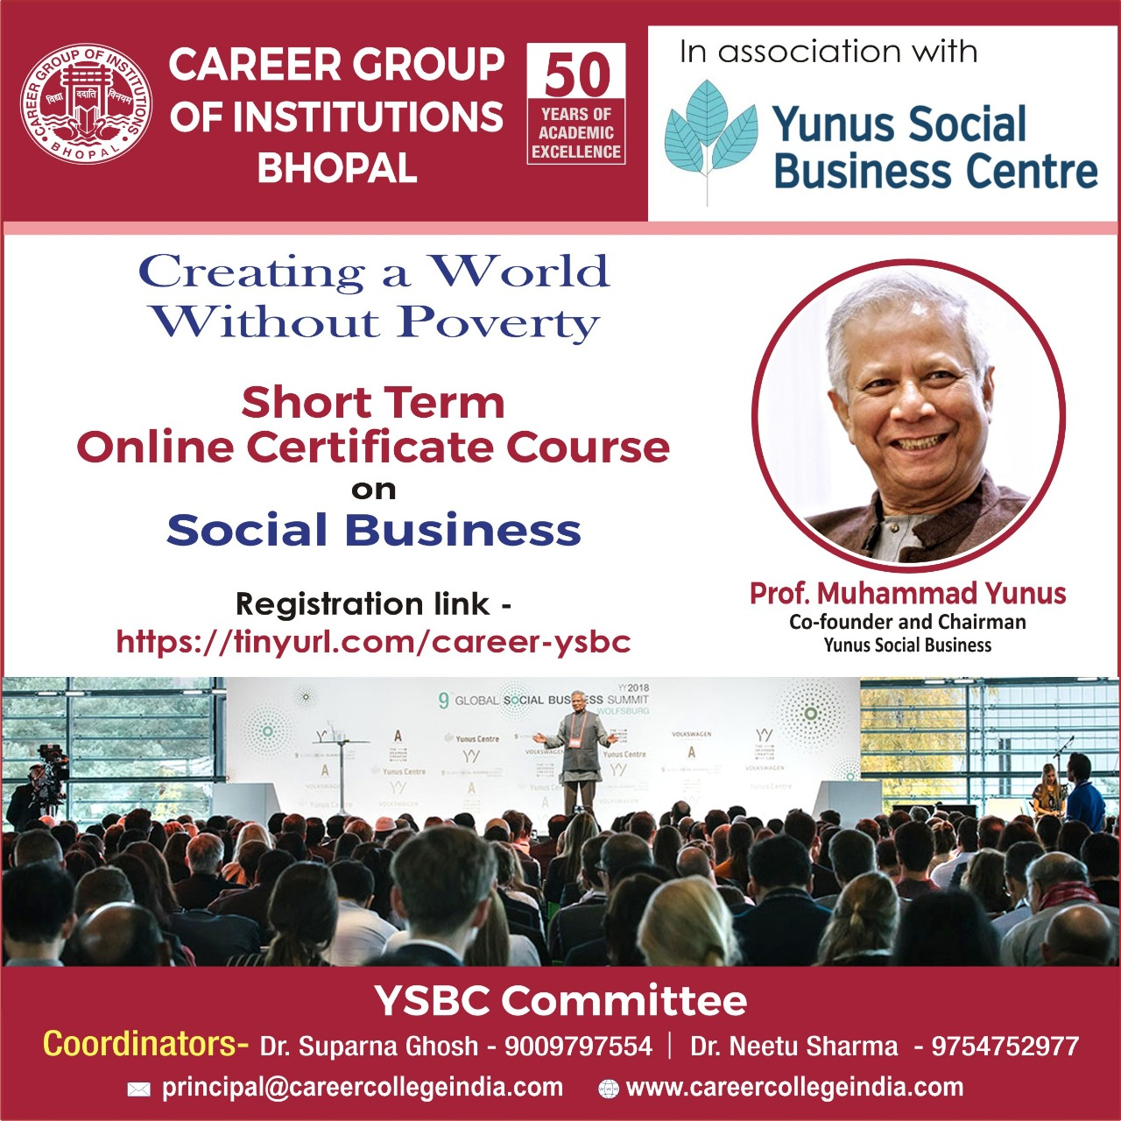
Social Business
Out of 8 million borrowers of Grameen Bank, 97 % were women. The repaying rate of loan was 100%.
Influenced with the noble cause of Prof Younus of Bangladesh,
We, the Career Society also decided to opt for certain social business-related short-term courses to infuse our students with social business skills and be on fore front to serve the society.
Together we can make this world a better place.

Slide 14
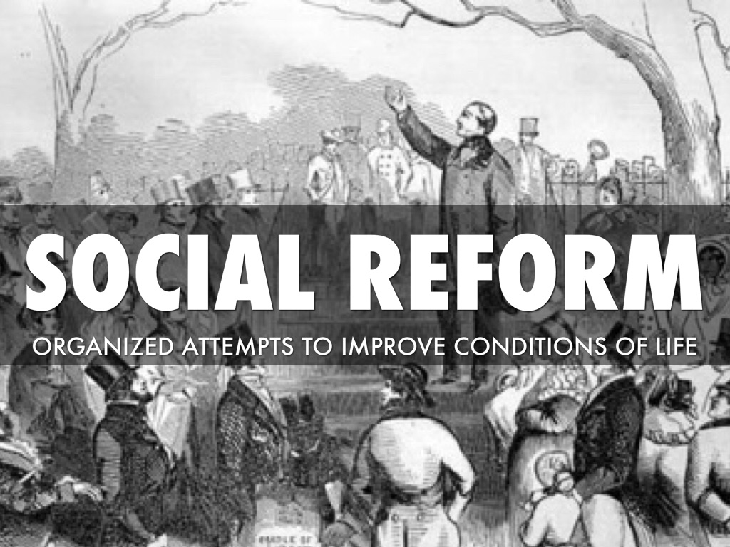
Social Business
Social Business is a special type of business for Positive Social Transformation and Social Reformation.
It is economically sustainable , non dividend business which is entirely different from charity.
It is non profit centric rather problem solving business.
Profit is reinvested in the business for its expansion.

Slide 15
Seven Principles of Social Business
Business objective will be to overcome poverty, or one or more problems (such as illiteracy, health, technology access, and environment) which threaten people and society; not profit maximization.
Financial and economic sustainability
Investors get back their investment amount only. No dividend is given beyond investment money.
When investment amount is paid back, company’s profit stays with the company for expansion and improvement
Gender sensitive and environmentally conscious
Workforce gets market wage with better working conditions
...Do it with joy

Slide 16
How can I become a Social Business Volunteer? How do I know whether I qualify?
Your interest itself qualifies you to become a “Social Business Volunteer.”
Irrespective of age, gender, occupation, religion, nationality, or location.
One can be a school student, or student at any level, or a school dropout, unemployed person, businessman, worker, public or private employee, professor, doctor, engineer, journalist, singer, writer, farmer, housewife, retired person, or whoever you are, you are welcome to become a Social Business Volunteer.

Slide 17
Social Business Volunteer
In order to be a Social Business Volunteer just fill up the Social Business Volunteer Registration Form which will be made available to you.
You will get a registration number. That’s it!
You will become a Social Business Volunteer for life.
5 or more ( less than 100 ) can constitute a Social Business Volunteer Circle.

Slide 18
Career College Online Course on Social Business
The course consists of 9 Modules of 1 hour each to be conducted 5 days a week.
Assessment will be done on the basis of performance in the examination conducted at the completion of every Module.
On successful completion of the course an Online Certificate will also be issued duly signed by the College Authorities

Slide 19
Course Plan of Social Business
Module 1
Module 2
Module 3
Module 4
Social Business and its Objectives, Dr. Neetu Sharma, Dean, Dept. of Com.& Management.
Classification of Social Business, Dr. Vibha Thakur, Director. Training and Placement Asst. Prof. Dept. of Computer Science.
Understanding Social Business, Dr. Priyanka Kurup, Asst. Prof. Dept. of Com.& Management.
Intensive study for the Evolution of Social Business, Dr. Kalpana Jain, Asst. Prof. Dept. of Physiotherapy

Slide 20
Continued………
Module 5
Module 6
Module 7
Module 8
Module 9
Exploration and Implementation for Social Business Idea, Dr. Ruchi Dubey Sharma, Asst. Prof. Dept. of Chemistry
Roadmap of Social Business , Dr. Suparna Ghosh, Dean, Life Sciences and Head, Dept. of Chemistry.
Financial and Legal aspects of Social Business, Dr. Jaswinder Mehta, Head, Dept. of Botany.
Investors, Investments and Social Business, Dr. Nikita Persai, Asst. Prof. Dept. of Physics
Launching your Social Business, Dr. Reena Antony, Head, Dept. of Microbiology

Slide 21
Career College, Bhopal

