Slide 1
How to create simple cross fade animation

Slide 2
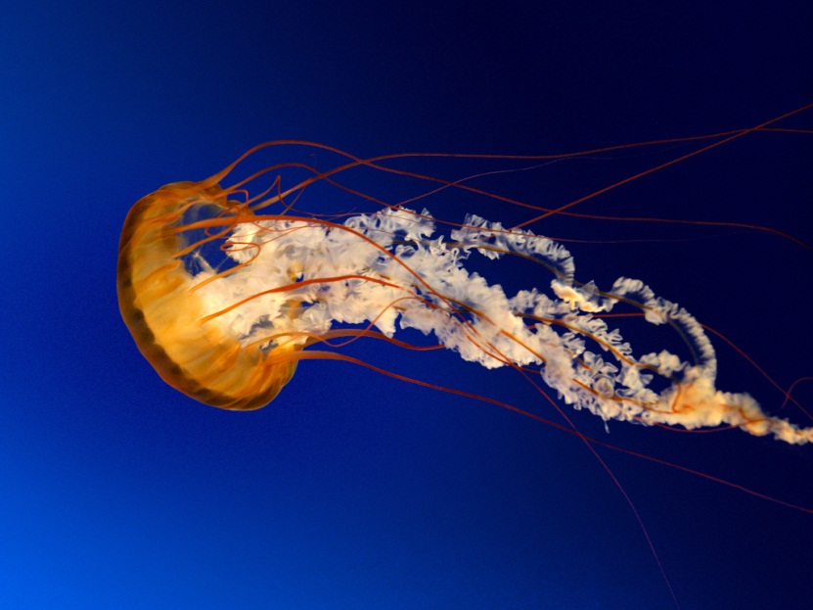
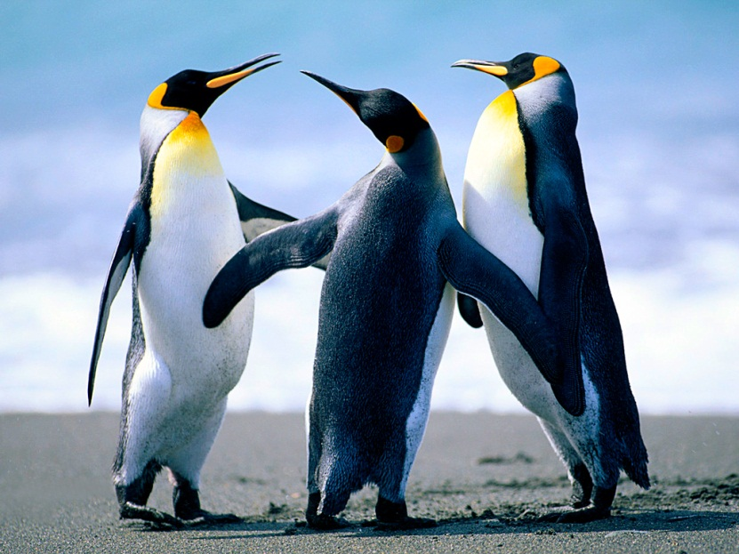
Simple cross fade animation

