Slide 1
Concept 1 Linear Equations

Slide 2
What are Linear Equations?

Slide 3
&
how do you solve them?

Slide 4
Solving Linear Equations

Slide 5
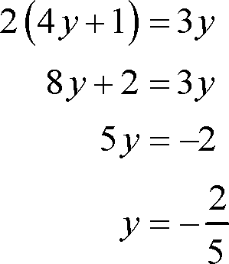
Linear Equations are equations with variables (x,y,z, etc.) and the number of variables can vary from problem to problem
In the equations it usually asks for a variable to solve for.

Slide 6
Identifying what is what…

Slide 7
In the linear equation there are different things to identify first what are you solving for, if it is a two variable equation, or what are coefficients and how do they work and the process of solving the linear equations.

Slide 8
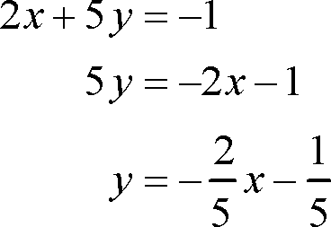
Example First the linear equation on the left to solve we would first have to know what to solve for an then make the next step because the equations have two variables, however they solved for y. The linear equation on the right only has one variable so they solved for y.

Slide 9
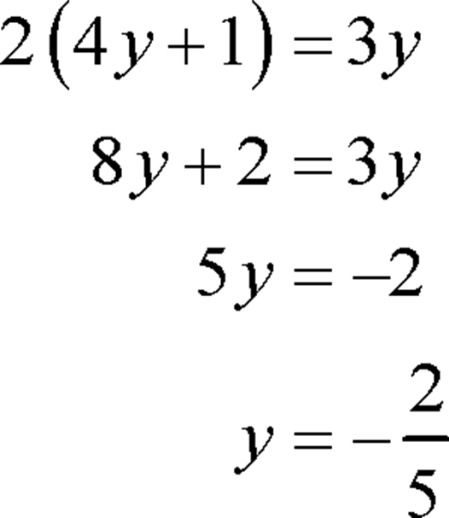
Here we have the perfect example of coefficients. If you look at 4y and 3y, these are variables that have coefficients attached to them. Numbers that come with variables are called COEFFICIENTS

Slide 10
The Process Of Solving…..

Slide 11
Step One Get the variable on to one side of the equation
*Reminder* whatever you do to one side of the equation you have to do to the other

Slide 12
Step two Get all the non-variable numbers to one side
*Reminder* numbers without variables can’t be added to numbers with variables

Slide 13
Step Three Simplify
* The only part of simplifying missing is separating the coefficient from the variable using division, which gives you the answer x equals -27 over 7

Slide 14
Quick Review
Remember what you do to one side of the equation you must do to the other.
Remember to combine like-terms
Solve for what the problem is asking you for

Slide 15
How to Graph Linear Equations

Slide 16
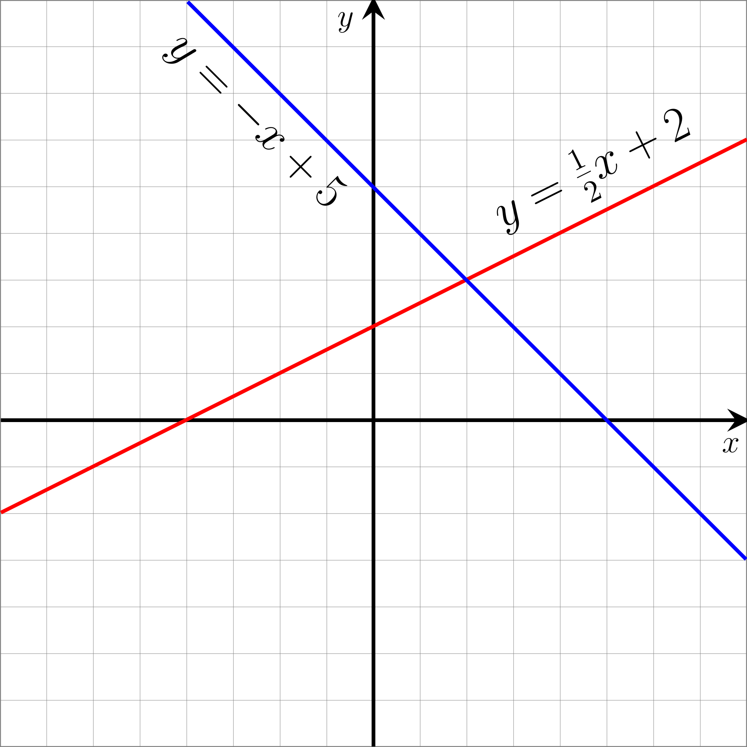
Linear Equations are equations with variables and when placed (plotted) onto a graph they create a linear line.

Slide 17
And to graph them you have to place them into a formula known as slope intercept form.

Slide 18
But Wait……

Slide 19
If that is the formula what is it X? how about B? & what in the hell is M?
“Each different variable has it’s own individual meaning and purpose in the equation.”

Slide 20
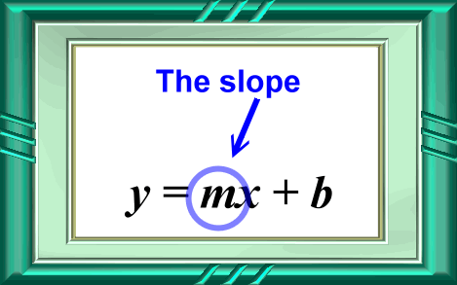
Finding the slope…

Slide 21
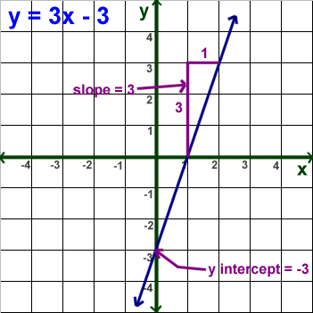
Slope controls the rate of change at which the linear equation moves along the graph when plotting points
The slope (M) is always in front
of the X in the equation

Slide 22
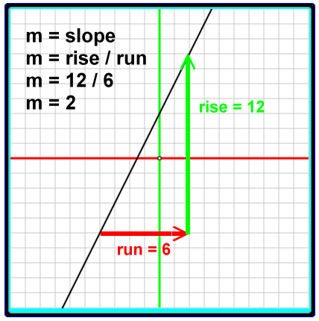
Another way to look at slope is to identify it as rise over run. Which is often written in the form of a faction
Rise = movement on y-axis
Run = movement on x-axis

Slide 23
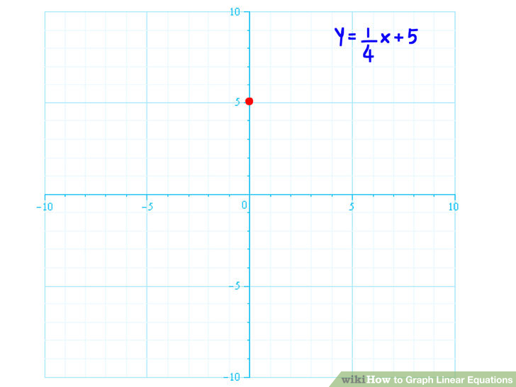
Now we can successful identify 1 over 4 as slope, however how do we know 5 is the correct starting point for us to began plotting on? As of now we don’t know but we will find out

Slide 24
B = Y-intercept…

Slide 25
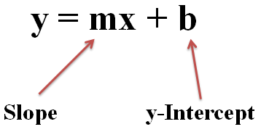
Y- Intercept (B) controls the starting point for the Linear Equations when graphing, much like slope (M) controls the rate of change
Y-Intercept (B) is usually located at the end of the equation, but its most identifiable because it doesn’t have any variable with it just a solo number.

Slide 26
But Wait
There’s MORE!

Slide 27
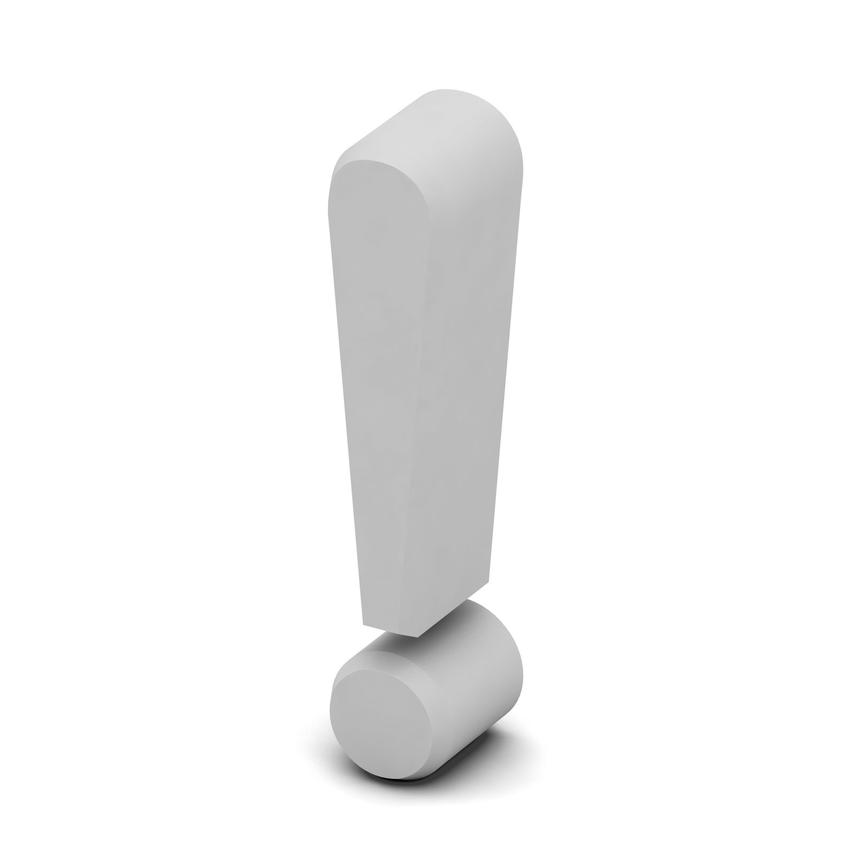
Graphing Linear Equations requires a firm understanding of the basics of identifying what each number and variable in the equations represents and does for the equation & how it effects it as well.

Slide 28
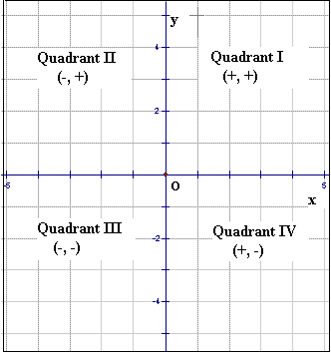
The Graph
Containing 4 quadrants (quads.) each with it own
positive and negative areas, reading from the graphs are done as (X,Y) & the term origin is 0,0 or the center of the graph

Slide 29
Putting it ALL TOGETHER

Slide 30
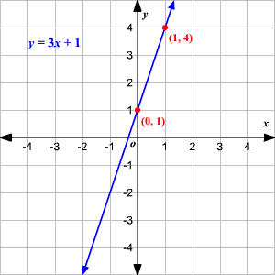
Example of putting it all together
Now if you have been following the information correctly it should be easy for you to ID what is the slope or rise over run.
Following the info I know that M(slope) is also next to X, so that would be 3.
Y-intercept is always the solo number with no variable behind it, so that would be 1
Now graphing it starting at 1 (y-intercept) and following rise over run 3/1 we rise up 3 and run right 1 and we have solved the equation.

Slide 31
Quick Review
Slope intercept form is needed first to graph the linear equation
Followed by identifying the slope and the Y- intercept
To graph you use the Y-intercept to plot the first point on the graph, then use the slope (M) and rise over run to plot the next point.

Slide 32
ADVICE

Slide 33
“Take your time identifying what each and everything is in the equation”.
“If you are stumped at an equation about how to place it in slope form or how to graph it go over the steps slowly and speak aloud”.
“If you still cant get it ask for another set of eyes over the problem”.

