Slide 1
Welcome to the DBHG Starter Course

Slide 2
About Your DBHG Starter Course

Slide 3
DBHG Course Description
Several business professionals assist small business owners in this 14-module course including DBHG Director Nancy O’Neale, Tammy Turner, Dichondra Johnson, MBA, Brandi Shelton, MBA, Attorney David Soble, Michael Chatas, Michael Rizzo, and Greg Blackwell. These business professionals offer access to capital information in the event of COVID-19, business planning, marketing, and legal advice.
Early bird course discounts pre-orders are available for $99 now until June 5, 2020. Regular sales for the course will begin June 6, 2020 at $249. The course is complete with a downloadable workbook for each module. The registration fee in non-refundable.
Course Description

Slide 4
Course Presenters
Nancy O’Neale is a teacher, author, and business consultant. Her business, Detroit Business Hub Group, LLC, is a fast track to help minority business owners jump start their businesses. It has been accredited with an A+ rating by the Better Business Bureau. As the Executive Director of the Women who Inspire 501 (c) (3) organization, she helped women start their own businesses. She is also the author of Fire Your Job! Be Your Own Boss! a self-help guide to motivate prospective owners stuck in dead end careers start their own businesses. With 10 years sales experience, she joined the elite circle of licensed insurance agents as a Championship Qualifier in 2014 and was at the top of the company’s growth model for multiple years. Nancy is also a member of the National Association of Women Business Owners. She earned her MA in Communications from Wayne State University, MA in Elementary Education from Grand Canyon University, and BA in Journalism and International Relations from the University of Wisconsin-Madison.
Nancy O’Neale is the Director of the Detroit Business Hub Group and the author of Fire Your Job! Be Your Own Boss! DBHG is a fast track for new business owners and newly established business owners (five years or less), especially disadvantaged minorities, to accelerate their competitiveness in the marketplace. DBHG is a full-service LLC company that assists with business plans, business structure, legal, real estate, human resources, retirement planning, insurance, marketing, and small business banking.
Nancy O’Neale

Slide 5
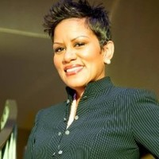
Tammy Turner
Tammy Turner is the Co-Owner and Co-Founder of Kapstone Employment Services (Certified MBE, WBE, WOSB). She is an Engineering Recruiter and a Head Hunter for the Automotive Industry. She recruits for all Engineering disciplines: Mechanical, Electrical, Quality, Software, Program Managers, CAD Designers, Design Engineers, with specific expertise with Controls Engineers. Her debut book, How to Talk to Strangers: A Step-by-Step Guide to Professional Networking, is a vital tool for any business professional looking to go to the next level. Tammy was also recently named one of the 25 Most Influential Women in Detroit.

Slide 6
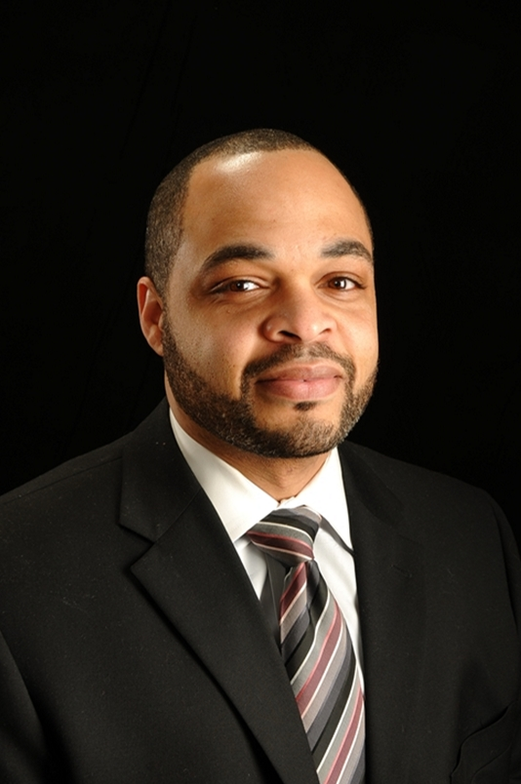
Greg Blackwell
Greg Blackwell is a proud Farmers Insurance Agent Owner. His agency is located in Southfield, MI. Greg Blackwell owns and operates a Farmers Insurance Agency in Southfield and has been serving the Metro Detroit area for over 10 years now. By focusing on the needs of his clients and providing “World Class Customer Service” his agency has become a frequent “Award Winning Agency”. Winning such awards as:
Farmers Topper Club (2)
Farmers Blue Vase (2)
Dumbroski Life Cup
District Agent of The Year
Because his goal is to provide the highest level of expertise to his clients, he continues to study his craft by taking courses within the field of insurance and financial services and has earned the following designations:
CSD – Consultative Sales Designee
FSCP – Financial Services Certified Professional

Slide 7
Course Presenters
Michael Rizzo, and his production company, RizzoRizzo Creative Services Company, creates business-to-business marketing videos across a variety of industries in the Metro Detroit area, and across the country. Over the course of his career Michael has created, managed, and executed creative messaging for brands that range from two hundred million-dollar corporations to the local body shop. He’s a writer, producer, director, editor, and creative director with hands on every facet of corporate communication. For members of the Hub Group, that means creating short, polished company overview videos that help startups present who they are and what they do affordably.
Mike Rizzo

Slide 8
Course Presenters
Brandi C Shelton, also known as B, has dedicated her life to the development of the company Utilize Consulting Service and Management Group. Brandi is a native Detroiter, focused on being the developer of dreams. Since Brandi’s younger days she has always been driven to be different. Starting UTILIZE was something different. A graduate from University of Phoenix with a double Bachelor in Business Management and Administration and 15 years of active experience in a variety of professional settings that continue to add wealth and knowledge to her professional portfolio, Brandi has the knowledge and experience it takes to help professionals turn their dreams into realities.
Brandi Shelton

Slide 9
Course Presenters
For over 25 years David Soble has provided no nonsense legal advice to banks, lenders and consumers alike, in the areas of commercial and residential real estate, business and residential lending and contract matters. His background is unique in that he has extensive practical experience and knowledge working with commercial, residential, and lending transactions. He has managed sizable loan portfolios ($500+ Million) consisting of commercial and residential real estate for national banks. He was managing attorney to several notable lending institutions and their default loan servicing portfolio. He is a licensed real estate broker and has authored numerous books and articles on issues related to real estate, contracts, foreclosure matters, loan negotiations, and creditor /debtor rights. David Soble is a graduate of Michigan State University ('87) and The Ohio State University College of Law ('90). His focus has been on real estate law and lending law.
Attorney David Soble

Slide 10
Course Presenters
DRJ & Associates, LLC founder, Dichondra R. Johnson, MBA, MPA, CBSP, has an over 20-year accomplished career and experience in the business, education and government sectors. Johnson recently was a Business Development Manager with Michigan Economic Development Corporation (MEDC), with a primary focus on business expansion, retention and growth in Wayne County, MI. Prior to joining the MEDC, Johnson was Michigan’s first Lead Education & Strategy Analyst with the Michigan Veterans Affairs Agency (MVAA), established in 2013 by Executive Order to oversee operations to connect veterans to services and benefits in Michigan. Johnson worked to develop statewide strategic veteran programs and lead statewide veteran education and career development initiatives, to include the development of Michigan Veteran Education Initiative campus program and Michigan’s Certified Veteran Friendly School Program recognizing over 70 Michigan public and private academic institutions.
Dichondra Johnson, MBA & MPA

Slide 11
Course Presenters
Mike Chatas is a Small Business Champion who enjoys creating capital solutions for businesses. Typical transactions include business acquisitions, commercial real estate and working capital solutions. Chatas is a self-directed leader who develops strong partnerships with all stakeholders, including clients, underwriters, loan coordinators and loan closers. Mike serves as a trusted adviser and business partner to both his clients and colleagues. Chatas is also committed to adding value and exceeding expectations through collaborative problem solving, disciplined decision-making, and a customer service mindset. Mike is committed to providing his business partners (such as CPA's, attorneys, brokers and clients) feedback within 24 hours of receipt of information. This quick turn-time is very helpful for business owners and advisors who are looking for business loans. Chatas serves as a Loan Committee member for the (Michigan) Community Development Block Grant (CDBG) Revolving Loan Program, which is focused on lending to small businesses that are unable to secure competitive financing traditionally. The Michigan Economic Development Corporation (MEDC), on behalf of the Michigan Strategic Fund, administers this federal grant program.
Mike Chatas

Slide 12
COURSE OVERVIEW
Lecture 1 – Detroit Business Hub Group Membership Video (free module)
Funding
Lecture 2 – The PPP/EIDL Scoop - Mike Chatas, SBA Team Lead at Bank Michigan discusses how small businesses can apply to the Economic Injury Disaster Loan (EIDL) and the Payroll Protection Plan (PPP).
Planning
Lecture 3 – Business Plan Blueprint - Nancy O’Neale educates small business owners on the importance of writing a business plan from a micro viewpoint, specifically your SWOT Analysis, marketing plan, your ideal customer, and cash flow analysis.
Planning (con’t)
Lecture 4 – Business Plan Nuts & Bolts I –Dichondra Johnson discusses how business plans from a macro viewpoint are a road map to your business success, using business plans to leverage funding, and why it’s important for a business consultant to critique your business plan.
Lecture 5 – Business Plan Nuts & Bolts II –Brandi Shelton, MBA, dives into the nuts and bolts of a business plan including your mission statement, cash flow strategies, and marketing strategies specifically targeting disadvantaged minorities including re-entry business owners.

Slide 13
COURSE OVERVIEW
Business Entity
Lecture 6 – Dichondra Goes Hollywood –
Dichondra Johnson, MBA, uses Hugh Hefner’s business model to examine talent and business operations. She also connects recent Hollywood films with entrepreneurs who used planning to engineer their success.
Lecture 7 – Laying the Right Foundation –
Attorney David Soble of Proven Resources, PLC, educates business owners on business entity structure, tax implications, and the difference between a sole proprietorship, an LLC, partnership, and corporation. He also discusses the importance of an attorney, business liability, and what to do in the event of a lawsuit.
State of Small Business Post-COVID-19
Lecture 8 – Surviving a Storm - Attorney David Soble, Michigan Chapter of the National Business League President Hodari Brown, Detroit Economic Growth Corporation M. Bivings, Dale Gant, CPA, and Farmers Insurance Agent Greg Blackwell discuss the State of Small Business Post-COVID19.
Marketing
Lecture 9 – Network to Build Your Net Worth –
Tammy Turner will share networking tips with participants including how to create a 30-second elevator speech, how to “work a room,” how soon to follow up with people you meet, and how your network becomes your net worth.

Slide 14
COURSE OVERVIEW
Lecture 10 – Build Your Brand – Mike Rizzo helps business owners develop effective marketing strategies initially at a low cost, how to establish their brand with their own website, and the importance of a positive business brand or reputation.
Marketing
Lecture 11 – Build Relationships through Marketing - Mike Rizzo instructs novice business owners on using social media to market their businesses, leads, marketing systems, active versus passive marketing, and how to use the marketing tools – business cards, logos, and websites to market.
Human Resources
Lecture 12 – Build Your Business with Talent – Brandi Shelton, MBA, advocates adding staff to leverage your time and build your business. She also compares salaried versus 1099 employees, and outsourcing. In addition, she discusses employer expenses such as hiring payroll companies and employee taxes.
Insurance/Retirement Planning
Lecture 13 – Cover Your Assets – Insurance – Greg Blackwell discusses the importance of business insurance, why hiring an insurance agent is important, differences between E & O, liability, and umbrella insurance, and life or key person insurance.

Slide 15
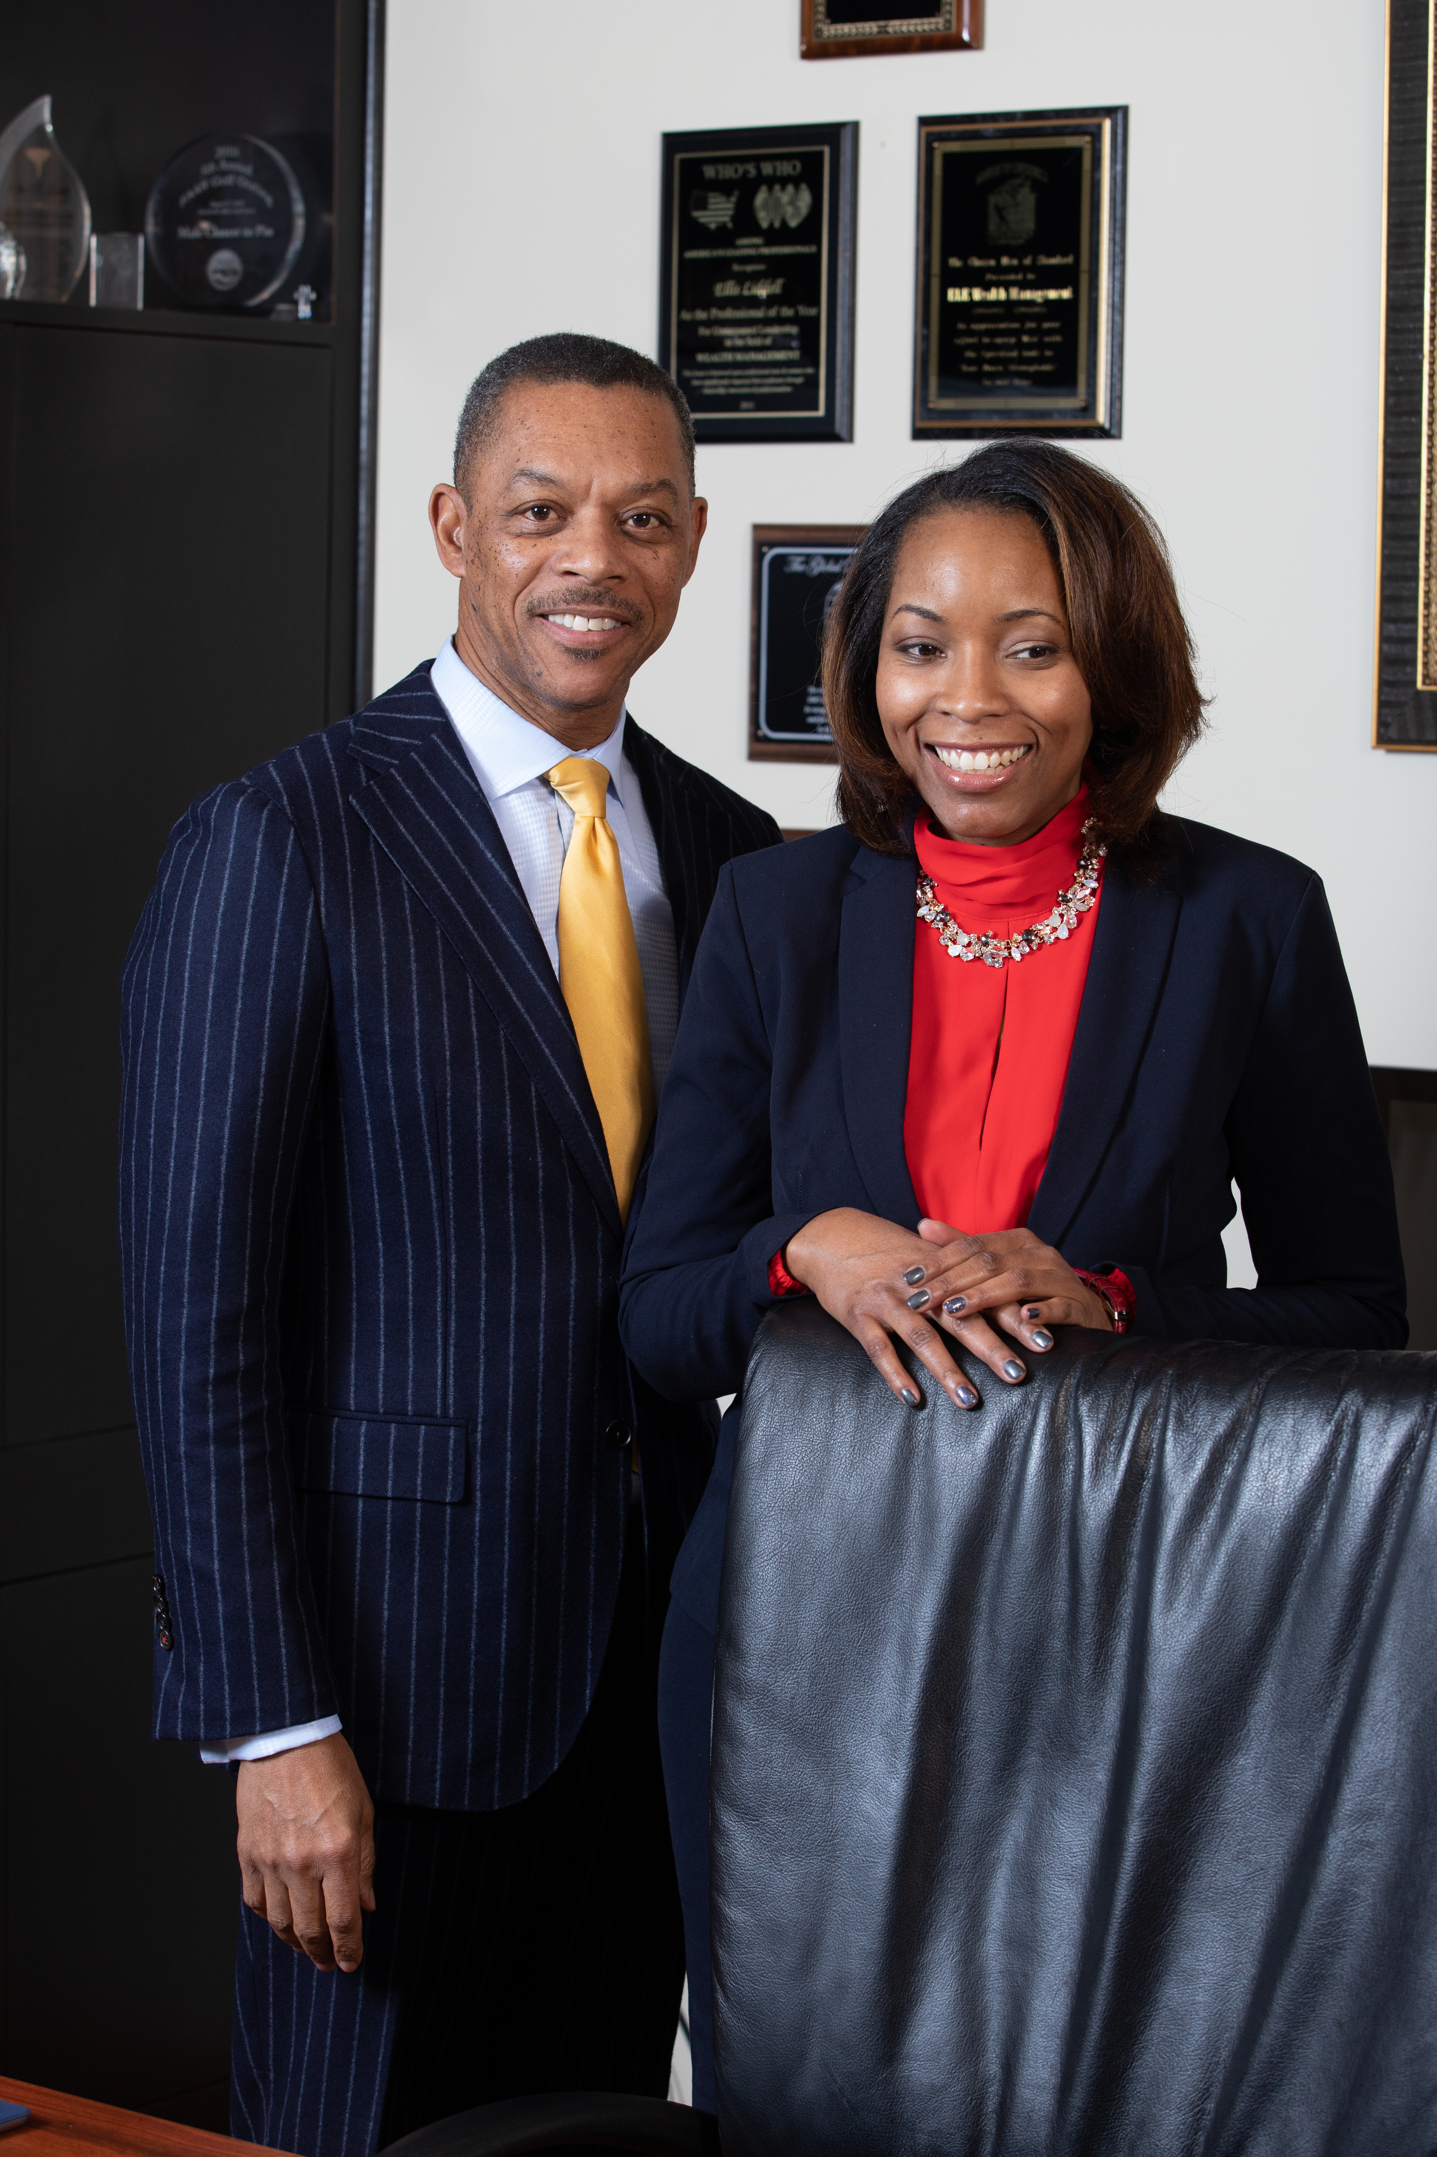
COURSE OVERVIEW
Insurance/Retirement Planning (cont’d)
Lecture 14 – Build a Safety Net – Retirement – Greg Blackwell provides practical advice to individuals who are ready to retire or retire their jobs and start a business. He also delves into detail about wills, living wills, and estate planning.
DBHG Mentorship Program
Lecture 15 – Build up Someone Else – Greg Blackwell and Nancy O’Neale discuss the importance of mentorship and the Detroit Business Hub Group mentorship program.
Nancy O’Neale with Detroit Business
Hub Group Advisor Ellis Liddell

Slide 16
Large image
7 MEMBERSHIP BENEFITS
Business plan/entity assistance – Members receive a free overview and critique of their business plan. They may also purchase a starter package if they require a business plan for lending or other purposes.
Starter and Master Courses – Members receive starter and master courses as part of their membership. There is an accreditation course in its development stage.
Access to Capital – DBHG works with lending institutions to provide members with up to date information on available funding sources and gives members the opportunity to network with lenders.
Bi-monthly Mentorship Call – This bi-monthly call is for start-up business owners and business owners five years and younger.
Speaking Opportunities – Members have opportunities to speak to live audiences, on podcasts, or video.
Networking opportunities – Members have opportunities to network at DBHG monthly and quarterly live and virtual events.
Referrals – Many of the members buy each other’s products or services. Members recycle dollars in the DBHG business community.

Slide 17
Thank You
Detroit Business Hub Group
888.393.3244
nancy@nancyoneale.com
https://nancyoneale.com/product/detroit-business-hub-group-starter-course/

