Slide 1
Business Plan Writing
Part 2 - Access Fundings for your business

Slide 2
Download Tools
2 Business Plan Sample
Business Plan Template
Business Model Canvas
Competitor Analysis Tool
Customer Profiling Tool
Team Profile
Problem and Solution Map
Marketing Plan Template
Market Segmentation
Market Sizing
Financial Plan Template
Download Tools

Slide 3
Section 1 - Executive Summary

Slide 4
10 Step Executive Summary Guide
The GRAB
Guy Kawasaki, a Californian speaker and investor who writes about business plans, start-ups and investing, suggests starting with ‘The Grab’.
The idea is to start with a compelling sentence or two that sums up your unique solutions to a big problem that should be direct and specific. If you are going to name drop – now is the time!
Review the simplified sample executive summary from the case study as an example.

Slide 5
Problem
What is the problem you are trying to solve? Describe it in one or two sentences, with numbers to back up your statement.
Solution
Briefly describe your solution. Explain what you offer to who.
Don’t use technical jargon.
Explain your Unique Value Proposition here.
Market
How big is the market?
Is it growing?
What is driving that growth?
Which segments will you be targeting?
10 Step Executive Summary Guide

Slide 6
Competition
Provide an overview of the competitive landscape. Who else is operating in the space?
Why are you different?
What is your unfair advantage (patent, people, first-mover)
The business model
How will you make money? Is it a subscription model? Are you buying goods for X and selling them at Y?
Will you be offering a free service and selling advertising?
Are you targeting companies or individual consumers?
Do you have distributors? How will you find and reach your customers?
How will you scale? What are your key costs? No need to get into the details of your
operating, technology and/or marketing plans here, but you might want to touch on any really important pieces of information.
10 Step Executive Summary Guide

Slide 7
Team
Explain why your team is best placed to win.
Where does each person on the core management team fit in? Have you covered all
At a smaller scale, if someone on your team has great relationships and connections in the community where you operate, then say so.
Traction
What have you achieved so far? Describe the evolution of your company.
Do you have a product or at least a prototype? How may units of your product/service/prototype have you sold to real customers? At what price?
Do you have larger customers ready to buy form you – letters of interest?
Have you received any endorsements or prizes?
10 Step Executive Summary Guide

Slide 8
The financial plan
Provide a snapshot of your financials.
How much revenue do you expect to generate within 5 years?
When do you expect to break even?
If you are seeking outside capital, you will need to show either that you have the ability to pay back a loan (plus interest), or if you are seeking equity investment, you need to show convincingly that you can grow to a point where you can provide a return to your investors.
The Ask
If you are asking for capital, spell out how much you need, what you will spend it on, and when you will be able to deliver a return.
10 Step Executive Summary Guide

Slide 9
RECAP
Next Video

Slide 10
Section 2 - The Business (Company Description)

Slide 11
Intro
This section describes your business idea. It answers the following questions:
What is the pain point?
What is your solution?
Also, it should include;
Mission & Vision Statement
Current & Future Milestone

Slide 12
The Business – Problems and Solutions
“Customers don’t care about your solution. They care about their problems.” – Dave McClure , 500 Startups
Too many entrepreneurs start with their solution; - they come up with a great idea, or piece of technology, or gadget. They are so excited about this idea, and they can’t explain why the rest of the world isn’t as excited as they are.
The problem is – they haven’t explained the problem!

Slide 13
Samples - Elites
More than 70% of graduates churned out in recent times by Nigerian Universities and other higher institutions of learning are unemployable.
Elites quest to a bridge between Graduates, Unemployed, Career switchers, job seekers and companies that are in dire need of the skilled personnel by building job ready developer, designers and Internet marketers

Slide 14
Samples – SME’s Clinic
Most SME’s are failing and Aspiring Entrepreneurs finding it very difficult to startup. Because they lack funding, access to market and network but most especially they lack access to right business training and mentorship
SME Clinic by Mayokun is a monthly workshop that will help Small and Medium scale Enterprises (SMEs) address challenges associated with setting up and Growing

Slide 15
NOTE
Keep it short and simple such that you can explain it to anyone unfamiliar with your idea and industry can get it. Please use the problem and solution map to fill in this section.

Slide 16
What is your end goals?
Your Vision Statement
Your Mission Statement
Your Current Milestone - Short-term Plan
Your Next Milestone - Long term Plan
Refer to the Business Plan Samples

Slide 17
Let’s Do it Together
To make this really impactful do not watch the next video until you have written the 2nd Section of your business Plan…

Slide 18
Section 3 - Market Analysis

Slide 19
Intro
This section covers 3 important pieces of information namely;
Understanding your market- market research, target market and segmentation
Market size, structure and growth potential- market sizing tool
Value proposition
.

Slide 20
Tools to use
Customer Profiling Tool
Market Segmentation
Market Sizing

Slide 21
Sizing your market
Practical example
If there are 10 people that you are trying to target selling books; five of them not in your region; and of the five in your region only 3 of them have money, then you are only targeting 3 out of the 10.
Before you know you have a viable market, you need to establish;
how many people might be interested in buying your product or service
how many other companies are already competing for their business
what’s special about your offer

Slide 22
Total market size - How big is the Market?
Customer Demographics
Location
Population
Gender
Age group

Slide 23
Total addressable market
The total addressable market is the total revenue you could expect to generate if you had 100% of the market
Imagine with me… Assuming there are 3M people in Ibadan Nigeria and on the average the 3m people eat food worth $5 daily.
What is the TAM for the food market of Ibadan?
Ans: $15m daily, Hence based on this sample the total money in the Ibadan food industry is $15 daily…. As a business owner you decide on the % of the $15m that comes to you daily

Slide 24
Total addressable market
From this percentage you need to find out how much of the market segment would come to your business as revenue. If your business took 1%,then your annual addressable market is only 1% of the total spend on food in Ibadan.
A business plan should be realistic and should help you test whether your idea is feasible.

Slide 25
SWOT Analysis
Internal Leverage on your strength
Work on your weakness
External
Maximize your opportunities
Deal with your Threat

Slide 26
Hit the Target
Use the tools provide to craft your target market. It is important your are very thorough and realistic in your approach.

Slide 27
Section 4 - Competition Analysis

Slide 28
Intro
Competition is important, and can at times be useful and healthy. If you have zero competition, you are either in an unprofitable business, you are ahead of your time, or the competition is coming very soon!

Slide 29
Competitors
Here describe in detail the competitive landscape of your business and outline the analysis of your business’ strengths and weaknesses compared to the competition. Highlight the competitive strengths of your business that will lead to success despite the existence of competitors. Information to include:
Main competitors and a description of their offering
Analysis of your business’ USP in comparison to the main competitors
Competitive advantage
Please refer to the competitive advantage tool to guide you through this analysis.

Slide 30
Competitors
List your competitors’ key strengths.
Are they great at marketing?
Do they have strong relationships with local authorities?
Do they have an excellent reputation for customer service?
Is their product just brilliant?
Finally list their weaknesses. It might be thier
Customer relationship
Model of Delivery etc

Slide 31
Competitive Advantage
It is the thing about your product or service that will create unique value for the user.
It is where your product or service intersects with what your customer needs or want.
It is the magic point where product meets market, right at the heart of the business model.
Are there ways you strengthen your unique value proposition to capitalise on your strengths and to take advantage of the weaknesses of you competitors
Is there something you could offer that no one else is offering, perhaps it could even help you reach a new group of customers?

Slide 32
Be Innovative
As a business owner you have a duty to ensure you get ahead of your competitors

Slide 33
Section 5 - Business Model

Slide 34
3 Typical Business Structure for Small Businesses
This is a critical section where you explain your chosen business model(s) and the rationale behind the business model(s) you will use. Give information on the background that led to the formation of this business idea (include evidence from your research) and the scope of opportunity that you want to take advantage of through the business.
Please refer to the business model canvas to map out this section.

Slide 35
Recap
Let’s See You have done so far

Slide 36
Section 6 - Operation Plan

Slide 37
Operation Plan should Include;
Production process
Suppliers
Plant & equipment/Assets
Inventory
Technology/Software
Communication channels
Quality control
Team Management Plan
Marketing Plan

Slide 38
Operation Plan
Production process: In this section you map out, the process involved in producing your products or services. This process will vary depending on your product or service.
Are you a manufacturing firm? You might need to consider:
Do you have a manufacturing process?
Who is involved in the process?
Are there any third parties involved?
What is involved in delivering the service to your customers i.e. distribution channels etc.?

Slide 39
Operation Plan
Suppliers
In this section you map out
Who your main suppliers are.
What do they supply to your business?
How will you maintain a good relationship with them?
Plant & equipment/Assets: Again this section is totally dependent on the kind of business.
Here you can list your current plant and equipment purchases or even asset needs. These can include vehicles, computer equipment, phones etc.

Slide 40
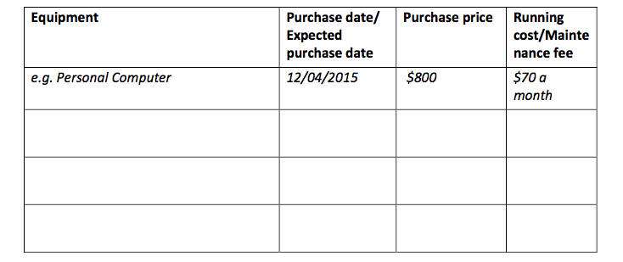
Plant & Equipment Table

Slide 41
Operation Plan
Inventory
This is also dependent on the type of business. Service firms may find this section irrelevant to them but if you sell actual goods, this section is critical.
You will want to list your current inventory items in the table below. If you have a substantial inventory, you may prefer to attach a full inventory list to the back of this business plan.

Slide 42
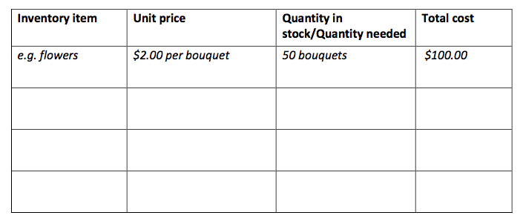
Inventory Table

Slide 43
Operation Plan
Technology/Software
In this section you answer the following questions.
Do you have any specific technology requirements such as website, point of sale software or accounting package?
What will be the main purpose for each?
Will they be off-the-shelf, open-source or purpose built?
What is the estimated cost of each technology solution?

Slide 44
Operation Plan
Communication channels: This section maps out how your customers get in contact with you such as telephone (landline/mobile), post box, email, blog or social media channels.
Quality control
This section is very important as it helps you describe your quality control process.
What checks or balances do you have in place to ensure the product or service you offer is produced to the same standard of quality?
What steps do you take to meet product safety standards?

Slide 45
Please refer to the Team Profile Tool

Slide 46
Marketing Plan - Refer to the Marketing Plan template

Slide 47
Marketing Plan
Sales and marketing strategy
In this section you are to explain your sales and/or marketing strategy by first deciding what your focus is. There are two main types of focus; B2B and B2C.
If your business is focused on selling to other businesses (B2B) – for example a software company, or an office cleaning company, or a supplier of agricultural inputs to farmers, then you will need to build your sales force.
Will you sell through partners, will you work with independent agents or will you hire in-house sales people?
What is your sales cycle like – that means, how long does it take you to make a sale?
Do you already have a database of prospective clients? If not, how will you build one?

Slide 48
Marketing Plan
If your company sells mainly to individual consumers (B2C), then you may have more of a consumer marketing focus.
For example, are you a chain of restaurants or are you selling a website or an app to individuals?
How will you market your product?
Will you use traditional advertising in the newspaper or on the radio?
Will you use word of mouth in your community?
What about social media, email or even printed flyers distributed in your neighbourhood?
How much will you need to spend to get a single customer?
Many businesses will need to use a combination of sales and marketing.

Slide 49
Conclusion
What we do to get the job done

Slide 50
Section 7 - Financial Plan

Slide 51
Financial Plan
The purpose of this section is to lay out the financial structure, expenses and revenue of your business. Please refer to the financials templates provided including:
Business expenses
Revenue projections according to your sales and marketing plan
Cash flow forecast
Financial structure including capital requirements

Slide 52
Business Plan Review

