Slide 1
Why is it so hard to spread good ideas and practices?
Notes:
Before I explain how we addressed that, let me get your predictions on what happened and put the question to you:

Slide 2
large-scale change
exponential increase in impact that in most cases
transcends the boundaries of your organization
Notes:
Joe
LS changem definitionally, refers to taking ideas, knowledge, evidence-based practices that can improve lives and save lives beyond the boundaries of where they were created to everyone who can benefit from them. This for us is really rooted in our social justice - it’s crazy that we have so much knowledge about what works and what leads to healthy, fulfilling and so little gets to those who can benefit. Particularly those who are PoC, marginalized, poor… as
The bald fact, which is starting point in figuring out how to address that, is that large-scale change can’t happen through harder work or by fiat or by evangelizing - if only it was so easy...the truth is that it requires deeply engaging others in our vision and our aim...

Slide 3
bad question
How can I get all these people to do what I want them to do?
Notes:
Joe.
It requires shifting from this very traditional management mindset which asks ...by directing, using hierarchy, manipulating or cajoling...to asking….

Slide 4
better question
How can I help all these people to do what they want to do?
Notes:
Joe
Everything we’ll teach you has this question beneath it: How can you more effectively tap into the energy and creativity of hundreds, thousands or even tens of thousands of other people to get the health outcomes you seek. Tapping into their dreams, passion, skills, insights and experiences...

Slide 5
unleashing*
Orchestrating the loss of control of thousands of creative people who are
moving in the desired direction.
Notes:
Joe
And if it happens - and it’s rare - it leads to this glorious phenomenon that we call unleashing where you’ve got all these people bringing their whole selves- all their intellect and creativity - to the table and pulling toward the same objective and it’s really sight to behold.
The steps that Becky is going to outline at a very high level here are how we think that phenomenon happens...somewhat paradoxically we have learned, from our own work and the 40-50 case studies we’ve looked at closely from across the social sector, that this unleashing, this letting go is something that can actually be orchestrated...so here are the elements of how that happens...

Slide 6
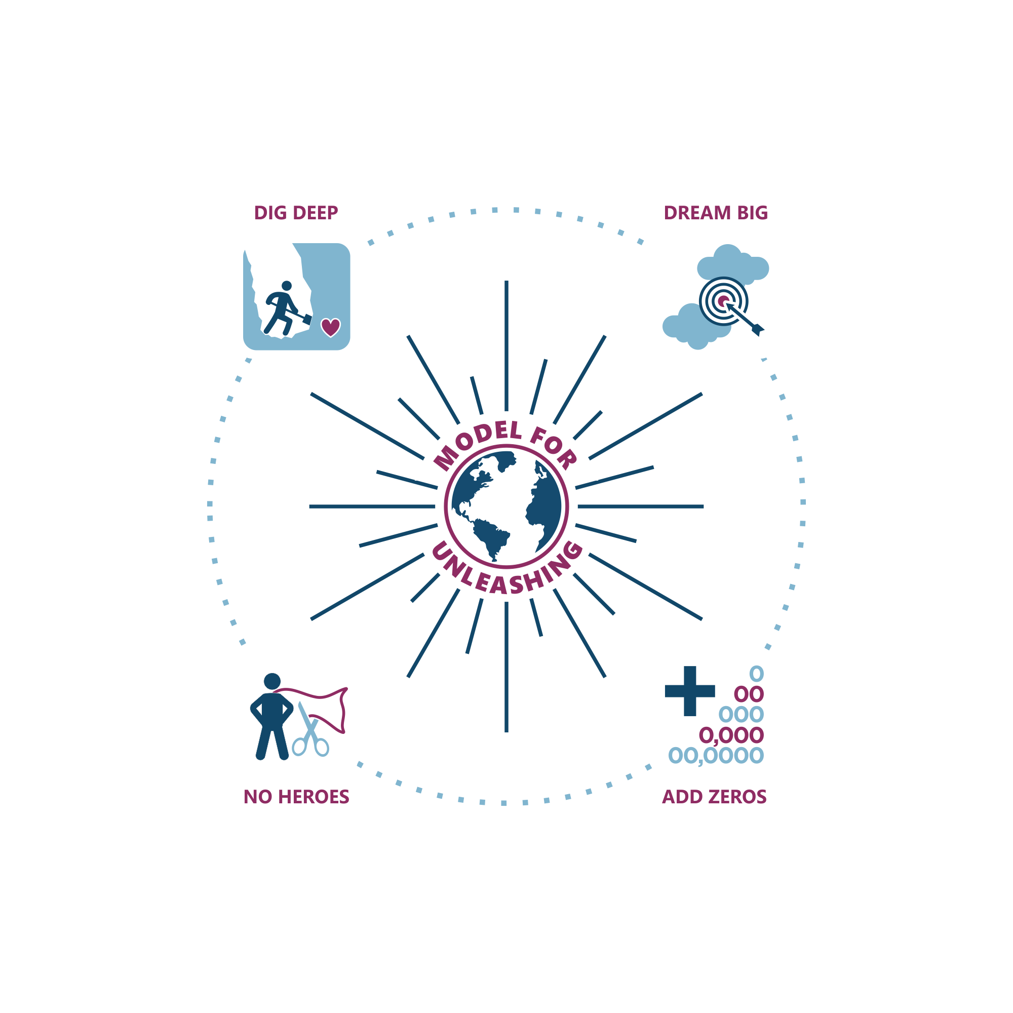
Notes:
Becky

Slide 7
Notes:
Becky

Slide 8
What’s your “Turkey Sandwich”?
What life experiences bring you to care about this issue now?
What makes for a compelling aim?
Are you committing data malpractice?
Are your operations primed for growth?
Who are you when you’re at your worst?
Who are you when you’re at your best?

Slide 9
What is essential and what can vary?

Slide 10
diffusion curve (rogers)
Notes:
don’t worry about everyone!!! f the laggards/dbs.

Slide 11
attributes that facilitate adoption (rogers)
Relative Advantage
Compatible
Simple
Trialable
Observable
Source: Rogers, 1995

Slide 12
turkey sandwich
Notes:
Write your name by the one’s that are important to you to learn.

Slide 13
breakout rooms
as your organization adjusted to COVID, what was essential and what could vary?
Notes:
Write your name by the one’s that are important to you to learn.

Slide 14
How do we set compelling aims?

Slide 16
How do we set aims that are compelling?

Slide 17
principles for setting compelling aims
Understand full scale.
Understand where you are today
Observe the rule of 5-10x
Specify how much, by when. (Some is not a number; soon is not a time.)
Walk the line between ‘electrifying’ and ‘electrocuting.’
Rate it and chunk it
Give the aim primacy

Slide 18
“Tight on aims. Loose on everything else.”
- Dennis Wagner -

Slide 19
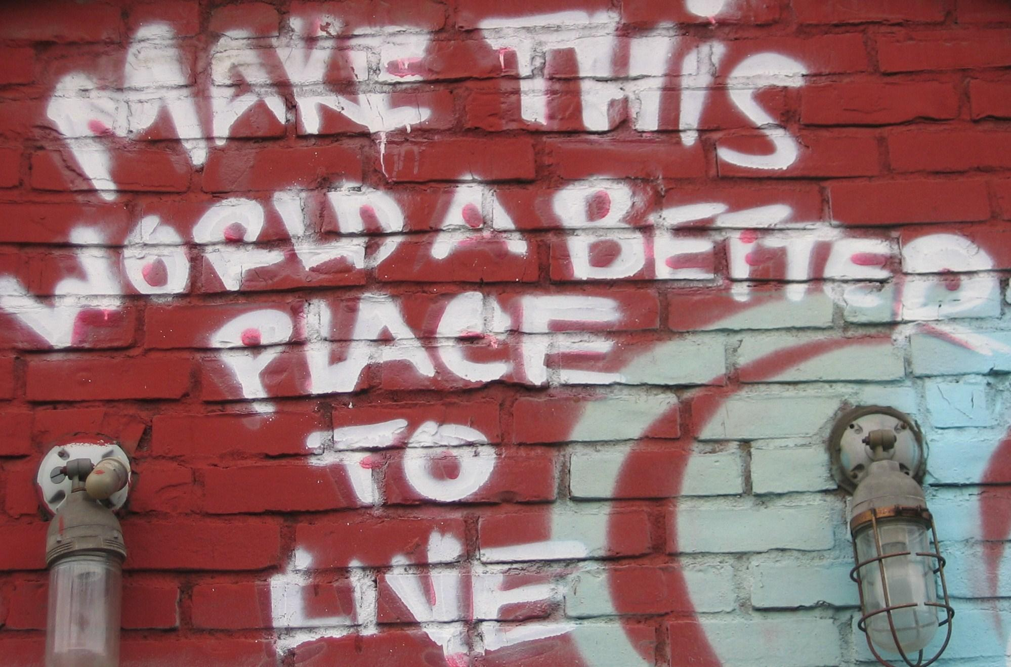
Notes:
Write your name by the one’s that are important to you to learn.

Slide 20
Notes:
Becky

Slide 21
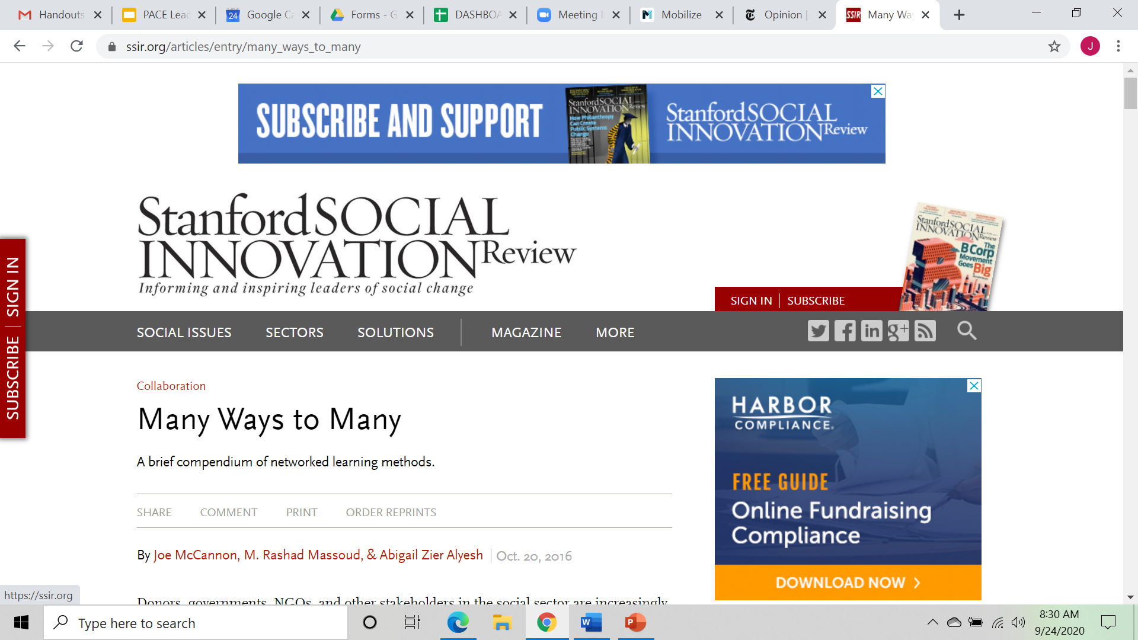
Notes:
Becky

Slide 23
as within, so without…
How we behave as a team, day in and day out, is every bit as predictive of success as our strategy and our design.
This is even more important as you expand.

Slide 24
keys to dynamic operations
Standard | Exceptional

Slide 25
keys to dynamic operations
Standard | Exceptional
Comprehensive strategic planning. | Bias toward starting.

Slide 26
keys to dynamic operations
Standard | Exceptional
Comprehensive strategic planning. | Bias toward starting.
Orientation toward “the boss.” | Orientation toward the field.

Slide 27
keys to dynamic operations
Standard | Exceptional
Comprehensive strategic planning. | Bias toward starting.
Orientation toward “the boss.” | Orientation toward the field.
Summative data. | Timely, actionable data for the front lines.

Slide 28
keys to dynamic operations
Standard | Exceptional
Comprehensive strategic planning. | Bias toward starting.
Orientation toward “the boss.” | Orientation toward the field.
Summative data. | Timely, actionable data for the front lines.
Fear-based management. | Joy-based management. (Waste no will)

Slide 29
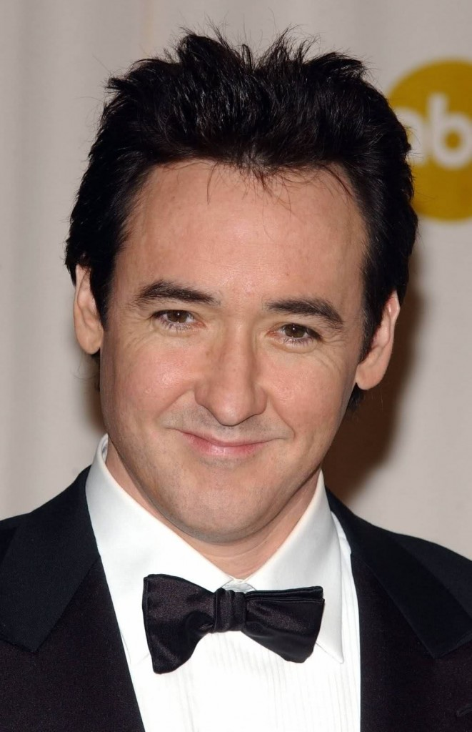
the john cusack rule
“Keep the set
Free
of fear”
Notes:
canvass group

Slide 30
keys to dynamic operations
Standard | Exceptional
Comprehensive strategic planning. | Bias toward starting.
Orientation toward “the boss.” | Orientation toward the field.
Summative data. | Timely, actionable date for the front lines.
Fear-based management. | Joy-based management. (Waste no will)
Adherence to plan. (Theory Lock) | Improvisation.

Slide 31
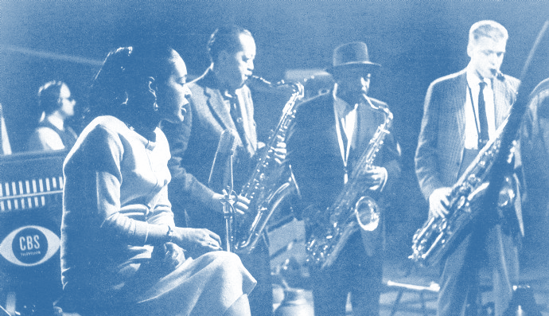

Slide 32
some insight on testing
tom chi (google x)
Any given idea has a 5% chance of success.
With 20 iterations on that idea ("tries"), the chance of success improves to 64%.
With 50 iterations on that idea, the chance of success improves to 92%.

Slide 33
keys to dynamic operations
Standard | Exceptional
Comprehensive strategic planning. | Bias toward starting.
Orientation toward “the boss.” | Orientation toward the field.
Summative data. | Timely, actionable date for the front lines.
Fear-based management. | Joy-based management. (Waste no will)
Adherence to plan. (Theory Lock) | Improvisation.
Experts and learners. | ‘All teach, all learn’ culture. (IHI)

Slide 34
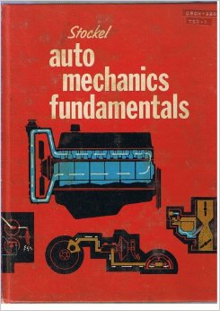
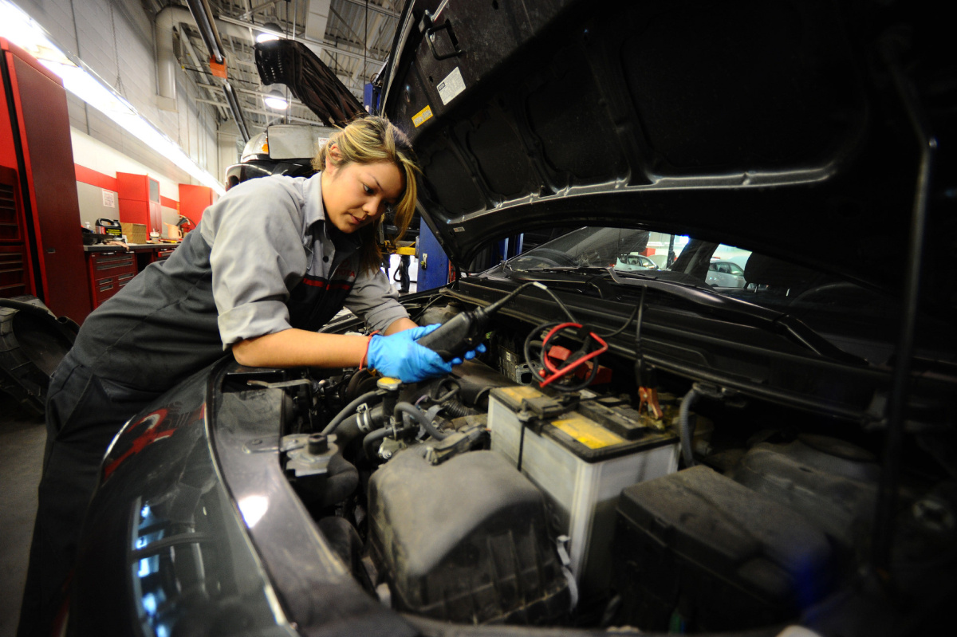
“tacit knowledge” exchange
Notes:
JOE

Slide 35
keys to dynamic operations
Standard | Exceptional
Comprehensive strategic planning. | Bias toward starting.
Orientation toward “the boss.” | Orientation toward the field.
Summative data. | Timely, actionable date for the front lines.
Fear-based management. | Joy-based management. (Waste no will)
Adherence to plan. (Theory Lock) | Improvisation.
Experts and learners. | ‘All teach, all learn’ culture. (IHI)
Grind it out. | Have fun.

Slide 36
team discussion
Are these values present in your day-to-day operations?

Slide 37
Data Malpractice

Slide 38
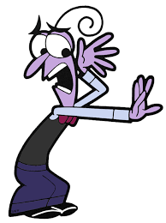
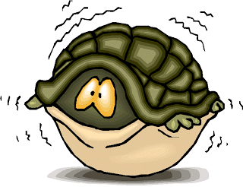
typical responses to data, measurement and evaluation
Perla, et al. Health Affairs Blog. April 22 2015.
Notes:
You can otherwise supplement with sampling…

Slide 39
evaluation malpractice
Phase | Questions
Prototype | Does the innovation work?
Pilot | Does the innovation work under a variety of different circumstances?
Spread | Which adaptations are appropriate for different contexts? How can we most effectively orchestrate distributed improvement?

Slide 40
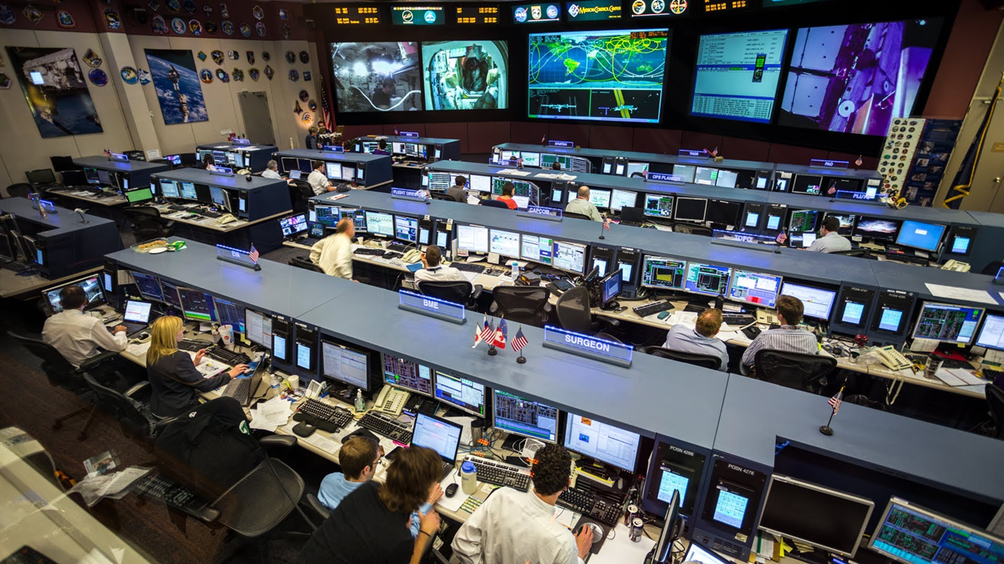

Slide 41
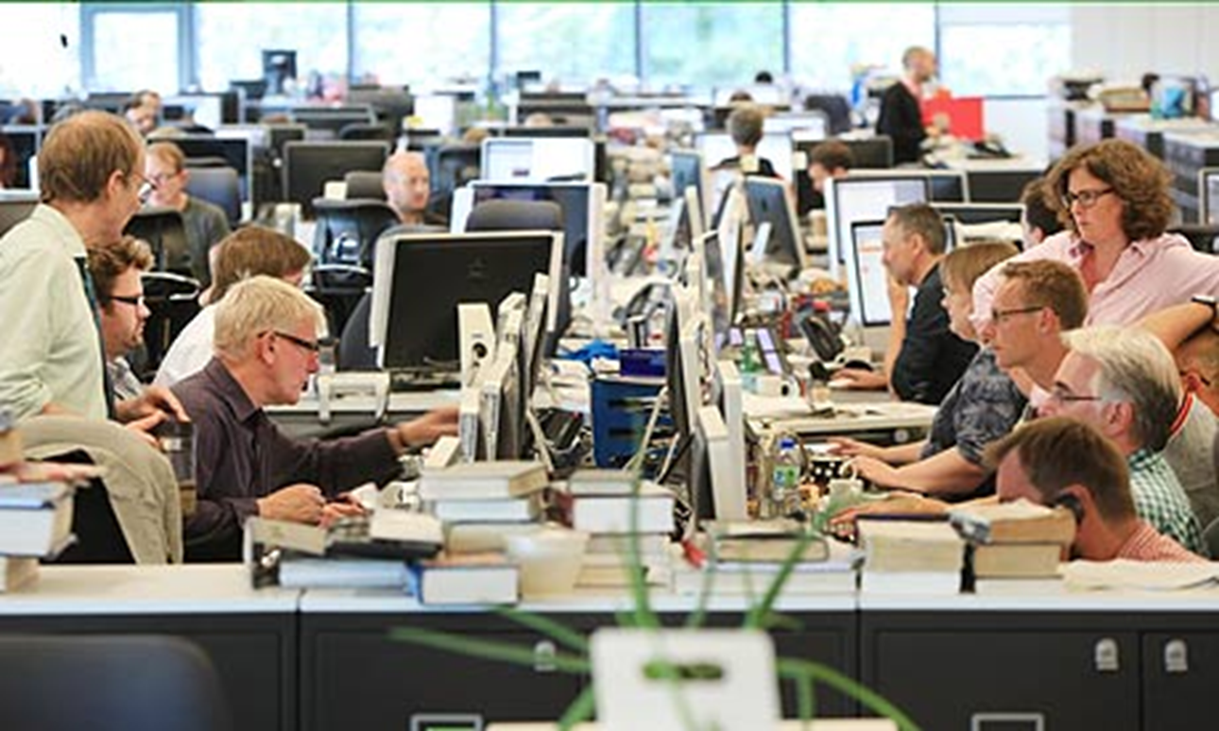

Slide 42
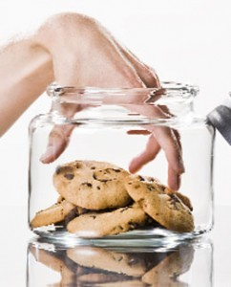
forms of data malpractice

Slide 43
forms of data malpractice
Method Misapplication

Slide 44
relevant evaluation questions
Phase | Questions
Prototype | Does the innovation work?
Pilot | Does the innovation work under a variety of different circumstances?
Spread | Which adaptations are appropriate for different contexts? How can we most effectively orchestrate distributed improvement?
Perla, et al. Health Affairs Blog. April 22 2015.
Notes:
You can otherwise supplement with sampling…

Slide 45
three faces of performance measurement (solberg, et al.)
Appropriate
Potentially toxic
Less appropriate
Aspect | Improvement | Accountability | Research
Aim | Improvement of services | Comparison, choice, reassurance, spur for change | New knowledge
METHODS: Flexibility of Hypothesis | Hypothesis flexible, changes as learning takes place | No hypothesis | Fixed hypothesis
Testing Strategy | Sequential tests | No tests | One large test
Bias | Accept consistent bias | Measure and adjust to reduce bias | Design to eliminate bias
Sample Size | “Just enough” data, small sequential samples | Obtain 100% of available, relevant data | “Just in case” data
Determining if a change is an improvement | Run charts or Shewhart control charts | No change focus | Hypothesis, statistical tests (t-test, F-test, chi square), p-values
Notes:
Second half of building this change package is to set up a measuremnt approach to determine how to judge if teams are making meaningful progress…

Slide 46
forms of data malpractice
Method Misapplication
Measure Malfeasance

Slide 47
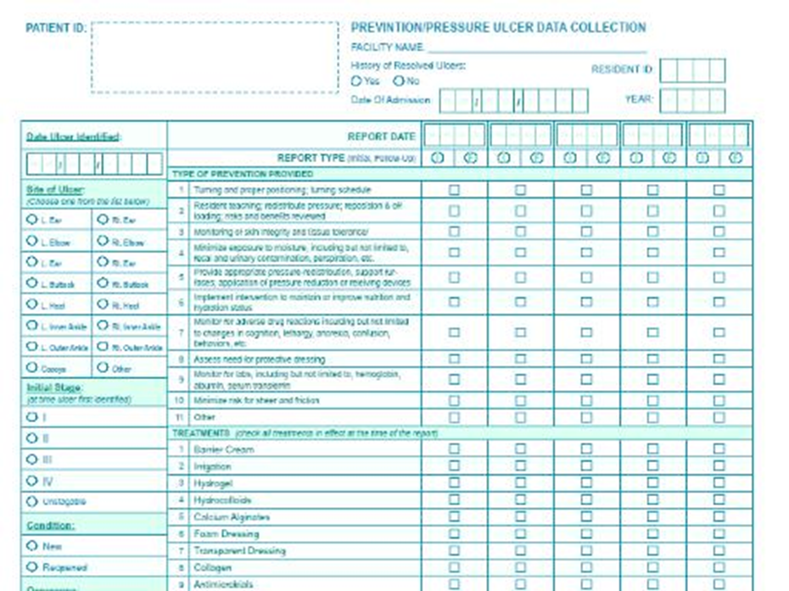
Perla, et al. Health Affairs Blog. April 22 2015.
Notes:
You can otherwise supplement with sampling…

Slide 48
what are….
…your three most important measures?
Notes:
You can otherwise supplement with sampling…

Slide 49
chance for redemption
What is the primary function of a good system of measurement?
Perla, et al. Health Affairs Blog. April 22 2015.

Slide 50
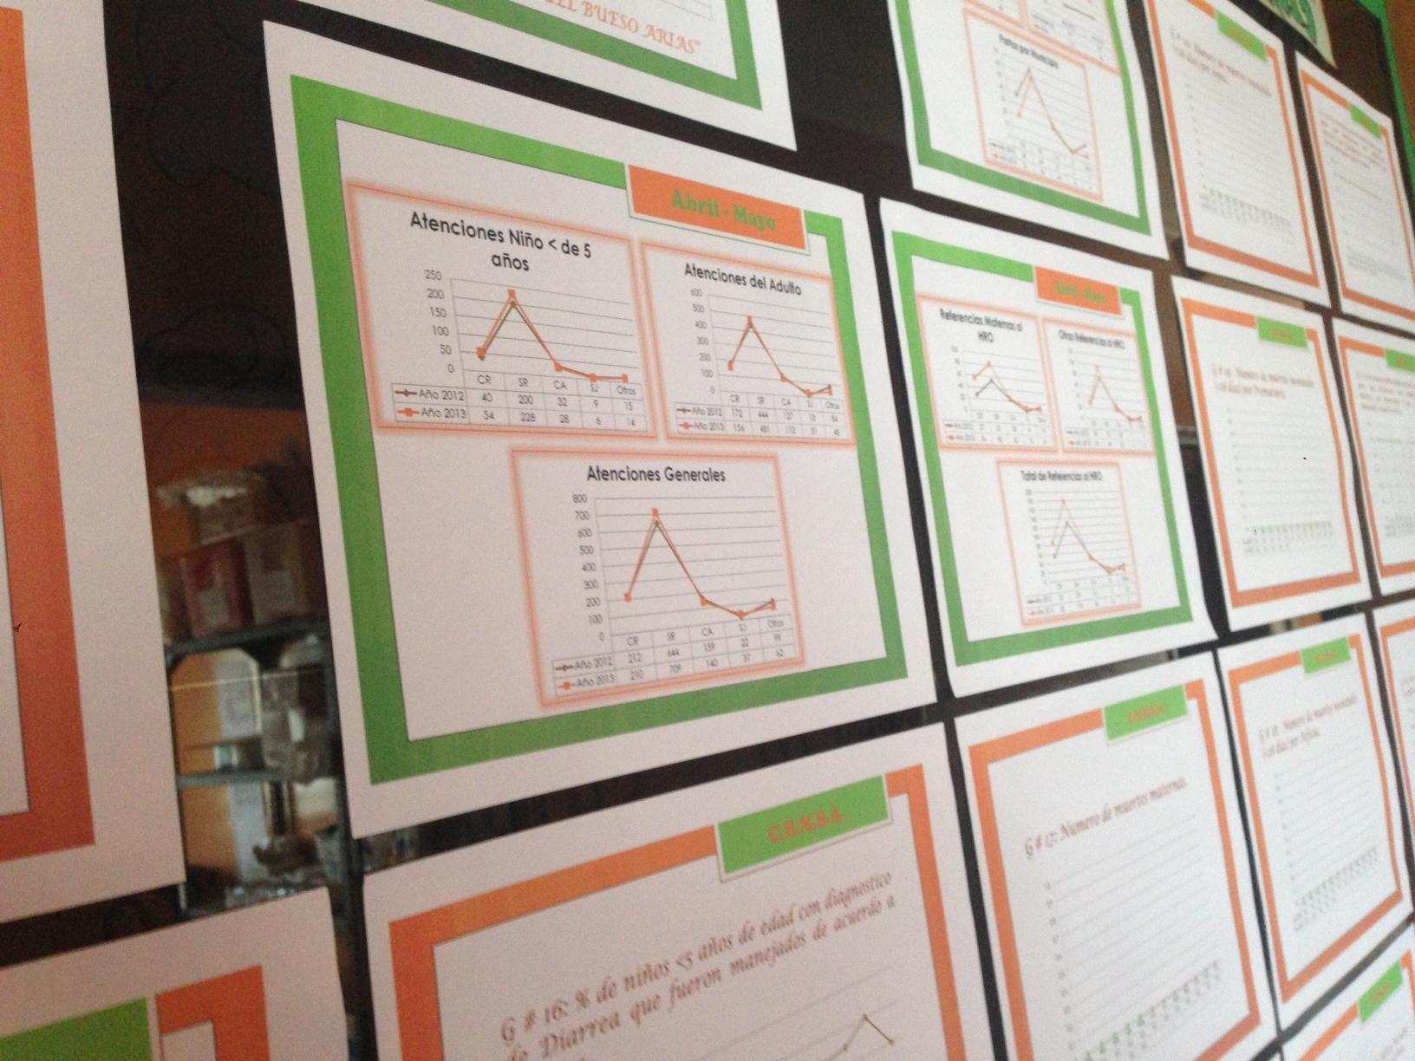

Slide 51
forms of data malpractice
Method Misapplication
Measure Malfeasance
Failing the frontlines

Slide 52
first principle of measurement system design
Design to support improvement by those at the front lines.

Slide 53
rankings of attendees
Torbay Charts (97.34)
#futurecare (88.4)
Epic (88.3)
Devon Flow Coaching Academy (85)
Springboard Collaborative (80)
Enhancing Inter-professional Collaboration (71)
Learning from Excellence (69)
Spreading HOPE (68)
Curious Collaborative (65)
Projected
Cut-Off Line
Notes:
You can otherwise supplement with sampling…

Slide 54
rankings of attendees
Torbay Charts (97.34)
#futurecare (88.4)
Epic (88.3)
Devon Flow Coaching Academy (85)
Springboard Collaborative (80)
Enhancing Inter-professional Collaboration (71)
Learning from Excellence (69)
Spreading HOPE (68)
Curious Collaborative (65)
TOTALLY BOGUS!!!
Projected
Cut-Off Line
Notes:
You can otherwise supplement with sampling…

Slide 55
forms of data malpractice
Method Misapplication
Measure Malfeasance
Failing the frontlines
Fault-finding that fosters fear

Slide 56
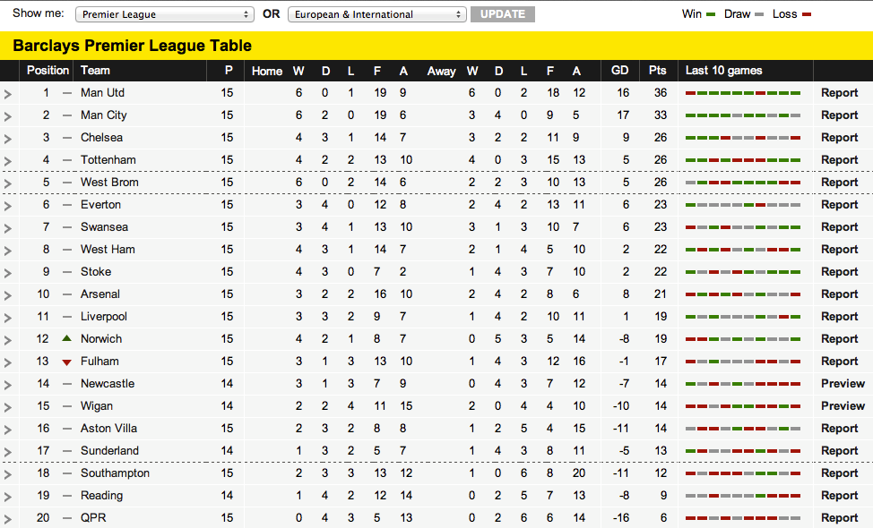
league tables
Notes:
Main tool this major form of fear, which we specifically took on…code words “holding people accountable” – which they know means, ‘you’re coming for me’

Slide 57
responses to ranking (berwick)
•The data are wrong!
•The data are right…but it’s someone else’s fault.
•The data are right…and I will now “play games” with what I report.

Slide 58
forms of data malpractice
Method Misapplication
Measure Malfeasance
Failing the frontlines
Fault-finding that fosters fear
Fidelity fanaticism

Slide 59
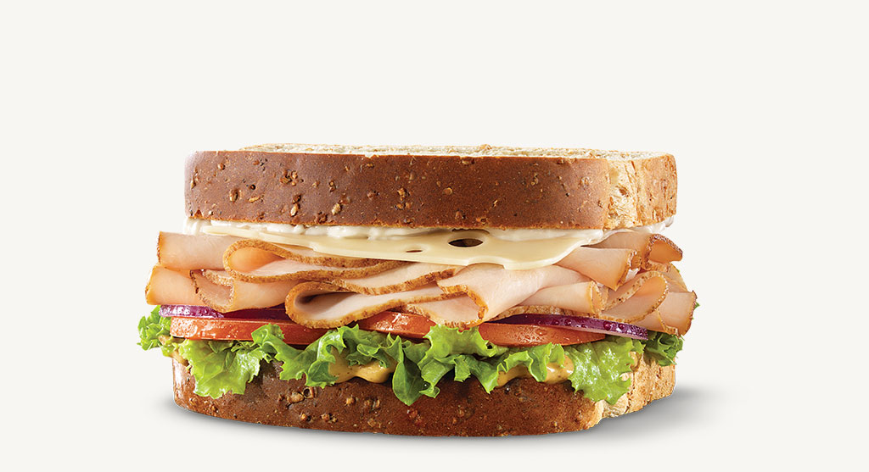

Slide 60
what about reliability?

Slide 61
forms of data malpractice
Method Misapplication
Measure Malfeasance
Failing the frontlines
Fault-finding that fosters fear
Fidelity fanaticism
Unfounded understanding

Slide 62
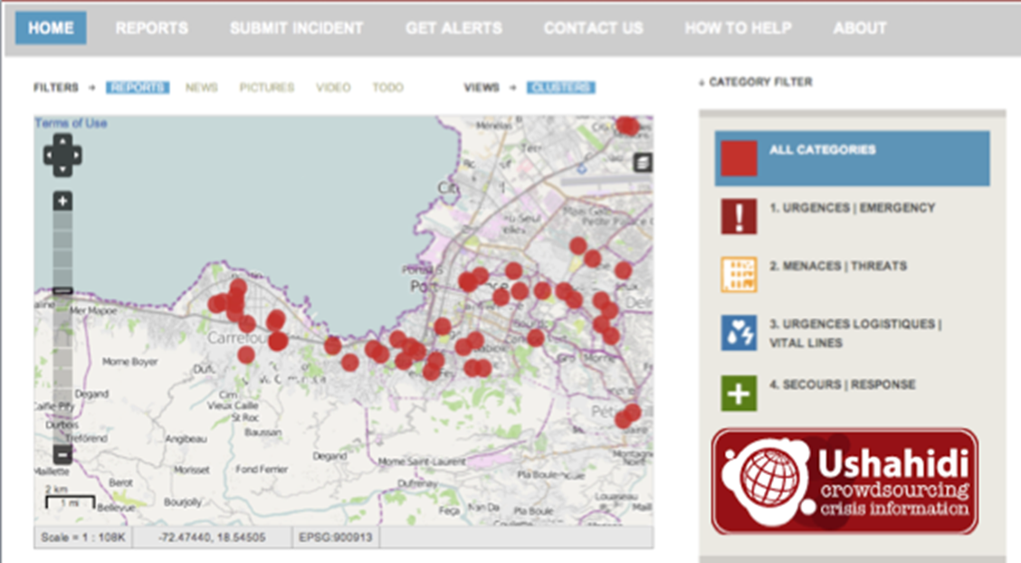

Slide 63
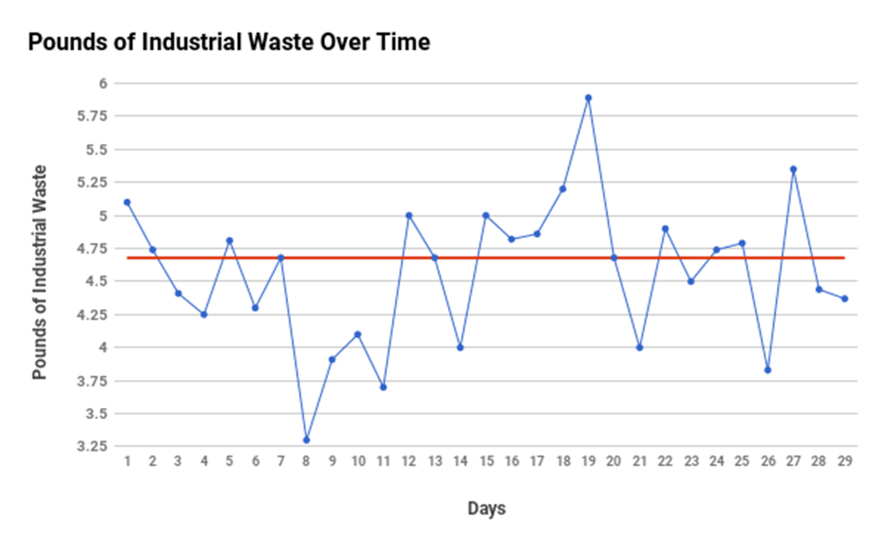

Slide 64
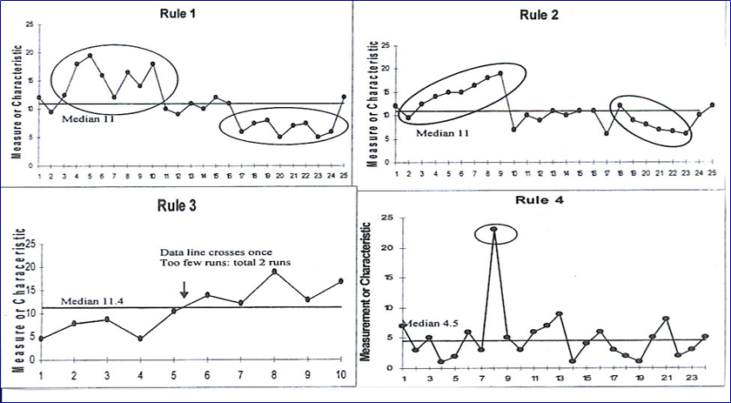
evidence of meaningful (non-random) variation

Slide 65
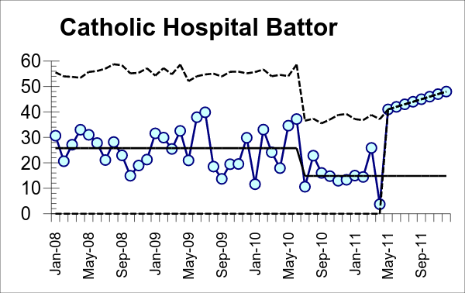
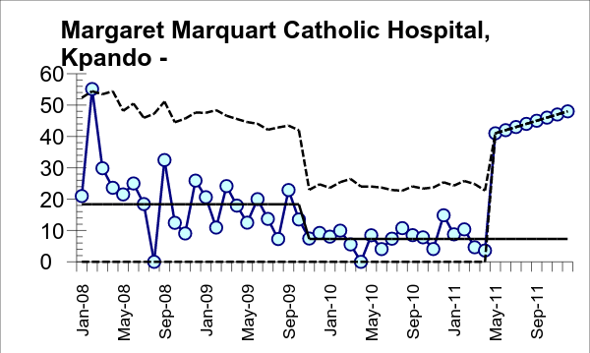
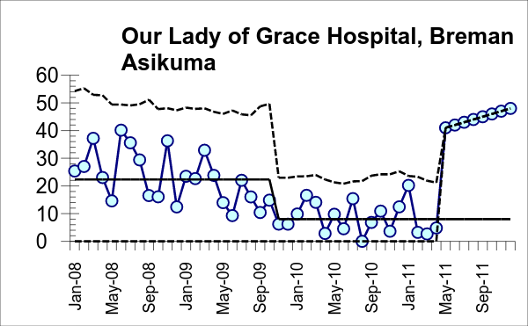
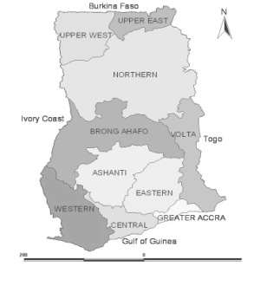
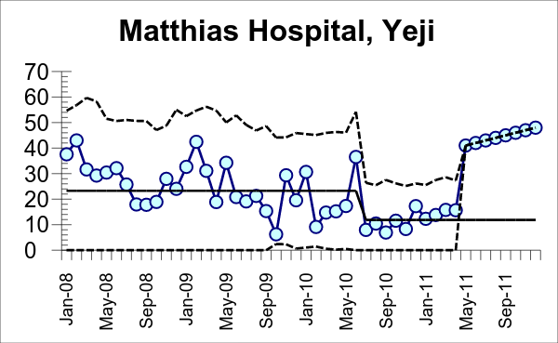
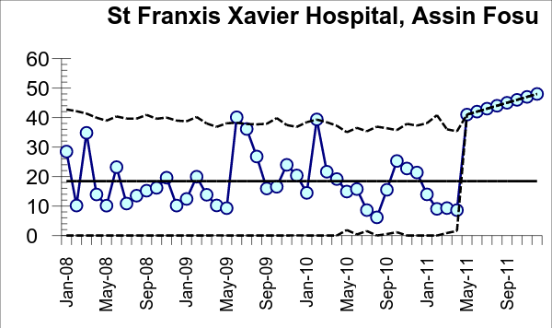
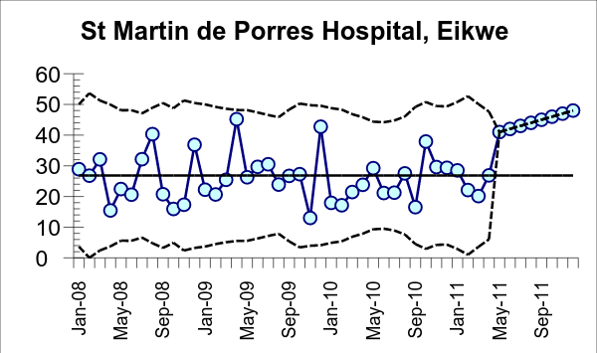
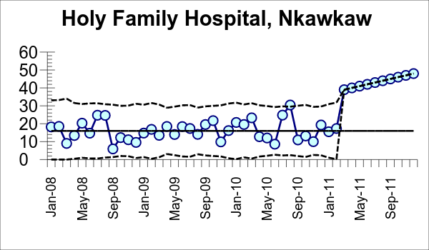
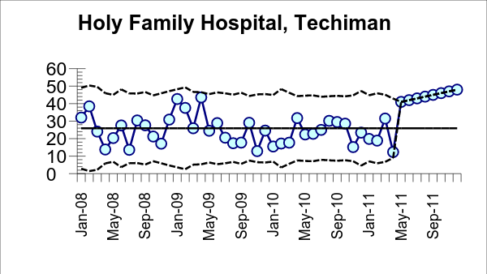
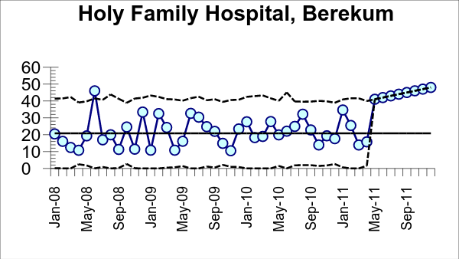
wave 3
facility-based under-5 deaths by hospital
Deaths Per 1000 Admissions
7 regions
9 hospitals
9 QI teams
Source: Project Fives Alive!, Ghana

Slide 66
forms of data malpractice
Method Misapplication
Measure Malfeasance
Failing the frontlines
Fault-finding that fosters fear
Fidelity fanaticism
Unfounded understanding
Unenergetic Unvestigation

Slide 67
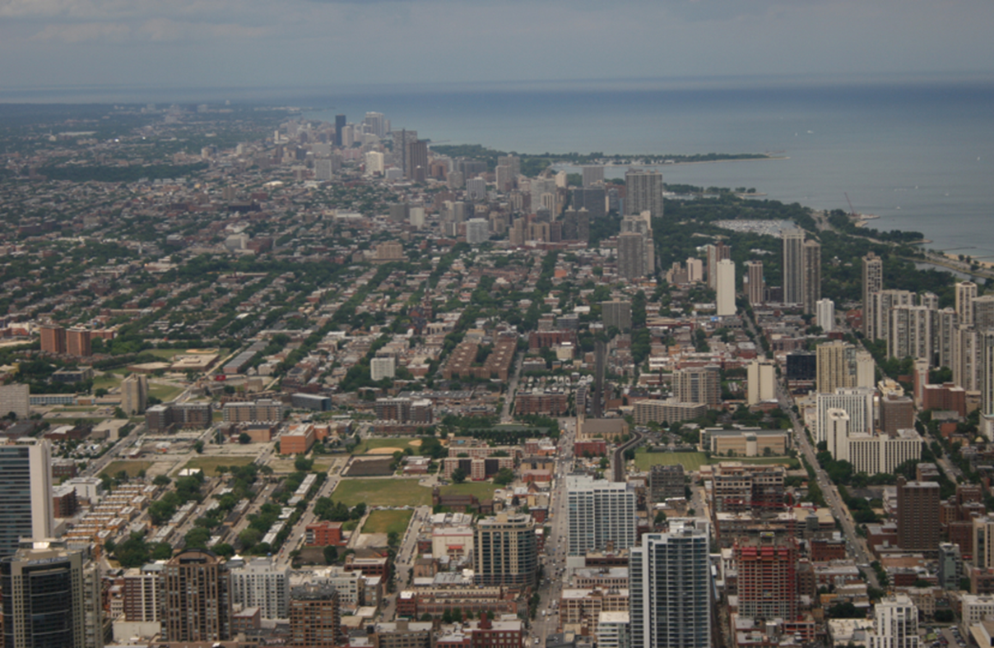
The data are clues…
the answers are out here!

Slide 69
invisibles
transactional goals
priorities and timelines reinforce white dominant culture
overwork as the stated norm
fear of open conflict
comprehensiveness
transactional relationships
individualism and separateness
perfectionism
power hoarding
official title outweighs experience
equity washing
Notes:
JOE

Slide 70
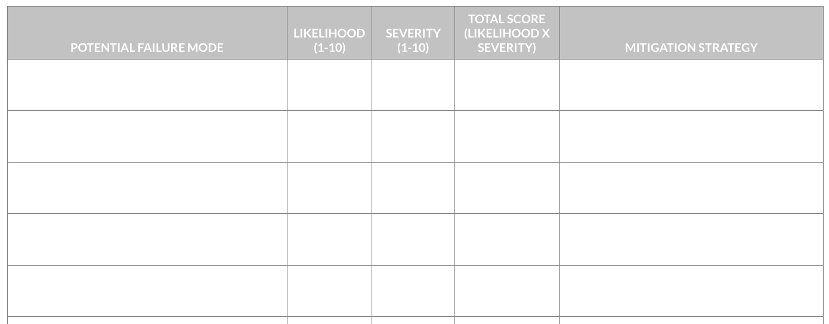
failure modes effects and analysis
https://docs.google.com/spreadsheets/d/1kjLbyy6h3aZNC43I45EOfTohaKtVdwqS8em9Qxa1vjk/edit#gid=0
Notes:
JOE

Slide 71
community building
Take 8 minutes to discuss with your colleagues what are your biggest take-aways from today?
Notes:
Becky

Slide 72
Day 2:
All About You

Slide 73
What’s your “Turkey Sandwich”?
What life experiences bring you to care about this issue now?
What makes for a compelling aim?
Are you committing data malpractice?
Are your operations primed for growth?
Who are you when you’re at your worst?
Who are you when you’re at your best?

Slide 74
check-in
As I think about leading my organization to grow, I feel ____________.
Notes:
Klaxoon

Slide 75
community building
Take 8 minutes to discuss with your colleagues about how you’re feeling about supporting your organization in expanding your impact
Notes:
Becky

Slide 76
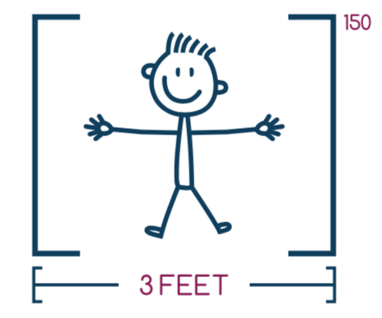
truth bomb:
Your impact in the world will be determined by how you use your three feet of influence.
Notes:
Becky

Slide 77
Life Maps

Slide 78
Notes:
Becky

Slide 79
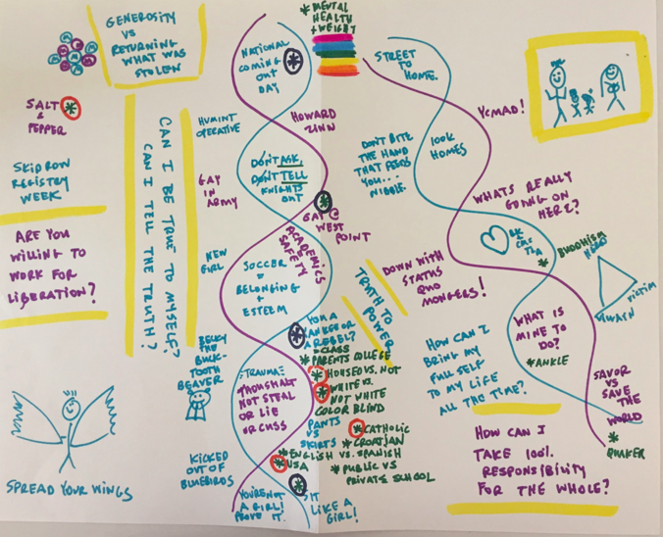
Notes:
before we talk about us, let’s talk about you. Let’s get to know who is in the room a little better.

Slide 80
life maps
When did you first become aware of:
your racial identity?
Your gender?
Your sexual orientation?
Your primary language?
Your citizenship status/country of origin?
Your socio-economic status?
Your parents’ education level?
Your housing status?

Slide 81
life maps
When did you first consciously become aware of any aspects of your identity that are oppressed in our society?
When did you first consciously become aware of any aspects of your identity that are privileged in our society?
When did you first purposefully use your humanity to disrupt the oppression of yourself or others?

Slide 82
Notes:
before we talk about us, let’s talk about you. Let’s get to know who is in the room a little better.

Slide 83
Personas

Slide 84
Notes:
Becky

Slide 85
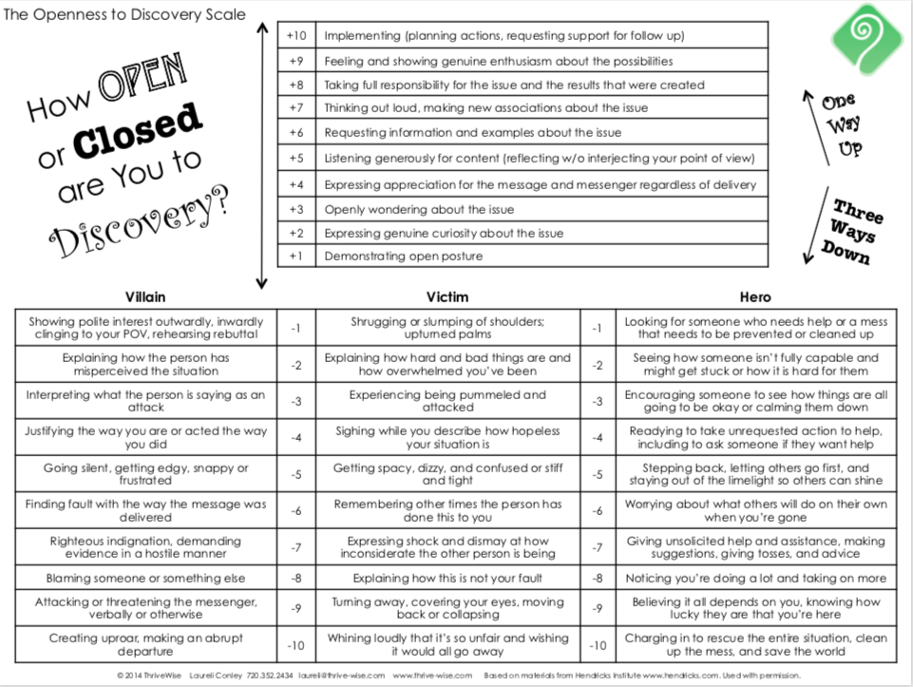
Notes:
Becky

Slide 86
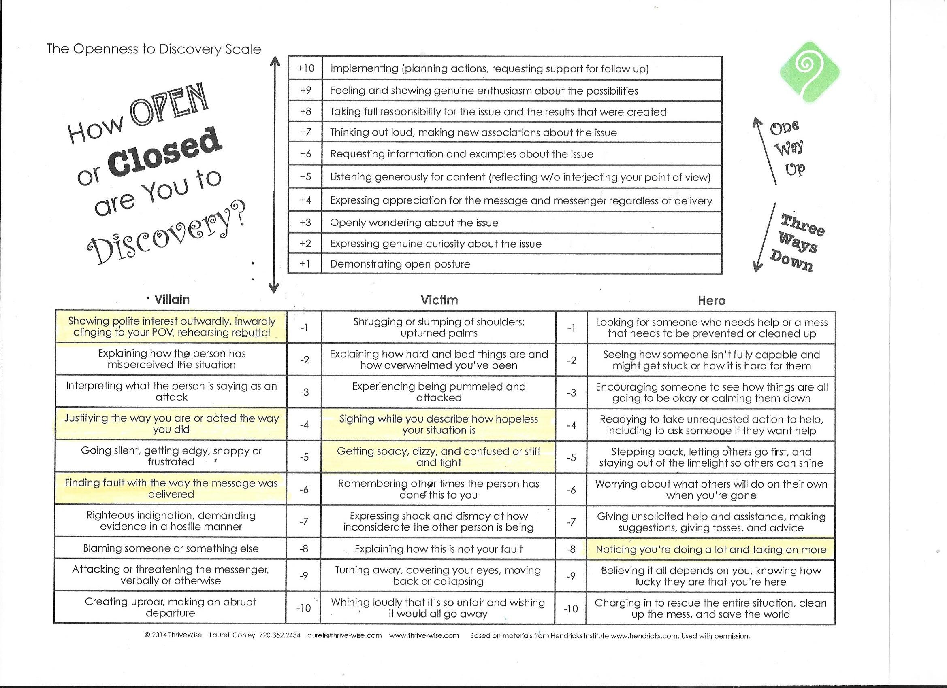
Notes:
Becky

Slide 87
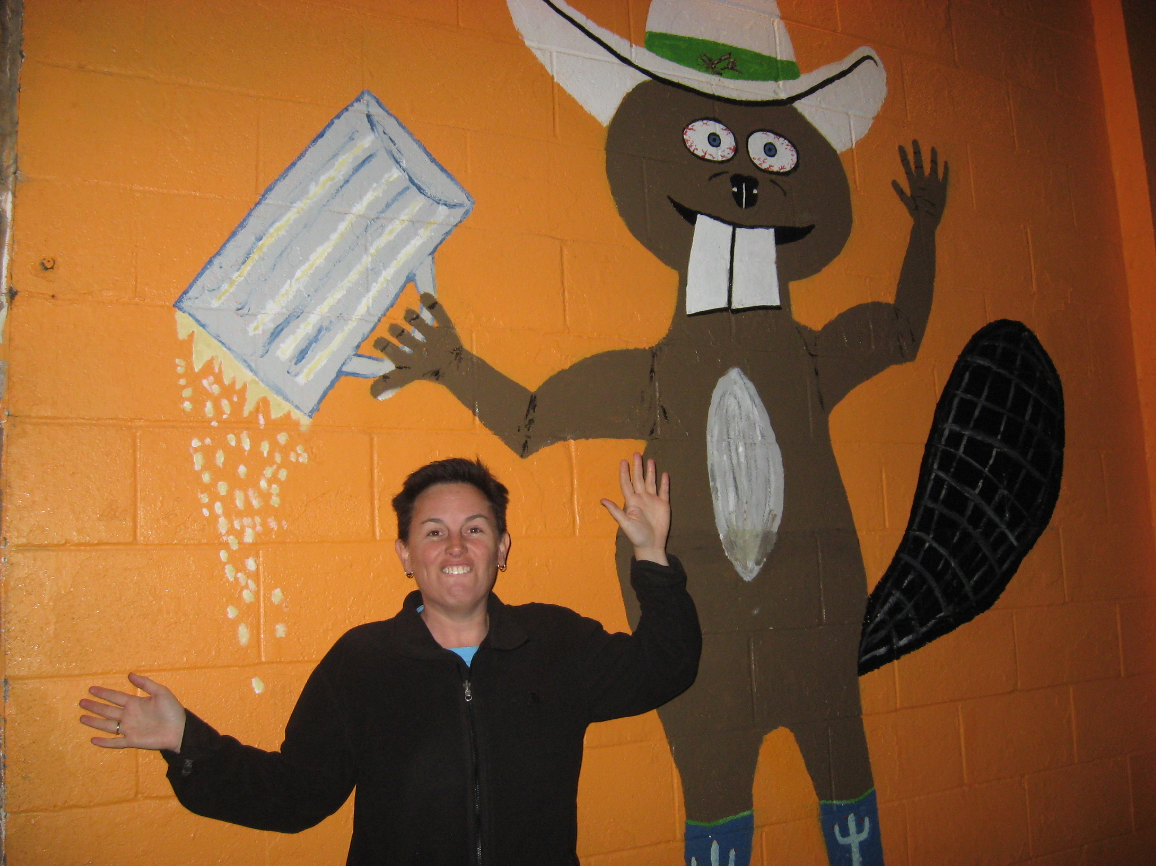
the hero: seeks temporary relief
Notes:
Seeks someone/something to blame

Slide 88
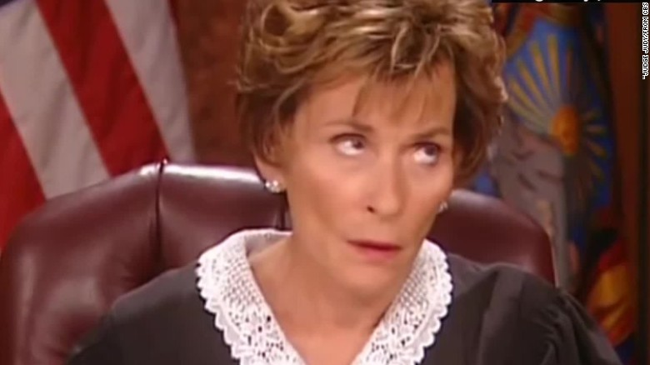
the villain: loves blame & criticism
Notes:
Seeks someone/something to blame

Slide 89
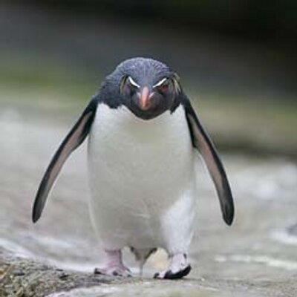
the victim: at the effect of
Notes:
Seeks someone/something to blame

Slide 90
persona interview
________, what’s the most important thing to you?
________, what are you most proud of?
________, when did you make your first appearance?
________, who did you learn your style from?
________, what are you most afraid of?
________, what do you most want?
Notes:
I wasn’t ok with my boss feeling scared. It made me feel too scared so I wasted a lot of energy trying to prevent that or shut it down.

Slide 91
Genius

Slide 92
Notes:
Becky

Slide 93
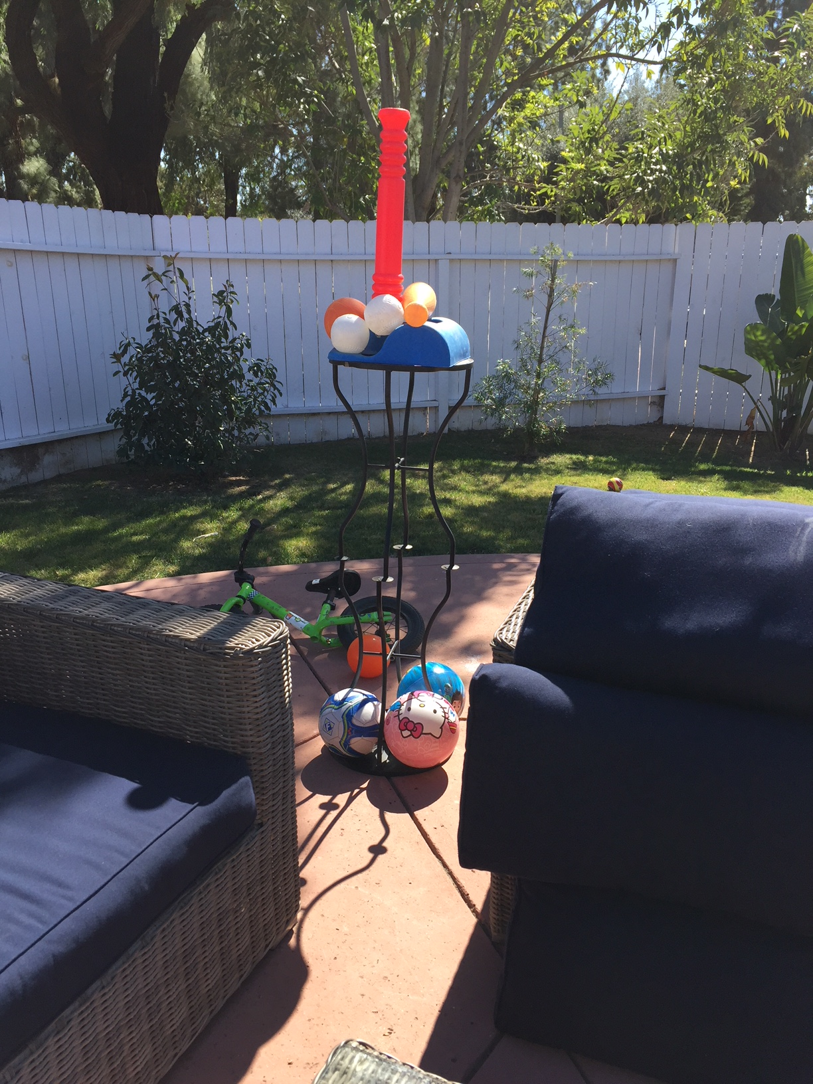
Notes:
Becky

Slide 94
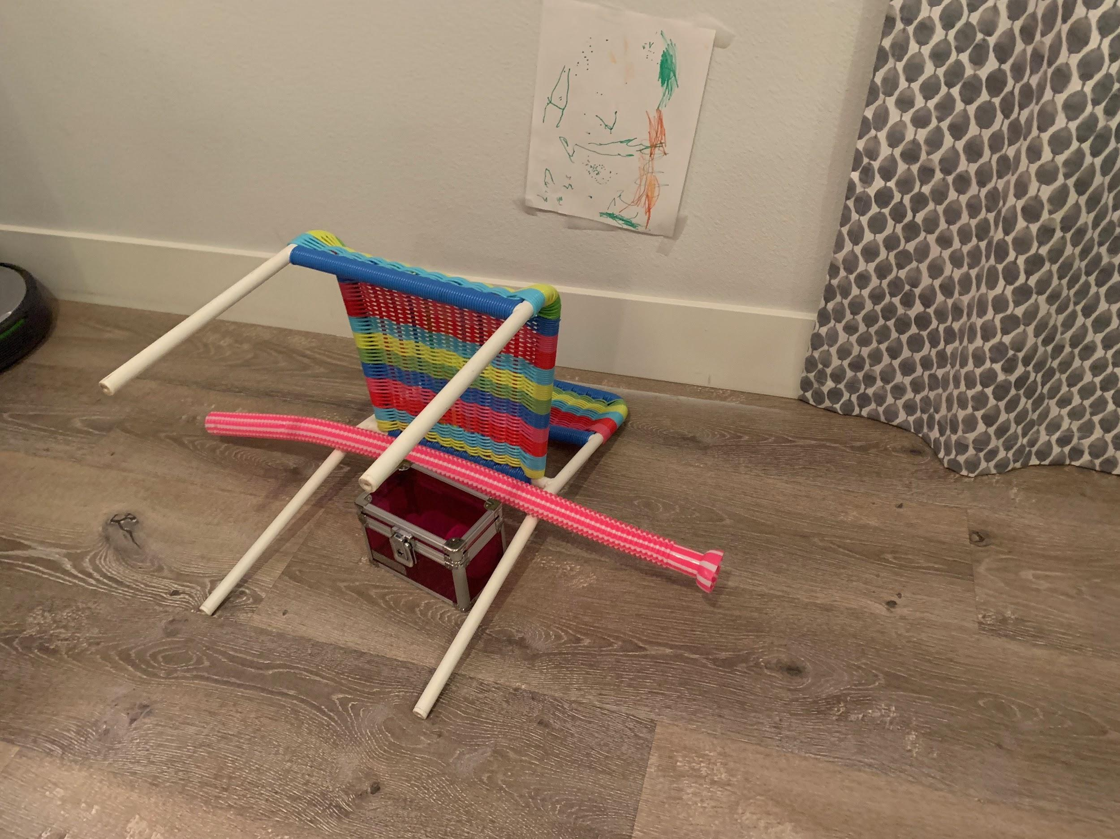
Notes:
Becky

Slide 95
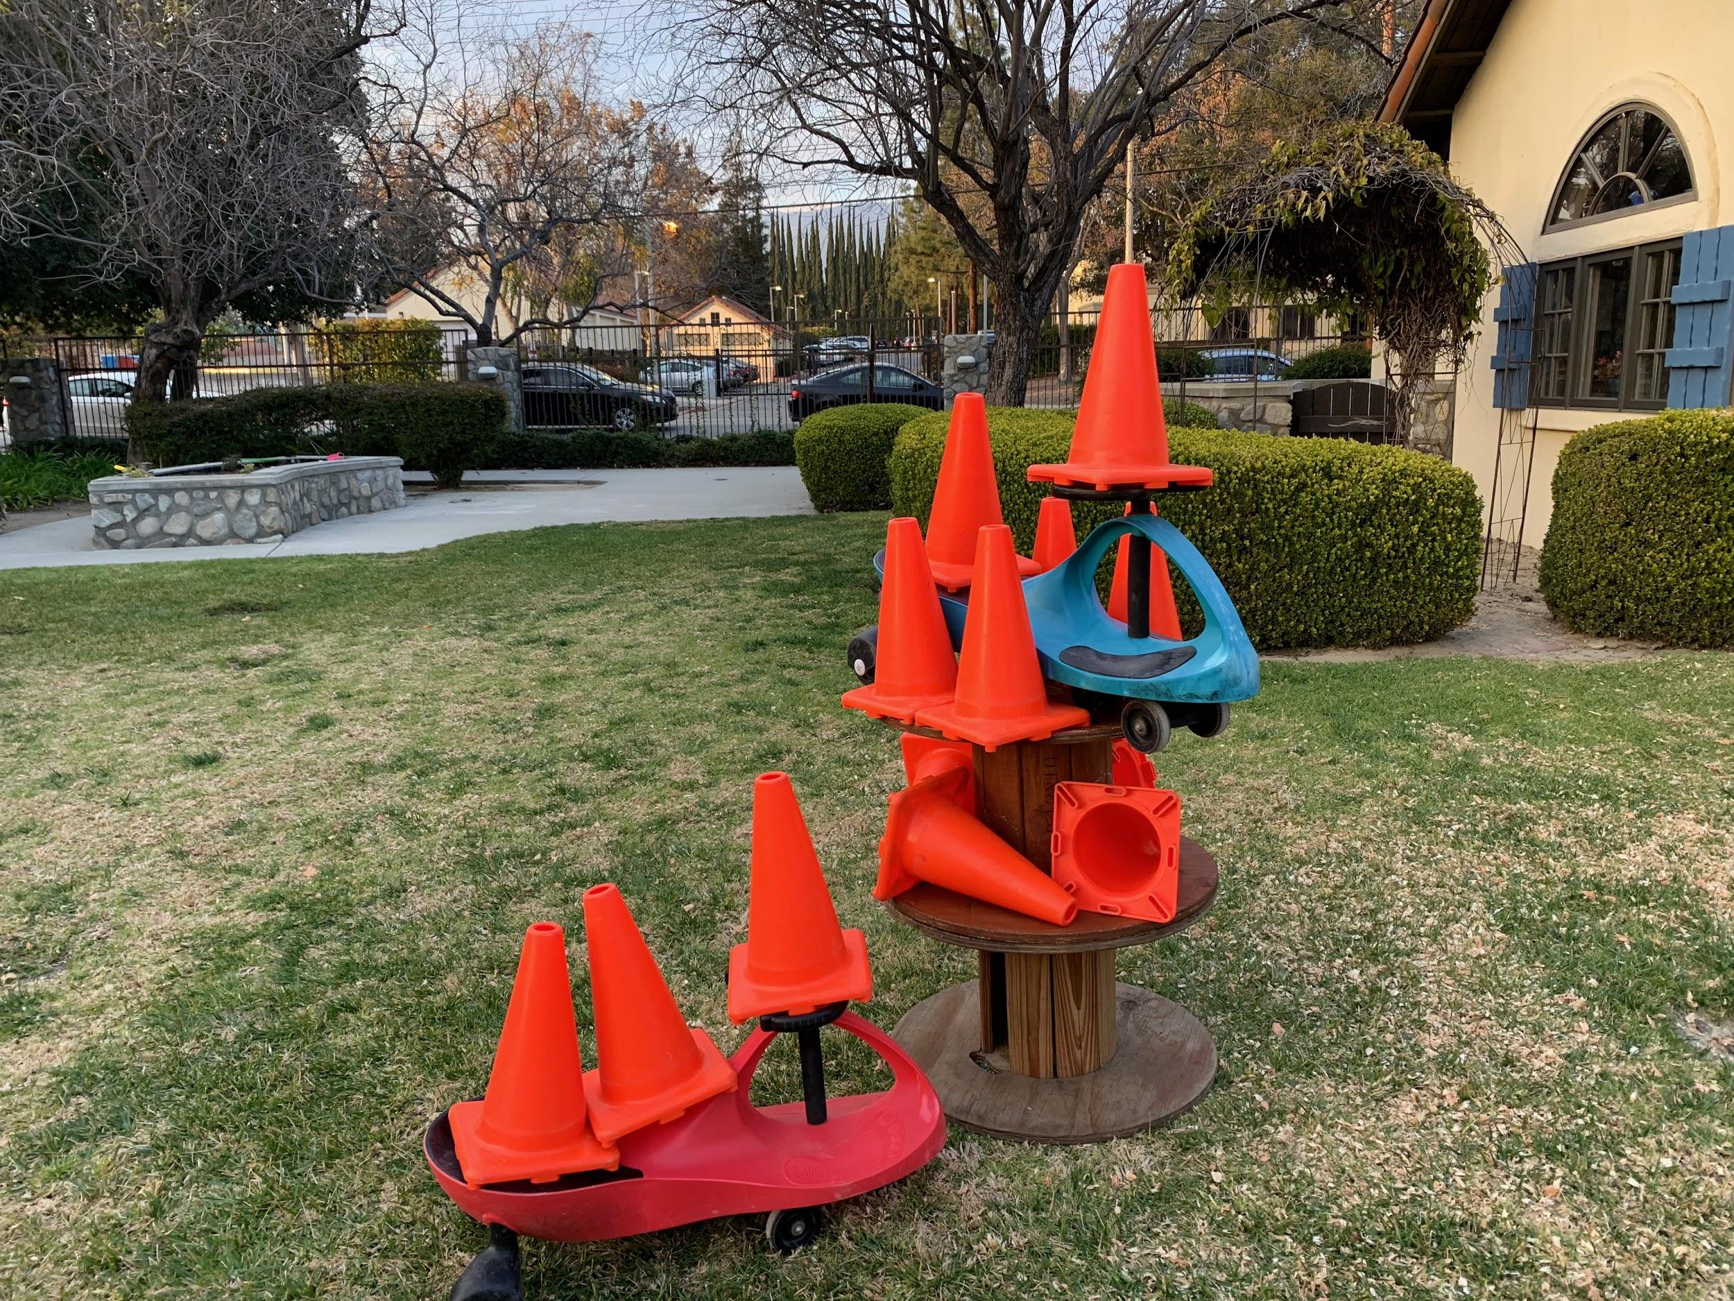
Notes:
Becky

Slide 96
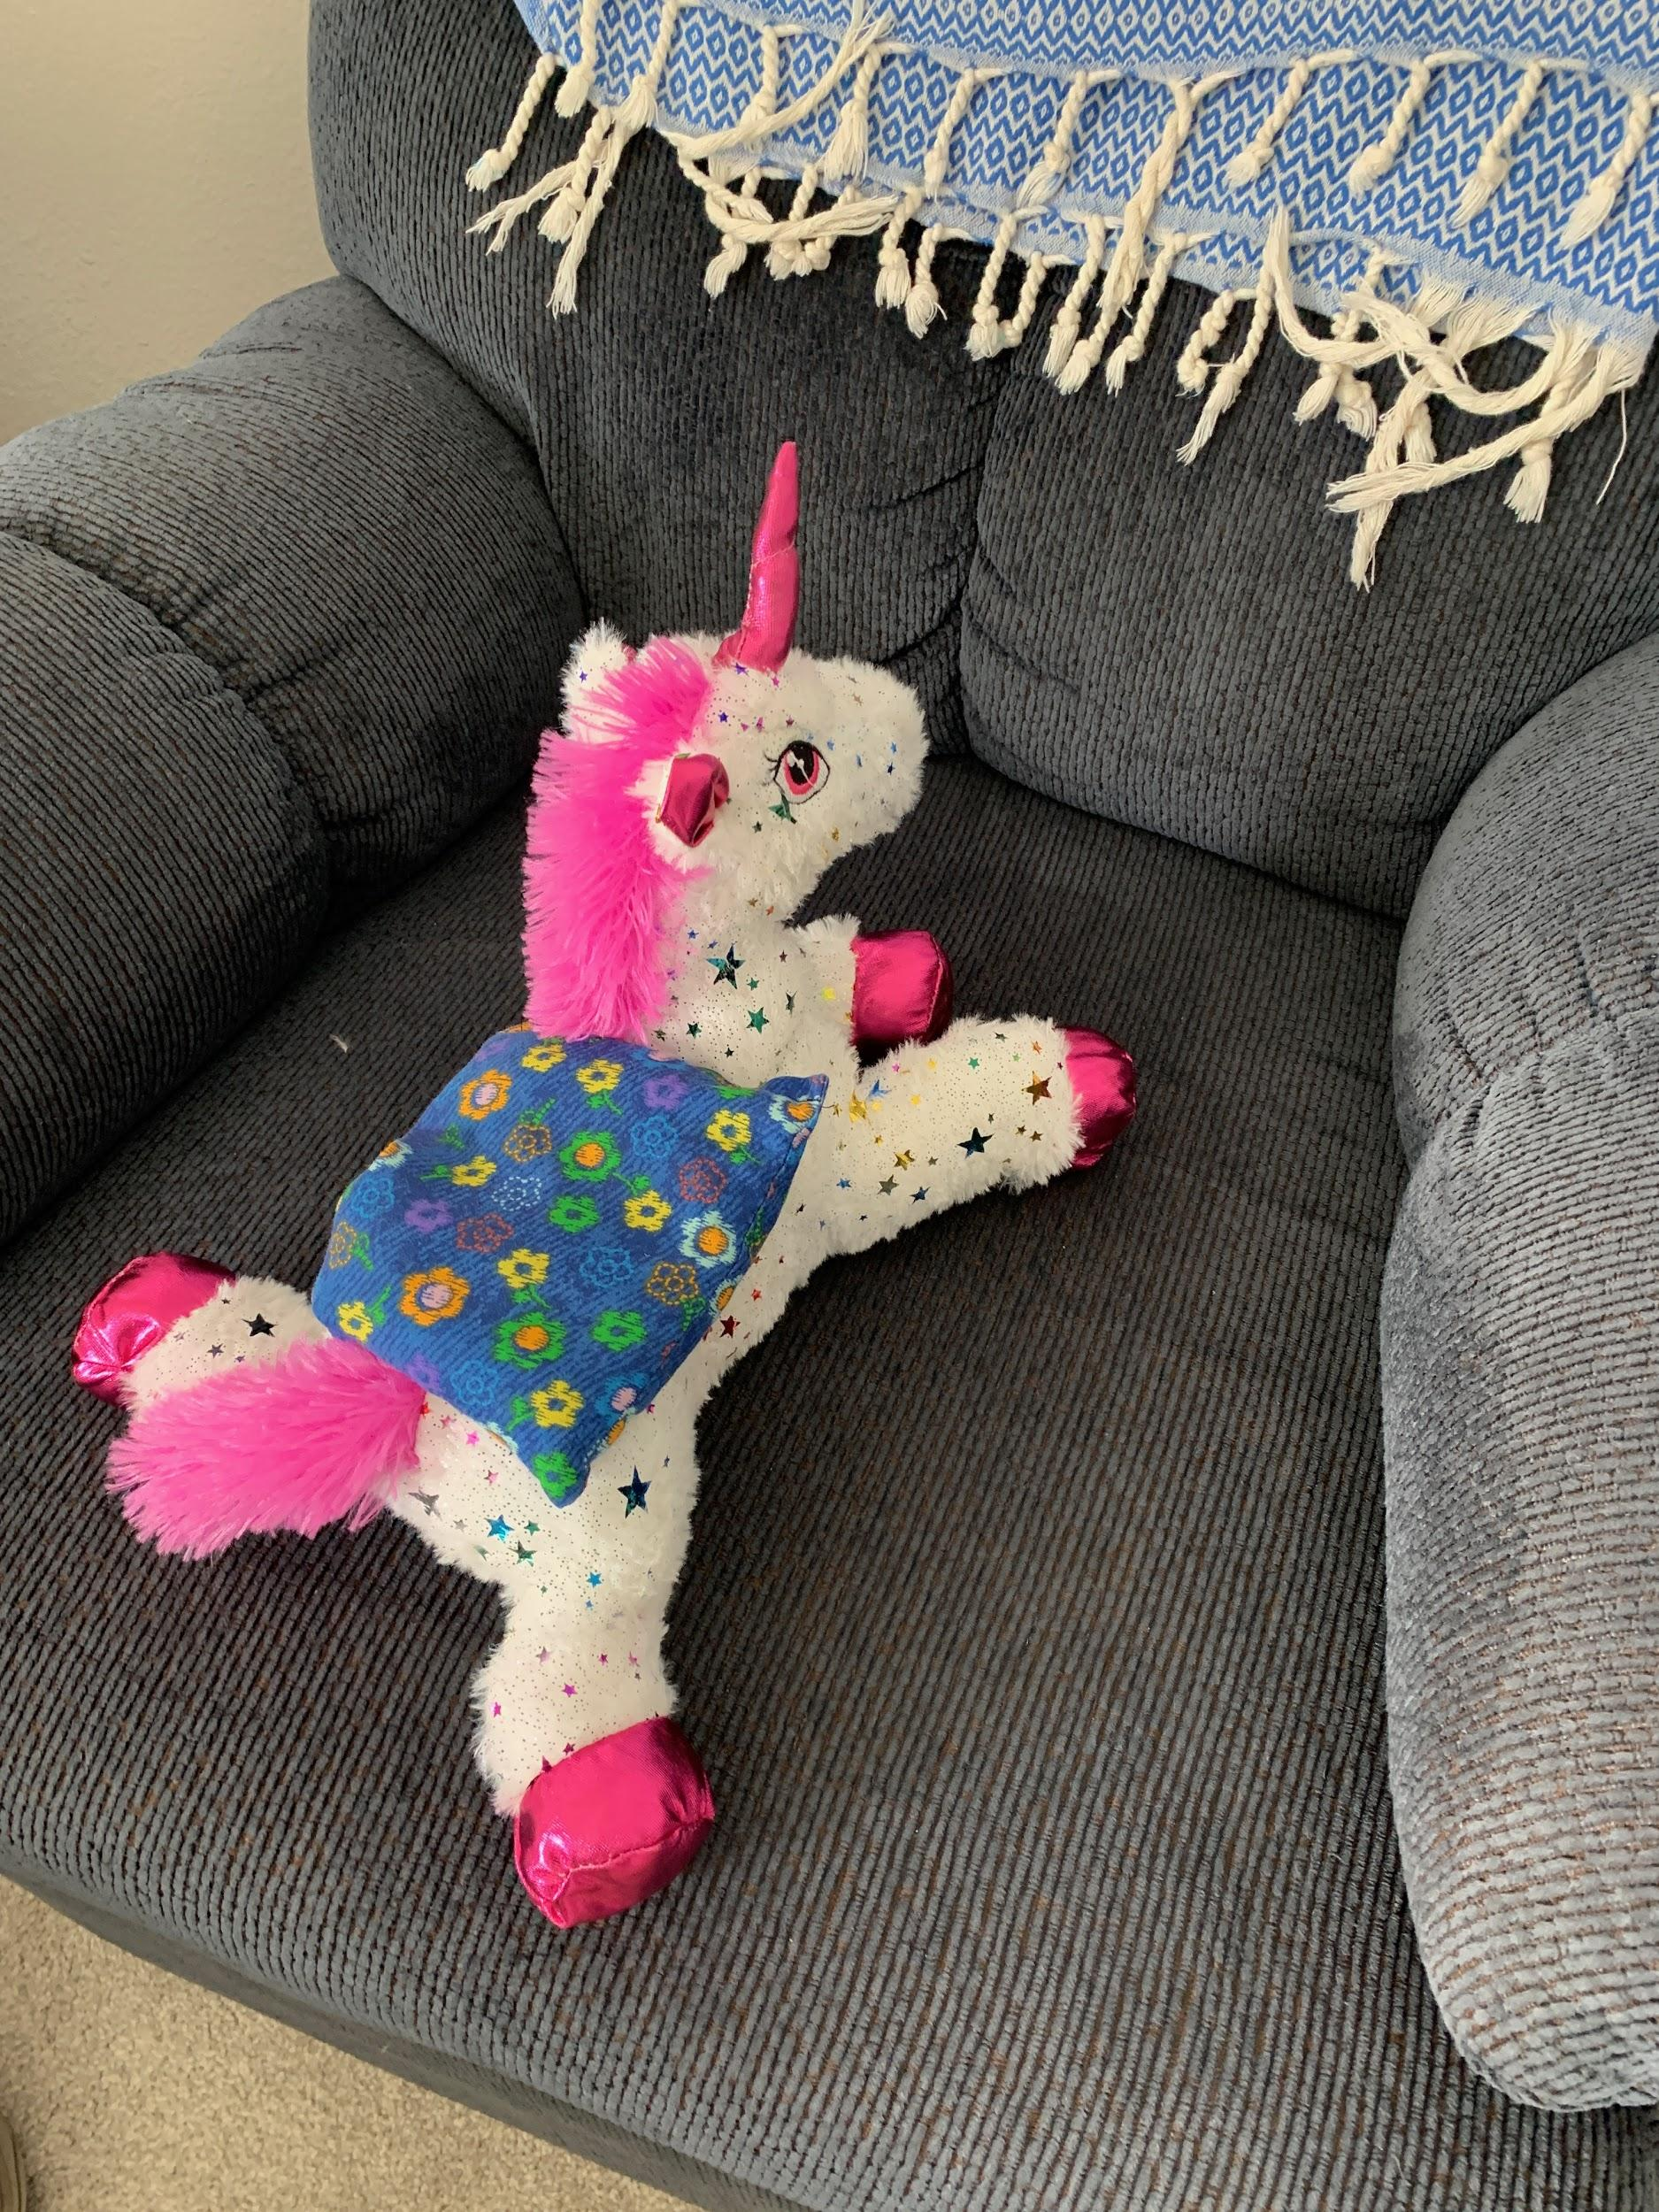
Notes:
Becky

Slide 97
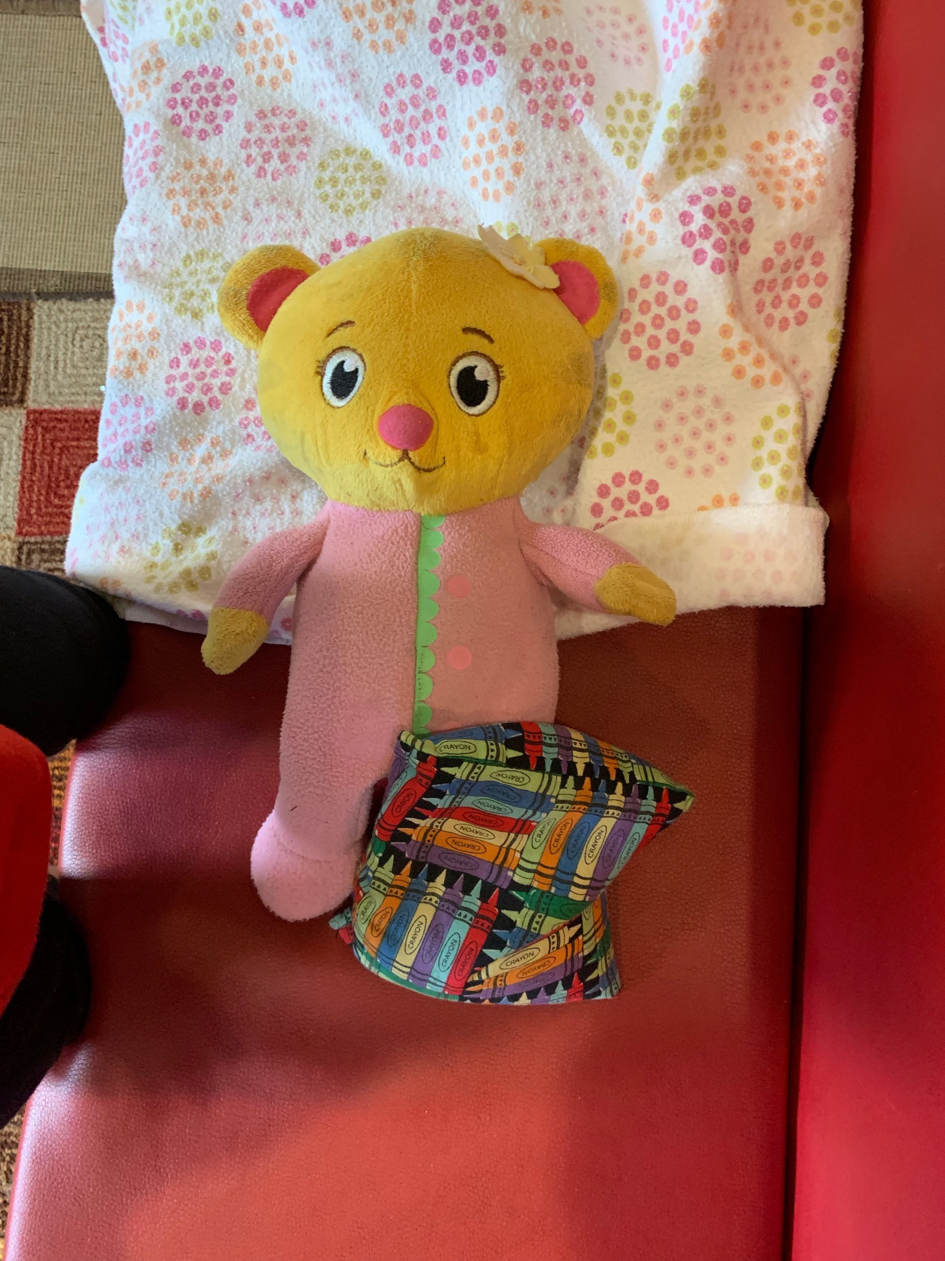
Notes:
Becky

Slide 98
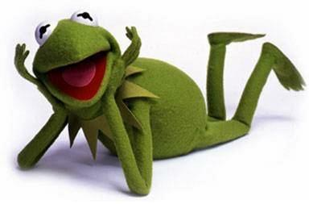
GENIUS
My unique skills.
I love doing these things.
Time flies.
The outcome is outstanding.

Slide 99
genius questions
What is my unique ability?
What do I most love to do?
What produces the highest ratio of abundance/impact per time spent?
What do I do that doesn’t seem like work?
Notes:
acknowledge privilege in even asking these questions.

Slide 100
zone of excellence
What do I persist in doing that I can do better than most other people?
Unconscious commitment: doing well but playing it safe
Notes:
Popcorn out

Slide 101
zone of competence
What do I persist in doing that others can do just as well?
Unconscious commitment to sleepwalking, going through the motions, playing small
Notes:
Popcorn out

Slide 102
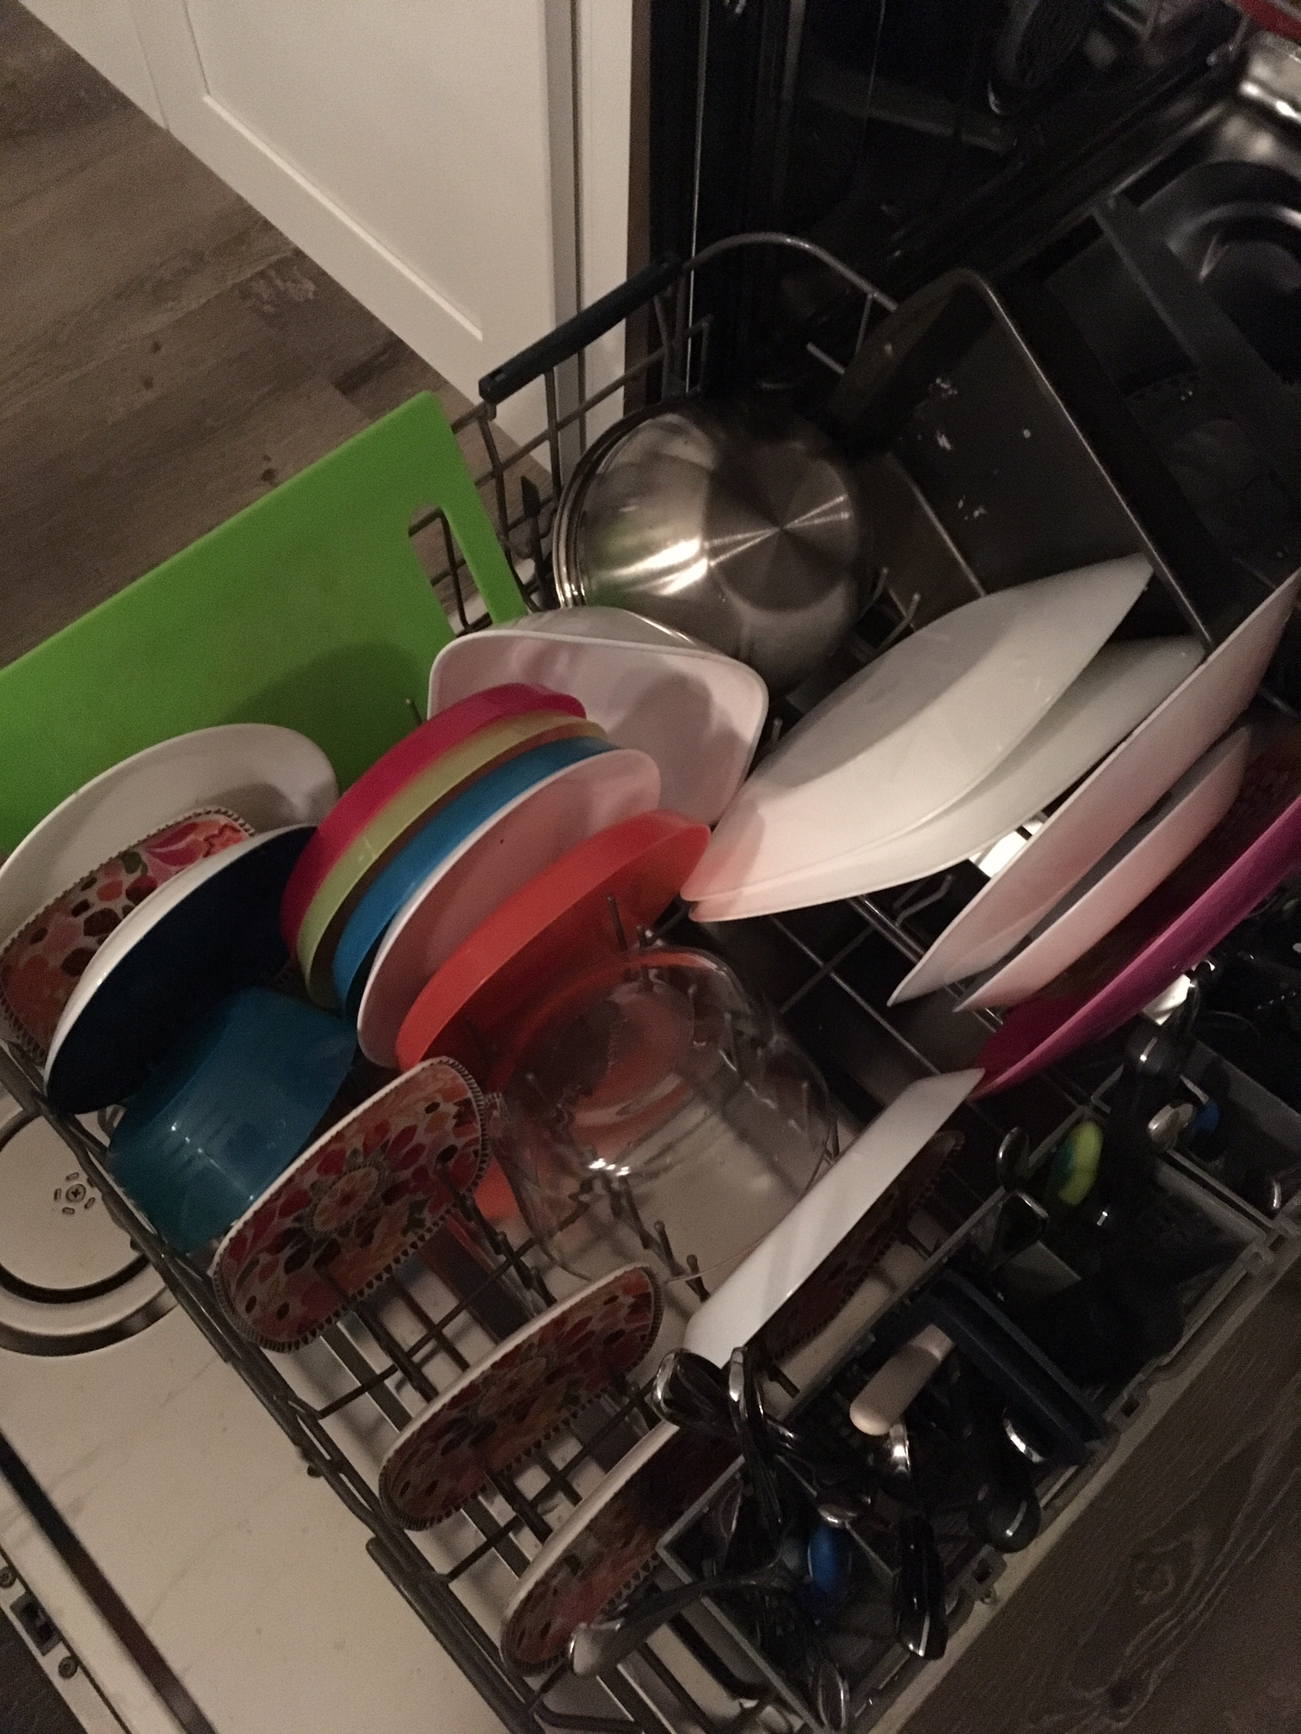
Notes:
Becky

Slide 103
zone of incompetence
What do I persist in doing that others can do better?
That I do not enjoy?
That I’m no good at?
Unconscious commitment: suffering and frustration
Notes:
Why this matters

Slide 104
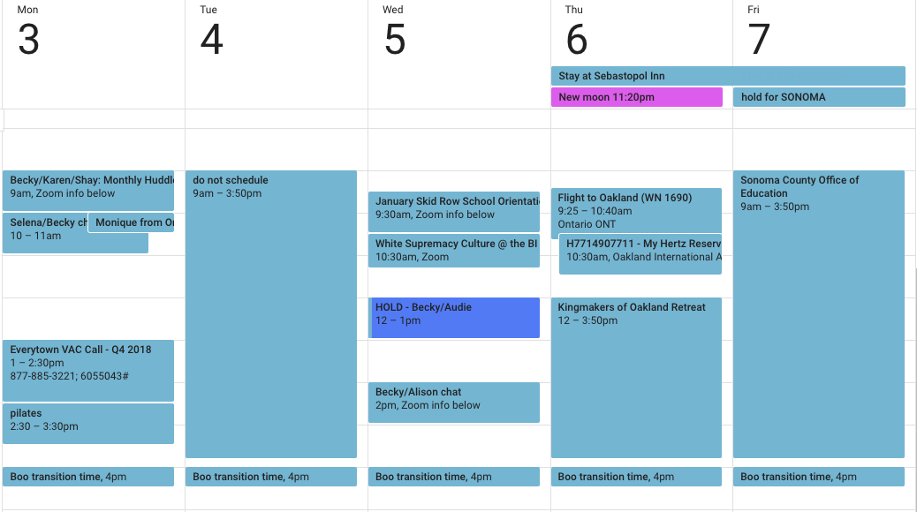
your calendar doesn’t lie

Slide 105
genius interviews
take turns interviewing one another and writing answers to genius questions
Notes:
Why this matters

Slide 106
genius tools for you
Genius Worksheet
Kolbe-A
Strengths Finder
The Big Leap by Gay Hendricks
Genius Tracker
Notes:
Why this matters

Slide 107
genius tracker
Notes:
Why this matters

Slide 108
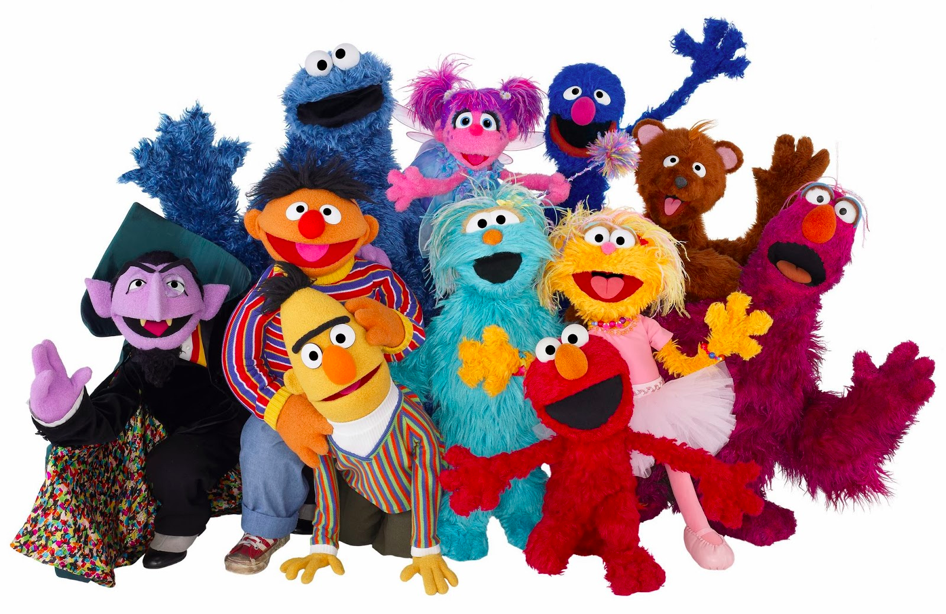
genius teams

Slide 109
great genius swap
Stop
Swap
Dump
Notes:
Why this matters

Slide 110
Impeccable Agreements

Slide 111
impeccable agreements
only say “yes” to things you genuinely want to do.
say “no” to things you don’t have a full-body yes to.
do the things you said you’d do, on time, without needing to be reminded.
if an agreement no longer works for you, proactively change it.
Notes:
Why this matters

Slide 112
changing agreements
acknowledge the original agreement
reveal what has changed for you and what you are now willing to agree to (if anything).
express regard for the other person and ask how this affects them.
request confirmation. make room for their yes or their no.
express appreciation.
Notes:
Why this matters

Slide 113
Commitment & Completions

Slide 114
