Slide 1
HOW WE GOT TO WHO WE ARE

Slide 2
Passing on the “Apostles’ Teaching”
Next 1500 Years
HOW WE GOT TO WHO WE ARE

Slide 3
God expects faithfulness
HOW WE GOT TO WHO WE ARE
Principles
Attempts to get back to God

Slide 4
Passing along the faith
Part One - Planting and growing
Apostles
Second Century
Constantine
Old Testament usage

Slide 5
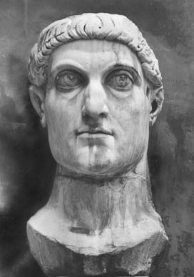
HOW WE GOT TO WHO WE ARE
Constantine
312-337 A.D.

Slide 6
Passing along the faith
Part One - Planting and growing
Apostles
Second Century
Constantine
Domination (6th-16th)

Slide 7
Universal church developments
Organization and power
Worship
Authority source
Reactionary movements

Slide 8
Passing along the faith
Part Two - Reforming
Printing Press
Martin Luther
Huldrich Zwingli
Anabaptists

Slide 9
Passing along the faith
Part One - Planting and growing
Part Two - Reforming
Part Three – Reforming for unity

Slide 10
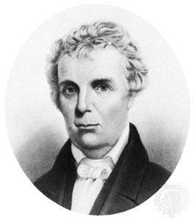
Barton W. Stone
“Last Will & Testament of the Springfield Presbytery”
Cane Ridge Revival

Slide 11
HOW WE GOT TO WHO WE ARE

