Slide 1
03
Express
© All rights reserved. 2019. Innovation & Research Foundation (IRF)

Slide 2
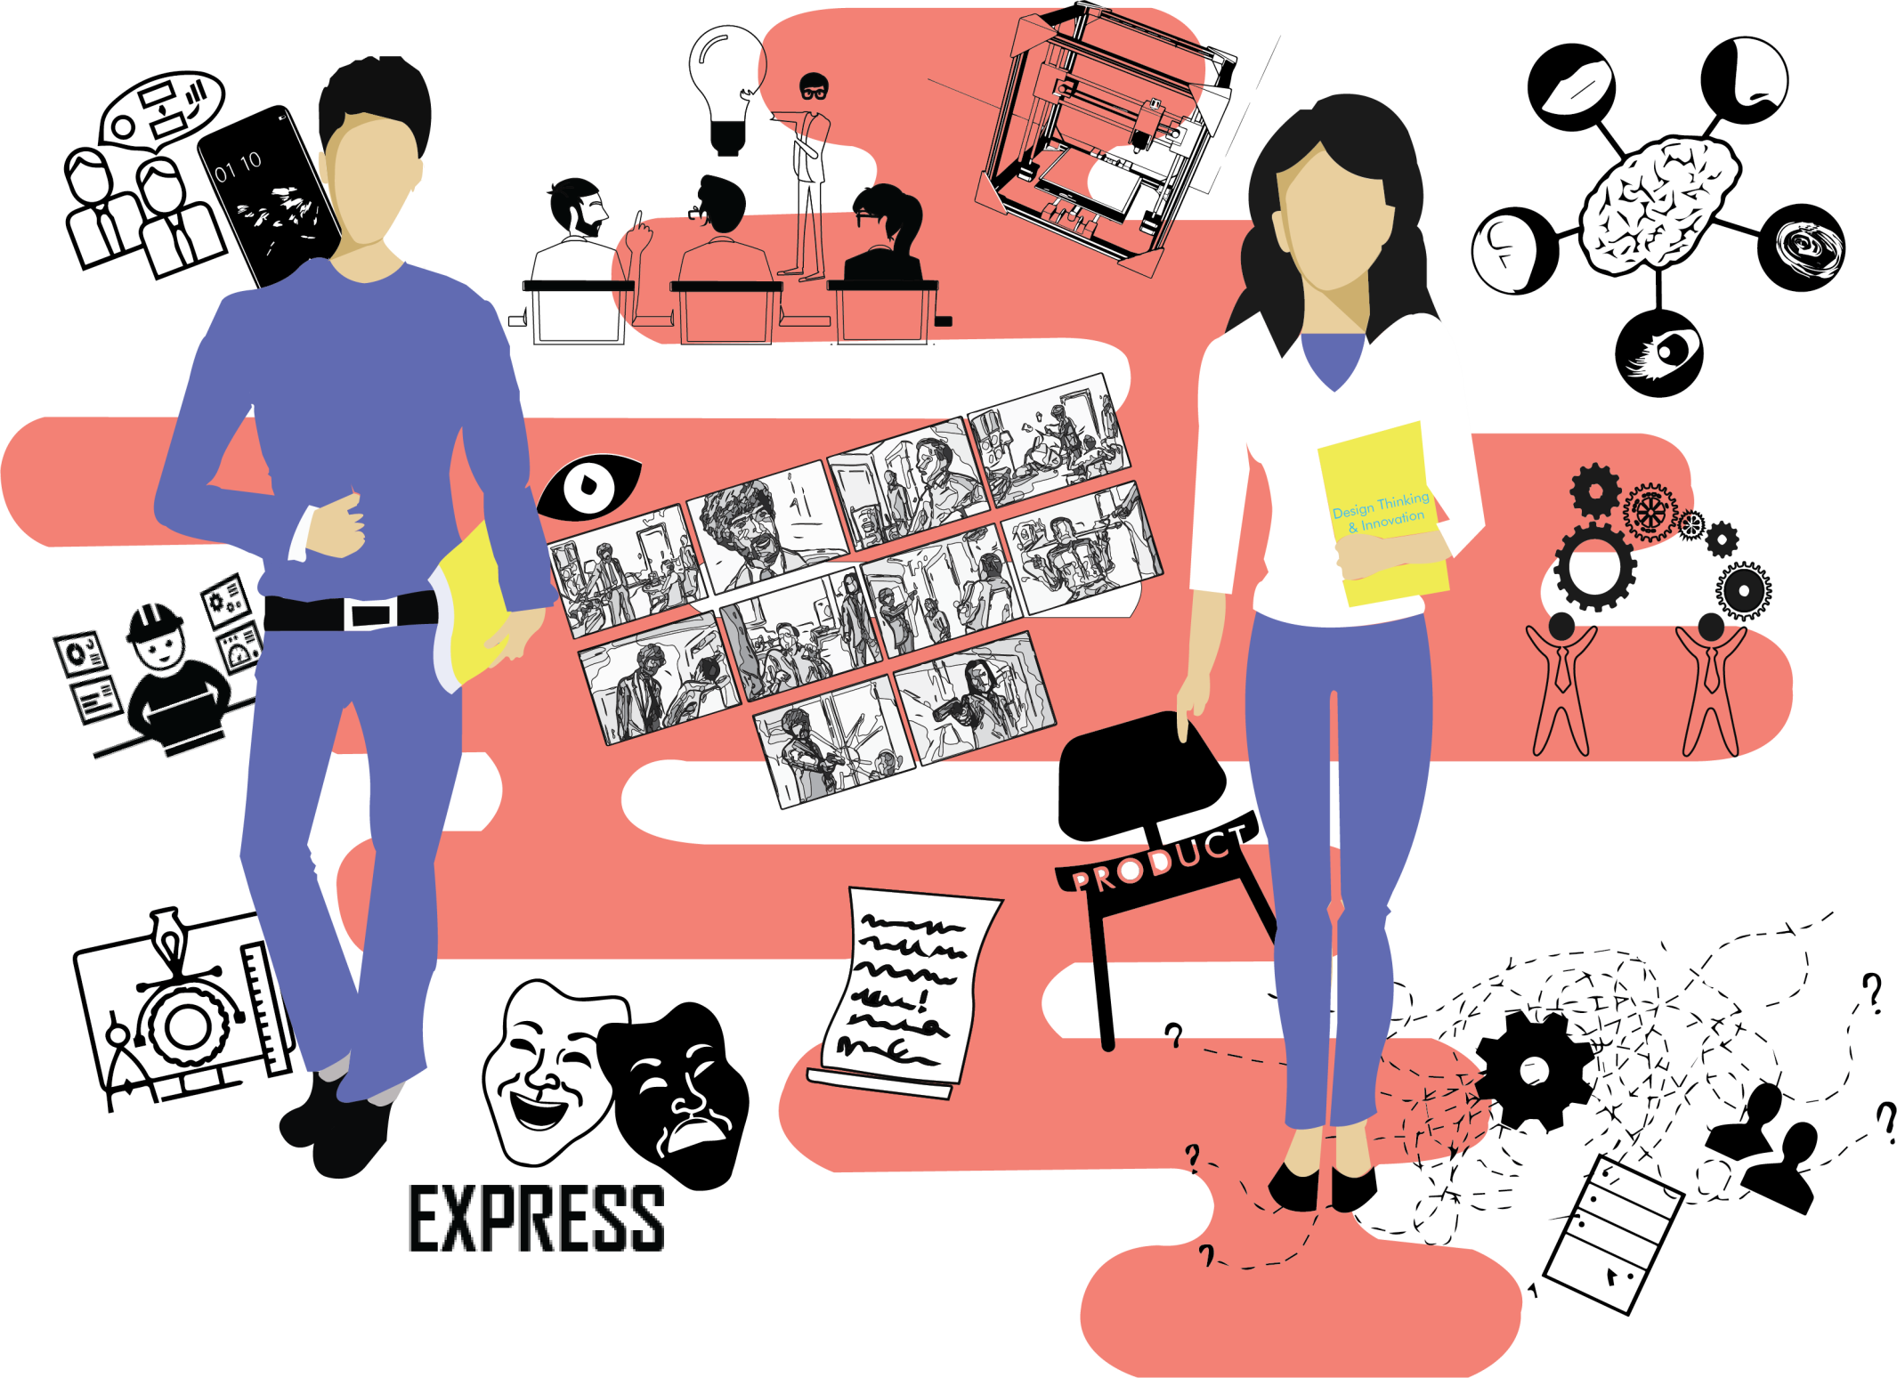

Slide 3
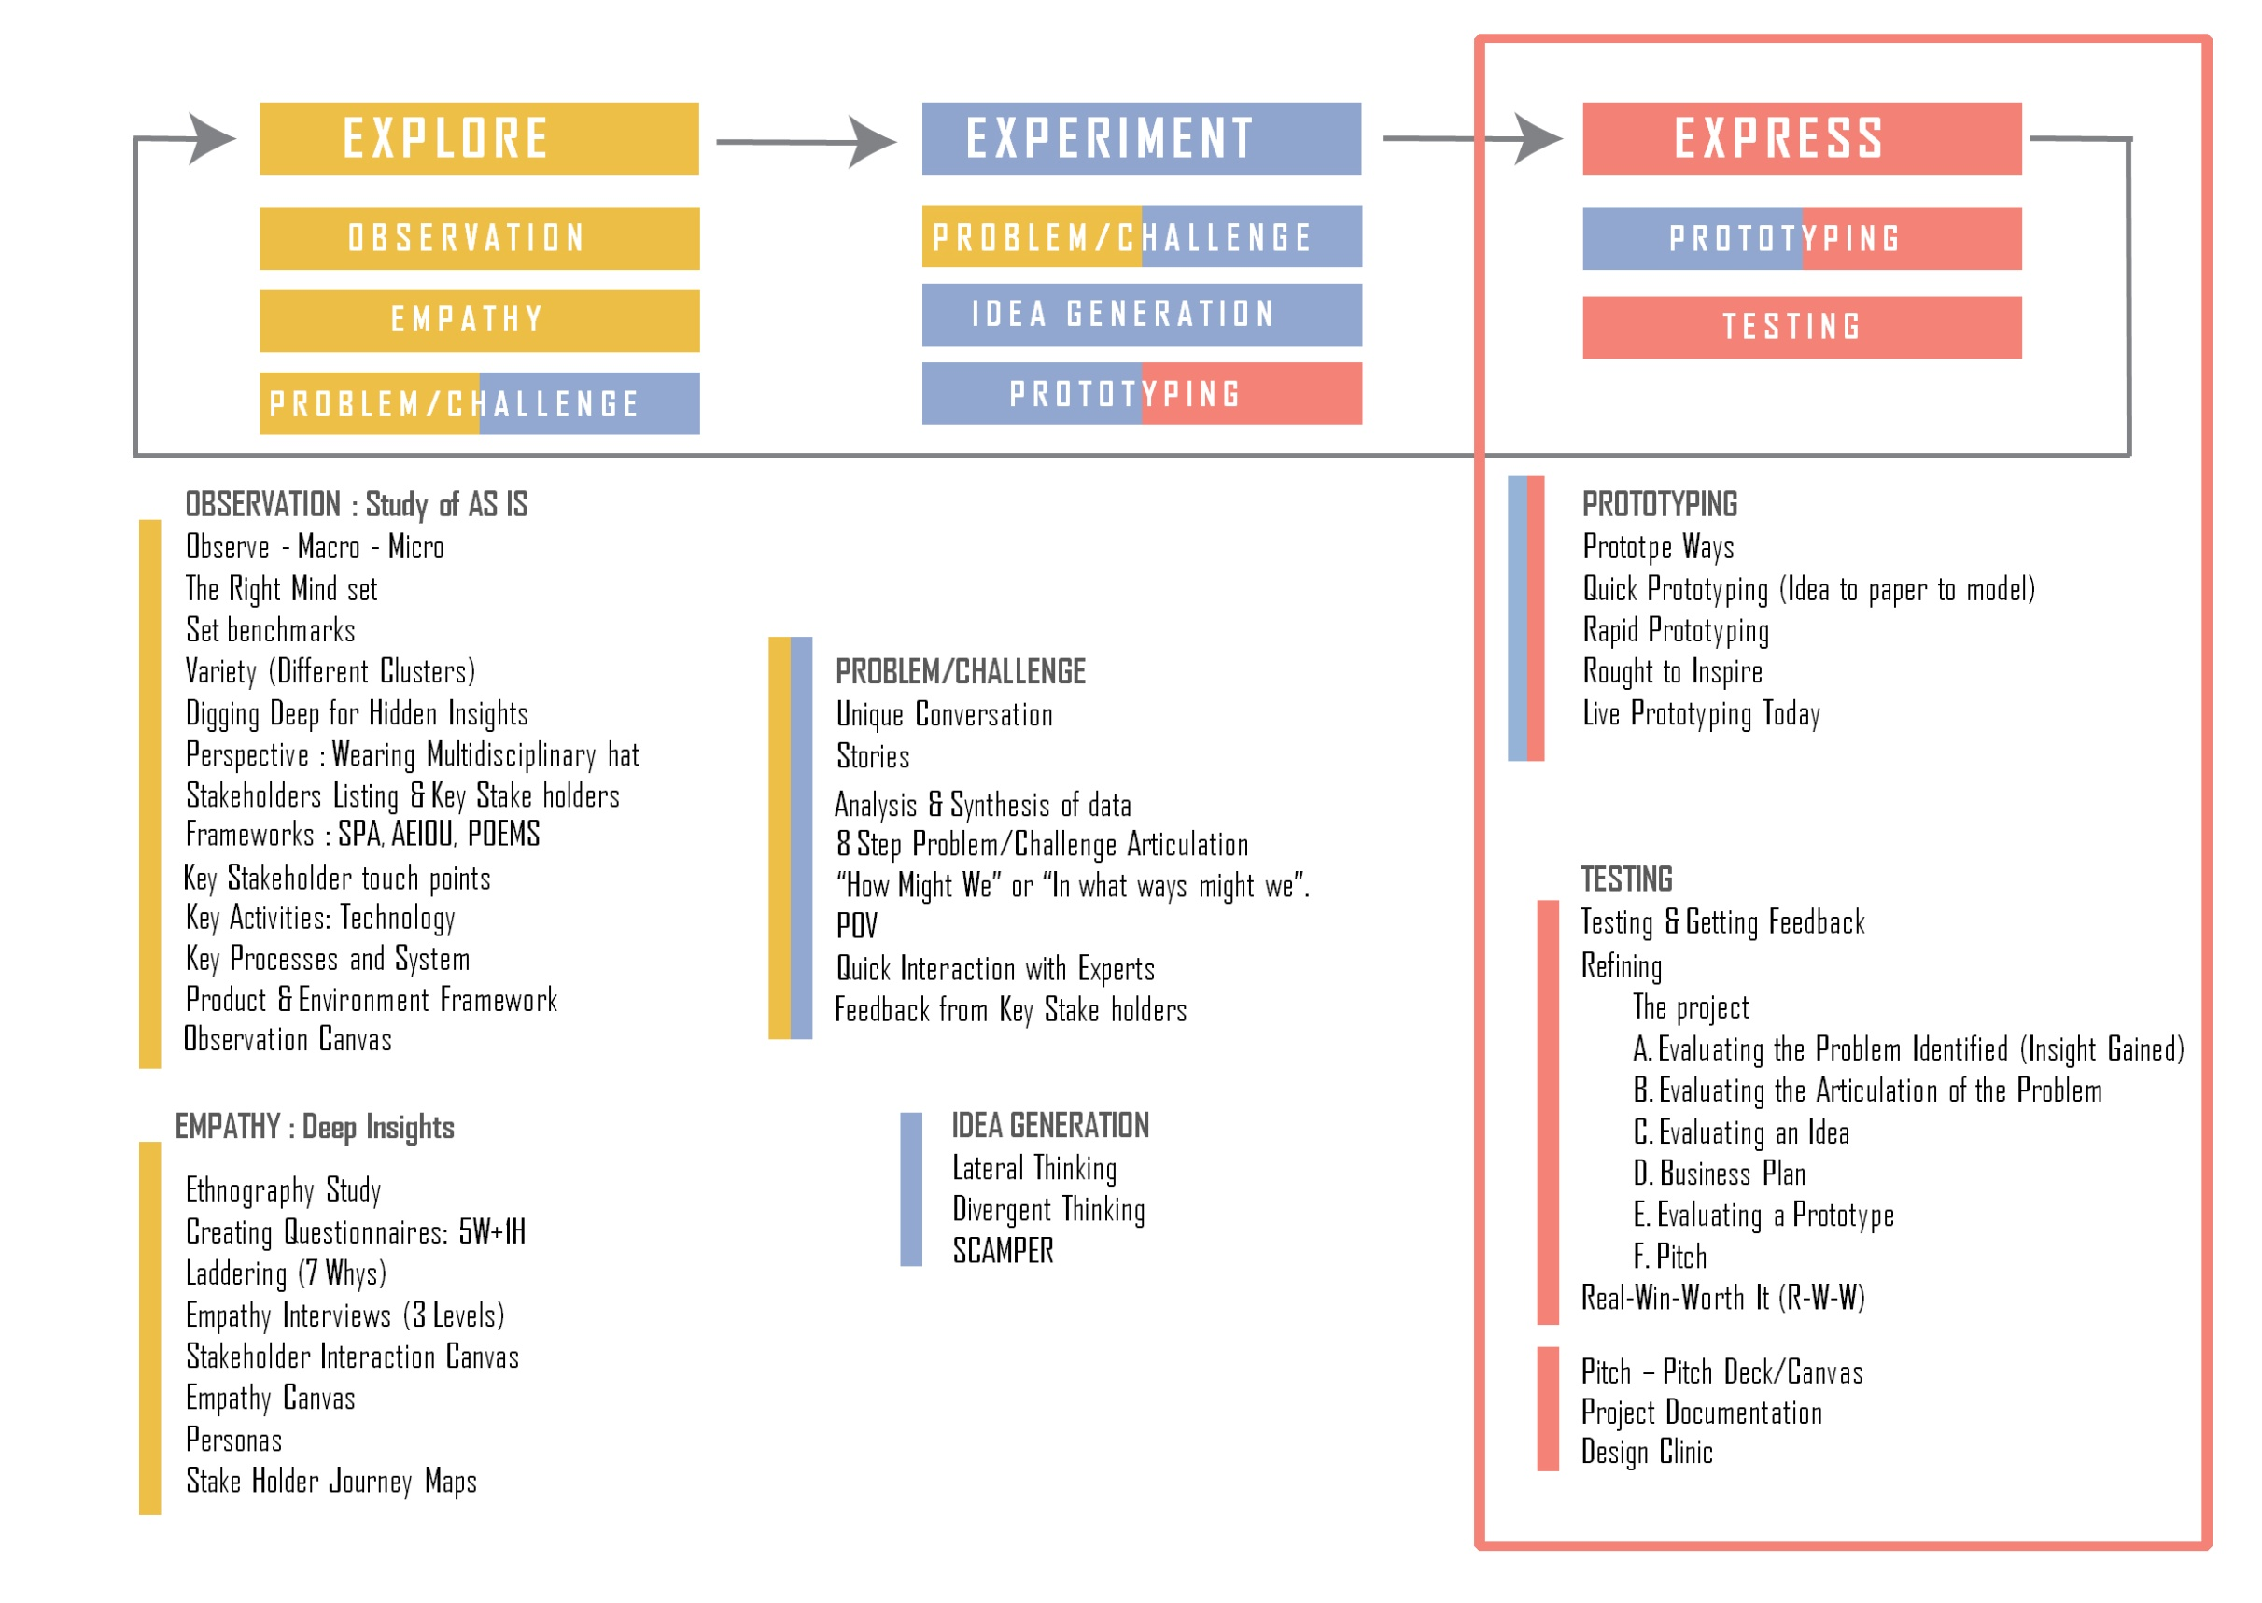

Slide 4
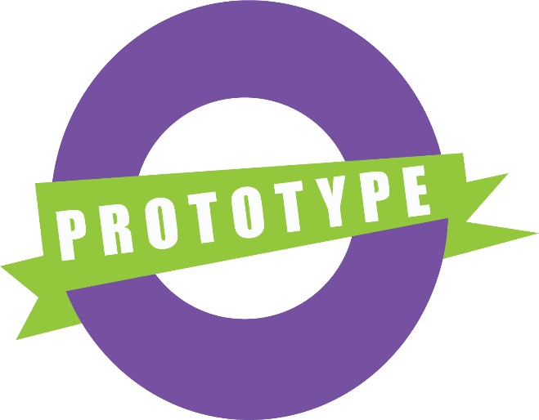
e.
Prototype
Solutions for real people, real situation, real world..

Slide 5
Why Prototype
- Know what shape will ones idea take – self understanding
- Explain the idea to the customer/expert in easy way
For purpose of testing the idea/product
Get opinions from users / experts about the prototype (feedback)
Enhance design by iterating the prototype (rapid prototyping)
What difficulties will one face in manufacturing/making the final product
Pass on the concept to the next team

Slide 6
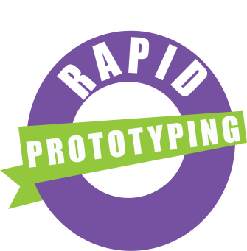
Why Prototype Most Important
Rapid Live Prototyping From,
- Customer Research to
- Deeper Customer Research (Ethnography etc.) to
- Customer as part of the development process

Slide 7
Building prototypes means
making ideas tangible, learning while building them and
sharing them with other people.
Even with early and rough prototypes, you can receive a direct response and learn how to further improve and refine an idea Whereby saving time & money for the company.

