Slide 1
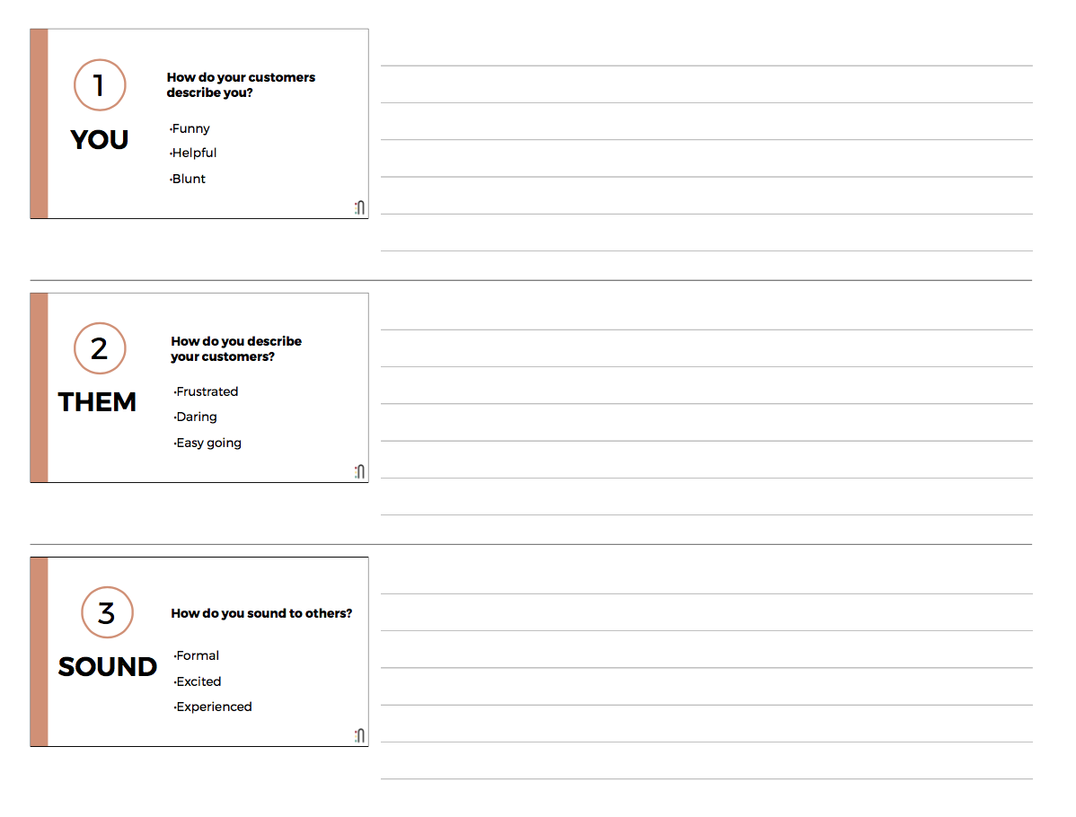
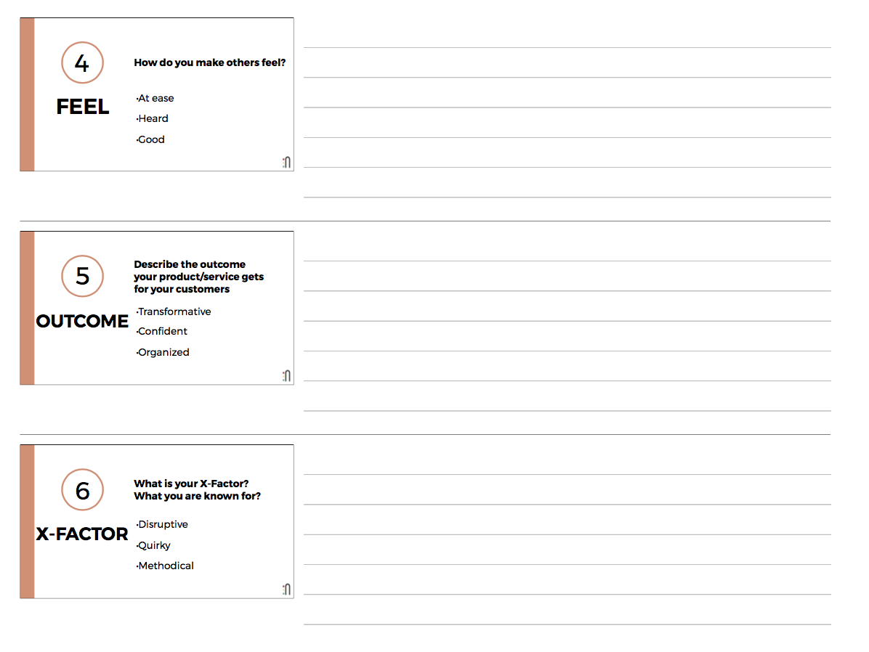
Visual Brand Workbook
Brainstorm your words

Slide 2
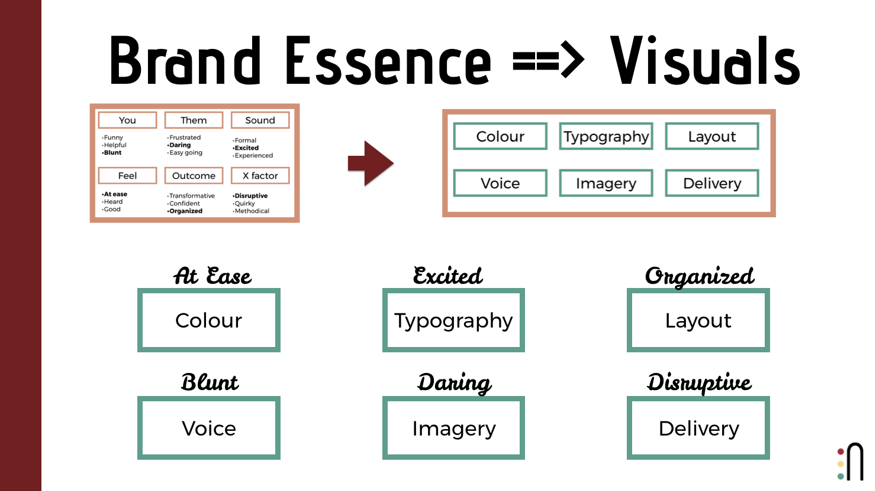
Pick your six words and
map them to visual elements
Your Brand Essence Mapped
Word 1 will map to colour
Word 2 will map to typography
Word 3 will map to layout
Word 4 will map to voice
Word 5 will map to imagery
Word 6 will map to delivery

Slide 3
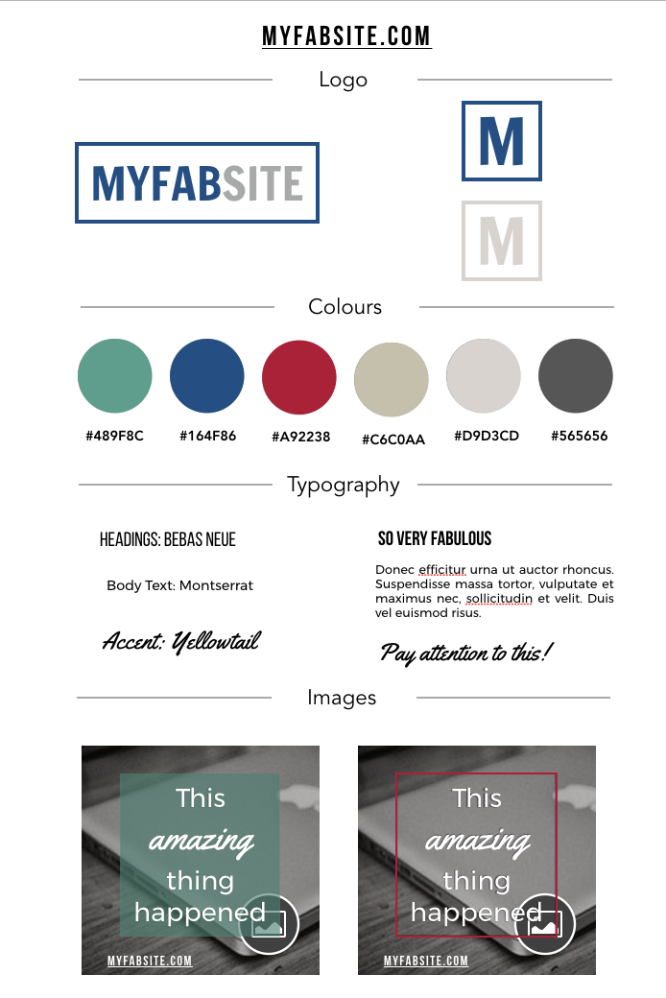
On the next page,
capture your visual elements.

Slide 4
myfabsite.com
Logo
M
MYFABSITE
M
Colours
#489F8C
#164F86
#A92238
#C6C0AA
#D9D3CD
#565656
Typography
Headings: BEBAS NEUE
SO VERY FABULOUS
Body Text: Montserrat
Donec efficitur urna ut auctor rhoncus. Suspendisse massa tortor, vulputate et maximus nec, sollicitudin et velit. Duis vel euismod risus.
Accent: Yellowtail
Pay attention to this!
Images
This
amazing
thing happened
This
amazing
thing happened
myFABSITE.COM
MYFABSITE.COM

