Slide 1
PESCO BEAM
Who, What, How & Why.
www.pescobeam.com

Slide 2
Contents Who we are What we do The PESCO BEAM Advantage Clients Vendors

Slide 3
Who we are What we do The PB advantage Clients Vendors

Slide 4
PESCO BEAM: A Summary PB is a synergy of cutting edge design, in-the-trenches experience, top engineering ability and global standard manufacturing. Over 25 years of environmental engineering experience in building affordable, turn-key, reliable, skid mounted, state-of-the-art plants. Roanoke, VA, USA: Design & Knowledge Hub Chennai, India: Engineering & Manufacturing Hub

Slide 5
We offer turn-key plants & systems for: Used Oil Re-Refining – over 14 plants commissioned globally Solvent Recovery – a list of who’s who as clients Petroleum Waste Treatment – semi solid & solid wastes Drying – for sludge, solids using a high efficiency dryer Ethanol from sugar wastes – pioneering effort in the US Bio-Diesel from waste streams

Slide 6
Cutting Edge Design First to develop the blue print for skid mounted, customized, highly efficient, small and medium sized used oil re-refineries; operating commercially and handling 200 to 7500 lit / hr used oil feed on continuous basis Built, owned & operated solvent recovery systems for multiple solvents Designed and built plants using various types of evaporators and distillation columns and know exactly how to combine these components for any given application and/or result Huge back-up of design data to link vacuum/temp in commercial conditions

Slide 7
Cutting Edge Design (contd.) Unique designs to produce high quality base lube distillates using short path distillation First to develop a continuous regenerative adsorption based media polishing system to produce a Group 2 base oil Has successfully applied Solvent Extraction to polish base lube distillates In combination with GIT, offers Hydrofinishing technology and plant Continuous Sludge drying systems with vacuum and condensate recovery

Slide 8
Experience, Ability & Manufacturing Standards A combined senior technical management experience of over 125 years in this field Multi-disciplined design and engineering department Organization has 45 people in management and supervisory positions Global standard manufacturing Designs to international codes - ASME, AS, Others as applicable Over a hundred SOP’s for design and manufacture Compliance with engineering standards and safety requirements for most countries

Slide 9
Who we are What we do The PB advantage Clients Vendors

Slide 10
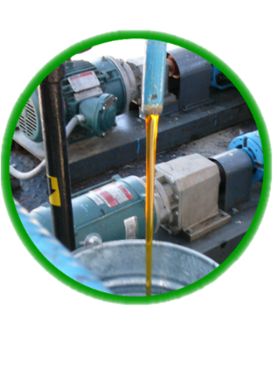
TURNKEY SYSTEMS FOR: Used motor oil and liquid hydrocarbon re-refining Solvent recycling Semi-solid and Solid Petroleum waste treatment Biodiesel from waste materials High efficiency drying of solids and sludge Custom built process equipment

Slide 11
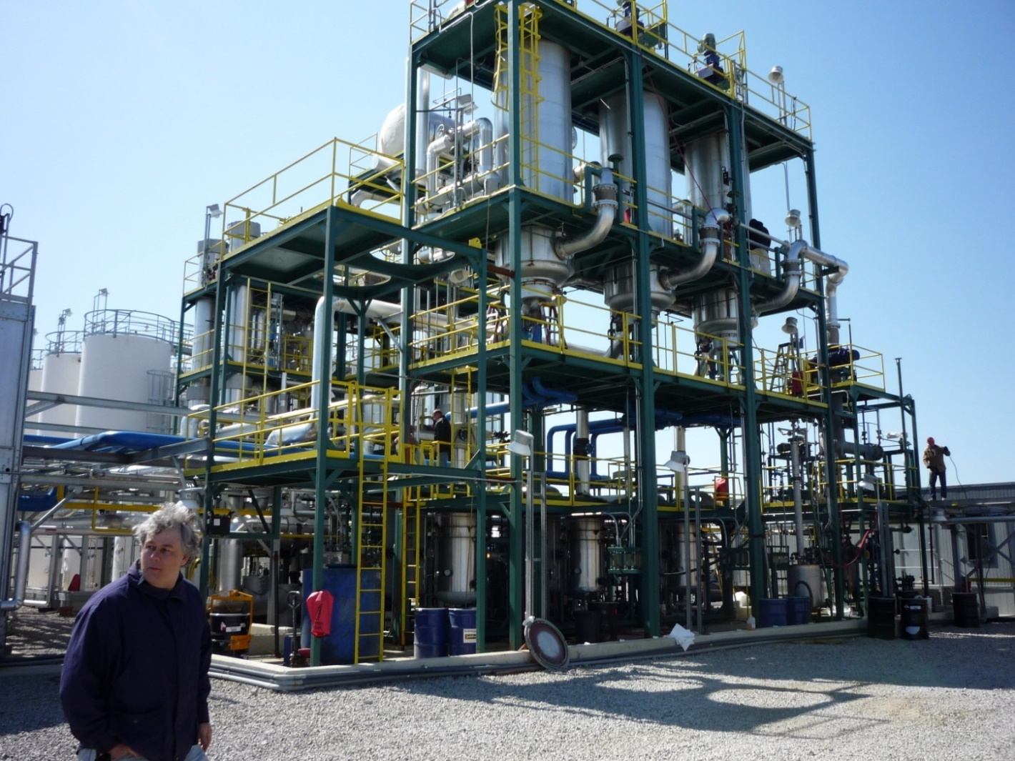
A 2000 US GPH USED OIL RE-REFINERY

Slide 12
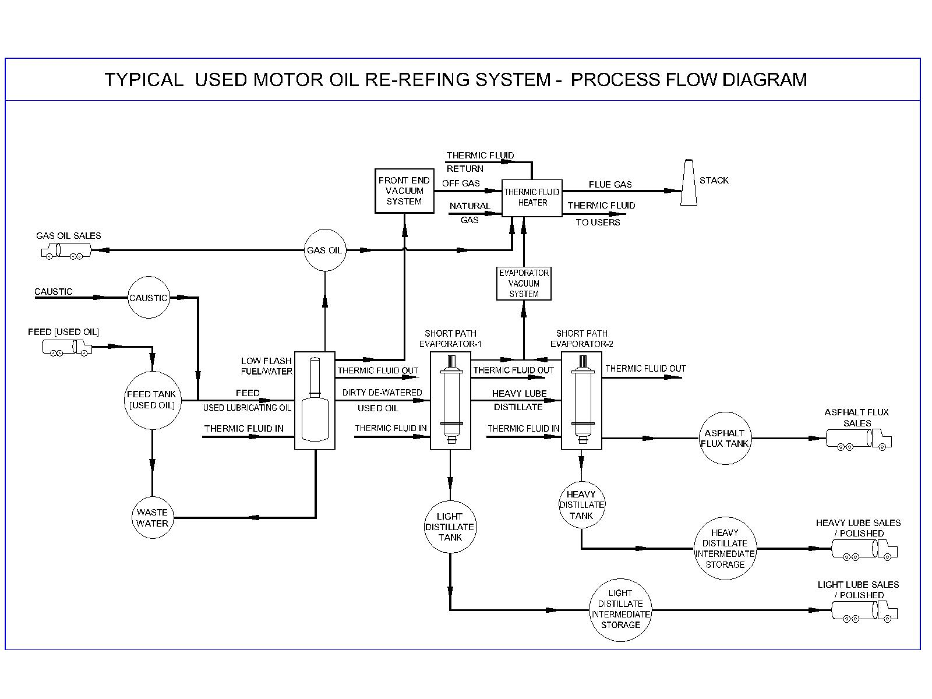

Slide 13
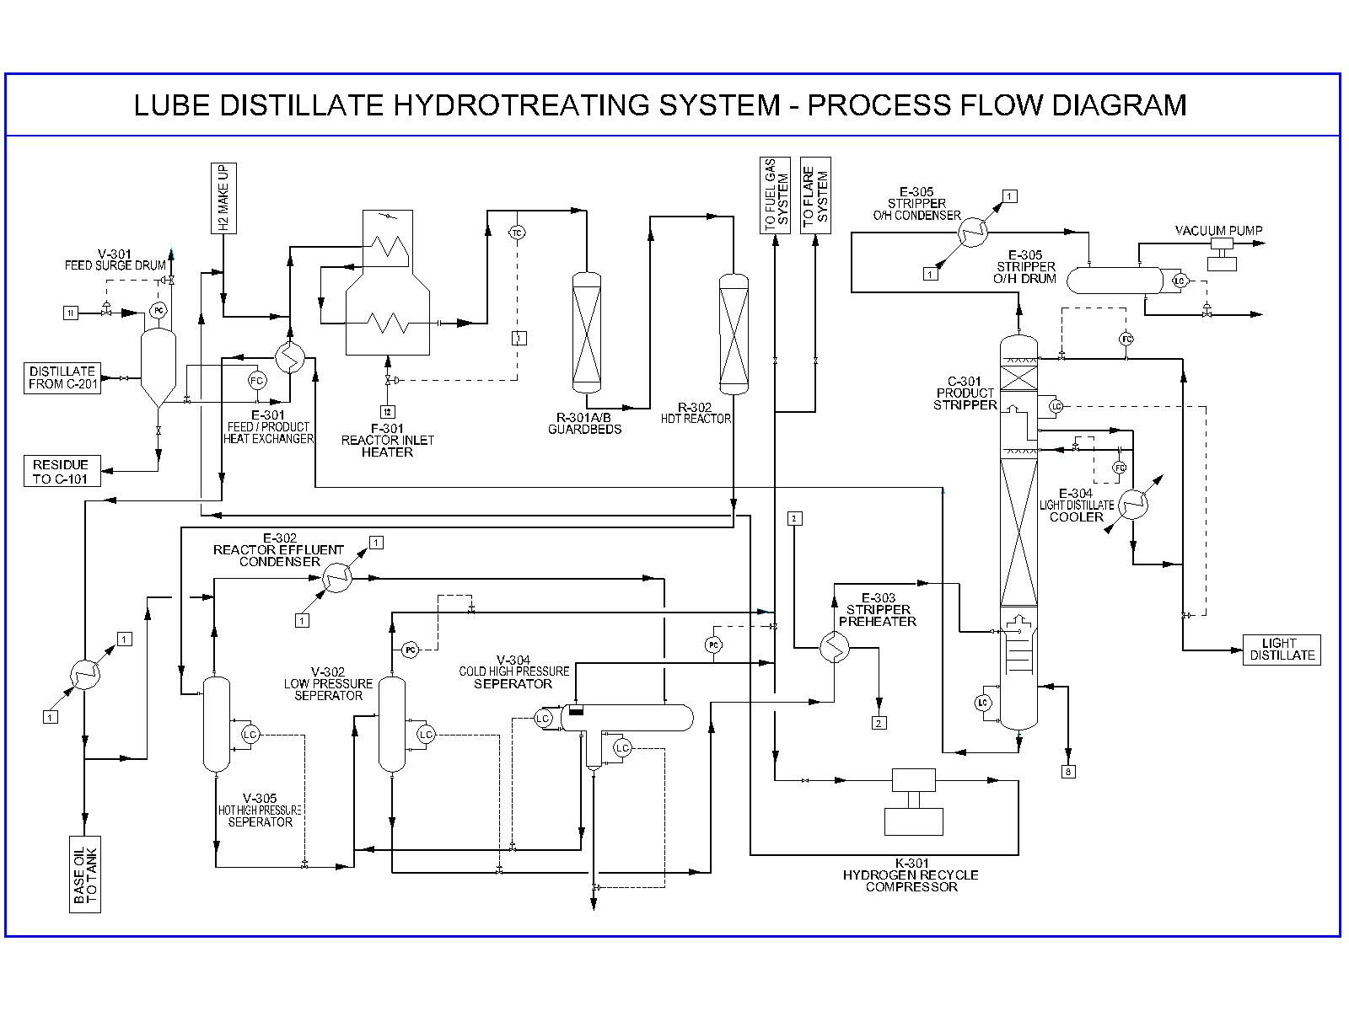

Slide 14
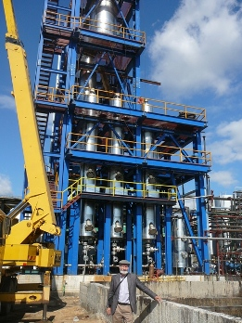

Slide 15
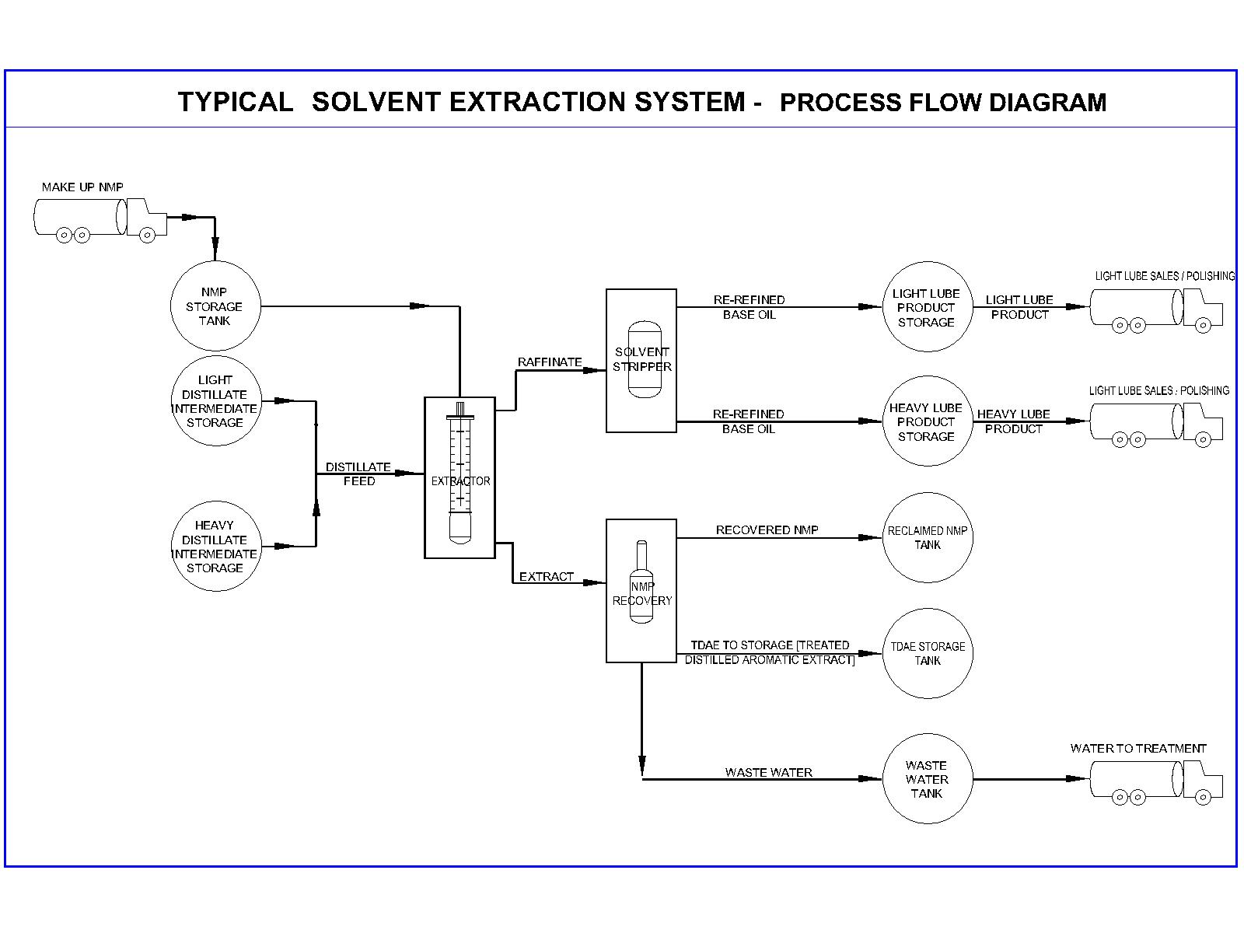

Slide 16
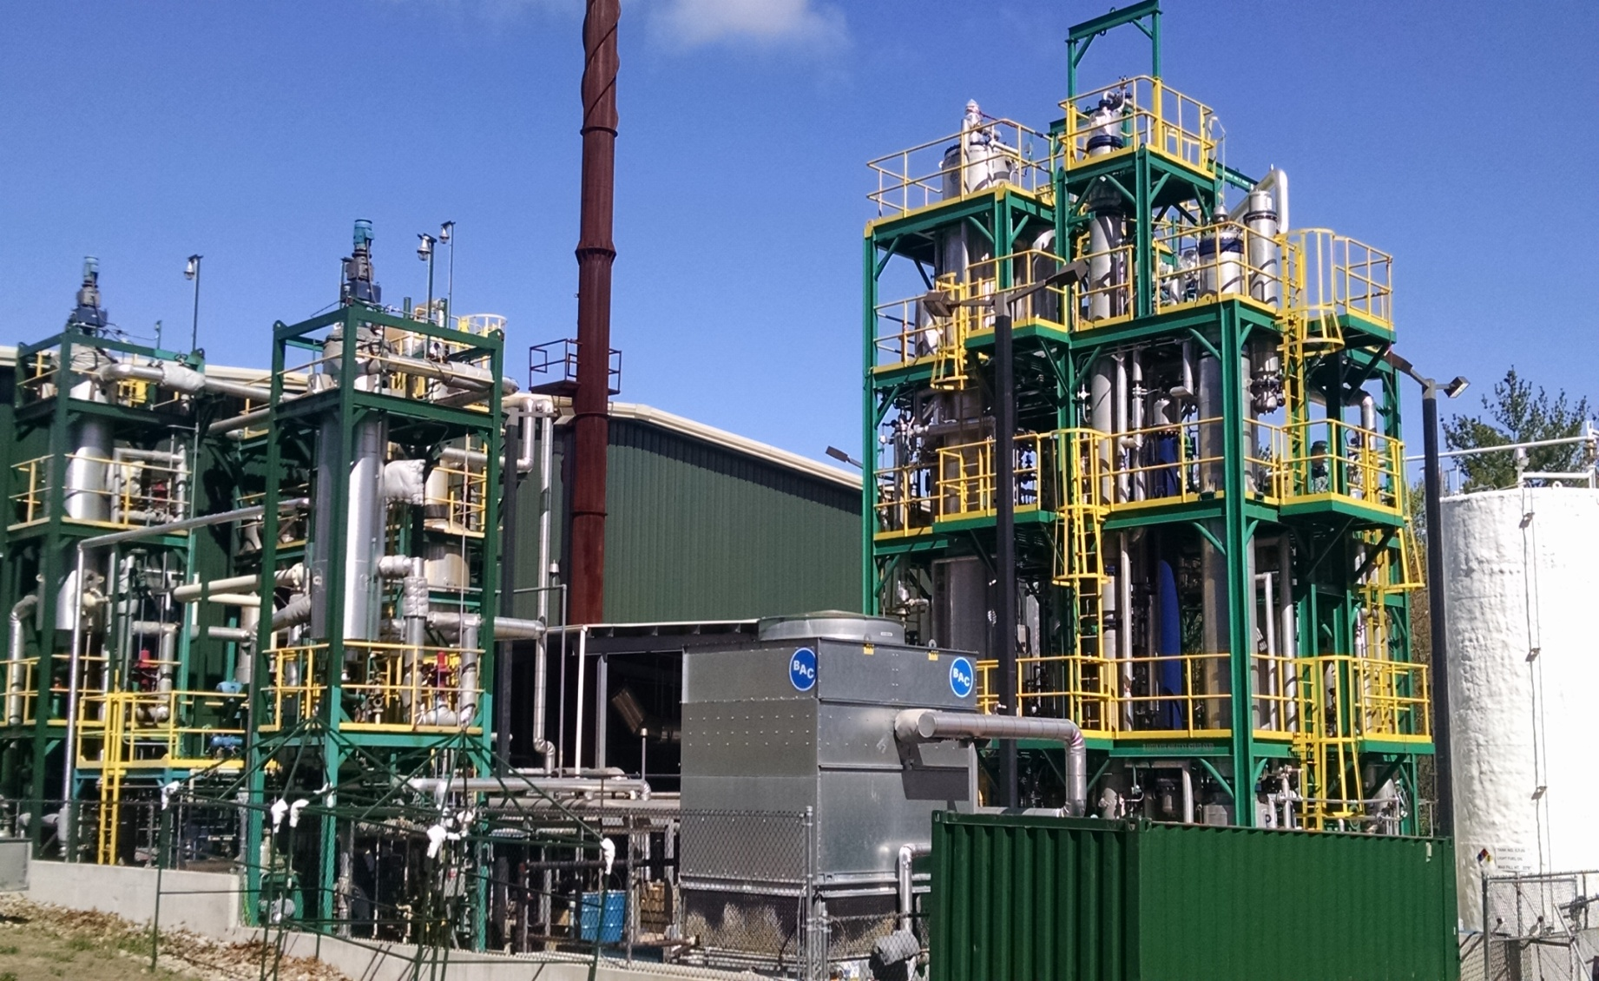

Slide 17
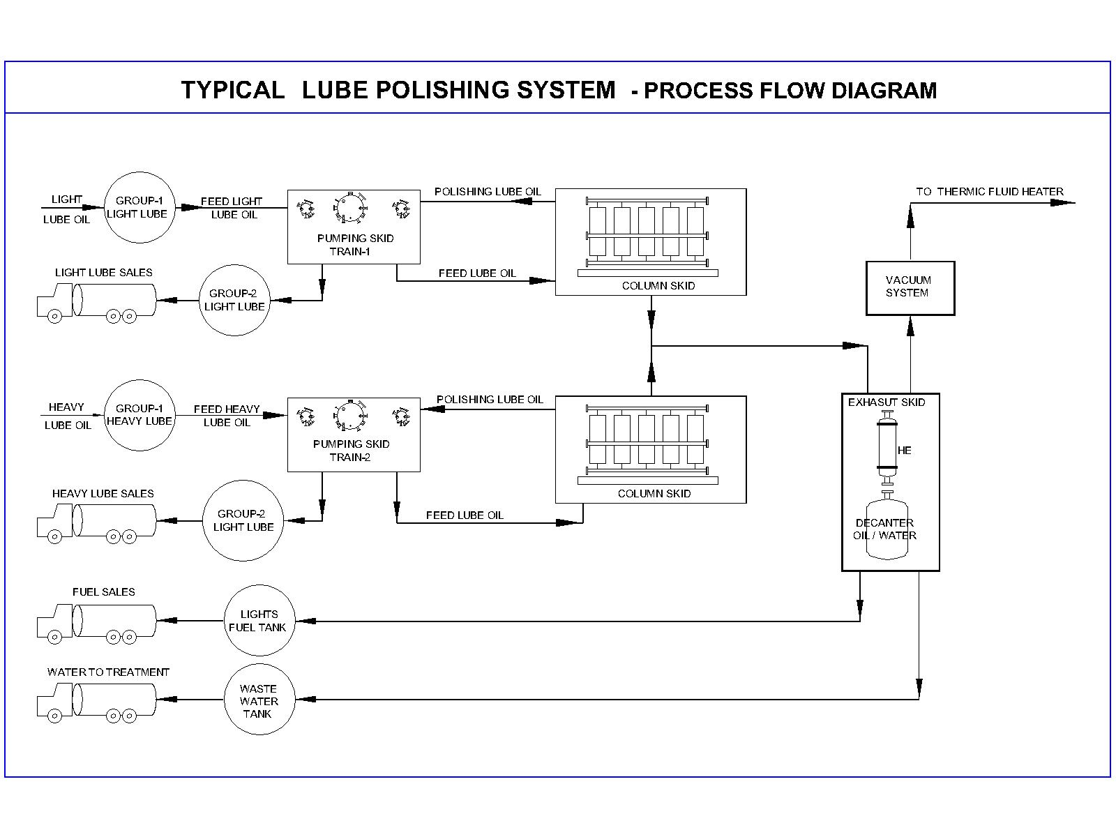

Slide 18
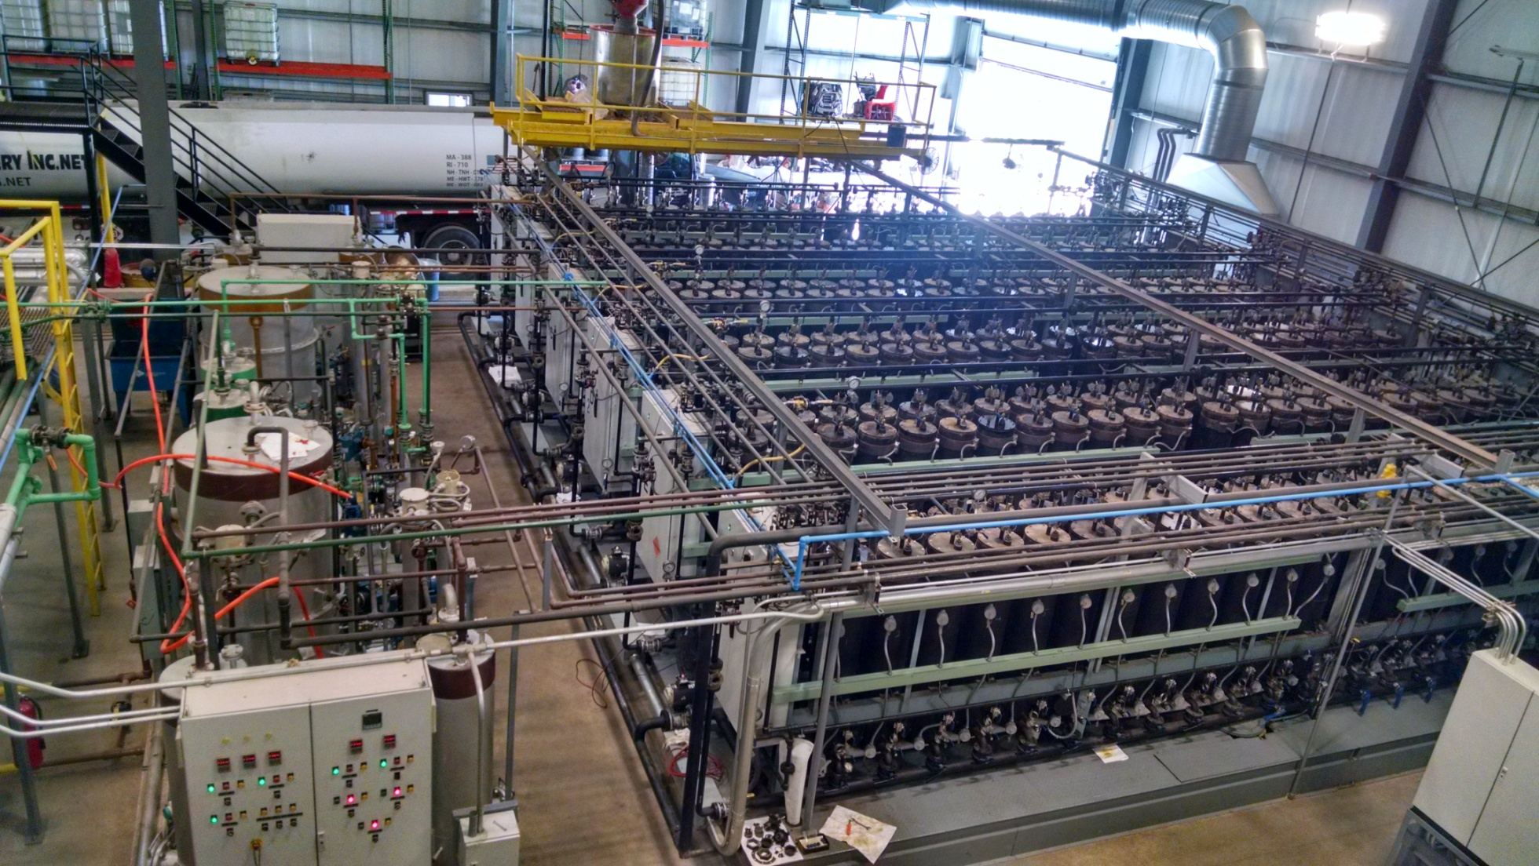

Slide 19
The major steps involved (common to all of our product range)

Slide 20
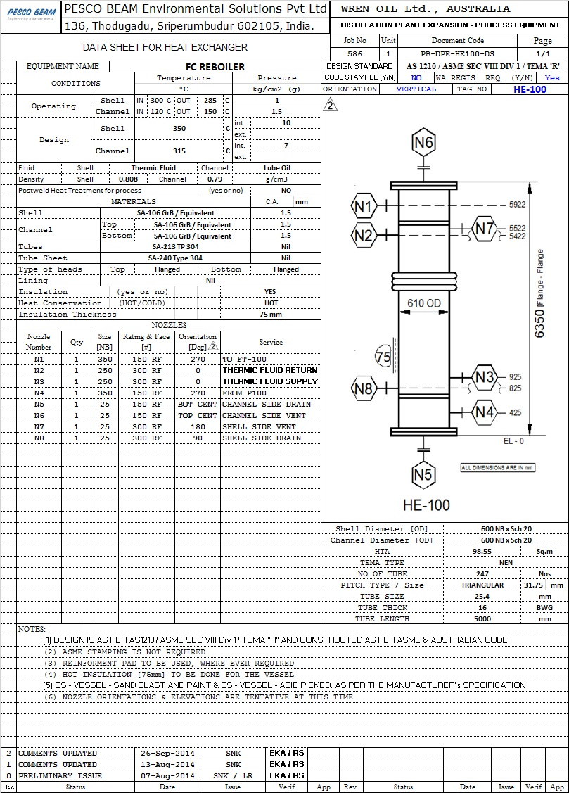
Equipment Data Sheet

Slide 21
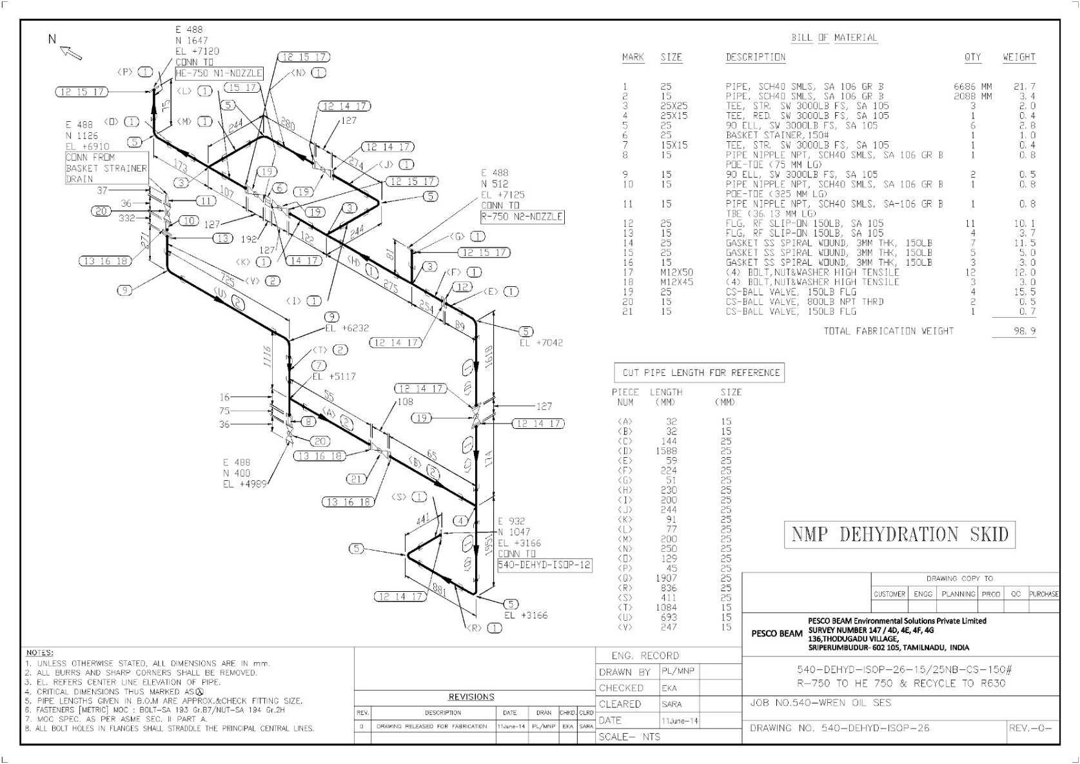
Every single pipe line drawn and then built

Slide 22
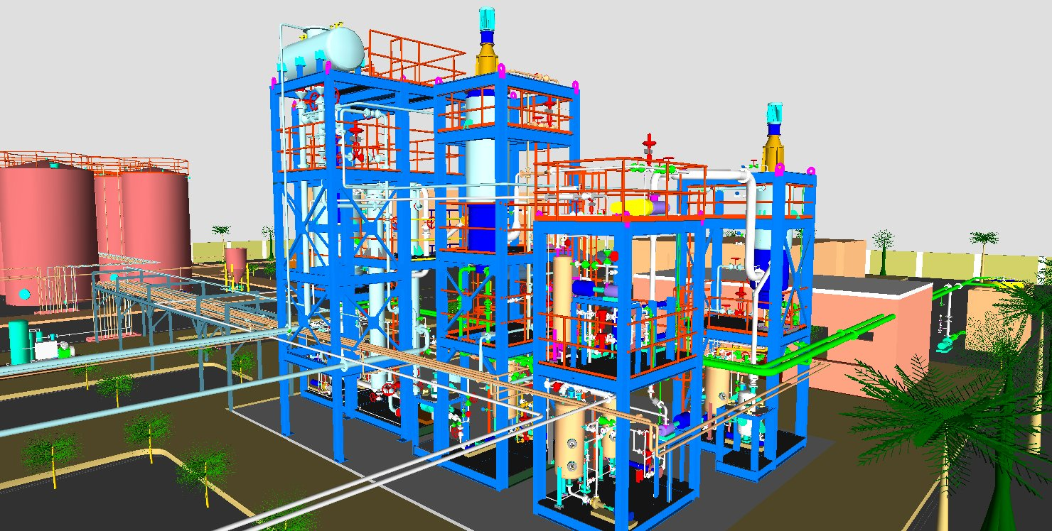
Down to the last detail – everything on the drawing board

Slide 23
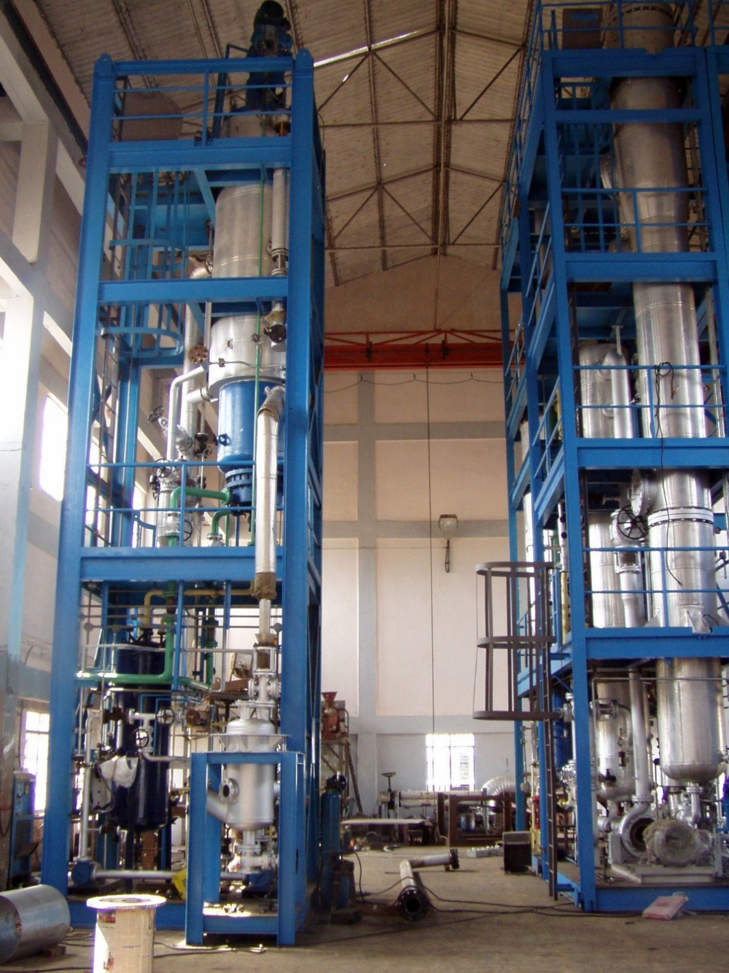
Built as skid mounted systems that can be containerized

Slide 24
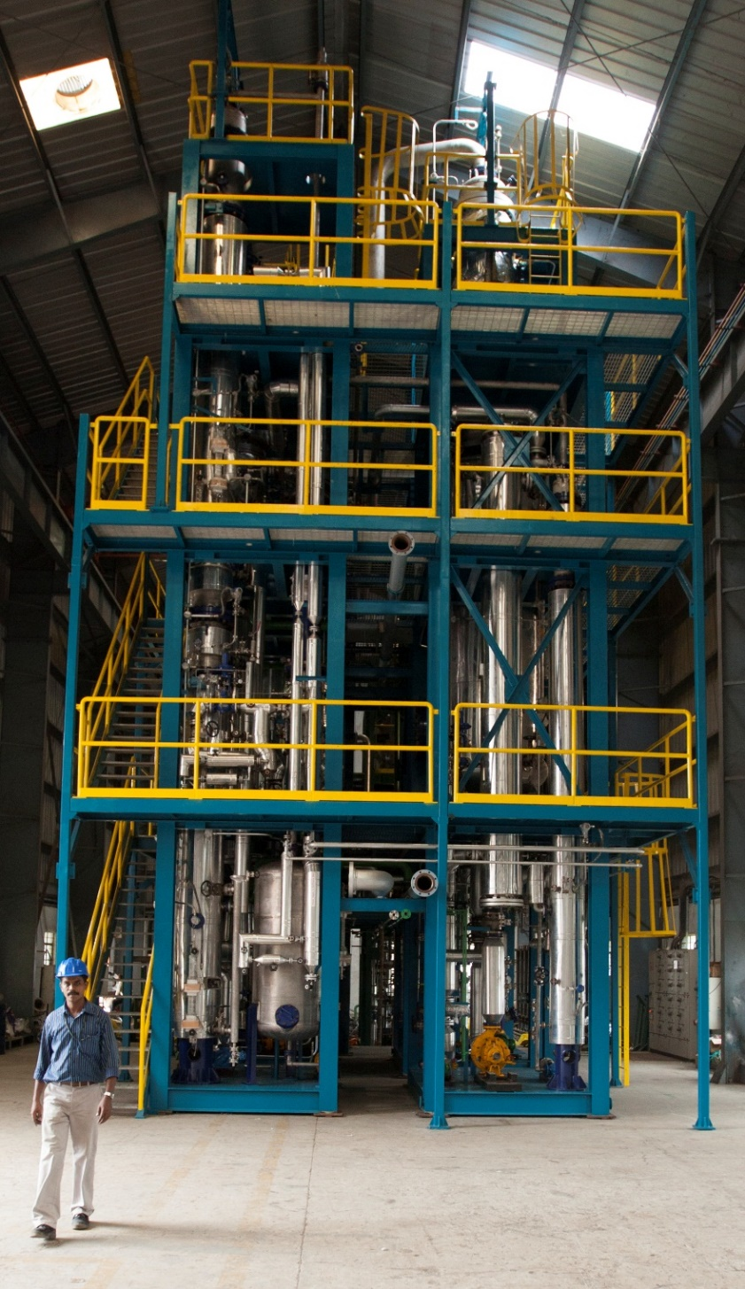
Assembled, checked, loop tested before shipping

Slide 25
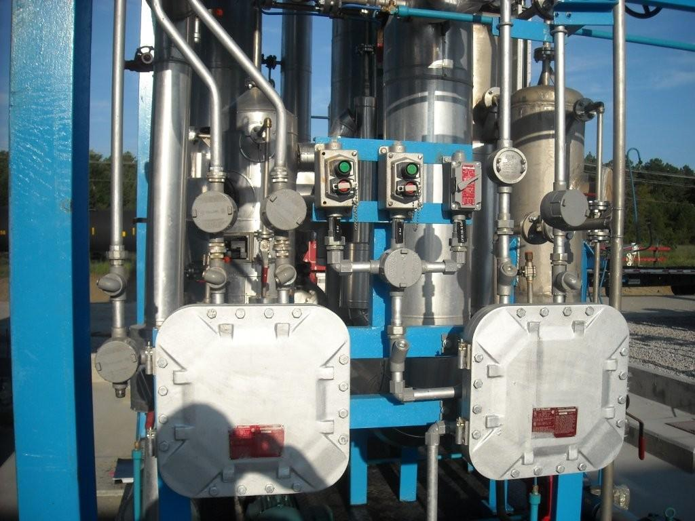
Pre-wired, pre-piped, complete with electricals, instrumentation & controls

Slide 26
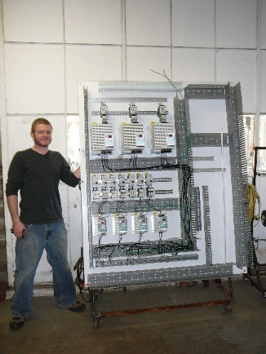
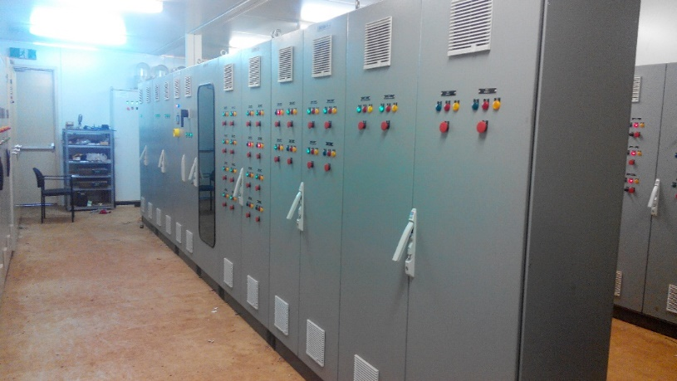
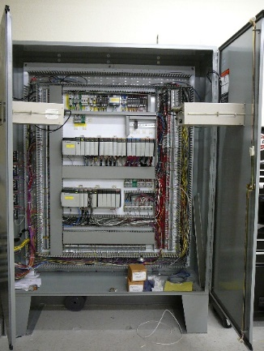
Pre-wired electrical and PLC panels

Slide 27
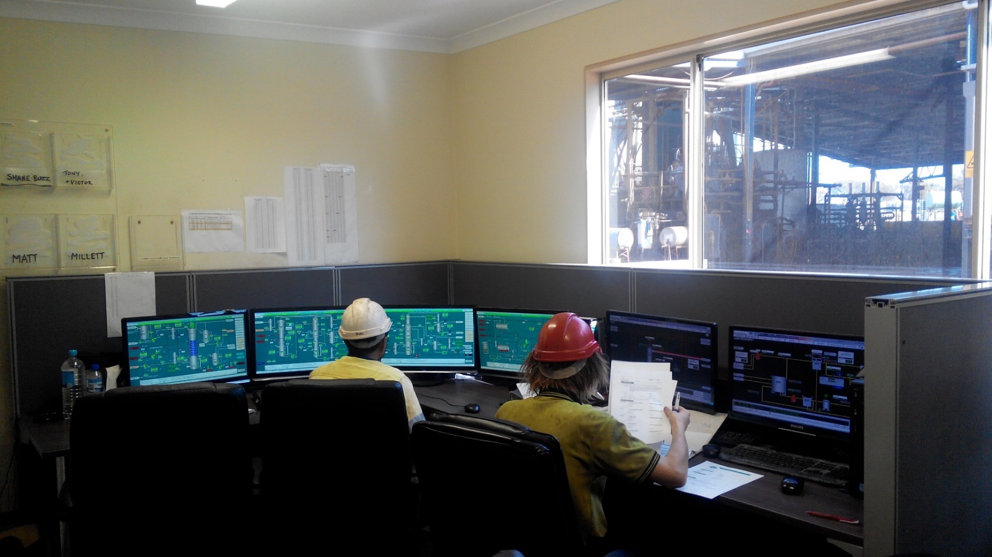
PLC Controls

Slide 28
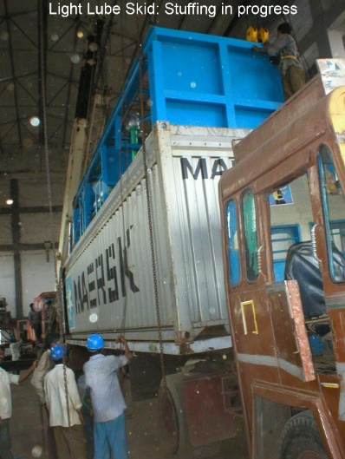
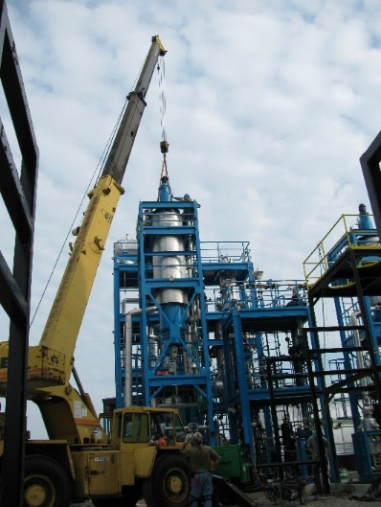
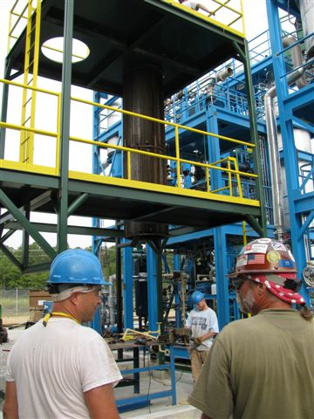
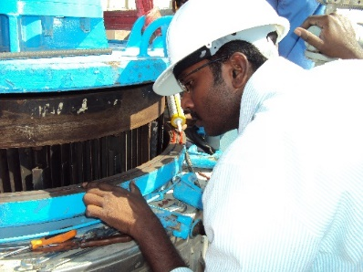
Stuffing & Site Erection - Easy & Quick

Slide 29
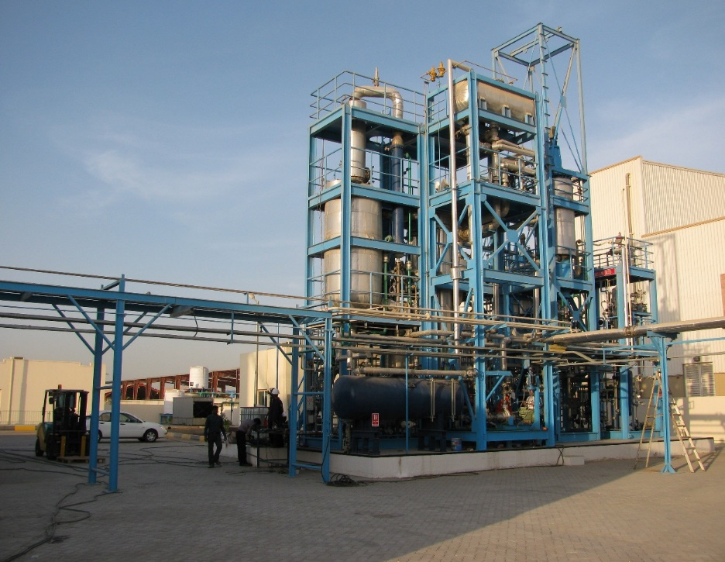
From concept to commissioning & beyond

Slide 30
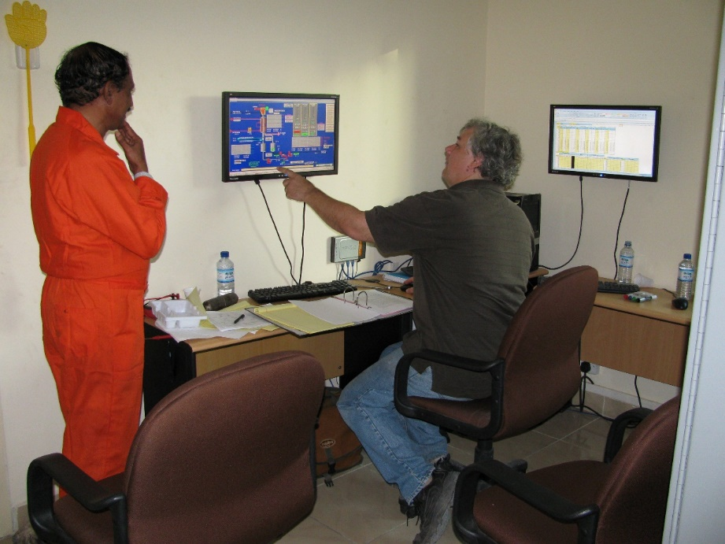
Commissioning & Operator Training

Slide 31
Final Documentation Consists of TWO hard copies and ONE soft copy of all as-built drawings, manuals, inspection certificates, specification for spares. Operating & Maintenance manuals are handed over after commissioning and operator training.

Slide 32
TURNKEY SYSTEMS FOR Used motor oil and liquid hydrocarbon re-refining Solvent recycling Semi-solid and Solid Petroleum waste treatment Biodiesel from waste materials High efficiency drying of solids and sludge Custom built process equipment

Slide 33
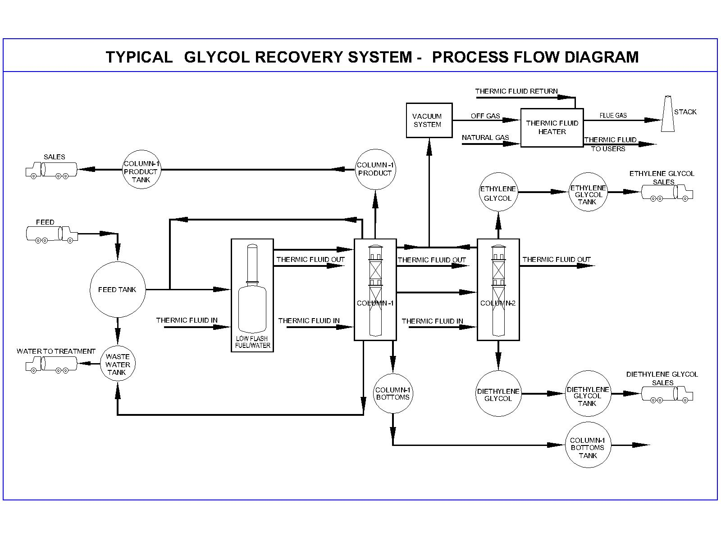

Slide 34
Typical solvents recovered in PB supplied operating plants are: Mineral spirits, Ethylene Glycol, Propylene Glycol N Methyl Pyrrollidone (NMP), Dimethyl Sulfoxide, Acetone, Ethyl Alcohol, Iso Propanol, Methyl Alcohol, Acetates, Limonene and many others. Mixtures of solvents are handled. 99.98% purity

Slide 35
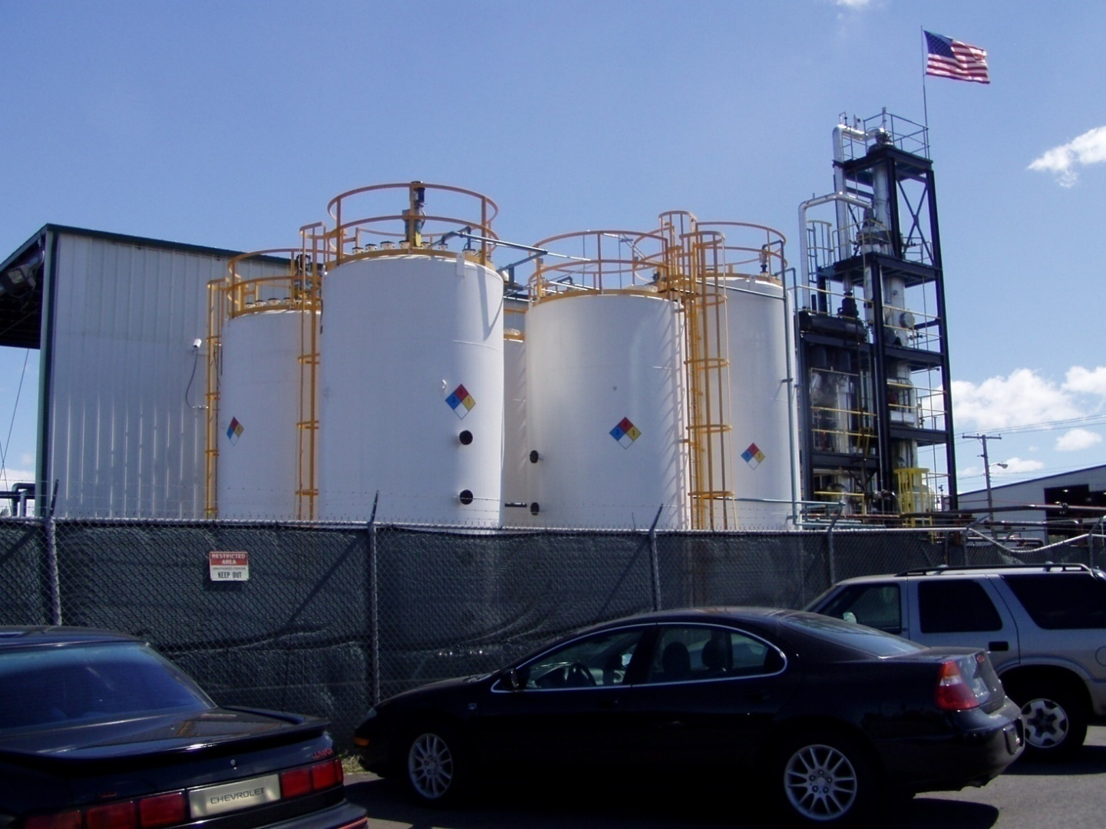
Clients include DuPont, Vivendi, Fina Total, Solvay, Solutia, PPG and many others

Slide 36
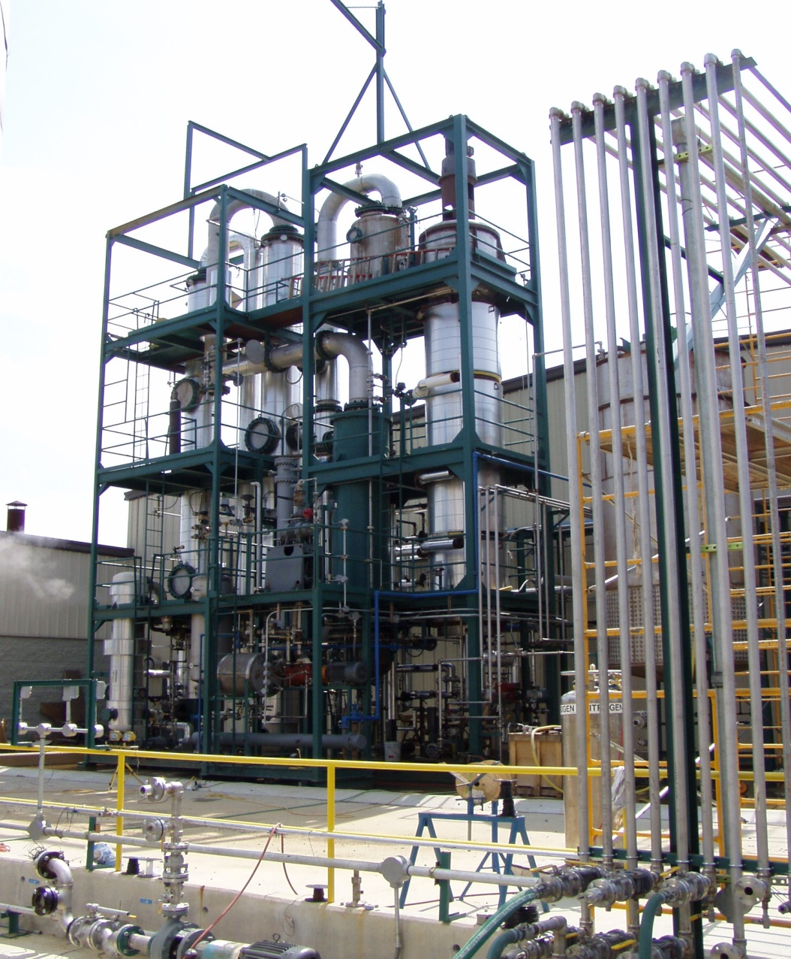
Multi-Solvent Recycling System – ECP in North Carolina

Slide 37
TURNKEY SYSTEMS FOR Used motor oil and liquid hydrocarbon re-refining Solvent recycling Semi-solid and Solid Petroleum waste treatment Biodiesel from waste materials High efficiency drying of solids and sludge Custom built process equipment

Slide 38
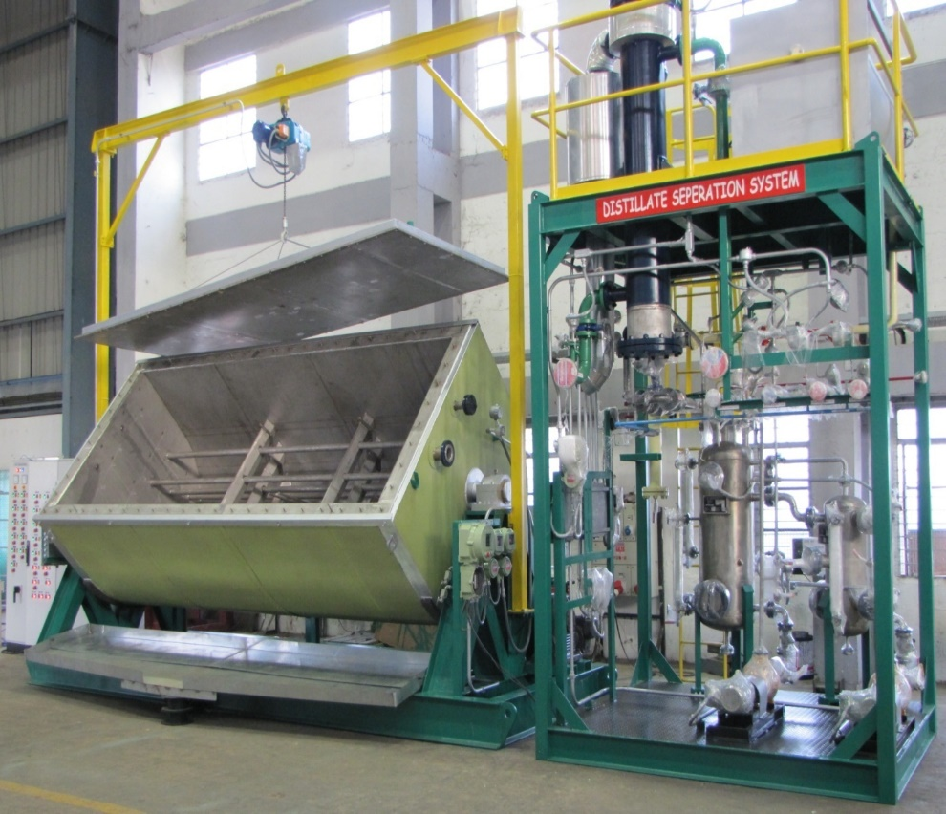
Reactor to handle solid and semi solid petroleum wastes and generate fuel Batch operated systems complete with recovery unit, PLC controlled Modular

Slide 39
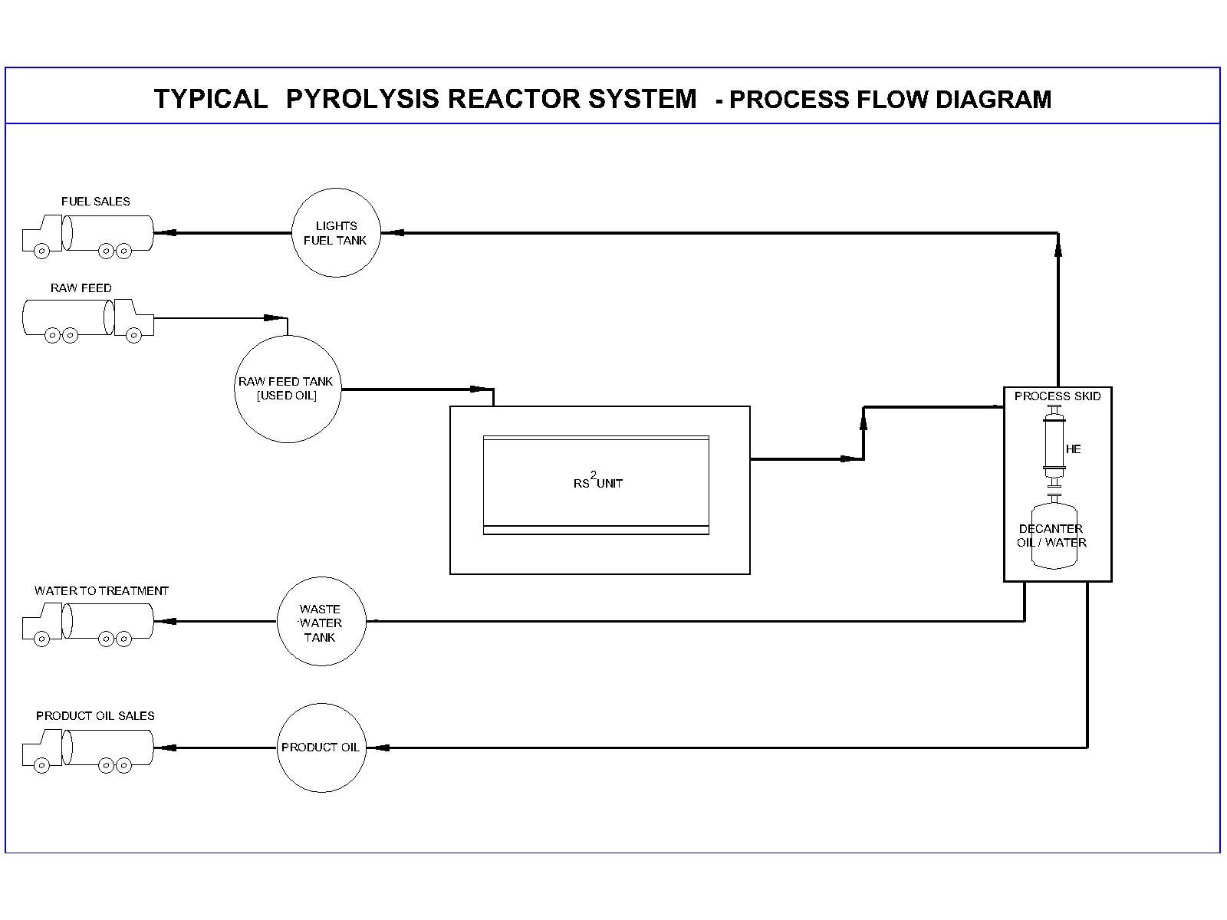

Slide 40
TURNKEY SYSTEMS FOR Used motor oil and liquid hydrocarbon re-refining Solvent recycling Semi-solid and Solid Petroleum waste treatment Biodiesel from waste materials High efficiency drying of solids and sludge Custom built process equipment

Slide 41
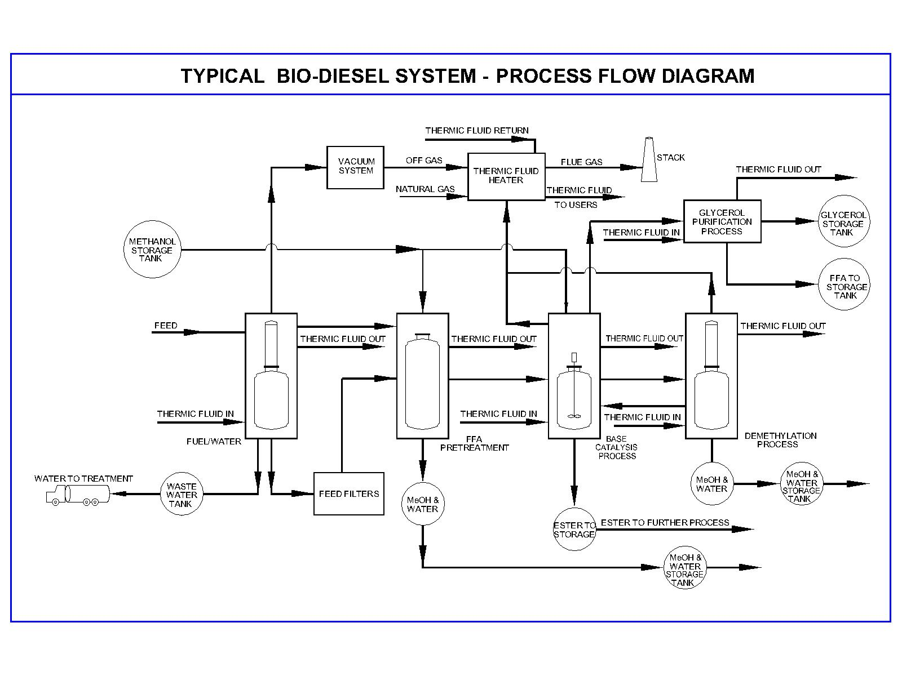

Slide 42
Bio-diesel systems to deal with a wide variety of feedstock, including: Yellow Grease Canola Oil Soy Oil Palm Oil, and Animal Fats.

Slide 43
Better than 98% conversion Systems recover valuable byproducts like methanol and glycerin Guaranteed to produce products to meet ASTM, EU, and Turkish Standards

Slide 44
TURNKEY SYSTEMS FOR Used motor oil and liquid hydrocarbon re-refining Solvent recycling Semi-solid and Solid Petroleum waste treatment Biodiesel from waste materials High efficiency drying of solids and sludge Custom built process equipment

Slide 45
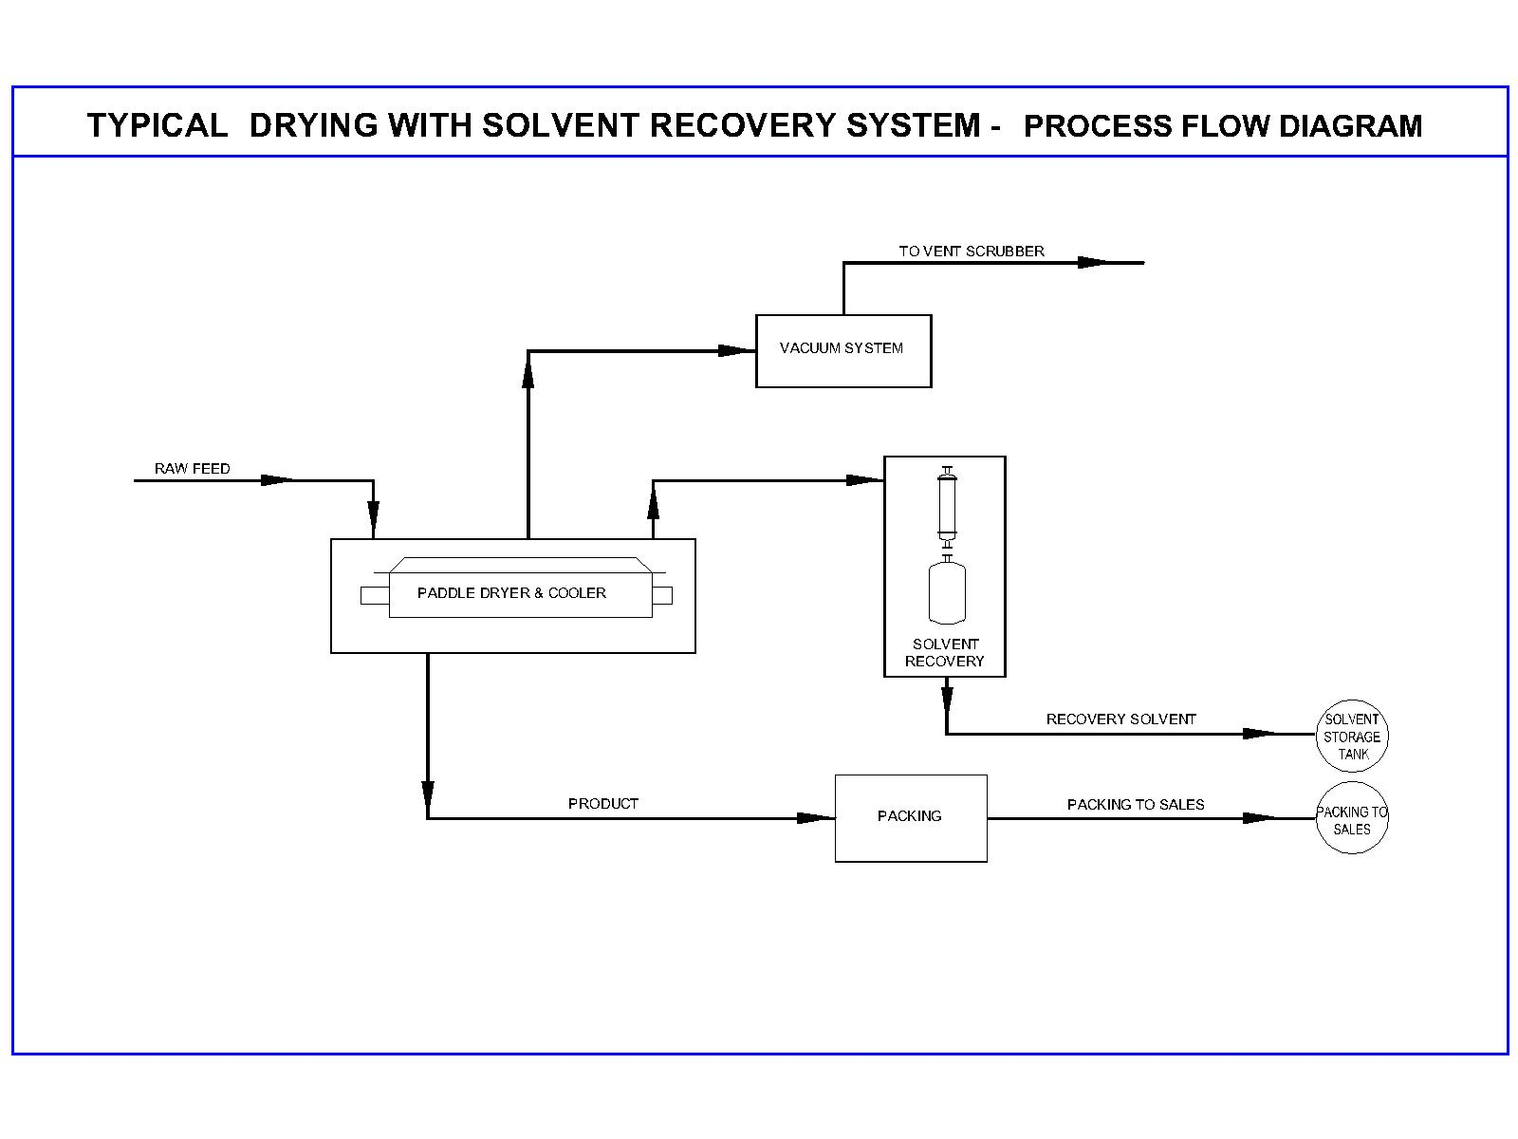

Slide 46
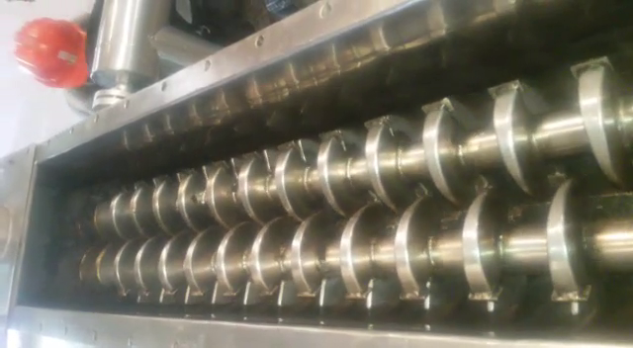
For Drying, Heating, Cooling solids that are difficult to handle, with or without Solvent Recovery Typical Applications: Oily Sludge, Modified Starch, Saw Dust, Filter Cakes, Paint Sludge, Cooling of Nutrients, Sterilization of powders for IP grade requirements

Slide 47
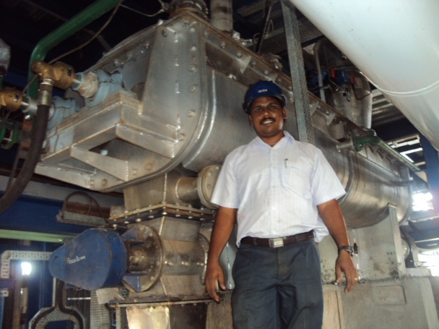
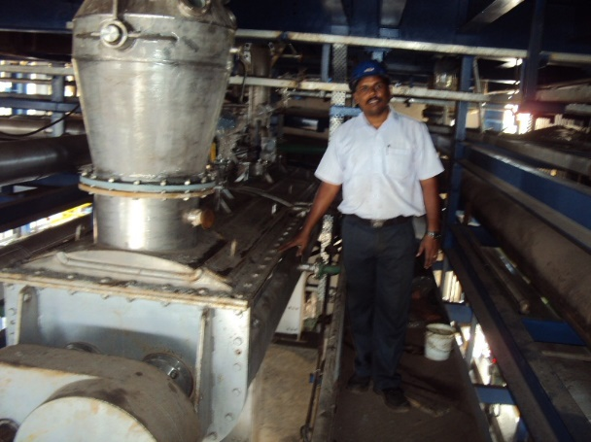
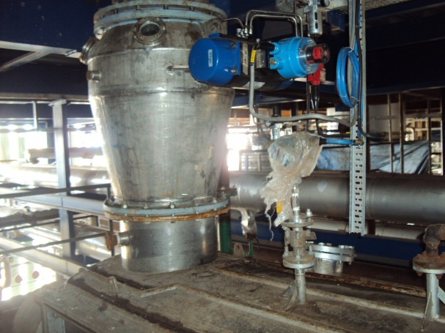
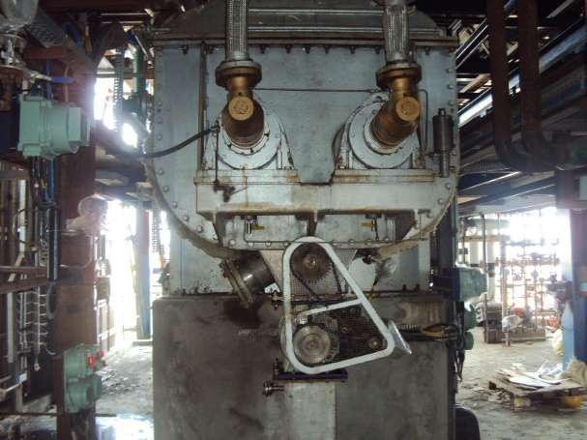
Paddle Dryer for ATBS cake drying with solvent recovery

Slide 48
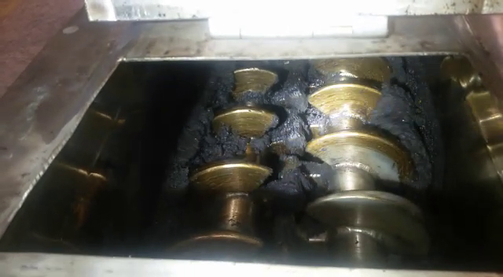
Drying oily sludge in pilot plant

Slide 49
TURNKEY SYSTEMS FOR Used motor oil and liquid hydrocarbon re-refining Solvent recycling Semi-solid and Solid Petroleum waste treatment Biodiesel from waste materials High efficiency drying of solids and sludge Custom built process equipment

Slide 50
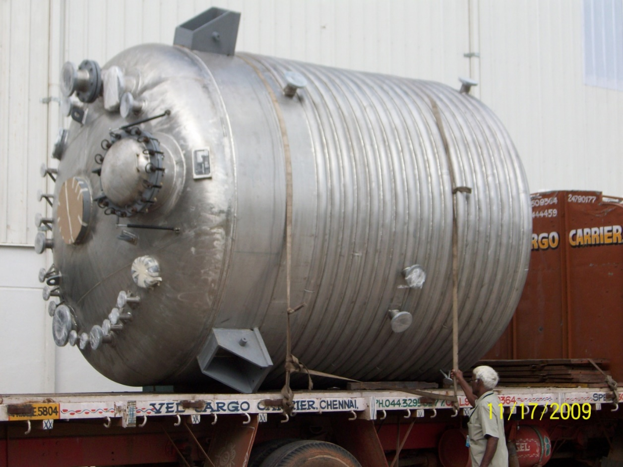
A Limpet Coiled Reactor in Stainless Steel construction for Asia’s largest paint manufacturer

Slide 51
Who we are What we do The PB advantage Clients Vendors

Slide 52
Over 25 years experience, more than 35 plants commissioned, 16 of them for UMO re-refining - First UMO plant commissioned in 1996 with the client continues to work with us till today with most recent expansion to double his re-refining capacity now under execution by PB. Pioneers in the development of new approaches to re-refining UMO - First to develop the designs to distil even very high viscosity lubricants without cracking them, by using short path evaporators, deep vacuum and relatively low temperatures. Our plants recover oils with viscosities up to N-600+. No other re-refinery does this even now.

Slide 53
The complete range of Downstream Polishing Technologies: - Solvent and Clay technologies for smaller sized plants which do not need high pressure hydrogen based technologies to polish the recovered distillates. These technologies operate at low temperatures and pressures, and do not deal with explosive gases. - Clay based Lube Polishing System (LPS): PB was the first to apply bauxite adsorption technology, to distilled lubricating oils. After huge amount of R & D effort, we have now perfected this technology and it is still the best solution for smaller plants of less than 15,000 tons per year. Additionally we now recommend it as a further step after our Solvent Extraction technology to obtain a good Group 2 Base Lube.

Slide 54
Solvent Extraction Systems (SES) For plants larger than 15,000 TPA , SES is an excellent approach to polish distilled lube oil. This technology has been re-engineered to produce a light in color, fine product and our first SES is operating and producing Group 1 Base Oil. When distillate from our short path distillation process is solvent extracted and further polished in our LPS, a very high grade Group 2 Base Lube will result.

Slide 55
Hydrotreatment PESCO BEAM also recognized the need to supply hydrotreaters to those larger plants where the client wanted the highest quality results from a long established and proven technology – Hydrofinishing. We engage Green Industrial Technologies Ltd. (GIT) of Greece to supply these plants under our banner. GIT have extensive experience in this field, having worked in the hydrotreating sections of major refineries. They have also designed, constructed and commissioned a Hydrotreater which has been operating for several years with an excellent record of consistent operation and high quality product. Their technology is the most advanced and efficient that we have come across, with many innovations which reduce operating costs, reduced hydrogen consumption, and have a high degree of energy efficiency.

Slide 56
Not just a Supplier but an Owner & Operator of re-refineries America Owns 1 used oil re-refinery In final stages of acquisition of another Asia & MENA 2 more re-refineries to be set up by mid-2017

Slide 57
Client Support – Before, During and After a contract Before: Project engineering to include site layout, tank farm engineering, environmental impact assessment and abatement. During: Tank farm design, Load data for civil construction, Field piping data, complete plant design and drawings, final documentation, supply of critical spares, erection verification, start-up, operator training, Hazop study support data. After: Ongoing operator support, spare parts procurement, ongoing improvements in technology.

Slide 58
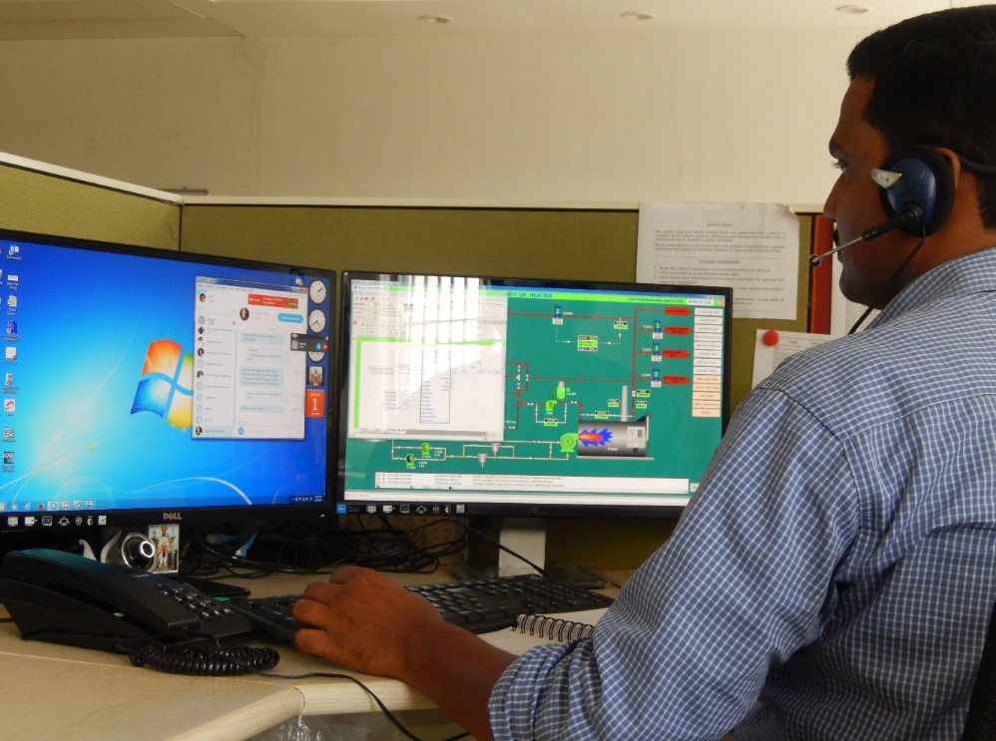
On going operator support: Ability to monitor the computer controls from anywhere in the world, any time of day.

Slide 59
Proven, robust, easy to maintain components only used: Selection is based on easy availability of spares, ability to withstand the harsh conditions of operation, approvals, internationality of supplier (major component vendors on Slide 67) Engineering support: The technical support available includes a complete organization headed by the Chief Engineer located in the US. Org chart follows this slide. A multi-disciplined team of seven engineers support the chief engineer during start-up, off and on site. We have the strength to start-up two plants and two locations simultaneously.

Slide 60
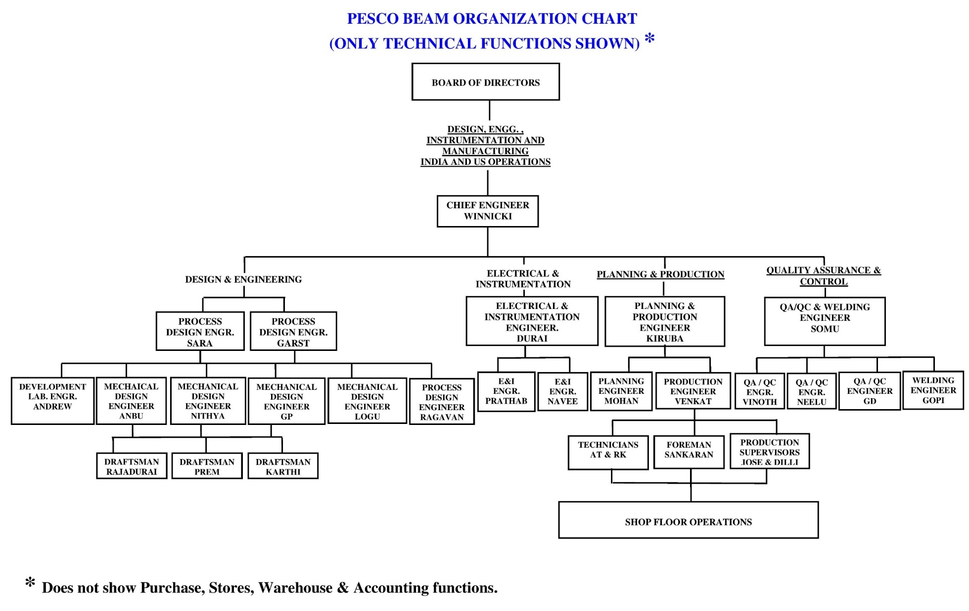

Slide 61
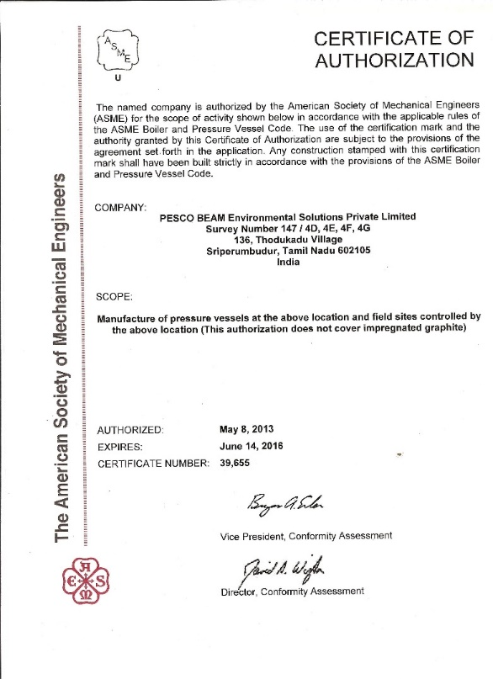
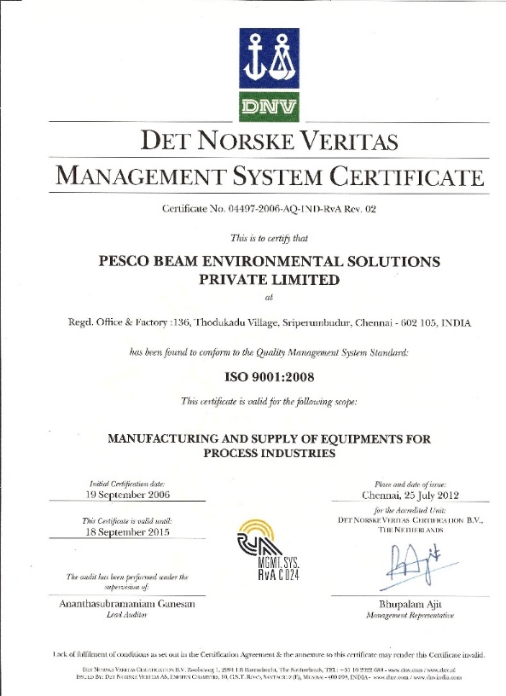
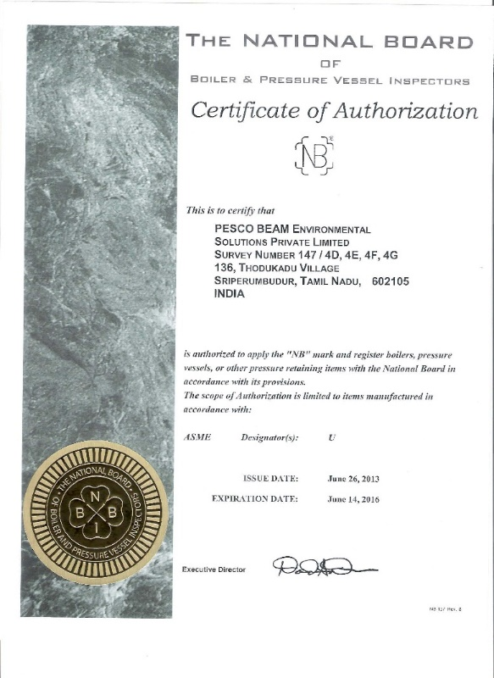
The plant is manufactured in a ASME U Stamp authorized shop . The location is also certified by ISO 9001-2008 & NB approved.

Slide 62
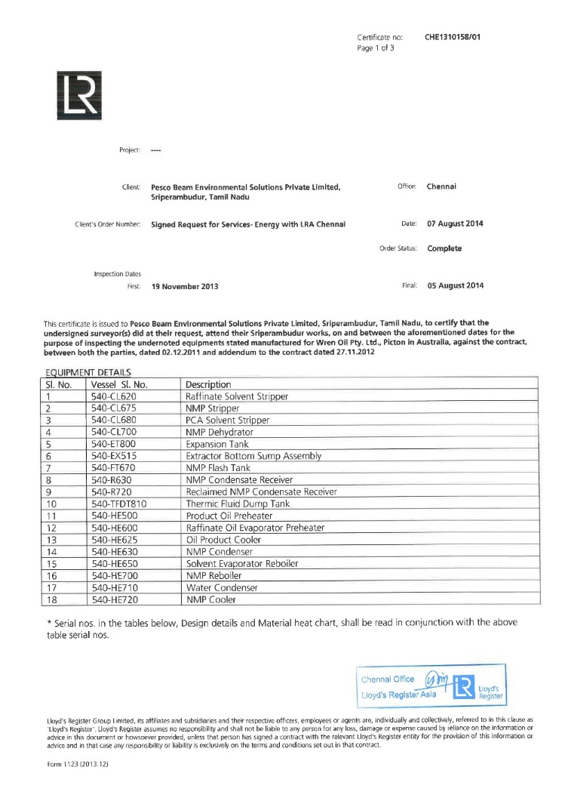
Equipment are built to approved third party inspection, if needed. Lloyds inspection certificate is displayed alongside.

Slide 63
Research & Development Lab & Pilot Distillation studies under high vacuum for a data base, unparalleled Continuous Oil / Water gravity separation during process; Establishing the superiority of the SPDU Vs Vertical evaporation to produce lighter coloured and heavier viscosity lube distillates; Study of flow dynamics of oil in media columns; Optimization studies for continuous production from media based polishing systems; Pilot studies to recover high vis fractions from SPDUs Pilot studies on solvent extraction of base lube distillates Pilot studies on drying of various materials in conduction dryer

Slide 64
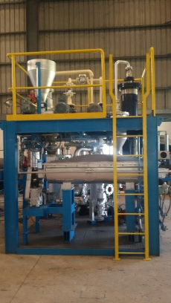
Pilot plant: High vacuum paddle dryer with solvent recovery

Slide 65
Who we are What we do The PB advantage Clients Vendors

Slide 66
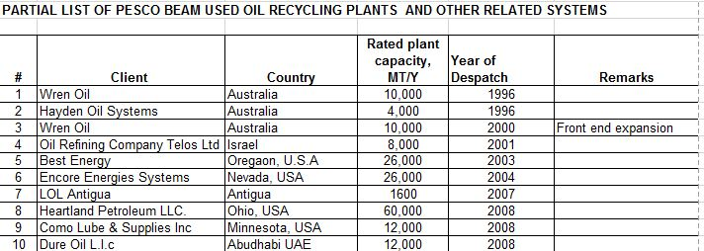

Slide 67
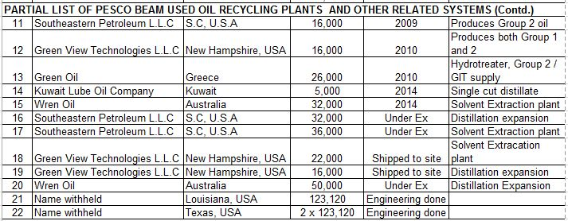

Slide 68
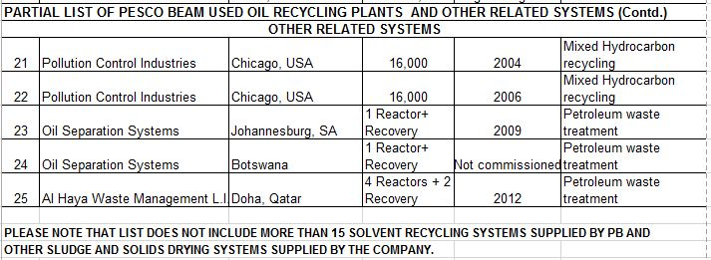

Slide 69
Attached to this presentation are: A letter from Wren Oil Analysis of product from Lubrizol (base oil from a plant supplied by PB)

Slide 70
Who we are What we do The PB advantage Clients Vendors

Slide 71
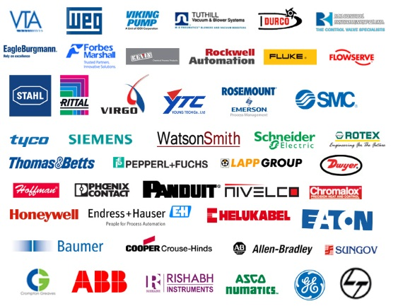

Slide 72
Thank you for your time!
www.pescobeam.com
luke@pescobeam.com
subu@pescobeam.com

