Slide 1
Covalent Nomenclature
Time to learn about sharing!

Slide 2
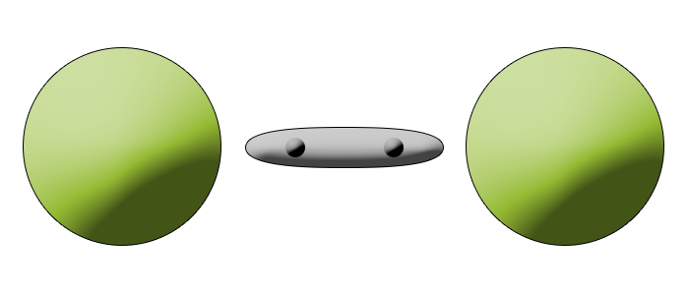
What is covalent bonding?
The name covalent means having valence electrons in common, i.e. sharing electrons.
Covalent molecules only include nonmetals.
The nonmetals are held together by covalent bonds, which are made up of two valence electrons shared between the two atoms.
Notes:
Reinforce where nonmetals are on the Periodic Table.

Slide 3
Writing names
Names use the following prefixes.
one | mono |  | six | hexa
two | di |  | seven | hepta
three | tri |  | eight | octa
four | tetra |  | nine | nona
five | penta |  | ten | deca
N₂O₅ | dinitrogen pentaoxide
C₃H₈ | tricarbon octahydride
Notes:
It will save time later if students memorize the prefixes.

Slide 4
Writing names
The names use prefixes to differentiate between the possible combinations of the same elements.
When there is only one of the first element, then it will not have the prefix mono-. Otherwise, there will always be a prefix.
CO | carbon monoxide
CO₂ | carbon dioxide
CO₂ | carbon dioxide
N₂O₅ | dinitrogen pentaoxide
Notes:
When to have a prefix on the first element or not is the most common place where students struggle with covalent nomenclature.

Slide 5
Writing formulas
This is the simplest task in nomenclature. We just have to write what the prefixes tell us.
Remember if there is only one of the first element, then it will not have a prefix.
nitrogen trihydride | NH₃
disilicon hexabromide | Si₂Br₆
xenon hexafluoride | XeF₆

