Slide 1
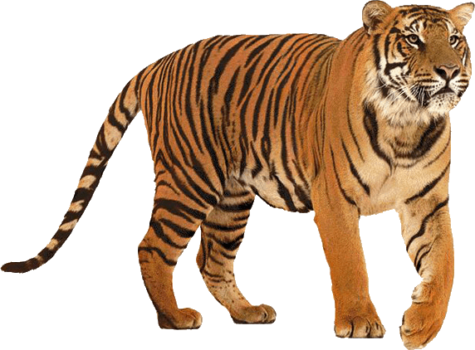
TIGER IYE
EDUCATION PART 5
INSTRUCTOR
QUENN V. GARRIS JR.

Slide 2
LET’S WRAP THIS UP SO YOU CAN MASTER THE MARKETS !

Slide 3
12 THINGS YOU NEED TO KNOW BEFORE YOU BEGIN !
SMALL GAINS ADD UP TO BIGGER PROFITS
COMPOUNDING IS THE SMARTEST AND FASTEST WAY TO GROW THE ACCOUNT
FOCUS ON THE LONG TERM GOAL (IF IT HAPPENS QUICKER, THAN BETTER FOR YOU)
DON’T RUSH IT. YOU’LL END UP RISKING TOO MUCH AND NOT FOLLOWING YOUR RULES
BE OPEN MINDED
DON’T BE AFRAID TO BUY & SELL

Slide 4
12 THINGS YOU NEED TO KNOW BEFORE YOU BEGIN !
IF THE TRADE IS GOING AGAINST YOU, CONSIDER WHAT COULD HAPPEN NEXT
ADAPT TO WHAT WORKS FOR YOU TO STAY CONSISTENTLY PROFITABLE
LEARN FROM YOUR LOSSES
PROFIT FROM YOUR GAINS AND KEEP REPEATING THE SAME PROCESS
YOU’RE GOING TO MISS SETUPS. IT’S OKAY. JUST MAKE SURE THE ONES YOU DO HIT ARE HOME RUNS !
BE HONEST WITH YOURSELF FIRST & FOREMOST !

Slide 5
NOW THAT YOU HAVE YOUR KEYS TO SUCCESS…

Slide 6
IT’S UP TO YOU TO GET IN THE DRIVER SEAT AND GO !

Slide 7
99% DONE
IF YOU PAID ATTENTION THROUGHOUT THE ENTIRE PROCESS, YOU NOTICED COUPON CODE LETTERS AT THE END OF EACH PART...

Slide 8
I TOLD YOU THERE WAS A SPECIAL GIFT…
THE FINAL 2 LETTERS ARE
“ER”
USE ALL THE LETTERS IN ORDER AS A $50 COUPON OFF THE ENTIRE TIGER IYE BOOTCAMP

