Slide 1
Class 1
WHAT IS
LEADERSHIP?
LEADERSHIP MODULE

Slide 2
Agenda
Module’s conceptual map
Definition of leadership
Leadership vs. management
Why is leadership so important?

Slide 3
Module’s Conceptual Map
MODULE’s VISION:
“We want YOUR COMPANYS’ golden nuggets to become not only excellent managers, but also leaders able to help others to do the right things, able to set direction, build an inspiring vision, as well as to innovate our company and the entire shipping industry”
MODULE’s MISSION:
“Provide a basic theoretical background on leadership, inspire with real life examples of great leaders, boost young managers’ leadership skills”

Slide 4
Module’s Conceptual Map
Class 1: Defining Leadership
Forge a shared notion of leadership and leadership styles that would enrich companys’ culture
Class 2: How to lead – leadership styles
Class 3: Mission Command
Raise the benchmark of ethical behavior, when dealing with superiors, equals, subordinates
Class 4: Leadership Ethics
Class 5: Leadership and Soft Skills
Enhance the quality of the working environment thanks to improved interpersonal relationships
Class 6: Leadership Mistakes
Prepare our Managers to lead their departments through the future changes that will affect the company
Class 7: Leading the Change
Class 8: Leading your Team
Class 9: Role playing – Team Leadership
Provide students with a better understanding of their weaknesses and strengths
Initial Self-Evaluation Test

Slide 5
The Pillars of Leadership
Leadership is an enabling force (⏎class 3)
Involves the concept of serving others (⏎class 4)
It is an opportunity to give (⏎class 4)
Involves an unique responsibility for people (⏎class 8)
“Leadership is a process of social influence, which maximizes the efforts of others, towards the delivery of a vision”
Notes:
In the modern age good leaders are an enabling force, helping people and organizations to perform and develop, which implies that a sophisticated alignment be achieved - of people's needs, and the aims of the organization. The traditional concept of a leader being the directing chief at the top of a hierachy is nowadays a very incomplete appreciation of what true leadership must be.
Effective leadership does not necessarily require great technical or intellectual capacity. These attributes might help, but they are not pivotal. Good leadership in the modern age more importantly requires attitudes and behaviours which characterise and relate to humanity.
The concept of serving is fundamental to the leadership role. Good leadership involves serving the organization or group and the people within it. Ineffective leaders tend to invert this principle and consider merely that the leader must be served by the people. This faulty idea fosters the notion that leadership as an opportunity to take: to acquire personal status, advantage, gain, etc., at the expense of others, which is grossly wrong.
Leadership is instead an opportunity to give; to serve the organization, and crucially the people too
Leadership is centrally concerned with people. Of course leadership involves decisions and actions relating to all sorts of other things, but leadership is special compared to any other role because of its unique responsibilty for people - i.e., the followers of the leader - in whatever context leadership is seen to operate.

Slide 6
Definition of Leadership
Manager: runs processes
Leader: inspires behaviours
Organizing and staffing
Creating a structure
Planning
Monitoring progresses
Controlling behaviours
Envisioning
Creating teams
Aligning to the vision
Setting the direction
Inspiring behaviours
But what is the most important difference?
Notes:
The leadership role is an inevitable reflection of people's needs and challenges in modern life. Leadership is therefore a profound concept, with increasingly complex implications, driven by an increasingly complex and fast-changing world.
This is a simple way to see how leadership is different to management:
Management is mostly about processes. Leadership is mostly about behaviour.
Effective managers achieve their goals by organising and staffing, creating an organisational structure and sets of jobs for accomplishing the plan’s requirements; staffing the jobs with qualified employees, communicating the goals and devising systems to monitor progress. Leaders try to align employees who share their vision. They create teams who understand and share their vision.
Finally, managers ensure that employees reach goals by controlling their behaviours; that is, they monitor results by means of reports and meetings and note deviations from the goal. Effective leadership requires motivating and inspiring teams of employees. It taps their needs, values and emotions.

Slide 7
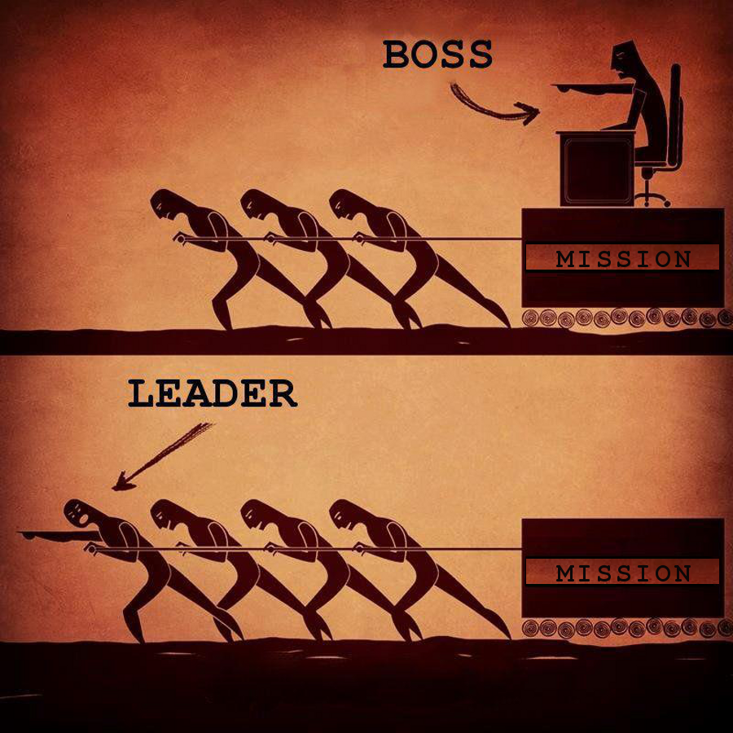
Definition of Leadership
Good leaders are followed because people trust and respect them
Leadership is about behaviour first, skills second.
Notes:
Leadership and management are commonly seen as the same thing, which they are not. Leadership is also misunderstood to mean directing and instructing people and making important decisions on behalf of an organization. Effective leadership is much more than these.
Good leaders are followed chiefly because people trust and respect them, rather than the skills they possess. Leadership is about behaviour first, skills second.
In the next short video clip, former US Secretary of State Gen. (US Army) Colin Powell provide us with a brilliant definition of leadership that completes what we have seen together in the previous slides

Slide 8
The essence of leadership
Former US Secretary of State – General Colin Powell
Notes:
Notes only for students:
Colin Luther Powell (/ˈkoʊlɨn/; born April 5, 1937) is an American statesman and a retired four-star general in the United States Army. He was the 65th United States Secretary of State, serving under U.S. President George W. Bush from 2001 to 2005, the first African American to serve in that position.During his military career, Powell also served as National Security Advisor (1987–1989), as Commander of the U.S. Army Forces Command (1989) and as Chairman of the Joint Chiefs of Staff (1989–1993), holding the latter position during the Persian Gulf War. He was the first, and so far the only, African American to serve on the Joint Chiefs of Staff, and was the first of two consecutive African American office-holders to hold the key administration position of U.S. Secretary of State.

Slide 9
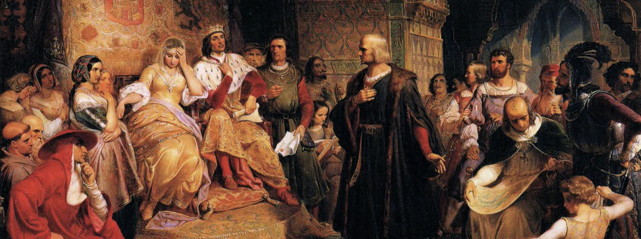
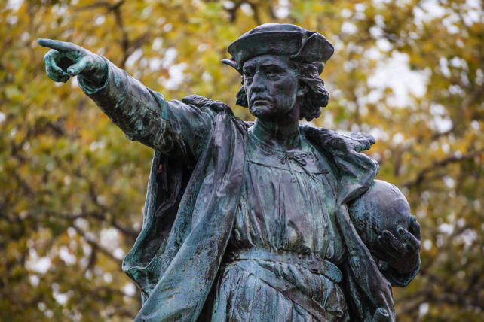
Why is leadership so important?
^{Because a leader:}
Creates an inspiring vision of the future
Motivates and inspires people to engage with that vision
Manages delivery of the vision
Coaches and builds a team, so that it is more effective at achieving the vision
Notes:
The leadership role is an inevitable reflection of people's needs and challenges in modern life. Leadership is therefore a profound concept, with increasingly complex implications, driven by an increasingly complex and fast-changing world.
This is a simple way to see how leadership is different to management:
Management is mostly about processes. Leadership is mostly about behaviour.
Columbus embodied all the carachteristics of a great leader and in its historical achievement of discovering America he:
Created an inspiring vision
Engaged Queen Isabella of Spain into is vision
Delivered the vision by organinzing his expeditions beyond what was commonly accepted as the borders of the known world
Motivated, led, inspired his crews up to the point of avoiding mutiny
Do you think that even without his leadership skills Columbus would have been able to deliver his vision?

Slide 10
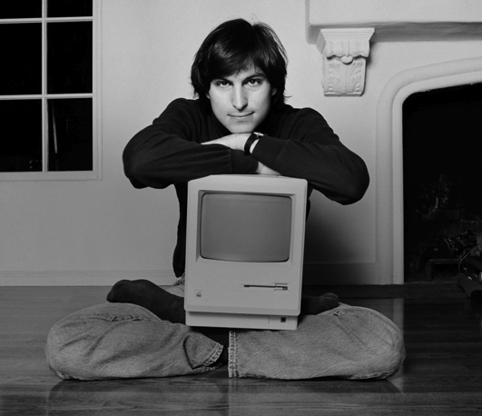
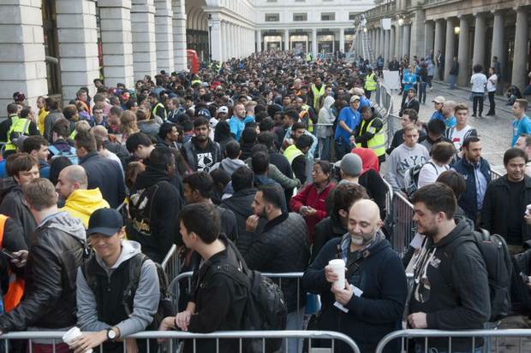
Create an inspiring vision
Steve Jobs
"Man is the creator of change in this world. As such he should be above systems and structures, and not subordinate to them.”
1980, Apple’s mission statement
2014, Launch of iPhone 6 – Apple store Covent Garden, London
Create a vision to inspire others
Make the vision compelling (see, feel, embrace)
Tell inspiring stories (⏎class 4)
But is Apple’s vision still meaningful to people?
Notes:
Therefore, leadership is proactive – problem solving, looking ahead, and not being satisfied with things as they are. Once they have developed their visions, leaders must make them compelling and convincing. A compelling vision is one that people can see, feel, understand, and embrace. Effective leaders provide a rich picture of what the future will look like when their visions have been realized. They tell inspiring stories, and explain their visions in ways that everyone can relate to.
Here, leadership combines the analytical side of vision creation with the passion of shared values, creating something really meaningful to the people being led.
Apple’s original vision is an example of a extremely succesful one delivered by an exceptional leader – Steve Jobs (beacuse it turned out to reach a worldwide compellment) that unfortunately ended in betraying its fundamental values (“man should be above system and structures”…and propbabl not queing for being part of the system!).
Therefore, always keep in mind the final purpose:
The vision that a great leader inspires and delivers must be meaningful to pepople and to their personal development

Slide 11
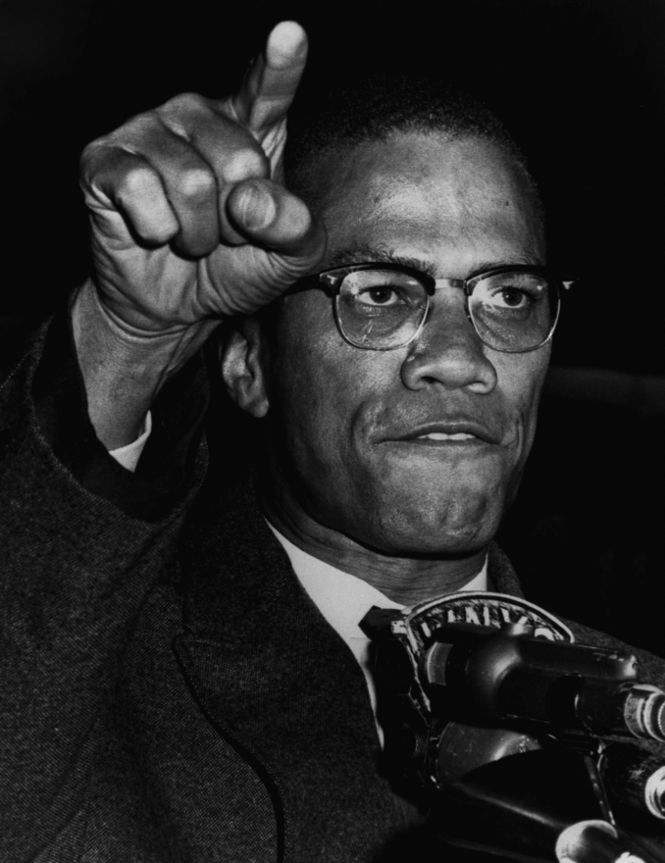
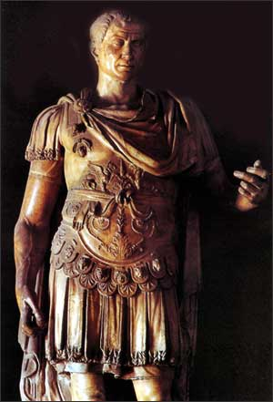
Motivating and inspiring
Good leaders create expectations by:
Using soft skills to inspire / motivate (⏎class 5)
Arousing admiration and respect (⏎class 8)
But do you think that this is enough?
Great leaders also fulfill expectations by:
Excercising their power (⏎class 8)
Being credible and accountable (⏎class 4)
Notes:
A compelling vision provides the foundation for leadership. But it's leaders' ability to motivate and inspire people that helps them deliver that vision.
For example, when you start a new project, you will probably have lots of enthusiasm for it, so it's often easy to win support for the project at the beginning. However, it can be difficult to find ways to keep your vision inspiring after the initial enthusiasm fades, especially if the team or organization needs to make significant changes in the way that they do things. Leaders recognize this, and they work hard throughout the project to connect their vision with people's individual needs, goals, and aspirations.
One of the key ways they do this is through Expectancy Theory. Effective leaders link together two different expectations:
1. The expectation that hard work leads to good results.
2. The expectation that good results lead to attractive rewards or incentives.
This motivates people to work hard to achieve success, because they expect to enjoy rewards – both intrinsic and extrinsic – as a result.
Other approaches include restating the vision in terms of the benefits it will bring to the team's customers, and taking frequent opportunities to communicate the vision in an attractive and engaging way.
What's particularly helpful here is where leaders have expert power. People admire and believe in these leaders because they are expert in what they do. They have credibility, and they've earned the right to ask people to listen to them and follow them. This makes it much easier for these leaders to motivate and inspire the people they lead.
Leaders can also motivate and influence people through their natural charisma and appeal, and through other sources of power, such as the power to pay bonuses or assign tasks to people. However, good leaders don't rely too much on these types of power to motivate and inspire others.

Slide 12
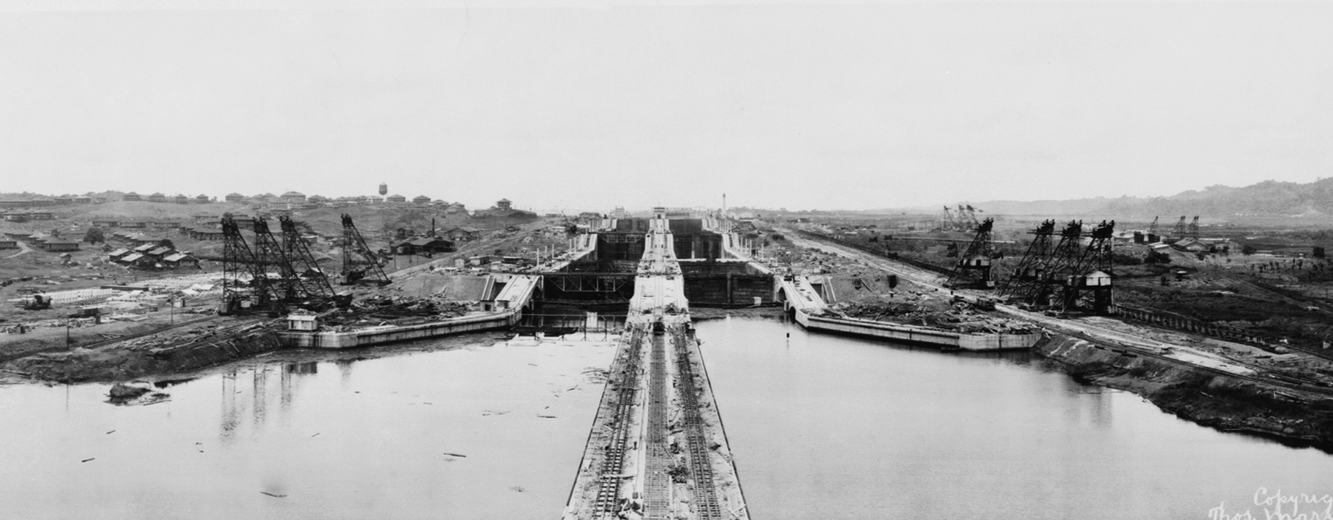
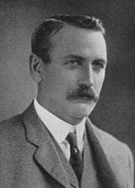
Managing delivery of the vision
How to deliver the vision?
Know the right approach to use (⏎class 2)
Manage and delegate vision’s implementation (⏎class 8)
Link performances to goals and goals to the vision (⏎class 3)
Be able to manage change effectively (⏎class 7)
John Frank Stevens
Panama Canal
Project Manager
Notes:
This is the area of leadership that relates to management. According to the (Tannenbaum continuum) there is time to tell, sell, suggest, consult, join, delegate.
Knowing which approach you need to use, and when you need it, is key to effective leadership.
Leaders must ensure that the work needed to deliver the vision is properly managed – either by themselves, or by a dedicated manager or team of managers to whom the leader delegates this responsibility – and they need to ensure that their vision is delivered successfully.
To do this, team members need performance goals that are linked to the team's overall vision.
Leaders also need to make sure they manage change effectively. This helps to ensure that the changes needed to deliver the vision are implemented smoothly and thoroughly, with the support and backing of the people affected.
A great example of vision delivery is John Frank Stevens, the American Engineer that eventually succeded in leading the construction of the Panama Canal after centuries of unsuccessful attempts. He started the delivery of one of mankind’s greatest vision starting from small detais that turned to be the key of implementing an historic change in the world trades
“One of Stevens' primary achievements in Panama was in building and rebuilding the housing, cafeterias, hotels, water systems, repair shops, warehouses, and other infrastructure needed by the thousands of incoming workers. Stevens began the recruitment effort to entice thousands of workers from the United States and other areas to come to the Canal Zone to work, and tried to provide accommodation in which the incoming workers could work and live in reasonable safety and comfort.”

Slide 13
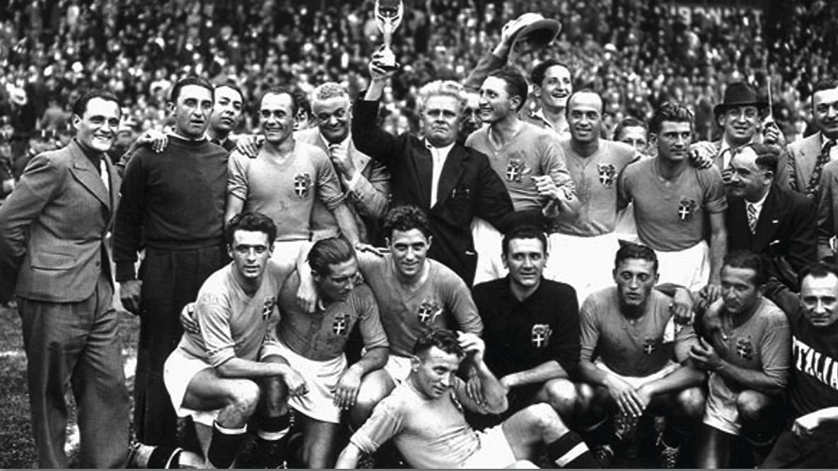
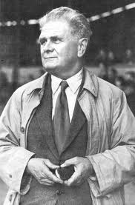
^{Coaching and Building a Team} ^{to Achieve the Vision}
Ensure that team members have the necessary skills and abilities to do their job and achieve the vision
Give / receive feedbacks
Make your people proud to be part of the team
Alberto Pozzo
Italian National Footbal
Team Coach
Notes:
Individual and team development are important activities carried out by transformational leaders. To develop a team, leaders must first understand team dynamics. Several well-established and popular models describe this, such as Belbin's Team Roles approach, and Bruce Tuckman's Forming, Storming, Norming, and Performing theory.
A leader will then ensure that team members have the necessary skills and abilities to do their job and achieve the vision. They do this by giving and receiving
feedback regularly, and by training and coaching people to improve individual and team performance.
Leadership also includes looking for leadership potential in others. By developing leadership skills within your team, you create an environment where you can continue success in the long term. And that's a true measure of great leadership.
Note:
The words "leader" and "leadership" are often used incorrectly to describe people who are actually managing. These individuals may be highly skilled, good at their jobs, and valuable to their organizations – but that just makes them excellent managers, not leaders.
So, be careful how you use the terms, and don't assume that people with "leader" in their job titles, people who describe themselves as "leaders," or even groups called "leadership teams," are actually creating and delivering transformational change.
A particular danger in these situations is that people or organizations that are being managed by such an individual or group think they're being led; but they're not. There may actually be no leadership at all, with no one setting a vision and no one being inspired. This can cause serious problems in the long term.
A great example of team leder psichology comes from Mr. Alberto Pozzo, coach of the Italian National Football team during the 30’ (the only coach who won two world cups)
Legend has it that ahead of the semifinal against Brazil in 1938, Pozzo learned that the Brazilians were so sure of themselves and confident of appearing in the final in Paris that they had requisitioned the only airplane from Marseilles to Paris on the day after the semifinal against Pozzo's Italy. Pozzo went to the Brazilians that sunbathed in Côte d'Azur and asked them to surrender him the aerial bookings in case of Italian victory. The Brazilians apparently arrogantly answered "it is not possible because to Paris we will go, because we will beat you in Marseilles”. They then reportedly offered Pozzo the ironic hospitality of a plane ride to Paris to see them play in the final. Pozzo reported to the Italian team what the Brazilians had told him to rouse the pride of the players. It was the psychological premise for revenge in the match, which Italy went on to win 2–1. Brazilians did not want to sell the tickets to the Italians, who were then forced to reach Paris by train. In the resulting final, Italy duly won their second world title in a 4–2 free-scoring game against Hungary.

Slide 14
Closing takeaways
Leadership is an enabling forces
Leadership involves serving others
Leadership goes beyond management
Delivery of the vision is the final purpose of the leader
Leadership is setting the example

Slide 15
Question time

