Slide 1
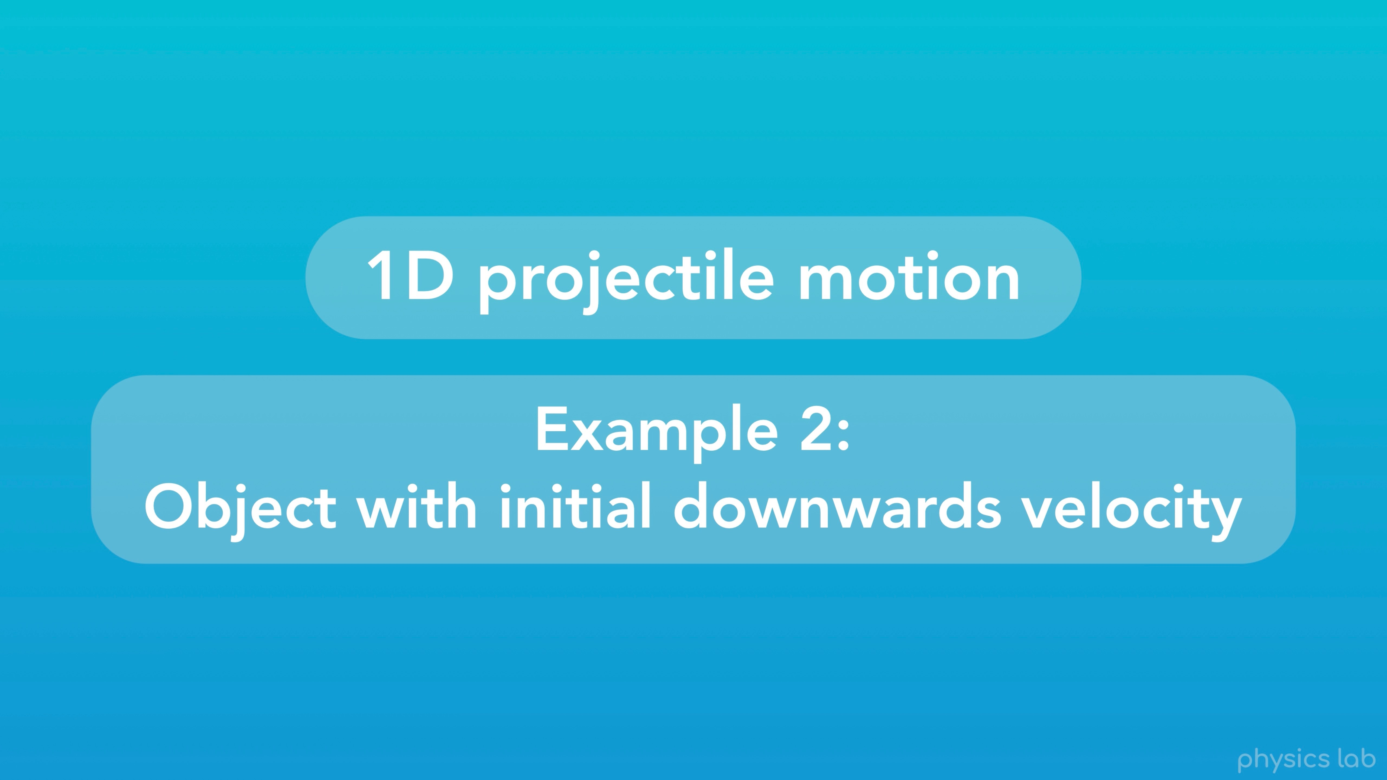
Notes:
The second example is an object with an initial downwards velocity.

Slide 2
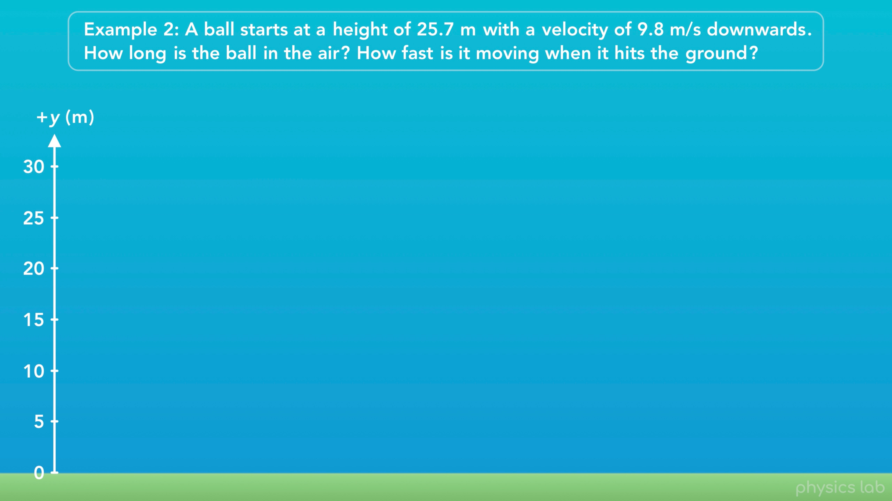
Notes:
“A ball starts at a height of 25.7 m with a velocity of 9.8 m/s downwards. How long is the ball in the air? And how fast is it moving when it hits the ground?”

Slide 3
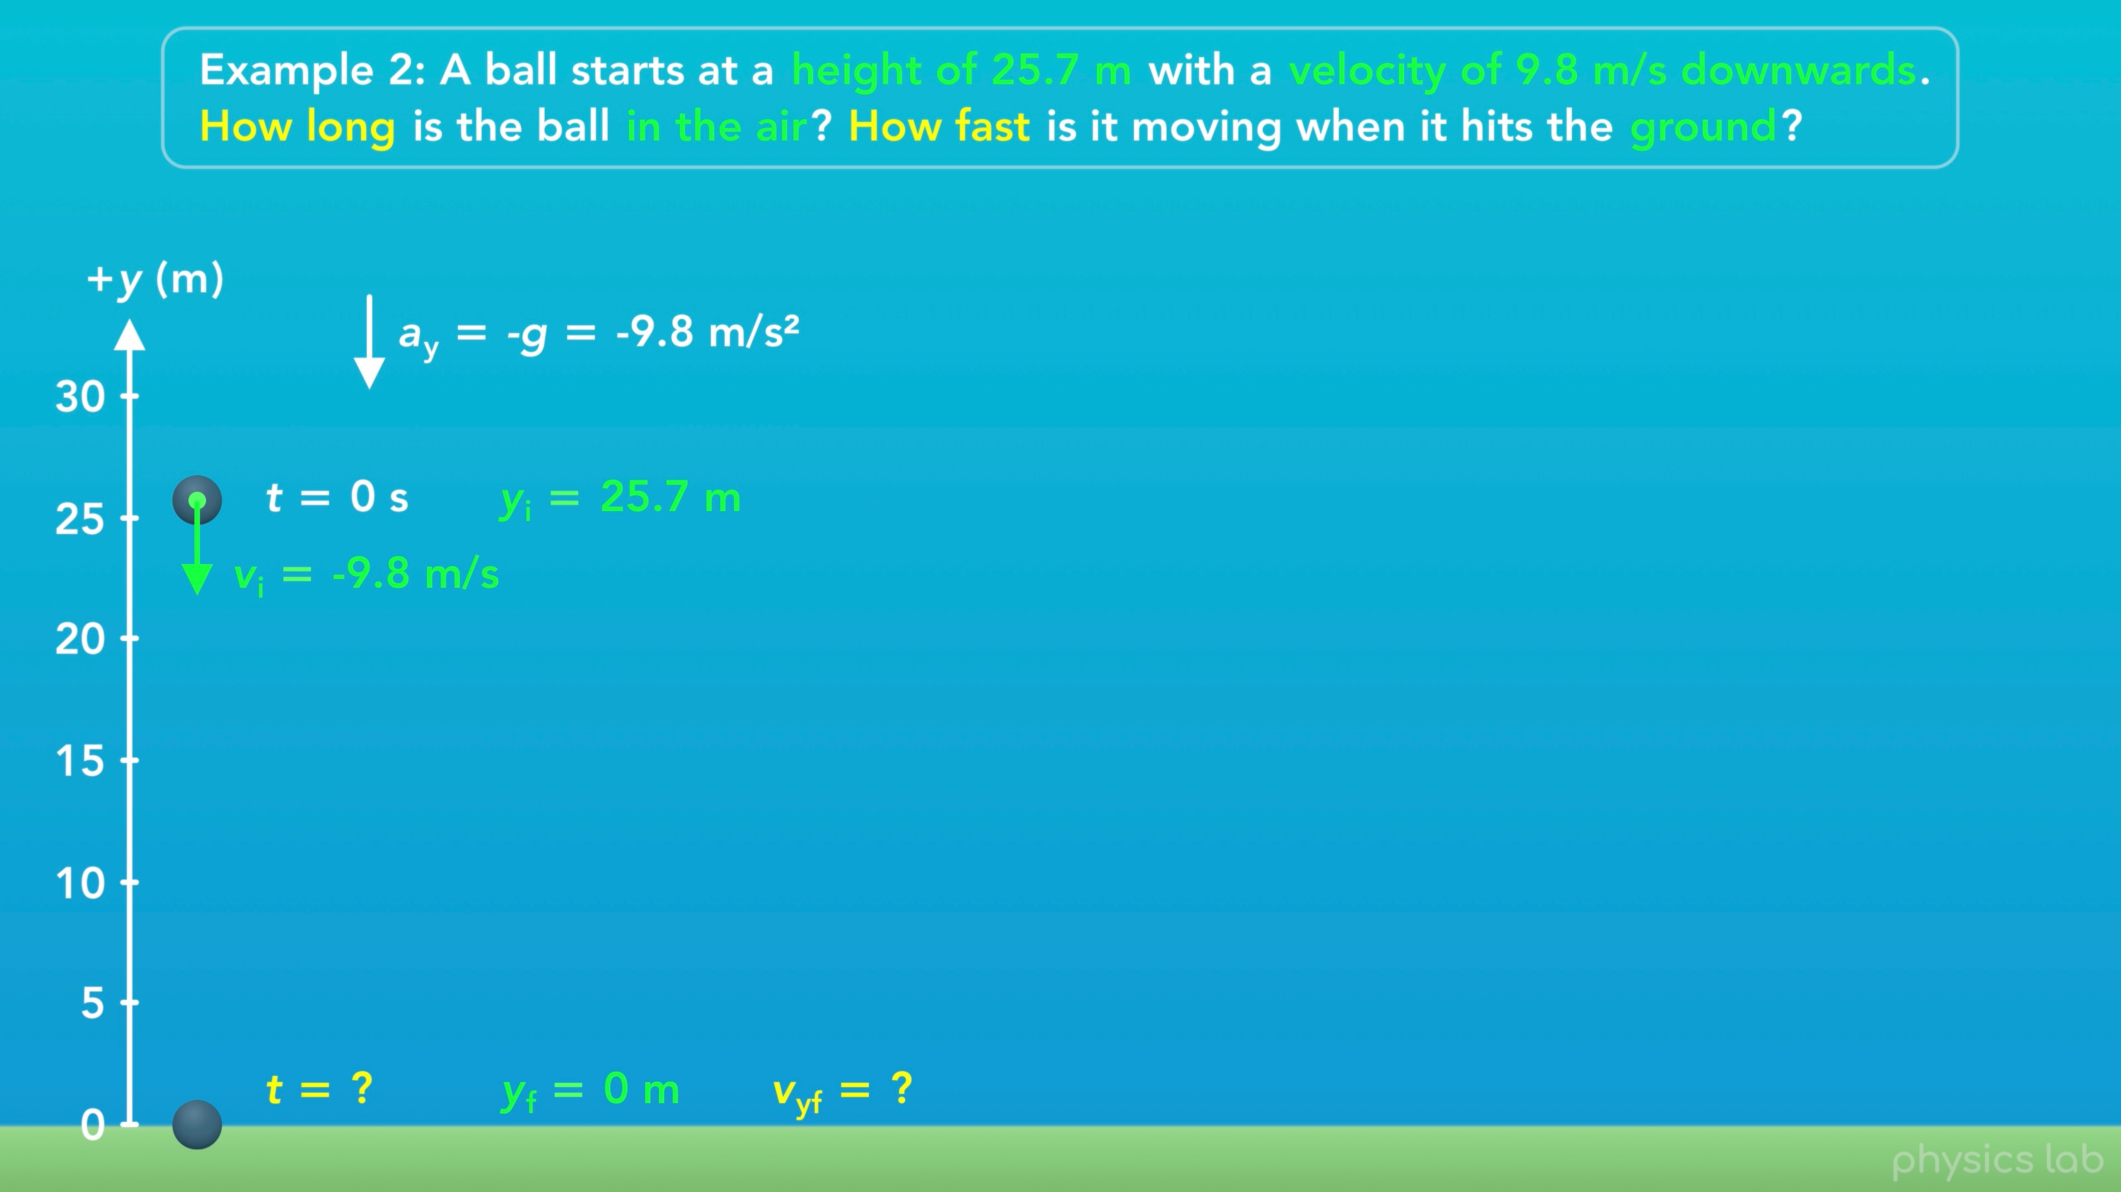
Notes:
So the ball starts at an initial y position of 25.7 m, with an initial y velocity of -9.8 m/s. We know the acceleration is -9.8 m/s^2, which happens to be the same value as the initial velocity, but they’re two different things.
The question says “how long is the ball in the air?” which is another way of asking for the time when the ball hits the ground. Then it says “how fast is it moving when it hits the ground”. This means we’re looking for the final speed, which is the magnitude of the velocity.

Slide 4
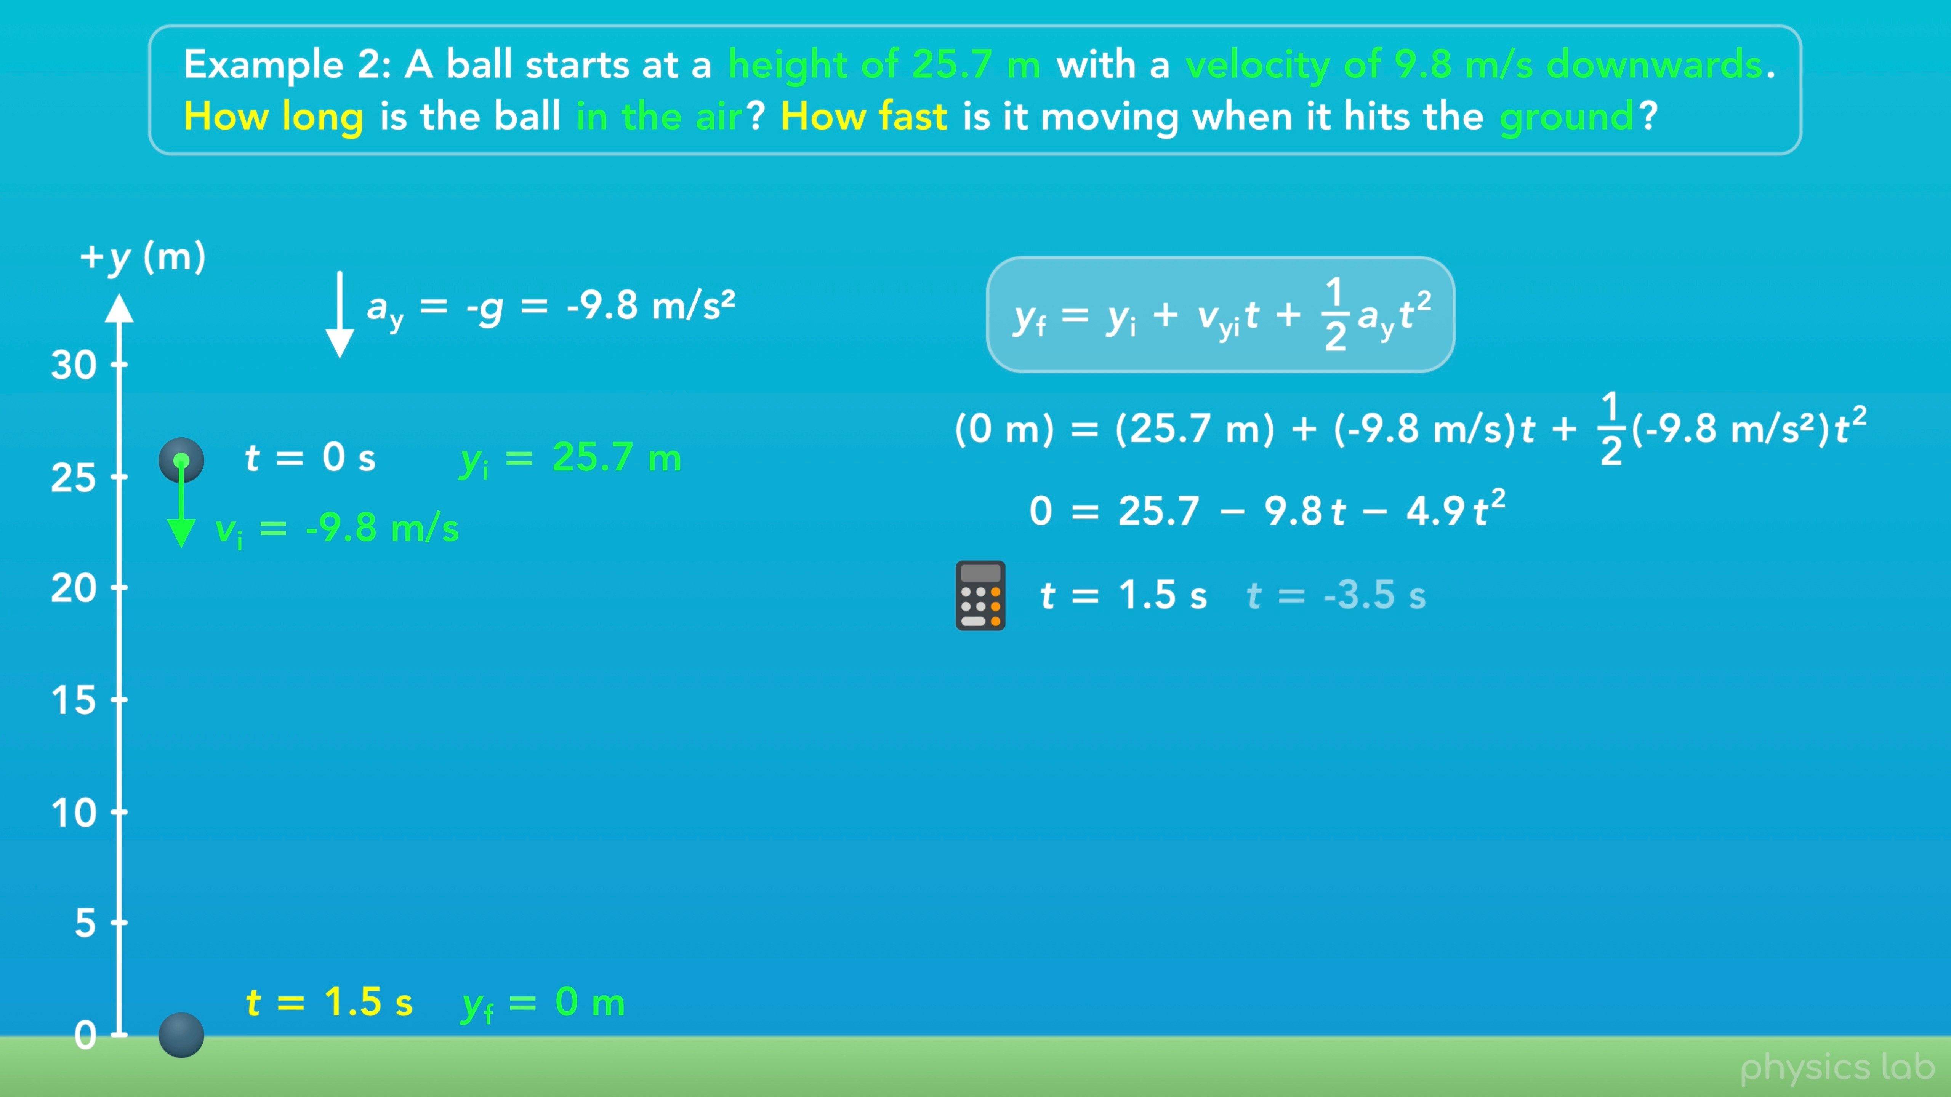
Notes:
So to find the time when the ball hits the ground and the y position is 0 m, we’ll use the same equation as the first example.
We plug in 0 m for the final position, 25.7 m for the initial position, negative 9.8 m/s for the initial velocity, and -9.8 m/s^2 for the acceleration.
When we simplify that, we get this equation. This time, we can’t rearrange this equation to isolate t. If you have a calculator with a solve feature, you can plug in this equation and ask it to solve for t.
If we do that, we get two values for t, positive 1.5 seconds and negative 3.5 seconds.
Since we’re looking for a positive time value, a time later than 0 seconds, then the answer would be positive 1.5 seconds. We’ll explain that more in a second.

Slide 5
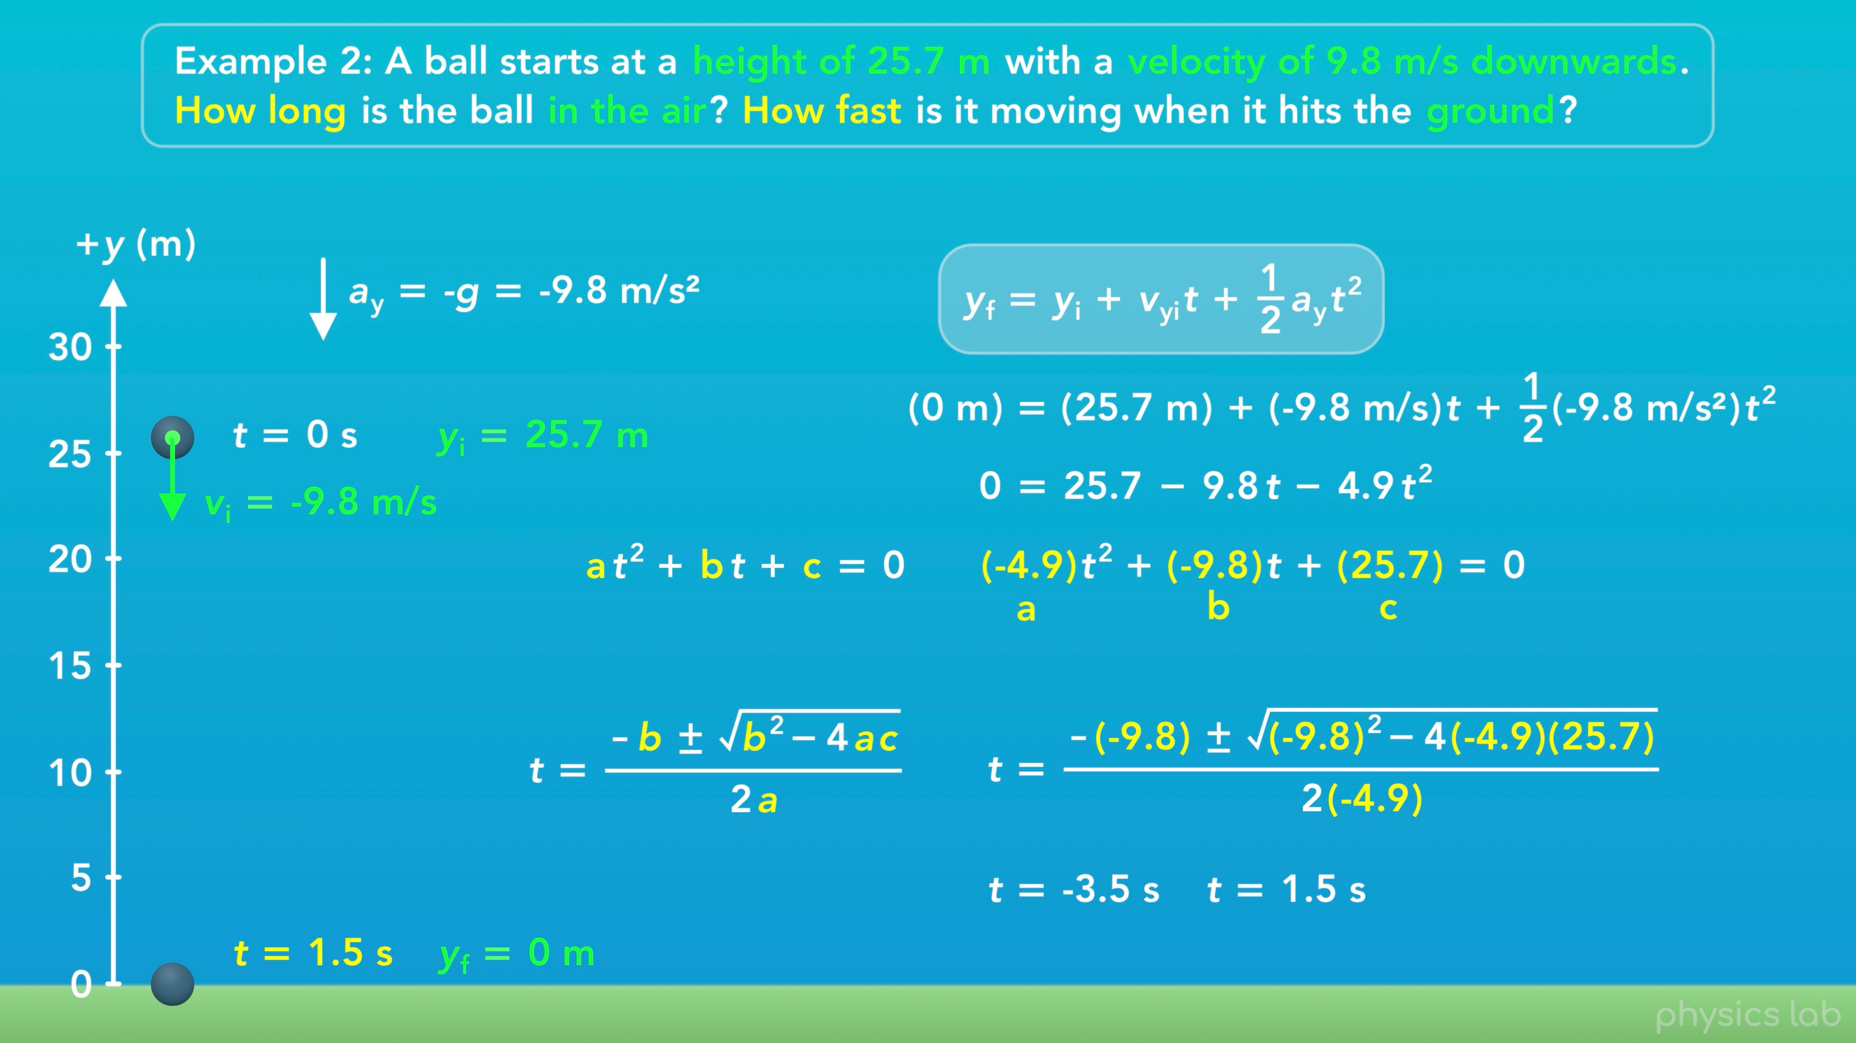
Notes:
If we don’t have a calculator that can solve this, we need to use the quadratic formula, which is covered in the Basics section.
First, we need to rearrange this equation so it’s in this form. a, b and c are the coefficients, and each term is added together.
If we rearrange things in our equation, a is -4.9, b is -9.8, and c is positive 25.7.
Now we can plug those values into the quadratic formula to solve for t. Remember, a is just a coefficient, the value being multiplied by t^2, it’s not the acceleration.
When we calculate this using the plus sign and the minus sign, we get two answers for t. So t = -3.5 seconds or positive 1.5 seconds.
But how can we have two answers for the time when the ball hits the ground, and why is one negative?

Slide 6
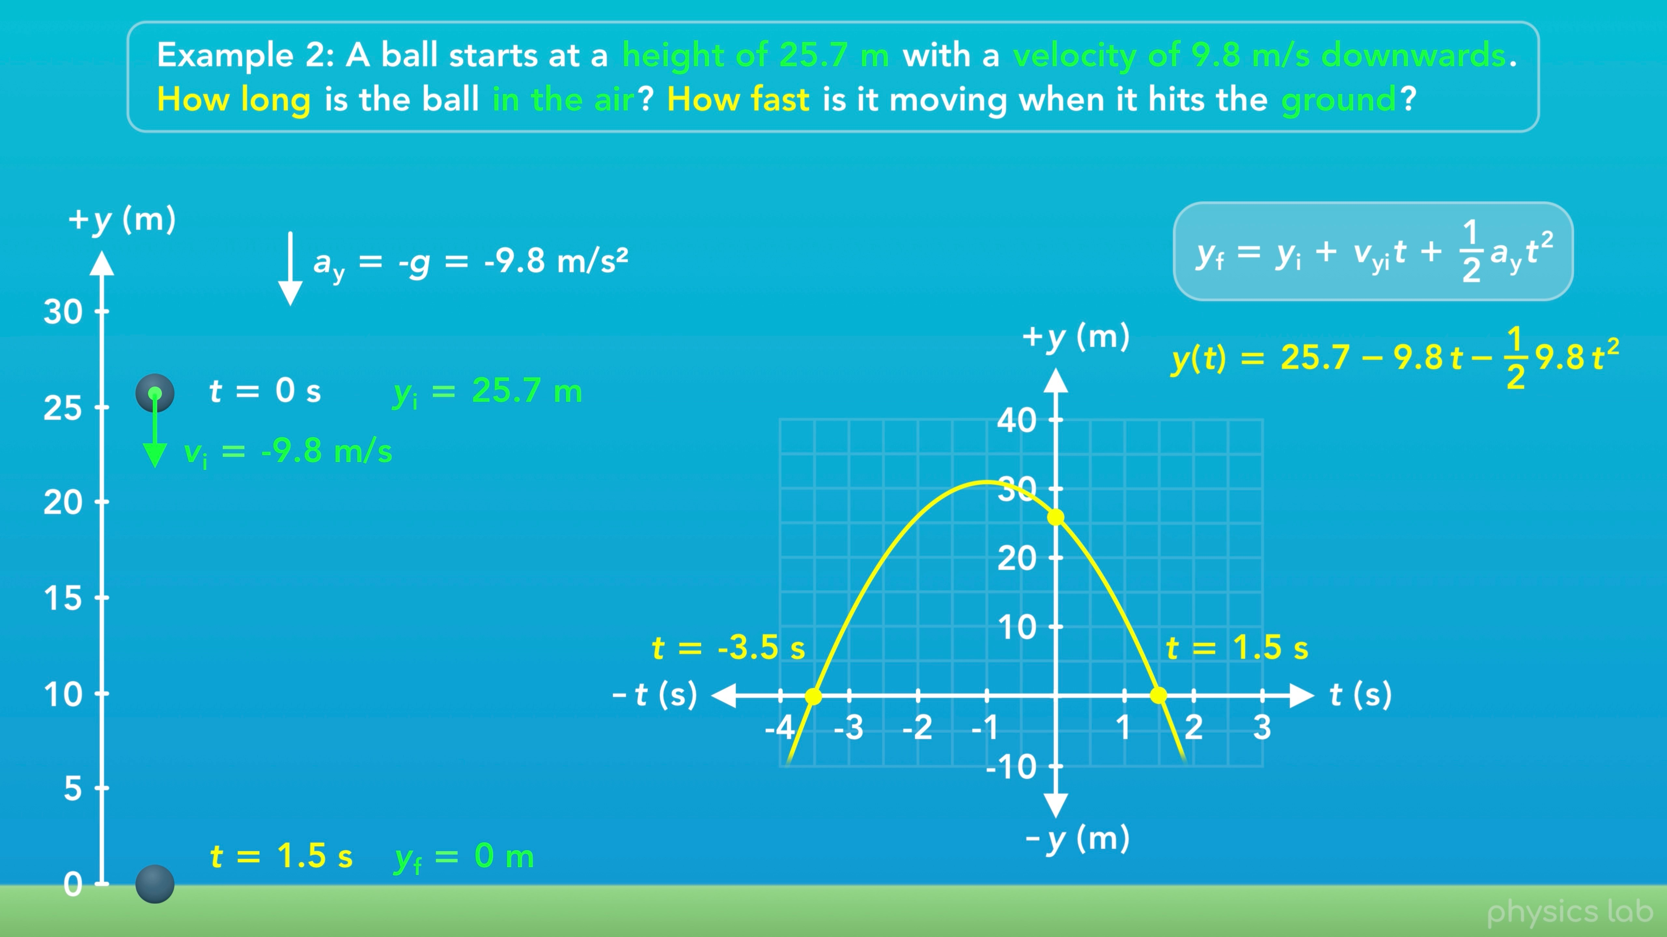
Notes:
Let’s look at a graph of the y position vs time. It starts at 25.7 m, and the y position equals zero at 1.5 seconds.
But this graph, and the projectile motion of the ball, is described using this equation, the kinematic equation for the y position.
This equation and the graph aren’t restricted to positive time values. The graph keeps going in both directions.
We’re looking for the time when y equals zero, which happens at positive 1.5 seconds, and negative 3.5 seconds. The kinematic equation doesn’t know there’s a ball hitting the ground, it’s gonna give us all of the values that satisfy the conditions we give it.
So as a rule of thumb, we’re gonna ignore negative time values and just use the positive value we get from the quadratic formula. But always double check that the values you get make sense in the physical scenario. In this case, the time when the ball hits the ground must be a positive time after 0 seconds, so the answer would be the positive 1.5 seconds.

Slide 7
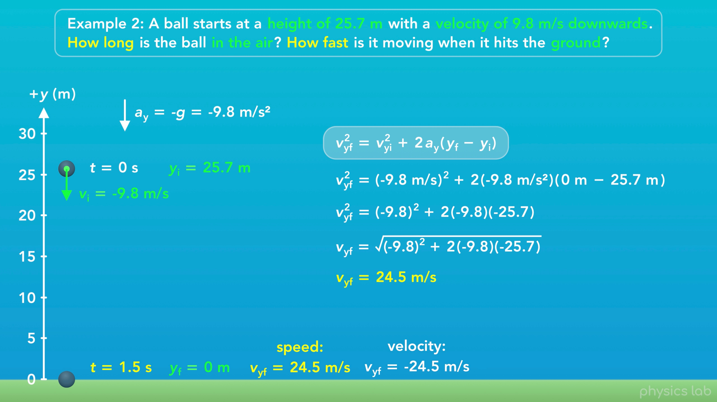
Notes:
Alright, now let’s find the speed of the ball when it hits the ground. We’ll use the same equation that we used in the first example.
We plug in -9.8 m/s for the initial velocity, -9.8 m/s squared for the acceleration, 0 m for the final position when the ball hits the ground, and 25.7 m for the initial position. If we simplify that a little and then take the square root of both sides, we get 24.5 m/s for the final speed of the ball, which is what the question is asking for.
Since the velocity is in the negative y direction, the final velocity would be negative 24.5 m/s.
So that’s the time and the speed when the ball hits the ground.

Slide 8
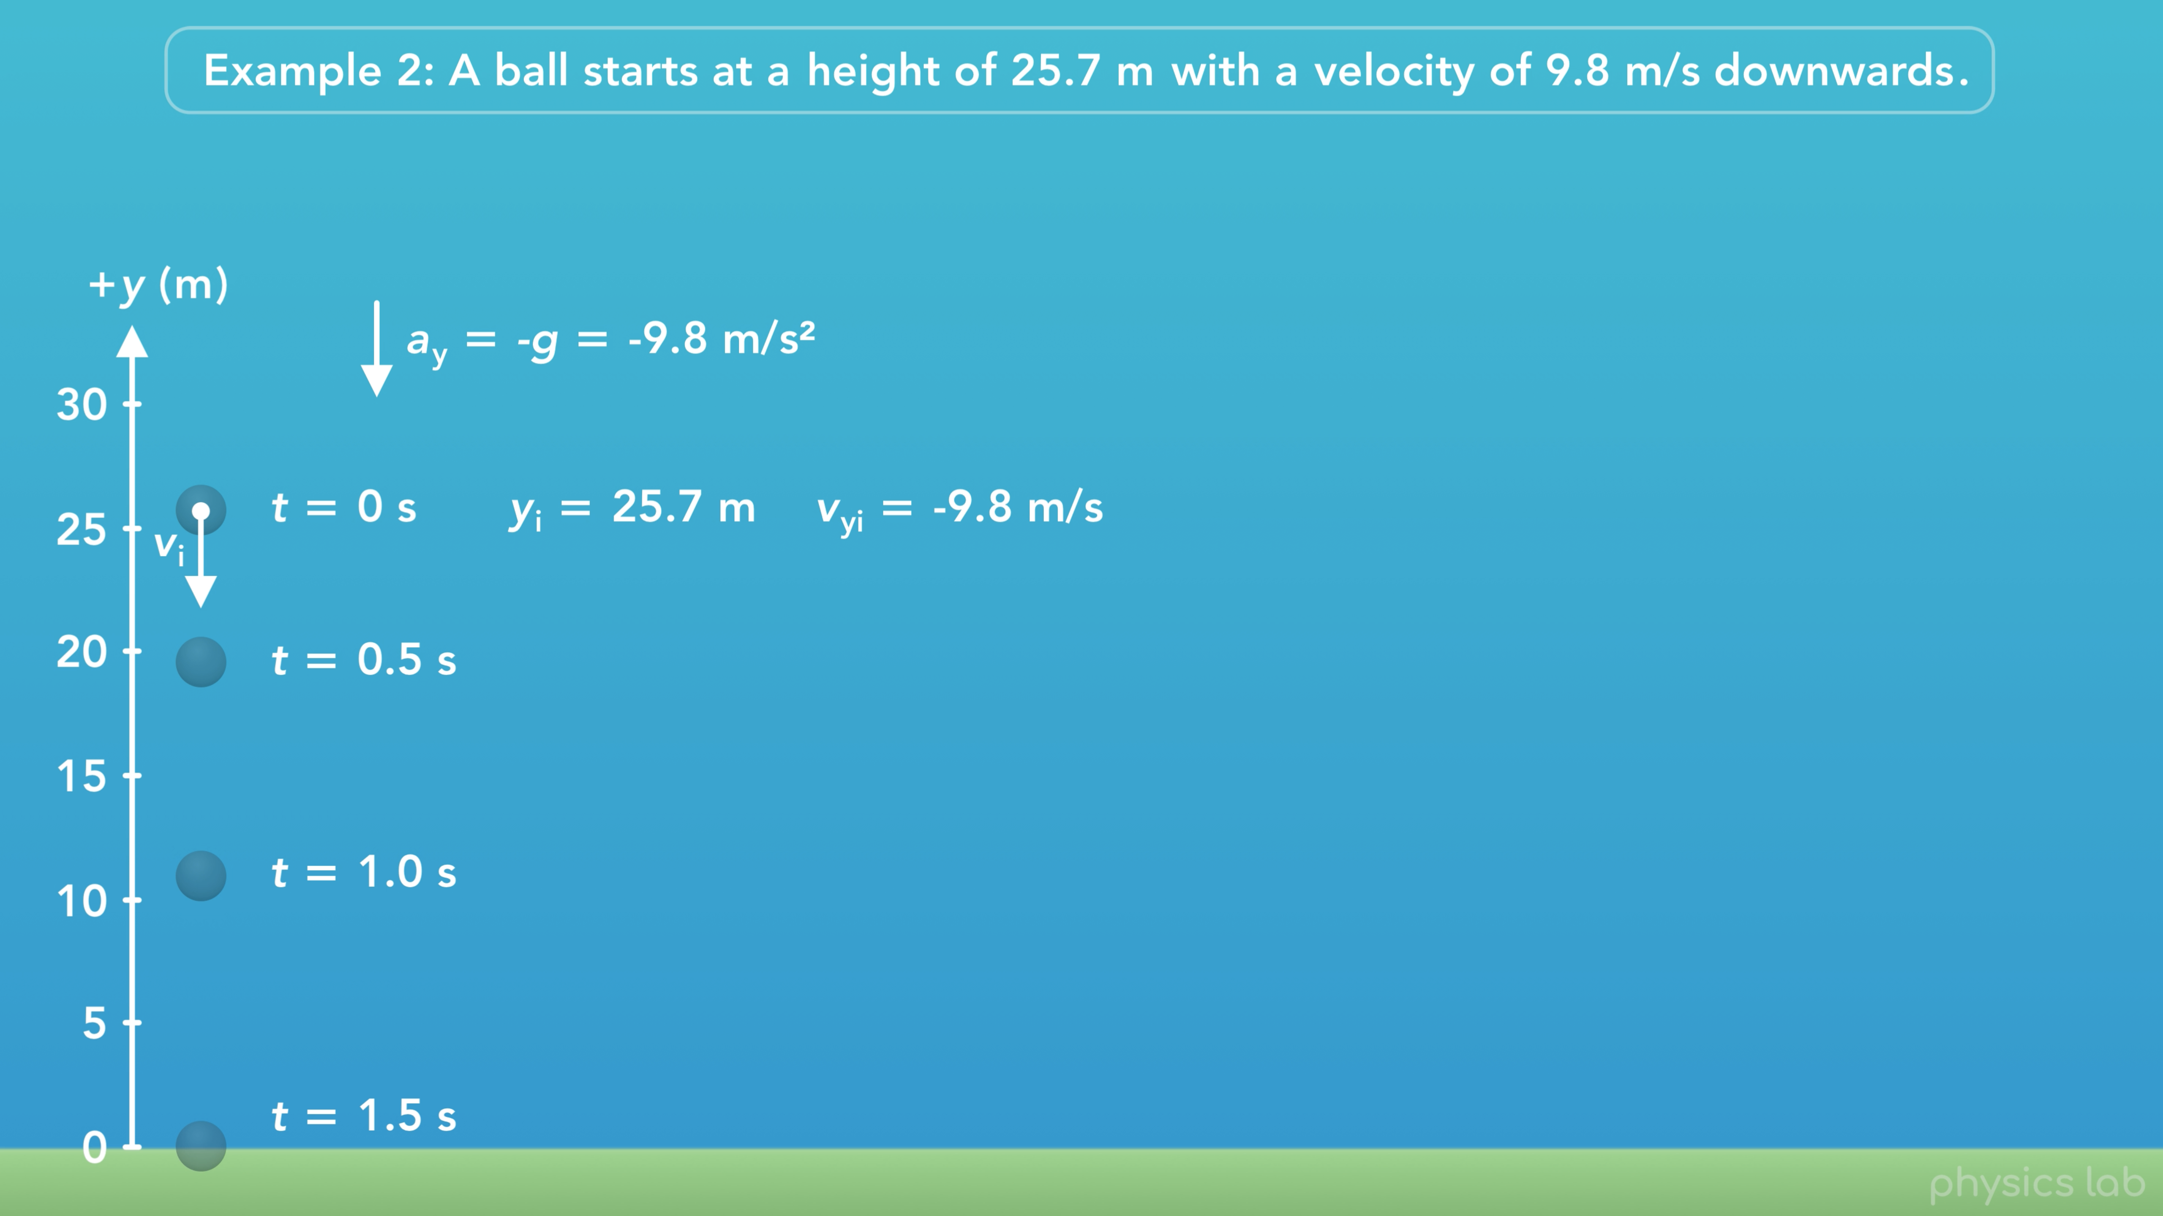
Notes:
Now, let’s explore this motion in more detail.
A ball starts at a height of 25.7 m with an initial velocity of 9.8 m/s downwards.
And here’s a snapshot of the ball at half second intervals.
Like the last example, the ball falls a greater distance during each time interval because it’s accelerating. But this time, the ball starts with some velocity so it moves further in the first interval compared to when it was dropped from rest.

Slide 9
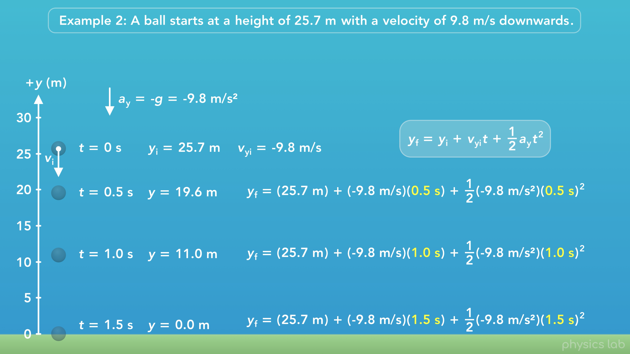
Notes:
We can find the y position at each timepoint using the same equation as before. But this time, we have a value for the initial velocity, -9.8 m/s.
At 0.5 seconds, the y position is 19.6 m.
At 1 second, it’s 11.0 m.
And at 1.5 seconds, it’s 0 m which is when the ball hits the ground.

Slide 10
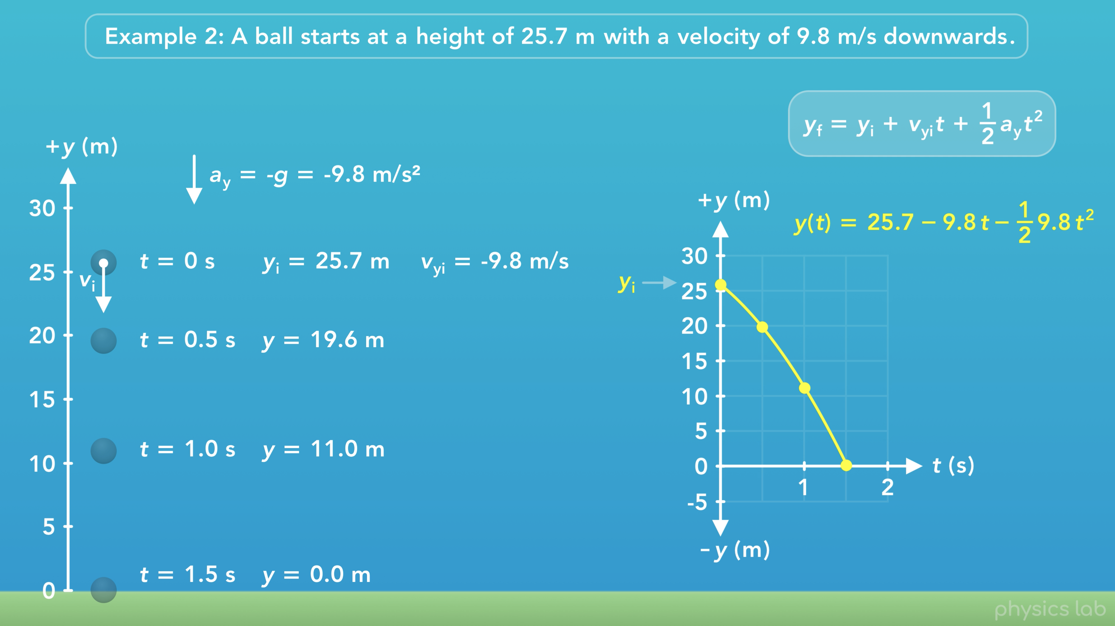
Notes:
Here’s what position vs time graph looks like for this motion. The y position starts at 25.7 m and it reaches 0 m at 1.5 seconds, when the ball hits the ground.
It’s harder to see but this position graph is still a curved line because the ball is accelerating.

Slide 11
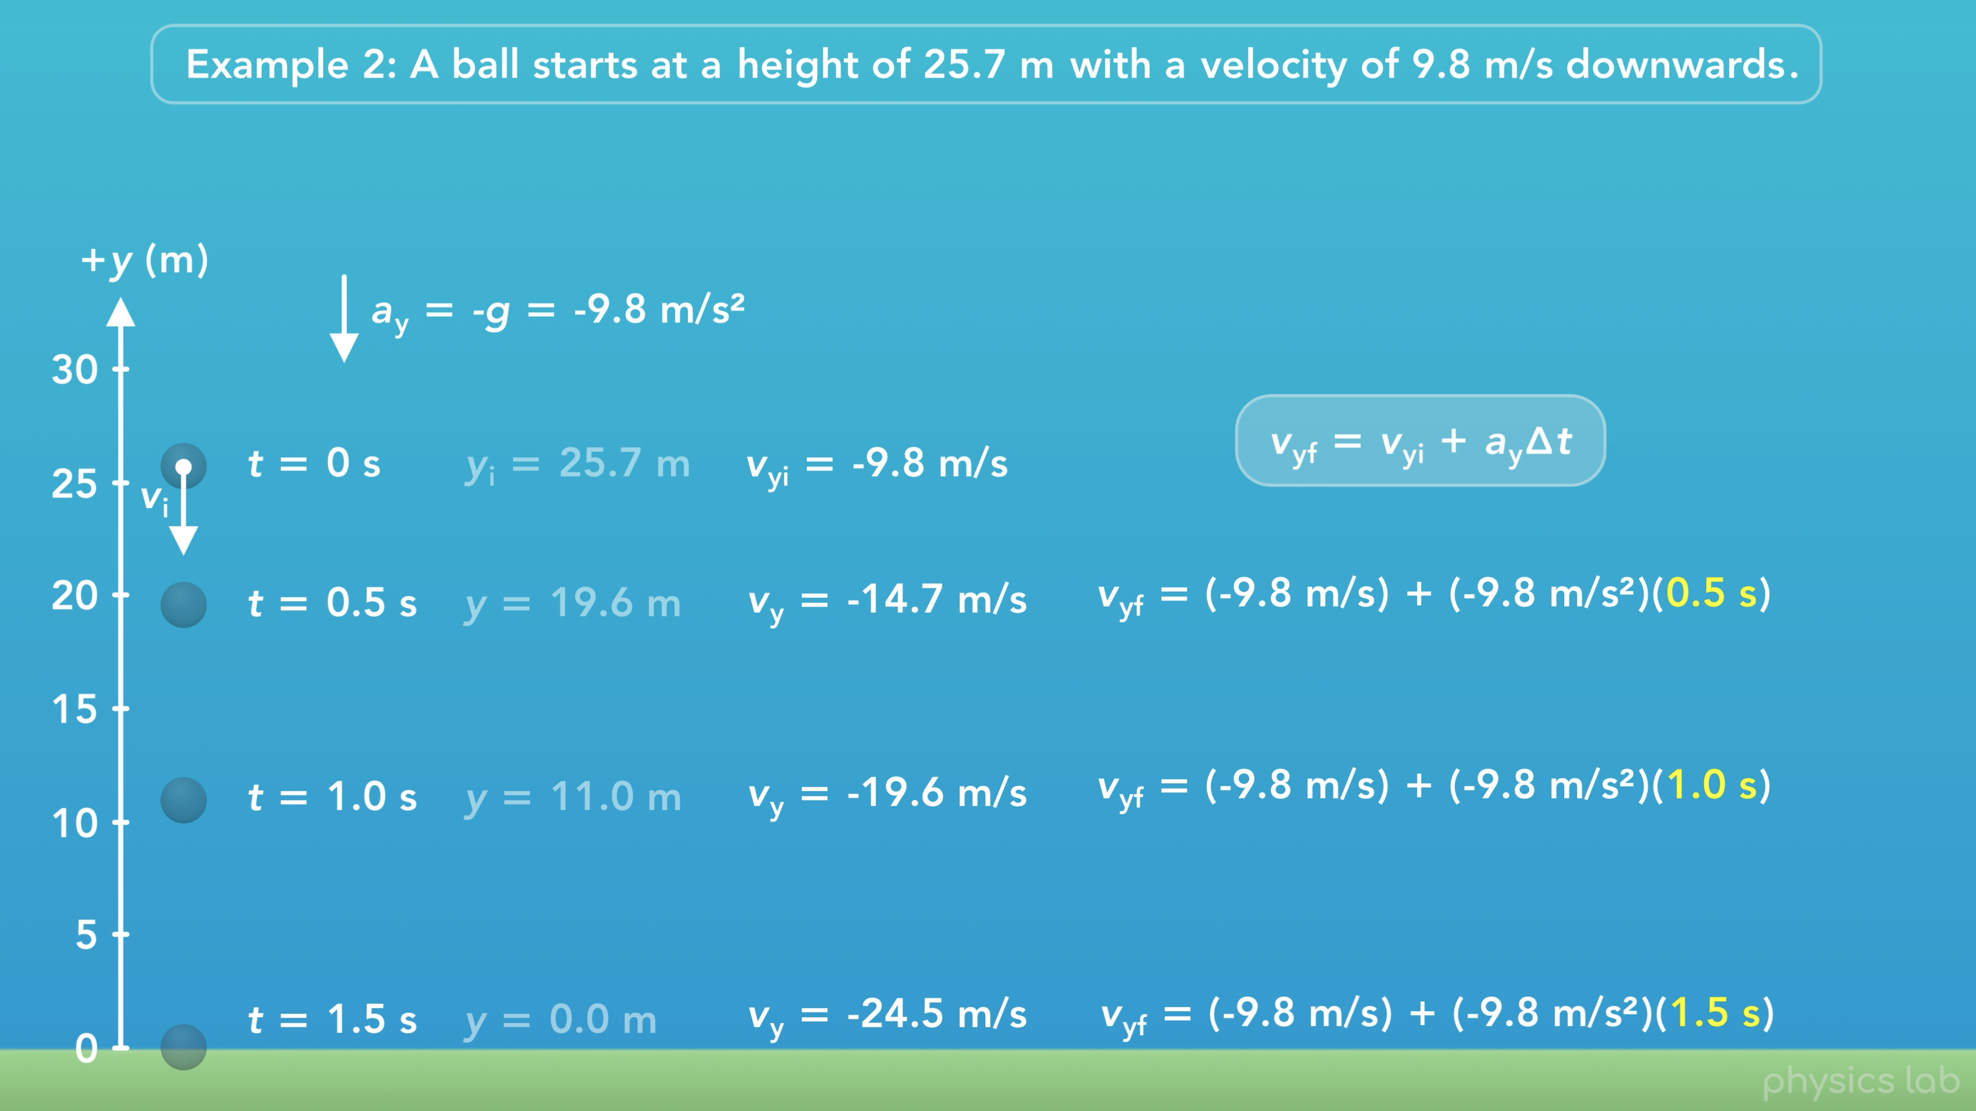
Notes:
Now let’s find the velocity at each timepoint using this equation.
We plug in -9.8 m/s for the initial velocity, -9.8 m/s squared for the acceleration, and we plug in each time value.

Slide 12
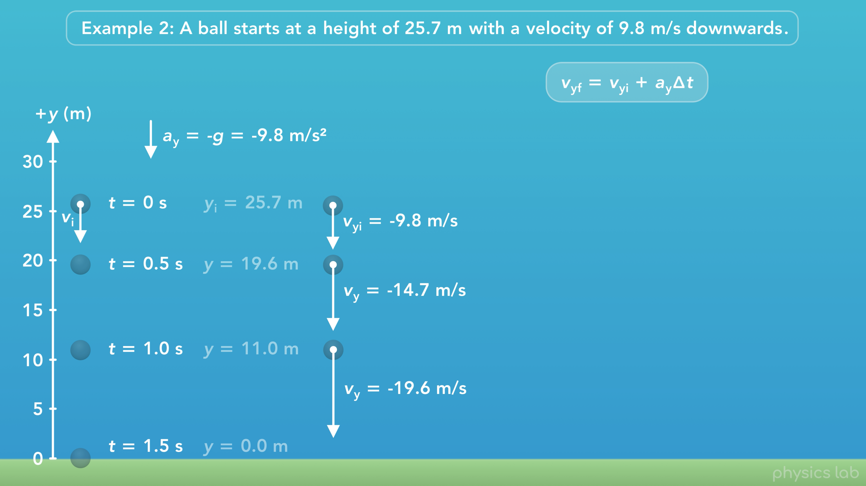
Notes:
Here’s what the ball’s velocity vector looks like at the first three timepoints. The ball starts with a negative velocity and it accelerates downwards so it speeds up and the length of the vector increases.

Slide 13
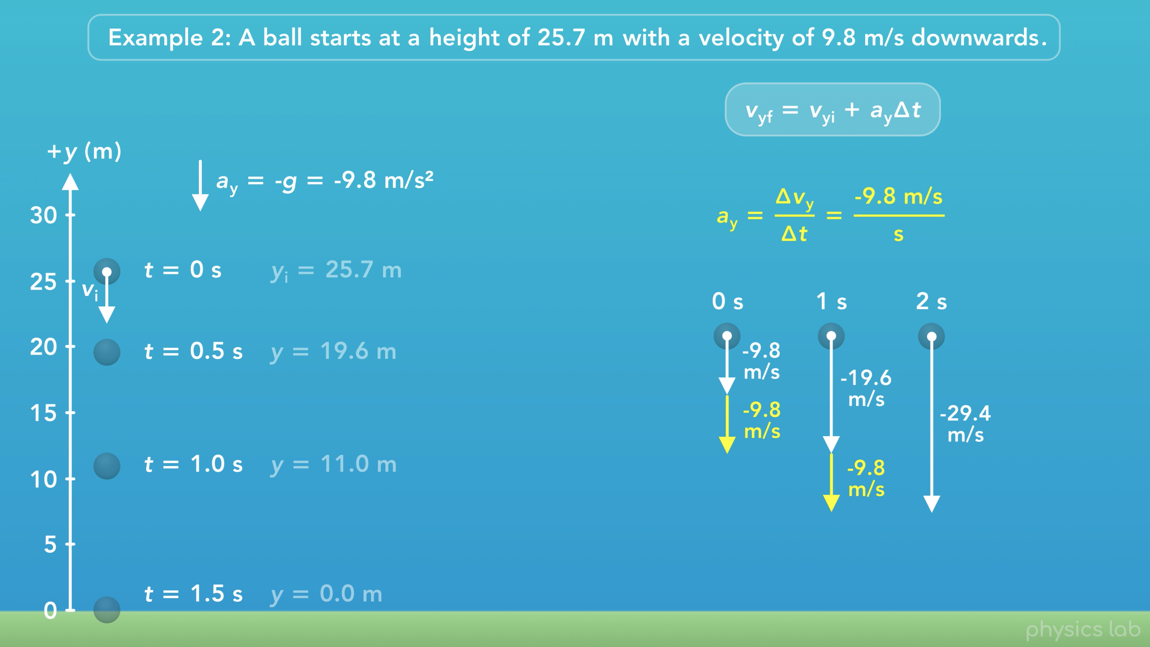
Notes:
Just like in the first example, the velocity at each second is the previous velocity plus the change in velocity due to the acceleration. It doesn’t matter what the ball’s initial velocity is, it always changes by -9.8 m/s, every second.

Slide 14
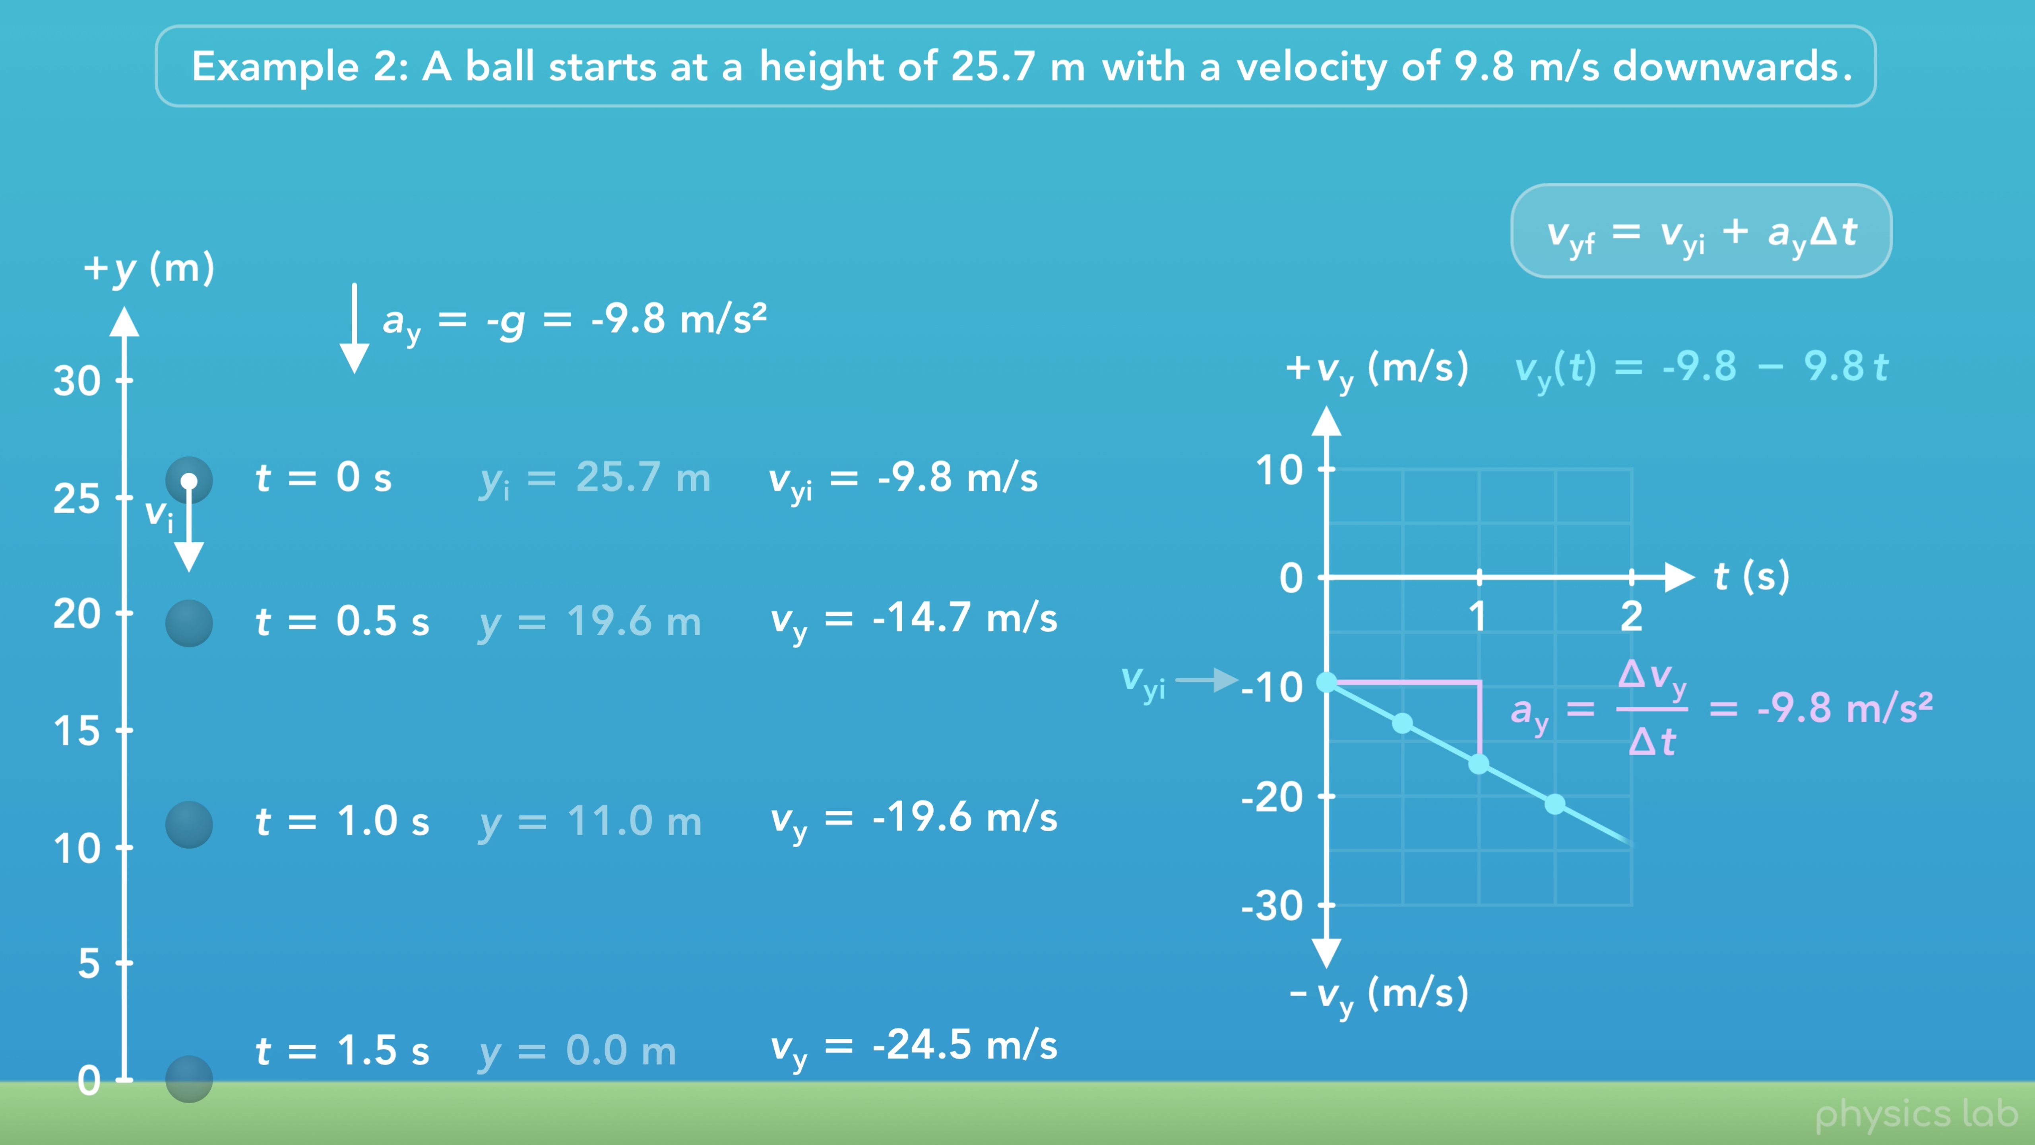
Notes:
And here’s the velocity vs time graph for this motion.
Now, the velocity starts at -9.8 m/s, but the slope of the velocity graph is still the acceleration. So just like before, it changes by -9.8 m/s every second.

Slide 15
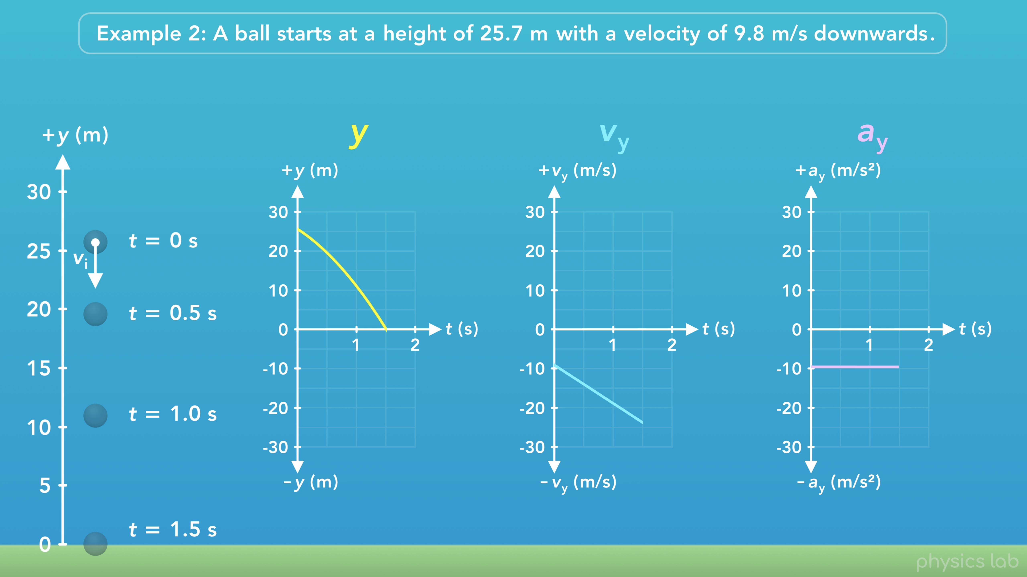
Notes:
Here’s all 3 graphs for this motion.
Remember, the slope of the position curve is the velocity.
Since the ball starts with a negative velocity, the position curve starts with a negative slope.
So that’s what the projectile motion looks like for an object that starts at some height with an initial downwards velocity.

