Slide 1
CASE STUDY | The Good Kitchen
What is?

Slide 2
Outside of the for-profit sector, other organizations were
bringing design thinking to address social issues: In Denmark, The Good Kitchen transformed meal delivery service for the elderly using a comprehensive design thinking process from end to end

Slide 3
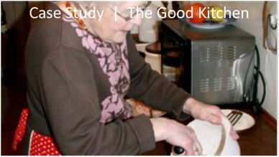
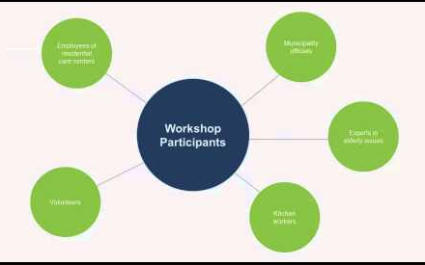

Slide 4
THE SOCIAL PROBLEM
Improving the nutrition of the elderly
THE CONTEXT
A program in Denmark’s Municipality of Holstebro for delivering subsidized meals
DESIGN’S CONTRIBUTION
Using the tools of design thinking to develop deep insights into both customers and employees to reframe the possibilities for improving the nutrition and health of the elderly by creating a more appealing meal service

Slide 5
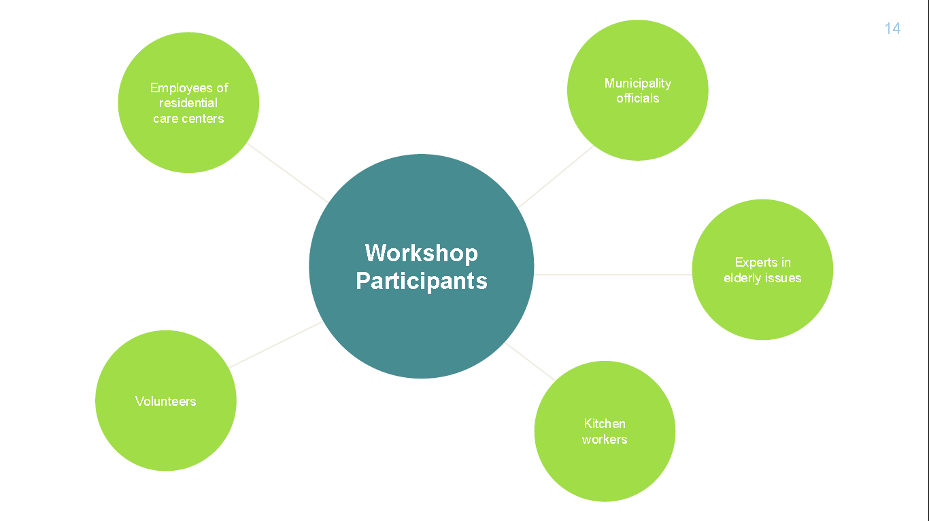
Once team members had finished their ethnographic research, they enlisted a broader group of stakeholders in understanding the nature of the challenges and participating in creating solutions. The goal was to solicit a wide range of ideas for developing a new and better meal service. To accomplish this they held a series of three workshops.

Slide 6
- How do Trigger Questions work? And what are its advantages?
- How will you use them in your project? Discuss in team

Slide 10
- What was the aim of the third workshop?
- What were the prototypes that got generated?
- Why were even the minutest of the details asked to the participants?

Slide 12
Prototyping Design Tool
Make it tangible and concrete. Draw a picture, tell a story, take a photo, make a map..

Slide 15
“If you have professional pride, you’ll also cook good food. Good food has to come from the heart!”
Anne Marie Nielsen, Director of The Good Kitchen

Slide 16
Make your inferences keeping in mind each stage of Design Thinking as
Observation: Study of AS IS
Empathy: Deeper Insights
Problem/challenge
Idea generation
Prototyping
Testing

