Slide 1
SPONSORED BY
JUNE 24
CANOPY BY HILTON
WEST PALM BEACH, FL
#BusDev2022

Slide 2
How do you feel about Sales Psychology?
Psychology as Your Strategic Sales Advantage
Presented By:
Anita Nielsen - President, LDK Advisory Services
#BusDev2022
SPONSORED BY

Slide 3
A bit about me
Author, Sales Performance Coach & Consultant
(aka: The Sales Sensei)
20+ Years in B2B IT Sales & Sales Enablement
BA-Psychology w/Honors @ U of I
MBA w/Distinction @ NYIT
Sales Coach - Entrepreneurial Sales @ Harvard Business School
SFDC Top Sales Influencer 2022
Mom of TWO Teenagers
SPONSORED BY
#BusDev2022

Slide 4
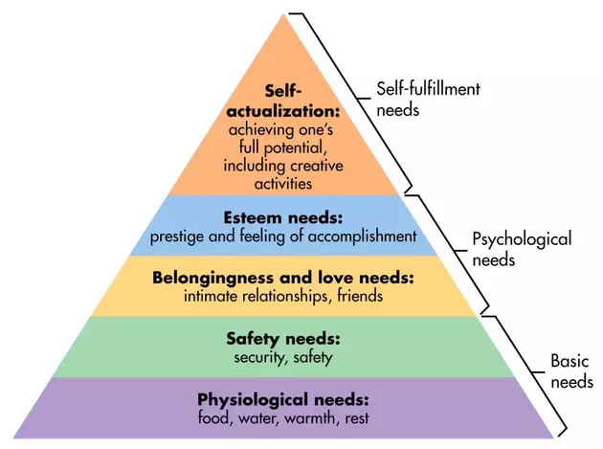
Who knows?
Abraham Maslow’s
Hierarchy of Needs
Who can tell me what this is?
SPONSORED BY
#BusDev2022
Notes:
theory of psychology explaining human motivation based on the pursuit of different levels of needs. Humans are motivated to fulfill their needs in a hierarchical order. most basic needs before moving on to more advanced needs

Slide 5
Buyers’ Needs
As modern sales professionals, our world revolves around our buyers’ needs.*
*IT BETTER!
SPONSORED BY
#BusDev2022

Slide 6
Buyers’ Needs
We learn, understand, and validate their needs using powerful discovery questions.
SPONSORED BY
#BusDev2022

Slide 7
Buyers’ Needs
When we show them how we (our product) can address their needs, the buyer sees VALUE.
SPONSORED BY
#BusDev2022

Slide 8
Buyers’ Needs
Perceived value MOTIVATES the buyer to make a decision in your favor.
SPONSORED BY
#BusDev2022

Slide 9
Buyers’ Needs
Hmm...maybe there should be a hierarchy of buyer needs that could help us motivate buyers to decide in our favor!?
SPONSORED BY
#BusDev2022

Slide 10
TADAH!
Unique
Personal
The Buyerarchy of Needs
BUYER-SELLER TRUST
Differentiated
Emotional
Table Stakes
Operational
SPONSORED BY
#BusDev2022

Slide 11
Address Needs
Unique
Buyers’ needs typically fall into 3 areas.
You have to uncover them.
Personal
Elite Sales Pros deliver value at these three levels.
When you meet needs, you create value.
BUYER-SELLER TRUST
Differentiated
Emotional
Table Stakes
Operational
SPONSORED BY
#BusDev2022

Slide 12
Operational Needs
Faster
Cheaper
Unique
Increase Productivity
Improve Quality
Personal
Simpler
Easier
BUYER-SELLER TRUST
Think Business Related:
For the Company
Differentiating
Emotional
Faster
Easier
Increase Productivity
Table Stakes
Operational
Simpler
Efficient
Cheaper
Improve Quality

Slide 13
Emotional Needs
Feelings to Eliminate
Feelings to Achieve
Frustrated
Overwhelmed
Appreciated
Energized
Proud
Envious
Vulnerable
Respected
Unique
Rejected
Valued
Understood
Apprehensive
Fulfilled
Insecure
Afraid
Safe
Personal
BUYER-SELLER TRUST
Feelings to Achieve
Feelings to Eliminate
Appreciated
Energized
Frustrated
Overwhelmed
Differentiating
Emotional
Proud
Respected
Envious
Vulnerable
Valued
Understood
Rejected
Apprehensive
Fulfilled
Safe
Afraid
Insecure
Think WORK Related:
In their role
Table Stakes
Operational
Notes:
Think of your last big win – what feelings did you help them achieve? What feelings did you eliminate or prevent?

Slide 14
Think about the HUMAN:
Related to the unique individual’s own life.
Purpose
LIVELIHOOD
Career Prospects
Unique
Self-Respect
Achieving Potential
Self-Confidence
Personal
Legacy
Growth & Development
Quality of Life
BUYER-SELLER TRUST
Purpose
Career Prospects
Differentiating
Legacy
Self-Respect
Emotional
Growth & Development
Quality of Life
Achieving Potential
Self-Confidence
LIVELIHOOD
Table Stakes
Operational

Slide 15
Mother didn’t force them to brush their teeth.
Now, it’s an obsession.
Unique
Personal
BUYER-SELLER TRUST
No more dealing with kids not brushing their teeth. AI coaching.
Differentiated
Emotional
Electric toothbrush. Faster, simpler, cleaner, app.
Table Stakes
Operational
Notes:
55

Slide 16
No more calls on weekends. Enjoy kids’ sports and family time. Quality of life.
Unique
Personal
BUYER-SELLER TRUST
Afraid of making the wrong decision. Need to gain respect.
Differentiated
Emotional
Outsourced Datacenter.
Better, faster, and no maintenance.
Table Stakes
Operational
Notes:
55

Slide 17
Think about a deal you lost. One that really hurt.
Exercise
How well did you truly understand that buyer’s operational, emotional, and personal needs?
SPONSORED BY

Slide 18
Make it Real
The Buyerarchy of Needs guides the development of Discovery Questions to uncover specific buyer needs at each level.
Once you uncover the need, you have to articulate how your product will address that need.
SPONSORED BY
#BusDev2022

Slide 19
Make it Real
Today we will focus on creating discovery questions to help you uncover each level of needs.
SPONSORED BY
#BusDev2022

Slide 20
Let’s pretend…
I am a B2B sales professional, and I sell a SaaS sales enablement platform.
I am preparing for my second discovery call with an SVP of sales (primary buyer persona).
SPONSORED BY
#BusDev2022

Slide 21
Operational
I need to ask a powerful discovery question that will help me uncover the OPERATIONAL needs of the buyer.
*What metrics are you hoping will improve by implementing a sales enablement tool?
Why?
SPONSORED BY
#BusDev2022

Slide 22
Emotional
I need to ask a powerful discovery question that will help me uncover the EMOTIONAL needs of the buyer.
*What concerns do you have about implementing something new for such a tenured sales team?
Why?
SPONSORED BY
#BusDev2022

Slide 23
Personal
I need to ask a powerful discovery question that will help me uncover the PERSONAL needs of the buyer.
*What opportunities do you have to grow your knowledge and improve your skillset?
Why?
SPONSORED BY
#BusDev2022

Slide 24
Think about an early-stage deal you’re working on…
Exercise
Create ONE discovery question for each tier in the Buyerarchy of Needs:
1. Operational
2. Emotional
3. Personal
SPONSORED BY

Slide 25
Let’s hear ‘em!
CANOPY BY HILTON | WEST PALM BEACH, FL
SPONSORED BY

Slide 26
QUESTIONS?
CANOPY BY HILTON | WEST PALM BEACH, FL
SPONSORED BY

Slide 27
Let’s Connect!
Connect with me on LinkedIn.
Let me know you joined the session and I’ll get you access to my e-book of Discovery Questions
https://www.linkedin.com/in/anitanielsen/
anielsen@LDKAdvisory.com
@anielsenLDK
www.LDKAdvisory.com

