Slide 1
Subject: English
Lesson/Topic :
sound a
Words that start with sound a

Slide 2
Sound
a

Slide 3
Sound a, repeat after teacher

Slide 4
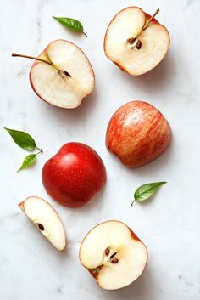
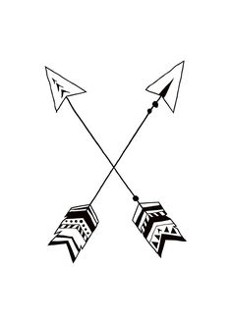
Sound a
ant
apple
arrow

Slide 5
Writing sound a

Slide 6
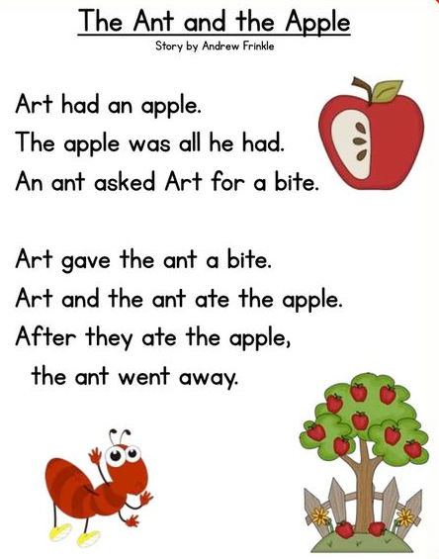
Read with teacher!

Slide 7
Reading words with sound “a”.
Repeat and spell
Repeat and spell
bag cat
bat hat
cap car
cash can
cab ant
angle arrow
ashes axel
away apple
Travel around
again alive

Slide 8
Worksheet
Write sound “a ” on your English notebook and let teacher check it..☺

