Slide 1
Cash Out On Cannabis
Session 2

Slide 2
This week is designed to teach you basic value investing. Value Investing is a strategy used by the most successful Investors such as Warren Buffet and Peter Lynch. In essence it is buying strong company stocks at a discounted price. So let’s get started:

Slide 3
VS
Value Stocks- are shares of a company with solid fundamentals that are priced below those of its peer.
Growth Stocks- are a company stock that tends to increase in capital value rather than yield high income.

Slide 4
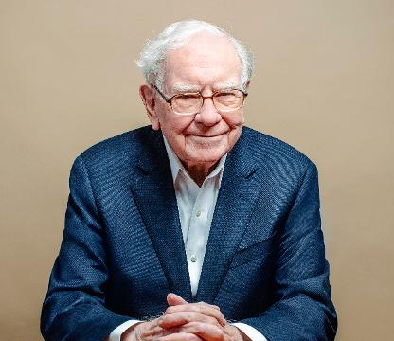
Cost is what you pay, value is what you get
~Warren Buffet

Slide 5
Profitability
Financial Healthy
Quality Of Management
Economic Moats
Stock Valuations
Learning the Intrinsic (True) Value of a stock.

Slide 6
Learning the Intrinsic (True) Value of a stock.
S- Seed To Sale
E- Executive Team
E-Expansion
D-Distribution

Slide 7
We are not gambling
This Photo by Unknown Author is licensed under CC BY-ND

Slide 8
Valuation Ratio
Price/Earning Ratio
Price/ Book Ratio
Price/Cash Flow Ratio
Price/Sale Ratio

Slide 9
Residual Income Formula
Intrinsic Value- is the Total Shareholder’s Equity
Market Value- is the number of outstanding shares multiplied by the current share price
Intrinsic Value > Market Value then the stock is undervalue and ready to buy.

Slide 10
Canopy Growth Stocks
Let’s Put Up The Financial Statements on Yahoo Finance
Intrinsic Value Shareholder’s Equity- 123, 785M
Market Value- 343.58M (Outstanding Shares) x 62.38 (Current Stock price= 21,432.5204M
Therefore the Intrinsic Value or True of 123,785M is less that the Market Value of 21,432.520M12
123,785<21,432.520 the stock is overvalued.

Slide 11
Remember We Buy Stocks The Are On Sale!!!
Buy Low
Sell High

Slide 12
See You In The Next Session

