Slide 1
DBH VIRTUAL PROVIDER TRAINING​
Introduction to HIPAA Compliance, Legal Aspects, and Ethical Considerations
Presenter: Andrea Piazza, Director of Virtual Programming​

Slide 2
Content Synopsis
OVERVIEW OF KEY IDEAS
Federal and state Specific Policies
State laws, rules, and regulations
Licensing, credentialing, and privileging
Licensure compacts
Credentialing
Malpractice & consequences
Privacy, security and confidentiality
Telehealth ethics
Continuity of care
Pertinent health emergencies
DBH documents and resources

Slide 3
Overview
OVERVIEW OF KEY IDEAS
Welcome to Discovery Behavioral Health’s Introduction to HIPAA Compliance, Legal Aspects, and Ethical Considerations training. With the expansion and enhancement efforts of telehealth, including DBH's virtual programming its imperative we understand and maintain regulatory compliance, manage risks, and implement ethical high quality care. It's our duty to mitigate liability and work towards aspirational telehealth.

Slide 4
Learning Objectives
FEDERAL AND STATE SPECIFIC POLICIES
LICENSING AND RELATED INFORMATION
CREDENTIALING
MALPRACTICE AND CONSEQUENCES
PRIVACY SECURITY, CONFIDENTIALITY, & CONSENT
PUBLIC HEALTH EMERGENCIES
EXCEPTIONS TO REGULATIONS
DBH DOCUMENTS AND RESOURCES

Slide 5
What are the federal and state laws on telehealth?
What are the licensure requirments specific to virtual?
5 Questions You Will be Able to Answer
How do I maintain privacy and security will conducting telehealth
What are the ethical considerations I need to keep in mind?
What are the DBH resources available to me?

Slide 6
Definitions
HIPPA Compliance: The Health Insurance Portability and Accountability Act of 1996 (HIPAA) is a federal law that required the creation of national standards to protect sensitive patient health information from being disclosed without the patient's consent or knowledge.
Legal: Law is a system of rules created and enforced through social or governmental institutions to regulate behavior, with its precise definition a matter of longstanding debate. It has been variously described as a science and the art of justice.
Ethics: Ethics or moral philosophy is a branch of philosophy that "involves systematizing, defending, and recommending concepts of right and wrong behavior".

Slide 7
FEDERAL & STATE SPECIFIC POLICIES
Licensure & Credentialing
Prescribing Practices
Privacy, Security & Confidentiality
Patient Safety Planning & Emergency Management
Identification and Informed Consent
Continuity of Care
Patient-provider Relationship

Slide 8
State Laws, Rules, & Regulations
Notes:
https://www.cchpca.org/
https://www.eatrightpro.org/practice/practice-resources/telehealth?rdType=short_url&rdInfo=telehealth&_zs=xmBlX&_zl=gHRO2#quickGuide
https://www.cdrnet.org/telehealth

Slide 9
Licensure:
A license is a state’s grant of legal authority to practice a profession within a designated scope of practice. It is required in order to practice or to call oneself a licensed professional. Some states have a single license and some have a tiered system, and the names of licenses, as well as requirements, vary from state to state. Licensing can also be thought of as mandatory certification.
Credentialing:
According to The Joint Commission (TJC), ‘Credentialing is the process of obtaining, verifying, and assessing the qualifications of a practitioner to provide care or services in or for a health care organization. Credentials are documented evidence of licensure, education, training, experience, or other qualifications.
Licensure, Credentialing, & Privileging
Privileging:
The delineation of clinical privileges is the process in which the organized medical staff evaluates and recommends an individual practitioner be allowed to provide specific patient care services in their healthcare facility within well-defined training criteria.

Slide 10
Licensing Initial Requirements
Generally speaking you must be licensed in the state where the originating site (the patient) is receiving services
Most of the time you can be in a state other than where you are licensed, as long as the patient is in the state where you're licensed
Every state has different requirments
There are some exceptions
Its common that telehealth providers seek licensure in multiple states
Exceptions:
Indian Health Service & Veterans administration
They both only require physicians to obtain a single unrestricted license

Slide 11
Telehealth-Specific Licensing
States can choose to offer or not offer a discipline -specific license ex. Fl Waiver
Telemedicine licensure is a special purpose license that allow providers to practice medicine across state lines only via telehealth
Some states have specific licensure for telehealth other than being fully licensed
There is also the NBCC Board Certification for Telemental Health Providers or BC-TMH

Slide 12
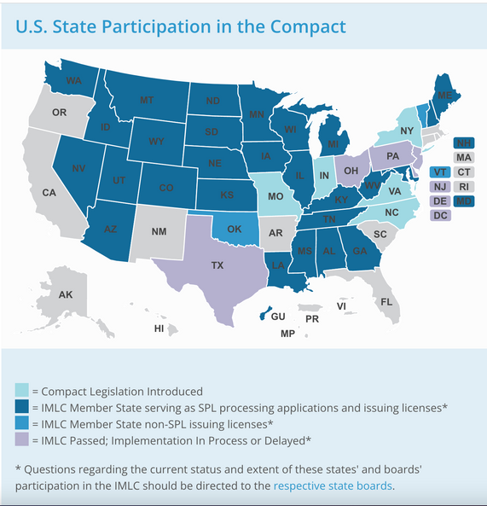
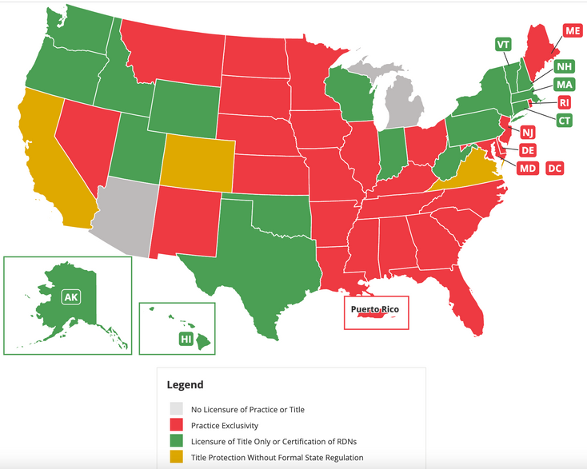
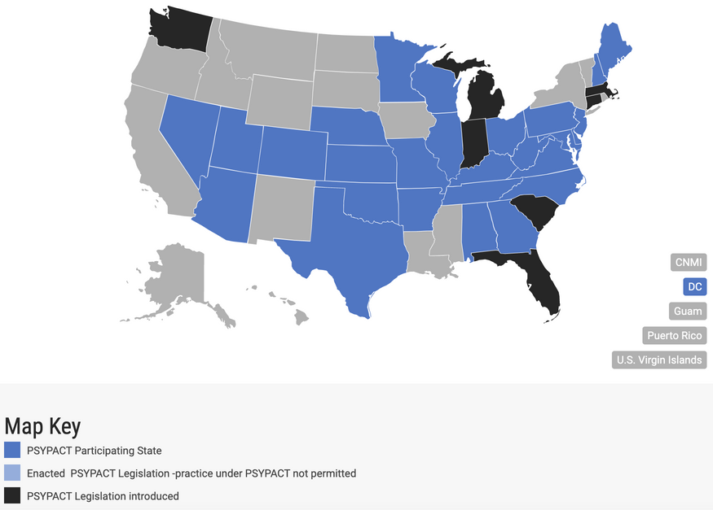
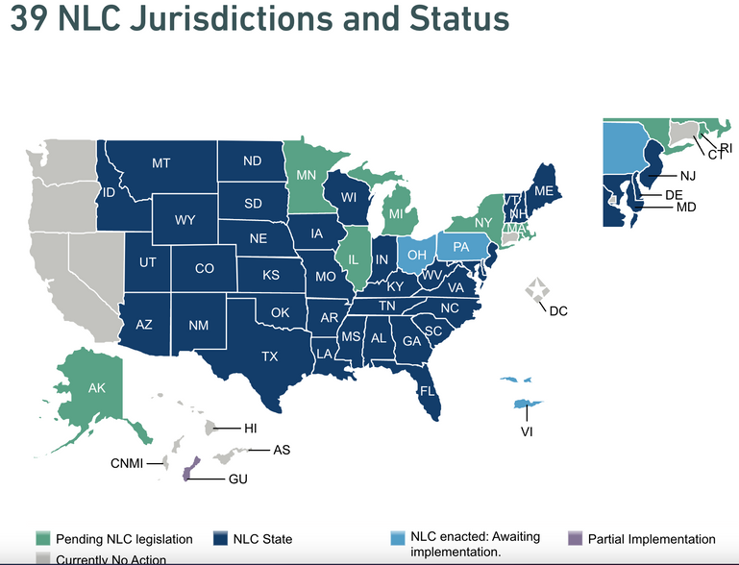
Licensure Compacts
A compact is an agreement that a provider can practice in multiple states, currently there are 3
Nursing, physicians, & psychologist
RDN vary by state. Its not exactly a compact but dietitians can potentially practice in multiple states
Check with your states

Slide 13
Portability Efforts
Counseling compact is in progress and is awaiting 10 states to enact the compact. Several are pending but only Georgia and Maryland have enacted it. You can write a letter to support it.
Social work is also working towards a compact.
You can also support the expansion of your contact by writing letters and participating on the task force for them.

Slide 14
Licensure Ongoing Requirements
Healthcare practicioners need to adhere to their profession's renewal requirements
Each state is different
Renewal periods are not uniform
Make sure you keep up to date with mandatory reporting requirments
Complete reporting on a timely basis

Slide 15
Behavioral health organizations are credentialed as a way to ensure quality.
Individuals that practice independently may not need to be credentialed.
Joint Commission is who mainly does our credentialing. They provide the Gold Seal of Approval.
Credentialing Requirements

Slide 16
Requirements
Generally patients should present 2 identifiers for any session- name and birthday, id number, etc.
This can look different and telehealth
Registering for groups can qualify as this identification
You can check identifiers in individual sessions

Slide 17
Malpractice insurance doesn't necessarily differ for telehealth
You should verify with your malpractice insurance provider on the specifics
Practitioners should also be sure to check with their state requirements because some require participation in state-sponsored patient compensation funds as an additional insurance requirment
Malpractice

Slide 18
Loss of license
Fines
Disciplinary issues are/can be noted on a license
Exclusion listing
Reporting to national practitioners database
If there is a mistake with one licensing board, it can effect other state licenses so be sure to check will all of them where you practice
Consequences

Slide 19
Technology security: its critical we be aware of security standard for technology in order to minimize the risk of PHI breaches
Privacy and confidentiality environment: using telehealth can create more opportunities for more PHI breaches because additional persons can be present in session spaces that should not be
There are legal and regulatory rights technology must abide to-we will review the DBH Policy later in this training
Privacy, Security, & Confidentiality

Slide 20
The HIPAA security rule requires that providers set up administrative, physical and technical safe-gaurds to protect electronic health information.
HIPAA guidelines on telemedicine are contained within the HIPAA Security Rule
only authorized individuals should have access to electronic health information (ePHI)
a secure system
a monitoring system to prevent breaches
Things that help
strong password rules or multi-factor authentication
encrypted storage
an audient trial on changes
Medical Record Protection

Slide 21
Response Methods for Breaches
Data back-up and continuous review - how?
Security response team - who?
Cybersecurity insurance - who is protecting you and how?
Public relations - how are breaches communicated

Slide 22
Who is in the room and do they all need to be there?
Everyone needs to identify themselves and their role.
Make sure your technology is HIPAA Compliant
Identification and Informed Consent
Avoid settings where the encounter can be overheard or seen

Slide 23
Remote Work HIPPA Considerations
Using a VPN to encrypt transmission of data
Do Not use public or guest wifi
Physically block sight lines to prevent any person from saying hi or looking over you shoulder during a session. Being in front of a wall is best.

Slide 24
Consent
Medicare does not require consent to be obtained from a patient before the session via telemedicine
Consent varies by state regulations on telehealth so be sure to check with your state
Telehealth consent should ideally include:
psychoeducation on telehealth
expected benefits and risks
information on data security measures
documentation of consents

Slide 25
PATIENT RIGHTS IN TELEHEALTH
Patients have the rights to privacy and confidentiality
Knowing the names of people helping them
An understanding of what consent means
A HIPAA compliant platforms
See your divisions patient rights document typically located in your employee handbook and in the patient's welome packet

Slide 26
Patient -Provider Relationship
Patients should be able to trust the practitioner to:
provide competent care
place patient welfare above all other interests
provide patient's with information they need to make decisions
respect to confidentiality and privacy
do their best to ensure continuity of care
maintain boundaries

Slide 27
Emergency Medical Treatment & Labor Act
EMTALA- patients should be assessed in person but a telehealth professional can oversee the assessment from a distance when necessary
patients are still required to be treated for emergencies even when being treated via telehealth
review the EMTALA criteria specific to your state

Slide 28
DEA policies are federal but states have their own policies
Ryan Haight ACT: after a main died due to an overdose of medications he received from an online pharmacy. The act requires that a person be evaluated in person before being prescribed certain controlled substances online. There are exceptions. See DEA Guidelines.
See TITLE 21 Code to determine which of the 5 schedules a medication is a part of
Special Registration for Telemedicine Act of 2018: is one of the exceptions and requires the DEA to lift the need for prior face to face relationships
non-controlled substances are not regulated in the same way and only require a license to prescribe via telehealth
Prescribing Practices

Slide 29
A prescription drug monitoring program is an electronic database that tracks controlled substance prescriptions in a state.
Every state has different PDMP requirements
Requirements may look like
reviewing the PDMP for every prescription
checking their own prescribing practices within a specific time frame
PRESCRIPTION DRUG MONITORING PROGRAM (PDMP)

Slide 30
MENTAL HEALTH HOLDS
Most mental health holds cannot be placed by a telemedicine provider.
Check with your state guidelines.
If the telemental health professional cannot intiiate a mental health hold, they need to collaborate with a local provider to assess and admit the patient.

Slide 31
The following should be documented/available for EVERY patient encounter:
physical location of the originating site or patient
plan for if the technology fails
direct contact information for the patient
emergency or support person contact information
expectations between sessions
direct phone number for emergency services near the patient
direct phone numbers for non-emergency services for the patient like a PCP
Patient Safety Planning and Emergency Care

Slide 32
Ethical communication
Collaboration and Continuity of Care
Practicioner collaboration
Standards of Care
Integrate all medical and mental health history into the record

Slide 33
Public Health Emergencies
In a crisis regulatory flexibilities called Section 1135 Waivers can be granted.
They end when the state of emergency is declared over
They can change rapidly

Slide 34
ETHICAL CONSIDERATIONS
Scope of practice
Confidentiality
Discipline-specific ethics
Laws and regulations
Organization's mission, vision and values
Medical ethical principles
The patient's dignity, wishes, and values

Slide 35
DBH Documents
How to locate them in:
Zavanta
Intranet

Slide 36
Learn more about recent HIPAA Breaches
U.S. Department of Health and Human Services
Office for Civil Rights
Breach Portal: Notice to the Secretary of HHS Breach of Unsecured Protected Health Information
https://ocrportal.hhs.gov/ocr/breach/breach_report.jsf

Slide 37
SUMMARY
HIPPA compliance, legal aspects, and ethical considerations are imperative to understand and effectively implement in telehealth. Virtual programming for telemental health treatment is an ever-growing field of care, allowing thousands of historically underserved Americans to have access to quality care for the first time. According to SAMHSA’s Key Substance Use and Mental Health Indicators in the United States: Results from the 2020 National Survey on Drug Use and Health, 4.1 million people received substance use treatment virtually and 26.3 million adults received mental health treatment virtually (2021.) With this growth we have also seen a record breaking number of health information breaches. According to U.S. the Department of Health and Human Services
Office for Civil Rights,713 major health data breaches affecting more than 45.7 million individuals posted for 2021 (2022.) For virtual programming to produce positive patient health outcomes and experiences while maintaining privacy, security, and ethical care we need to know the regulations and best practice guidelines and how to implement them. We will review all of these aspects in this training.

Slide 38
Thank You!
For Questions:
Apiazza@discoverybh.com

Slide 39
Resources
“Key Substance Use and Mental Health Indicators in the ...” The National Survey on Drug Use and Health, Substance Abuse and Mental Health Services Administration, Oct. 2021, https://www.samhsa.gov/data/sites/default/files/reports/rpt35319/2020NSDUHFFR1PDFW102121.pdf.
HPSA and MUA/P: HPSA scoring criteria: Guidance portal. HPSA and MUA/P: HPSA Scoring Criteria | Guidance Portal. (n.d.). Retrieved January 28, 2022, from https://www.hhs.gov/guidance/document/hpsa-and-muap-hpsa-scoring-criteria
Two-thirds of primary care physicians can't get mental health services for patients. Commonwealth Fund. (2009, April 14). Retrieved January 28, 2022, from https://www.commonwealthfund.org/press-release/2009/two-thirds-primary-care-physicians-cant-get-mental-health-services-patients?redirect_source=%2Fpublications%2Fpress-releases%2F2009%2Fapr%2Ftwo-thirds-of-primary-care-physicians-cant-get-mental-health-services-for-patients
Behavioral Health Workforce Projections. (2020, December). Retrieved from Health Resources & Services Administration (HRSA).
Hilty DM, Yellowlees PM, Parish MB, et al. Telepsychiatry: Effective, evidence-based and at a tipping point in healthcare delivery. Psych Clin N Amer 2015;38(3):559-592.
Shore, J. H., & Yellowlees, P. (2018). Telepsychiatry and Health Technologies: A Guide for Mental Health Professionals. Arlington, VA: American Psychiatric Association Publishing.
https://www.healthdata.org/infographic/covid-19-pandemic-has-had-large-and-uneven-impact-global-mental-health
Ostrowski, J., & Collins, T.P. (2016). A Comparison of Telemental Health Terminology Used across Mental Health State Licensure Boards).
National Consortium of Telehealth Resource Centers. How patients can engage in telehealth. https://www.telehealthresourcecenter.org/wp-content/uploads/2020/03/How-Patients-Can-EngageTelehealth-FINAL.pdf
https://www.govinfosecurity.com/record-number-major-health-data-breaches-in-2021-a-18327
https://ocrportal.hhs.gov/ocr/breach/breach_report.jsf

