Slide 1
QuickBooks Desktop For Manufacturers & Wholesalers Part 1: QuickBooks Desktop Inventory workflows, AVG. vs. FIFO, and Landed Cost

Slide 2
About Presenter
Hector Garcia, CPA
Advanced QuickBooks ProAdvisor & QuickBooks Solution Provider
Principal @ Quick Bookkeeping LLC in Miami, FL
YouTube Channel: https://www.youtube.com/c/HectorGarciaCPA
Consulting Inquiries & QuickBooks Software Sales 954-414-1524
hector@garciacpa.com

Slide 3
QuickBooks Desktop For Manufacturers and Wholesalers
First Episode: 05/21/2020 – Inventory Workflow fundamentals (recording will be in YouTube) Complete Paid Monthly Series Includes:
QuickBooks Desktop Inventory workflows, AVG. vs. FIFO, and Landed Cost
Organizing and Importing your inventory data. Making inventory adjustments in batch
Working with Multiple Locations, Bin Numbers, Serial numbers, and Lot Numbers
Working with Barcodes and Mobile Warehouse with Android App
Multiple Units of Measure, Inventory Assemblies, and Bill of Materials
Other Manufacturing workflows: accounting for scrap, allocation labor, accounting for 3rd party manufacturing process
Inventory Management topics (tips to maintaining inventory accurate in real-time)
Advanced Inventory Topics, Shortcuts, Workarounds, and Efficiency Tips/Tricks
Sign up: https://bit.ly/AWDESKTOP $500 for the series

Slide 4
QuickBooks Desktop For Manufacturers and Wholesalers
To access parts 2 to 8, sign up: https://bit.ly/AWDESKTOP
$500 for the series
Use coupon “desktop40” for 40% off Expires 05/21/2020

Slide 5
Table of Contents
Introductions – About the presenter and webinar series (5 mins)
Comparing Inventory features across QuickBooks Desktop Pro, Premier, Enterprise Silver, and Enterprise Platinum versions (10 mins)
Non-Inventory Part Workflow vs. Inventory Part Workflow (10 mins)
Introduction to Bill of Materials and Assembly Items (10 mins)
Inventory Valuation Issues (5 mins)
Comparing Avg. Cost (Pro/Premier) vs. FIFO (Enterprise ONLY) (15 mins)
Landed Cost workaround for QuickBooks Pro and Premier (10 mins)
Landed Cost with QuickBooks Enterprise 2020 (10 mins)
Find and Select Items vs. The ultimate Item fetching shortcut (5 mins)
Item Receipt vs. Bill. Short introduction to Enhanced Inventory Receiving (10 mins)
Open Q&A (10 mins)
Outro / How to signup for the series (5 mins)

Slide 6
Comparing Pro vs. Premier vs. Enterprise Inventory-related Features

Slide 7
All version of QuickBooks Desktop have:
Non-Posting
Estimates
Purchase Orders
Inventory Affecting:
Invoices and Sales Receipts (REDUCE INVENTORY)
Customer Credit Memo (INCREASE INVENTORY)
Item Receipt /Bill, Checks, and Credit Charges (INCREASE INVENTORY) when include inventory items
Vendor Credit / Credit Card Credit (REDUCE INVENTORY)
Inventory Adjustment (INCREASE or REDUCE INVENTORY)
Non-Inventory Affecting:
JOURNAL ENTRIES

Slide 8
What QuickBooks Pro is Missing That Premier and Enterprise do have
Sales Orders
Current Availability (Quantity on Hand – Quantity on Sales Order)
Sales Order Fulfillment worksheet (and ability to batch print pick tickets)
Sales Order to Purchase Order Workflow
Estimate to Purchase Order Workflow (And automated “drop ship” address from estimate or sales order)
Max Reorder Points and Reorder Reports
Price Level setting based on cost
Price Level with unique price table for all items
Item pricing in batch
Inventory Center
Inventory Assemblies (Bill of Materials)
Multiples Units of Measure

Slide 9
What QuickBooks Premier is Missing That Enterprise does have
No maximum number of items (pro/premier is limited to 14,500 items, names, and accounts combined)
10 item-level custom fields (vs. 5 in Premier) + ability to create drop-down custom field
Default Class by Item (automate class entering based on item used)
Auto-PO: automatically create POs based on reorder points
Shortage Reports when building assemblies
Where Used: ability to replace component across all assemblies used
Ability to edit Assemblies on-the-fly during a build and/or with a “Pending” Build
Automatically build sub-assemblies
Auto-adjust sales price based on changes to cost (based on predetermined markup/margin)
Disallow Negative Inventory Items and disallow sales to overdue customers
Show Item costs inside sales transactions
Sort columns in transactions and search for items within transactions
Find and Select Items within forms
Advanced Pricing and Advanced Inventory Features (Platinum Only)

Slide 10
What QuickBooks Enterprise Silver/Gold is Missing That Enterprise Platinum does have
Advanced Pricing
Special price rules based on multiple conditions (Customer, Class, Item, and/or Rep)
Volume discounting
Advanced Inventory
USB Barcode Scanner support
Multiple Inventory Sites (and Bins)
FIFO Inventory Valuation Option
Serial Numbers or Lot Numbers
Mobile Android App w/ Scanner Support
Alternative Vendor support (track Item cost and lead time across 5 vendors)
Landed Cost calculation

Slide 11
What QuickBooks CANNOT do with Inventory
https://quickbooks-training.net/what-quickbooks-enterprise-can-and-cannot-do-with-inventory/

Slide 12
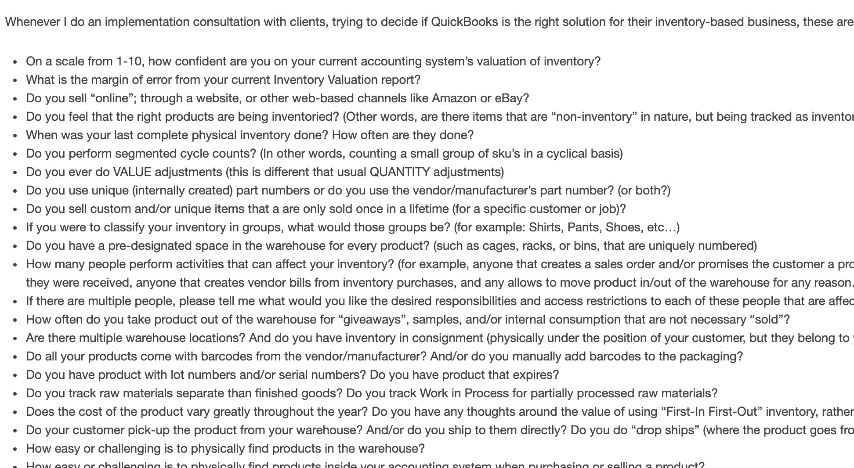
Implementing a NEW Inventory system
https://quickbooks-training.net/what-quickbooks-enterprise-can-and-cannot-do-with-inventory/

Slide 13
Non-Inventory Part Workflow vs. Inventory Part Workflow

Slide 14
Basic Inventory Workflow
Non-Inventory Parts (Single Sided or Double Sided)
Purchase Workflow
Sales Workflow
Inventory Consumption Workflow (Zero Dollar Sales)
Inventory QTY Adjustment

Slide 15
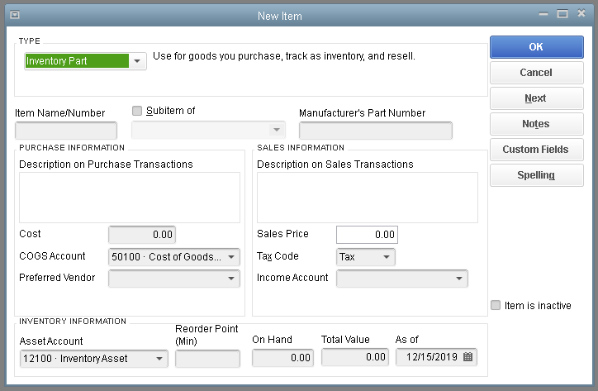
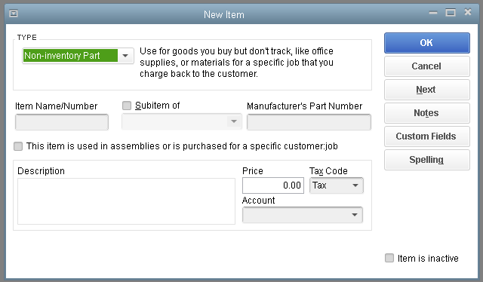
Inventory vs. Non-Invetory

Slide 16
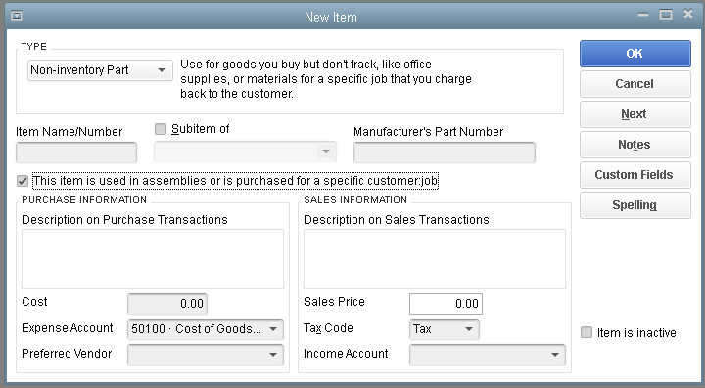
Inventory vs. Non-Inventory

Slide 17
Introduction to Bill of Materials and Assembly Items

Slide 18
Basic Inventory Assemblies
Accounts: Raw Materials, WIP, and Finished Goods
Bill of Materials
Building an Assembly

Slide 19
Inventory Valuation Issues

Slide 20
Inventory Valuation Issues
Beginning Inventory Balance
+ Purchases (Item Receipt/Bills, Checks, CC Charges)
- Cost of Goods Sold (Invoices, Sales Receipts, Inventory Adjustments)
= Ending Inventory Balance (Balance Sheet = Valuation Summary)

Slide 21
Inventory Valuation Issues
What if Inventory Valuation is overstated?
Direct Causes: missing invoices, used wrong Items on Invoices, did not make timely inventory adjustments
Effect: Net income and Gross Margins are overstated
What if Inventory Valuation is understated?
Direct Causes: missing item receipts or bills, used wrong Items on bills, did not make timely inventory adjustments
Effect: Net income and Gross Margins are understated

Slide 22
Inventory Valuation Issues
How to quickly know if inventory is “off”?
Inventory Valuation Summary does not match Balance Sheet
Asset Value in Inventory Valuation Summary doesn’t “feel” right
Potential Causes
Journal Entries affecting Inventory Asset account
Inventory adjustment using the Inventory Asset account as the adjusting account
Inactivated Inventory Items with a QOH other than zero
Using wrong units of measure on transactions
Using wrong items on transactions (similarly named)
Negative QOH on inventory items
Inventory items with zero QOH retaining a balance in the valuation report

Slide 23
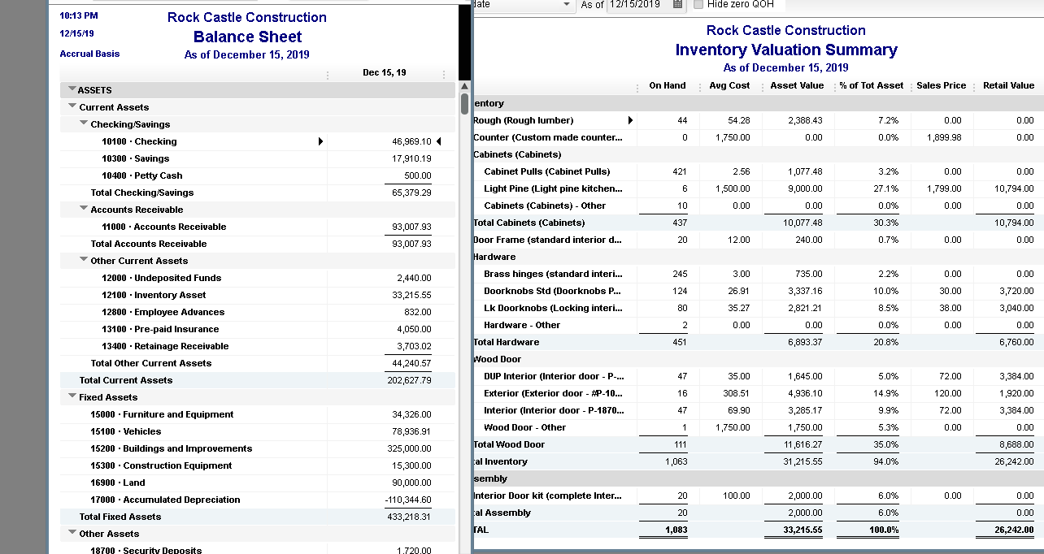
Inventory Valuation Issues

Slide 24
Comparing Avg. Cost vs. FIFO (Enterprise ONLY)

Slide 25
Landed Cost Workaround for QuickBooks Pro and Premier

Slide 26
Landed Cost with QuickBooks Enterprise 2020

Slide 27
Find and Select Items (Enterprise) vs. The ultimate Item fetching shortcut

Slide 28
Ultimate Item fetching shortcut
CTRL + L
CTRL + U

Slide 29
Item Receipt vs. Bill Short introduction to Enhanced Inventory Receiving

Slide 30
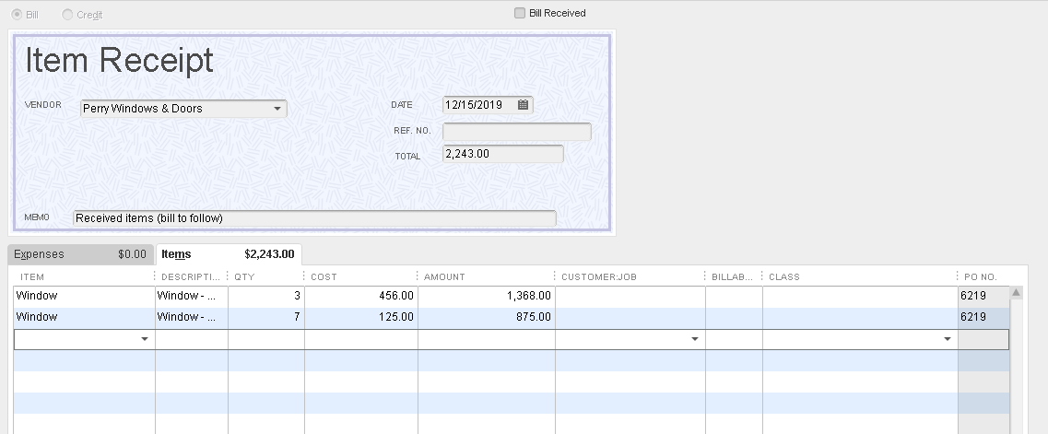
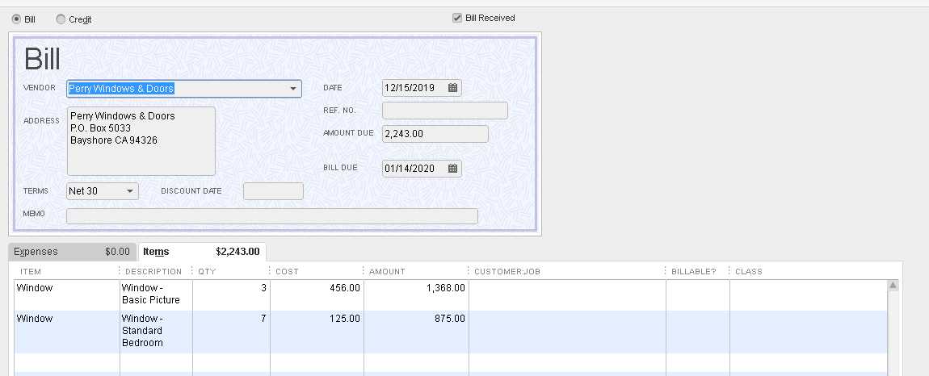
Item Receipt vs. Bill

Slide 31
QuickBooks Desktop For Manufacturers and Wholesalers
8-Part Complete Paid Monthly Series Includes:
QuickBooks Desktop Inventory workflows, AVG. vs. FIFO, and Landed Cost
Organizing and Importing your inventory data. Making inventory adjustments in batch
Working with Multiple Locations, Bin Numbers, Serial numbers, and Lot Numbers
Working with Barcodes and Mobile Warehouse with Android App
Multiple Units of Measure, Inventory Assemblies, and Bill of Materials
Other Manufacturing workflows: accounting for scrap, allocation labor, accounting for 3rd party manufacturing process
Inventory Management topics (tips to maintaining inventory accurate in real-time)
Advanced Inventory Topics, Shortcuts, Workarounds, and Efficiency Tips/Tricks
Sign up: https://bit.ly/AWDESKTOP $500 for the series

Slide 32
QuickBooks Desktop For Manufacturers and Wholesalers
To access parts 2 to 8, sign up: https://bit.ly/AWDESKTOP
$500 for the series
Use coupon “desktop40” for 40% off Expires 05/21/2020

Slide 33
Questions/Comments?
hector@garciacpa.com

