Slide 1
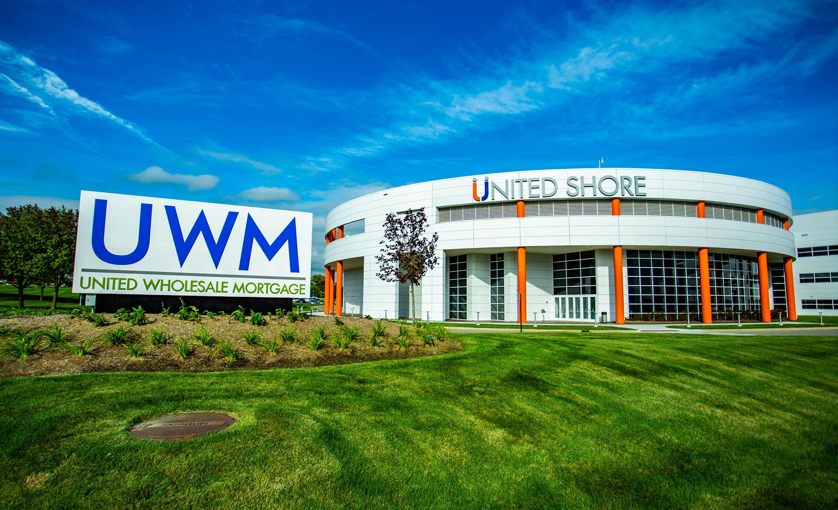
Residential Lending During COVID-19
Vince Parlove, AVP, Wholesale Development

Slide 2
Who is UWM?
# 1 Wholesale lender for 5 years in a row
2019 108 Billion in Residential Origination
2020 Projected 150 Billion in Residential Origination

Slide 3
Benefit of Independent Mortgage Broker
THE best place for a consumer to get a residential mortgage loan
Speed
Price
Service
Independent Mortgage Brokers are a part of your specific community

Slide 4
Market uncertainty—is it done?
Unemployment is high, but trending in the right direction
Forbearance is unprecedented, but still slowing
Agencies FHFA and TFPB were all quick to move through a series of changes to offer stabilization to the market

Slide 5
Looking Ahead
Pricing
Products
Overlays
Compensation
Notes:
Pricing: we are going to be seeing historically low rates for the next 18 months.

Slide 6
Opportunity to adapt
Brokers have more opportunity
Ability to adapt to market changes quickly
Notes:
UWM as a wholesale lender; 5800 person company and we made changes to products/guidelines overnight through people at different processes/stabilize the product that we had, when the time came we called bottom and adapted quickly to remove overlays

Slide 7
OPTIONS
Want to get licensed as a LO but do not want to be an Independent mortgage Broker?
Want to open up an independent mortgage broker shop?
Do not want to get licensed
Email us at
WDT@uwm.com
-or-
Findamortgagebroker.com will match you with a local mortgage broker who can help your client
Once you have your MLO license we can match you with an independent mortgage broker
Beamortgagebroker.com will help you decide if going independent is the right fit for you and guide you through the process.

Slide 8
Residential Mortgage Licensing Requirements
20 hour SAFE education requirement
Additional per state education
passing score of 75% or better on the UST exam
If you would like to get licensed in additional states, you will need to complete that specific states education requirement.
***reminder all states that you are licensed in will require yearly continuing education (CE) courses.

Slide 9
Opening Up Your Own Independent Mortgage Broker Shop
Decide to become an Independent Mortgage Broker (IMB)
Create a business entity, EIN and business bank account
Complete state licensing: MU1 filing, Satisfy conditions, submit package to state
Wait for State approval: 30-60 days
Set up vendors while waiting: LOS, Compliance and credit
Approved by state
Set up with Wholesale lenders
Start Originating

Slide 10
Opening Up Your Own Independent Mortgage Broker Shop
Decide to become an Independent Mortgage Broker (IMB)
Create a business entity, EIN and business bank account
State Licensing
-MU1 Filing
-Satisfy Conditions
-Submit package to state
Wait for state approval
~30-60 days
Start originating
$$$$$
Set up with wholesale investors
Approved by state
Set up vendors while waiting for approval: LOS, Credit, Compliance

Slide 11
QUESTIONS?
Vince Parlove, AVP, Wholesale Development
p 248.833.4811 m 248.943.3709 Email: Vparlove@uwm.com

