Slide 1
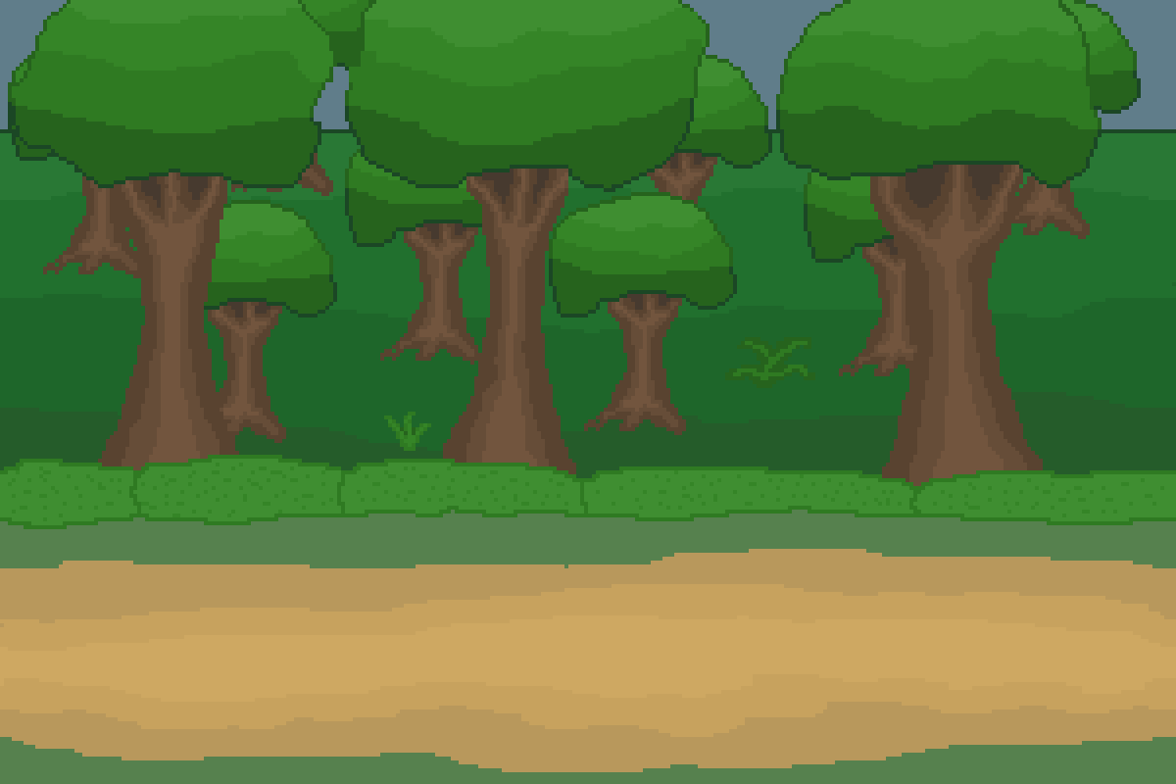
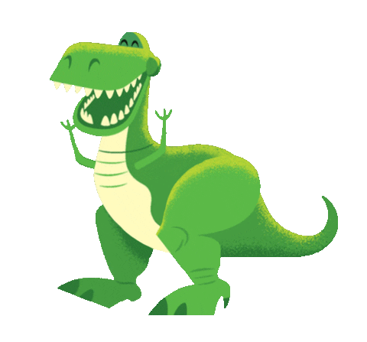
Dinosaurs

Slide 2
Extinct
does not exist anymore and no longer seen or live in the world.

Slide 3
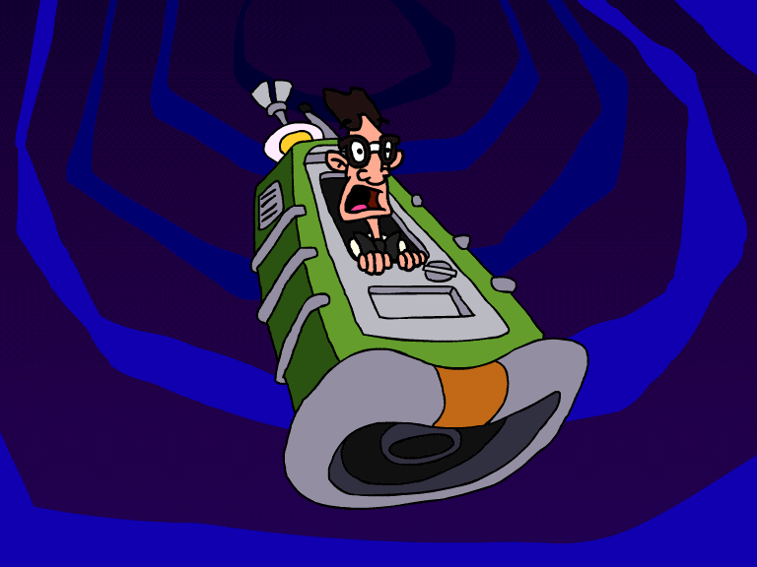
Let’s travel back in time…

Slide 4
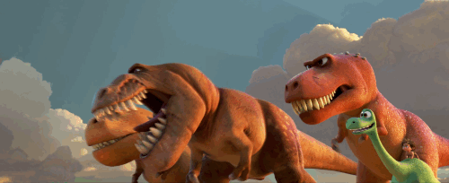
Dinosaurs
Lived million years ago…

Slide 5
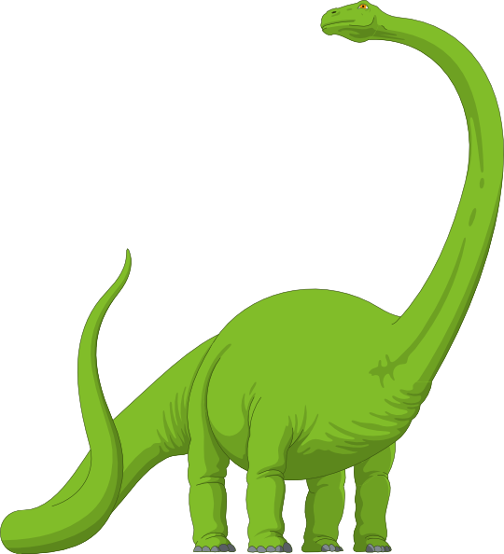
Dinosaurs
Are reptiles.

Slide 6
Female dinosaurs laid anywhere from three eggs up to 20 eggs at a time!

Slide 7
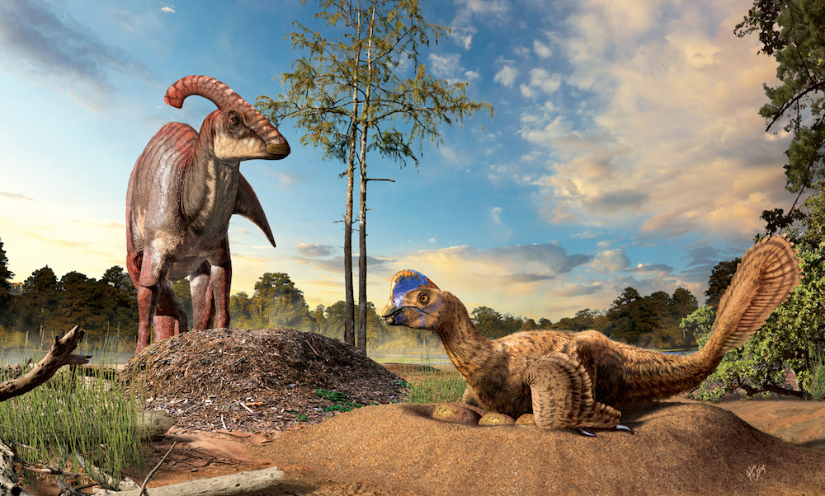

Slide 8
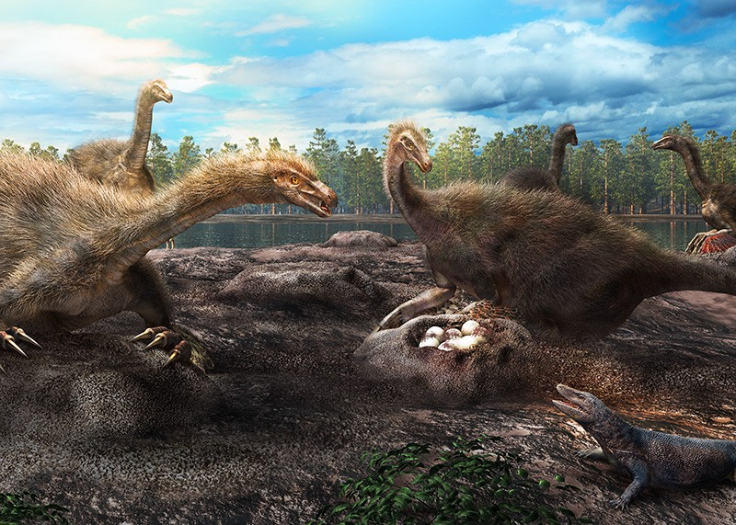

Slide 9
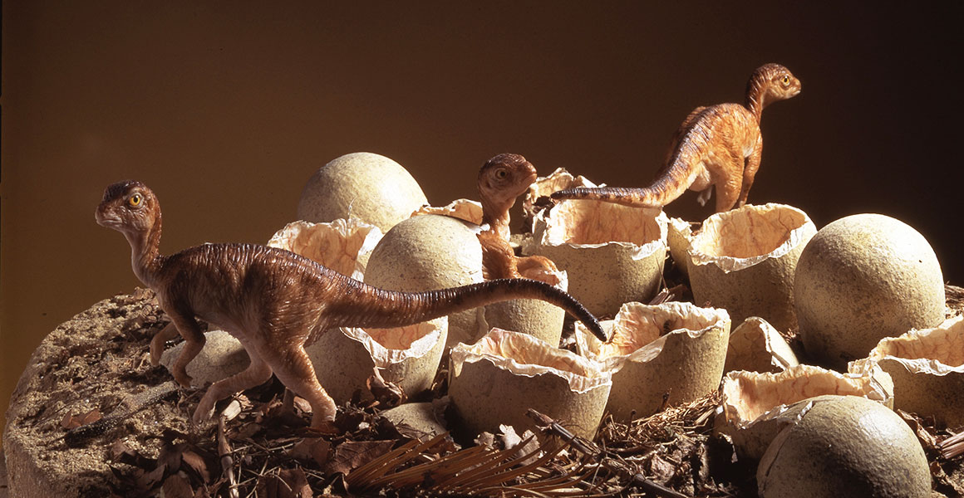

Slide 10
Body Parts Of a Dinosaur

Slide 11
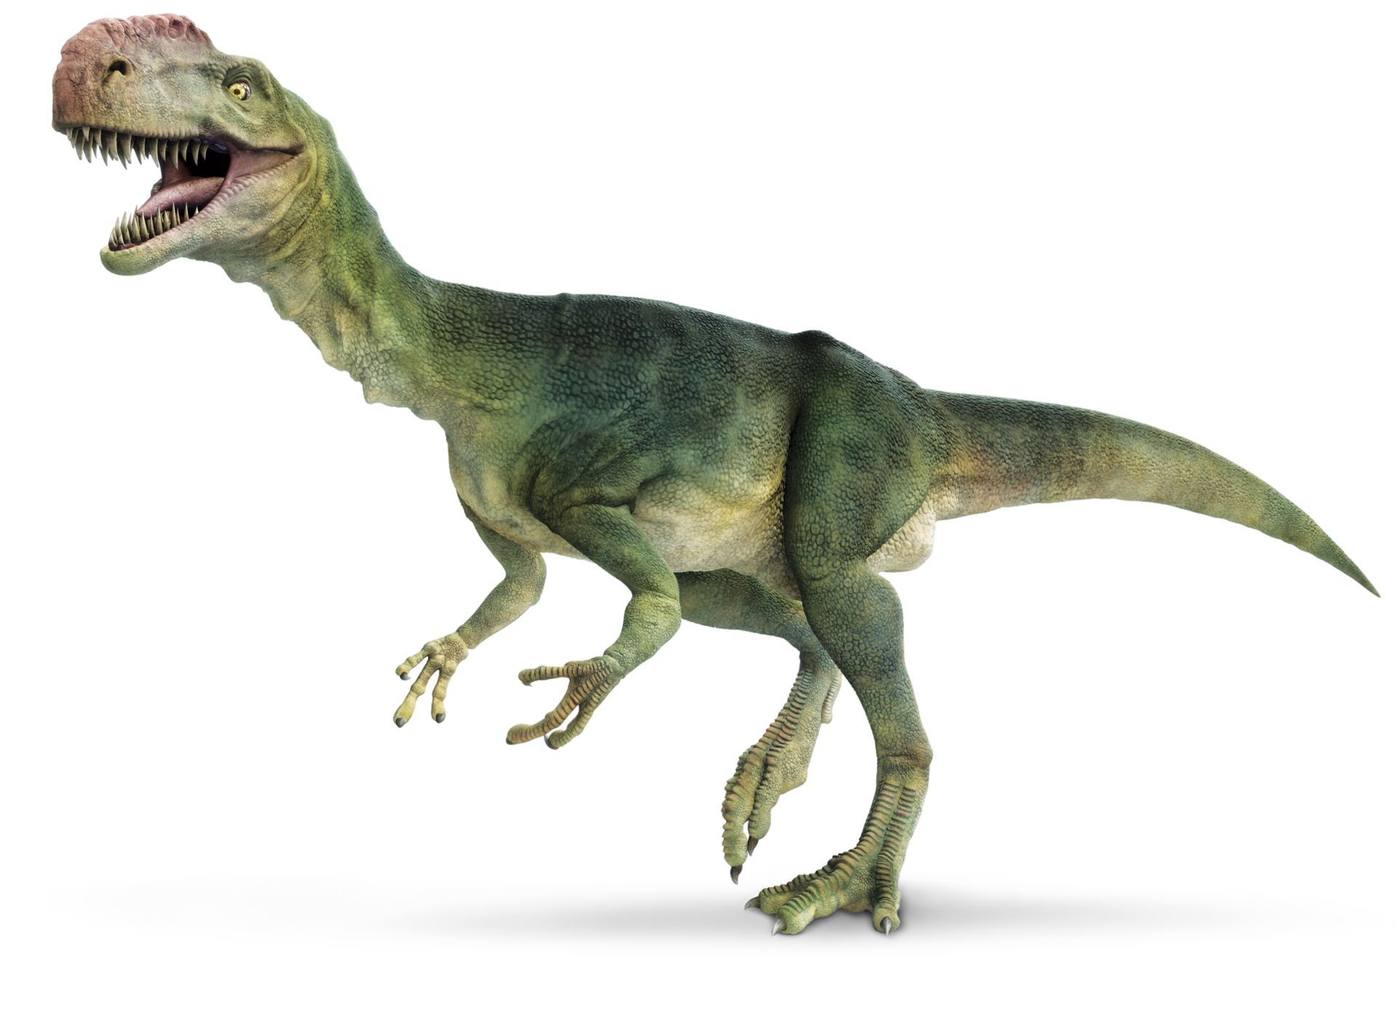
body
horn
tail
head
fangs
legs
neck
arms
claw

Slide 12
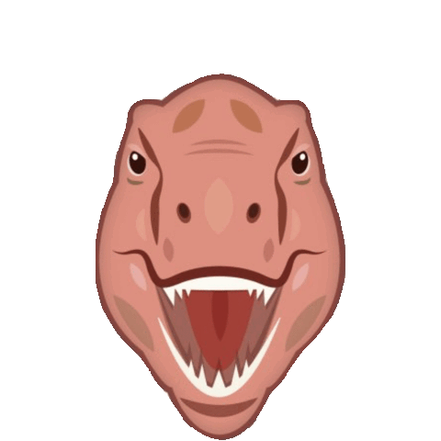
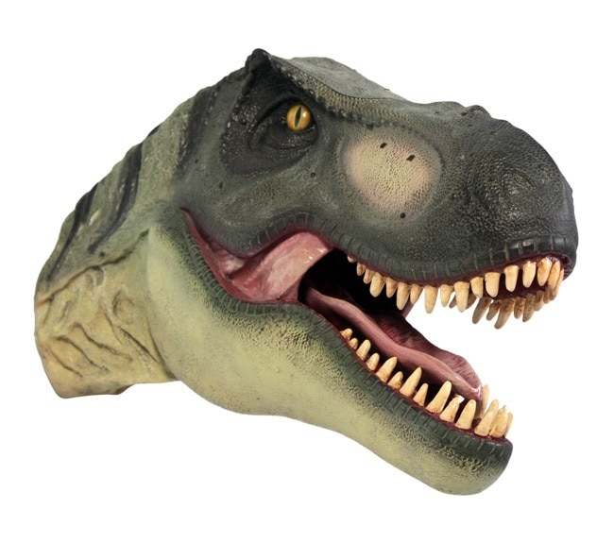
head

Slide 13
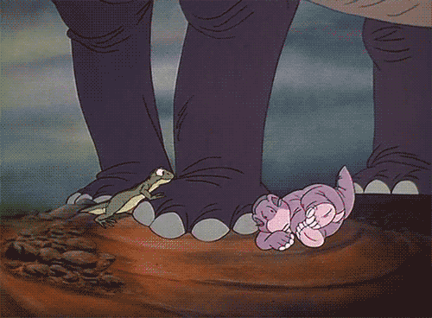
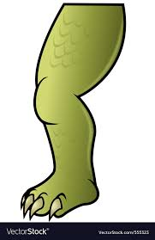
legs

Slide 14
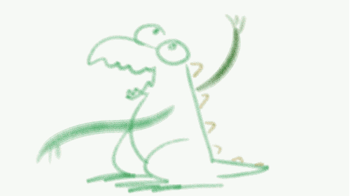
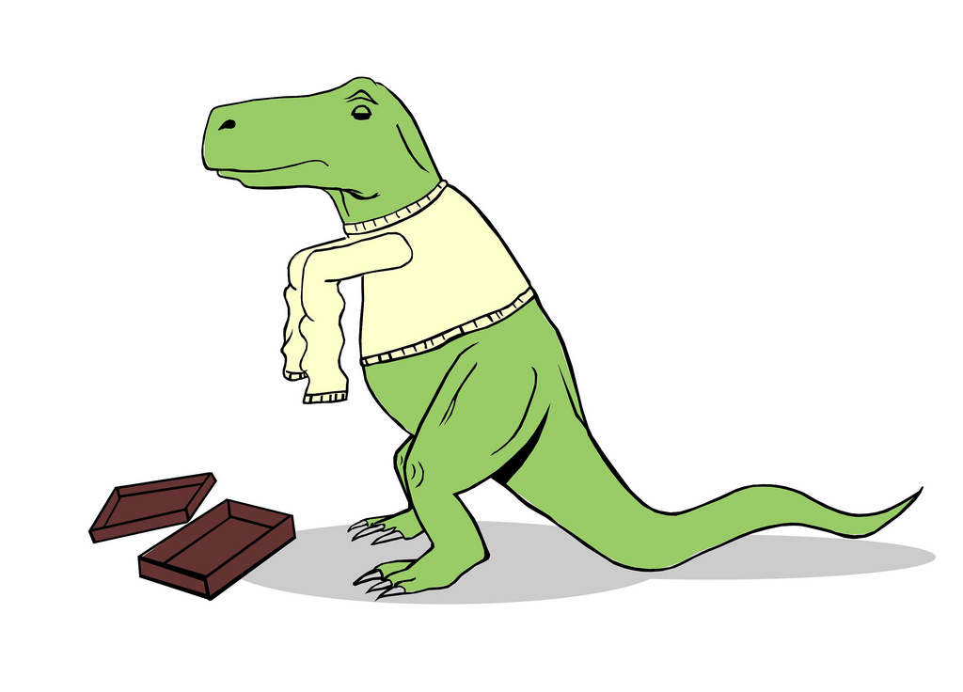
arms

Slide 15
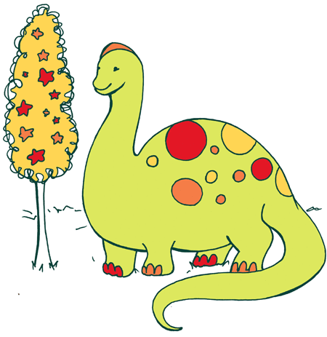
body

Slide 16
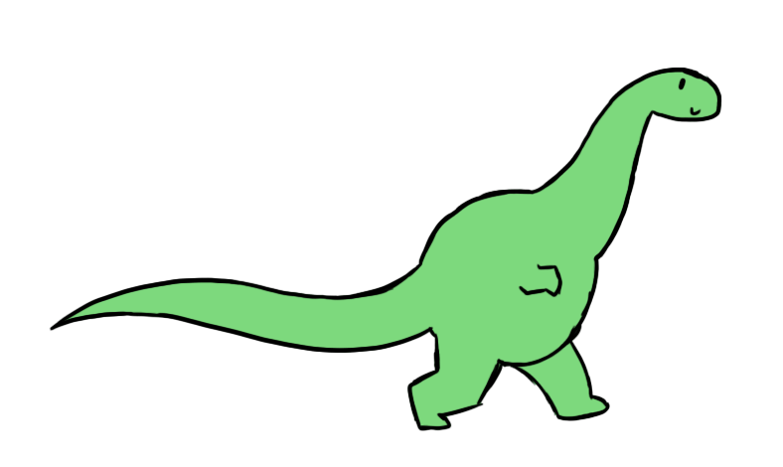
tail

Slide 17
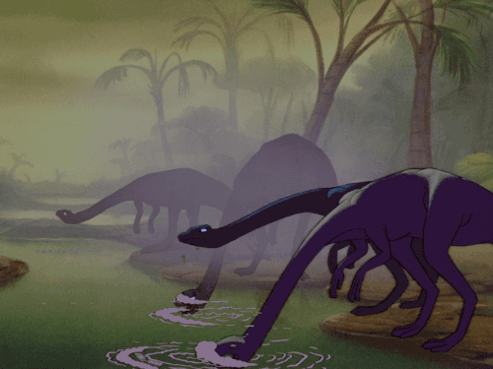
neck

Slide 18
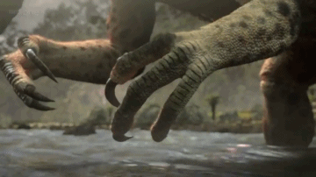
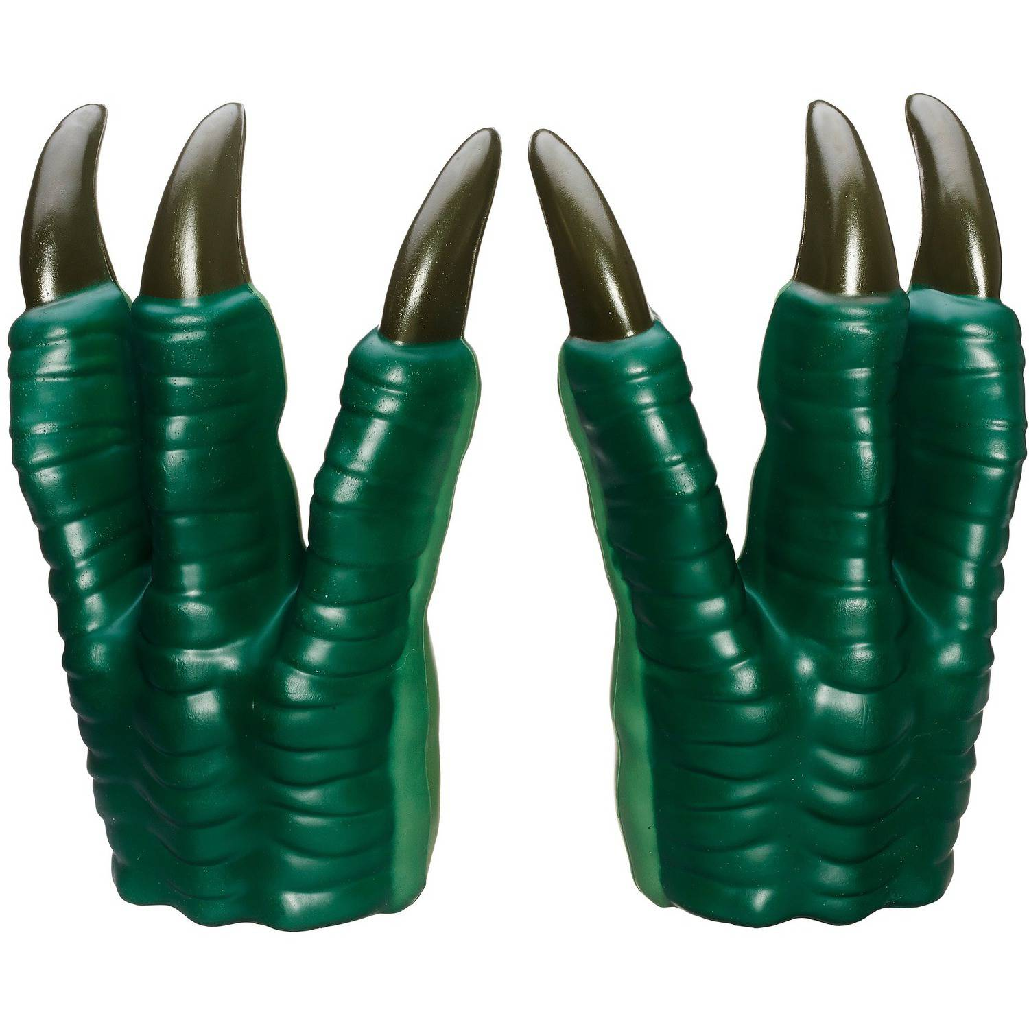
claw

Slide 19
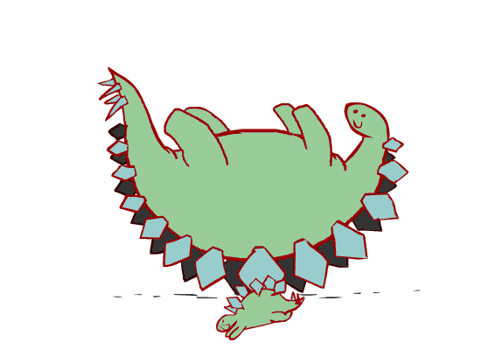
horns

Slide 20
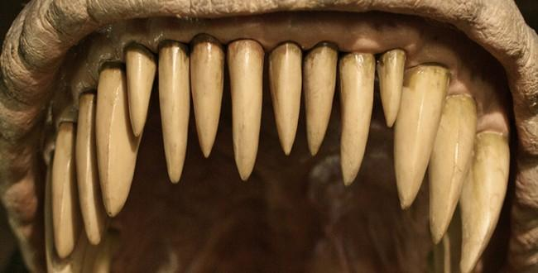
fangs

Slide 21
Why Do Dinosaurs become extinct?

Slide 22
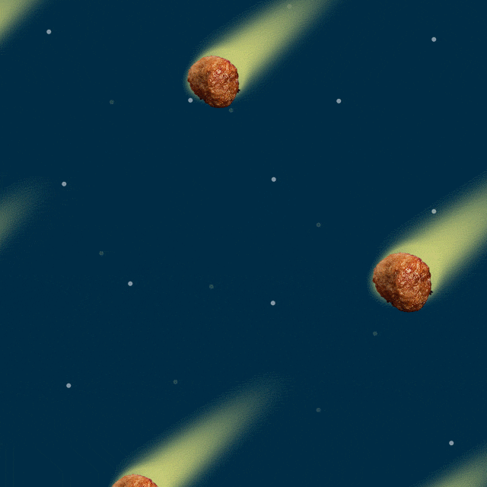
They become extinct because:
a comet or asteroid or meteorite hit the earth and made it very cold and dark. The dinosaurs could not live.

Slide 23
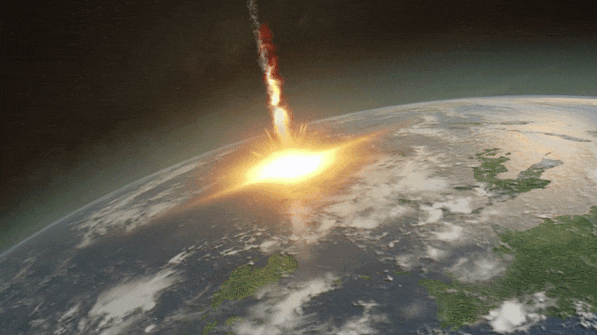

Slide 24
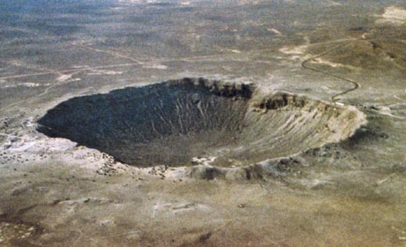

Slide 25
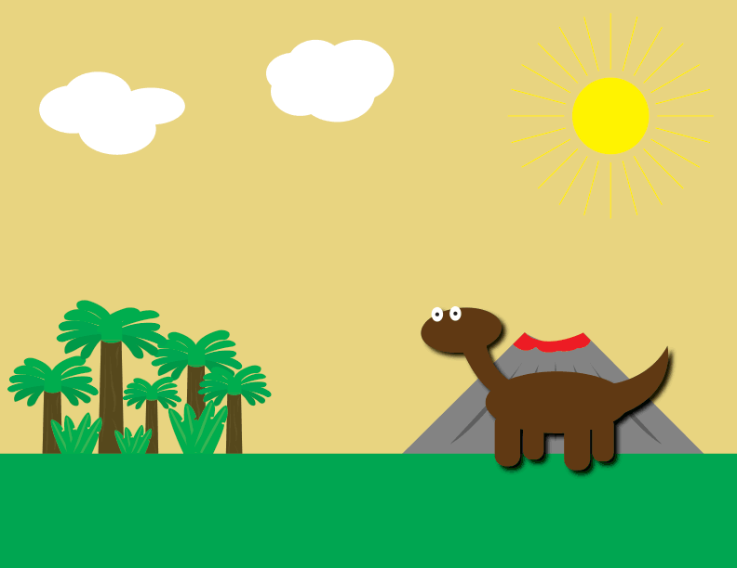
No-one has seen a live dinosaur.

Slide 26
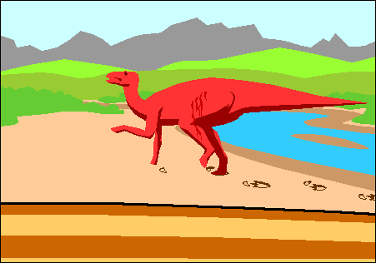

Slide 27
We do not know what dinosaurs looked like. We do not know the sounds they made.

Slide 28
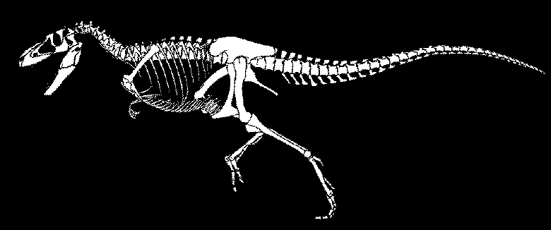
We know dinosaurs lived because of fossils.

Slide 29
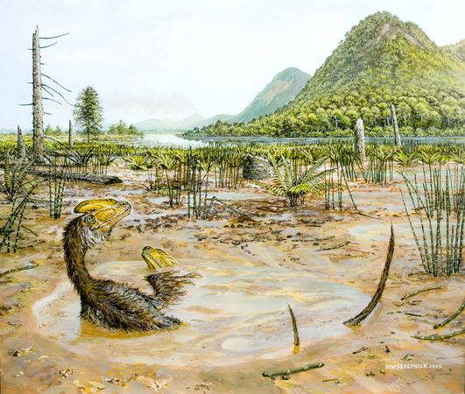

Slide 30
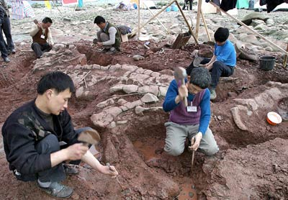

Slide 31
Many dinosaur skulls had big holes that both made them lighter and helped to keep them cool.

Slide 32
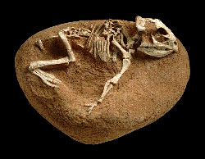

Slide 33
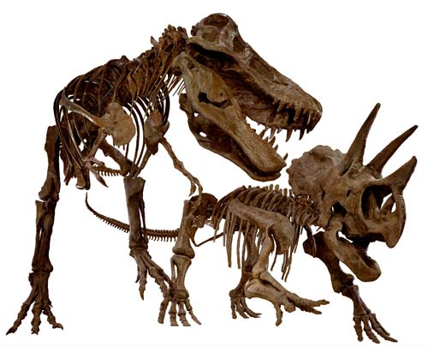

Slide 34
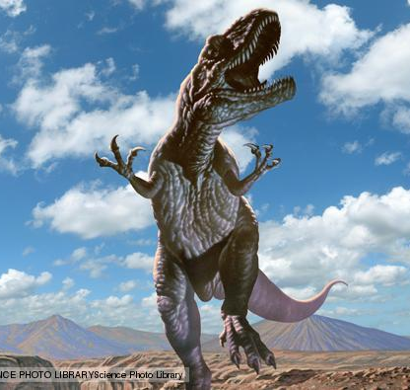

Slide 35
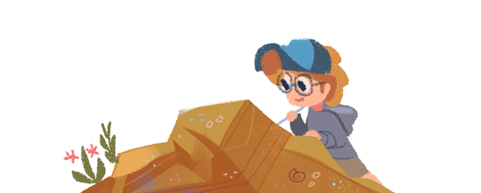
We can have some ideas how dinosaurs looked from the fossils.
Scientists can make a good guess by studying the fossils and animals today.

Slide 36
Physical Appearance of A Dinosaur

Slide 37
small
big

Slide 38
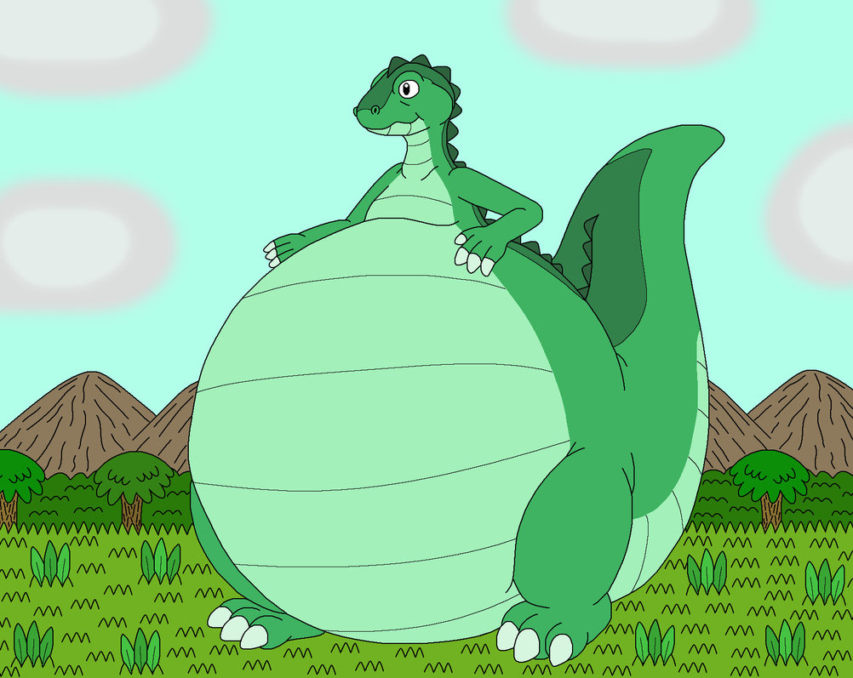
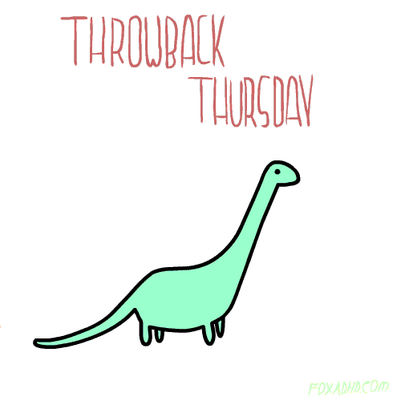
fat
thin

Slide 39
long
short

Slide 40
Some dinosaurs looked strange!

Slide 41
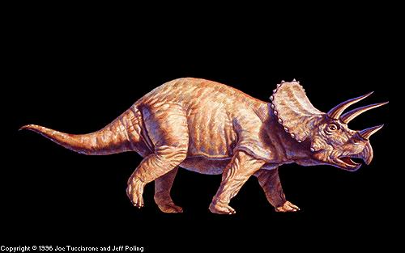

Slide 42
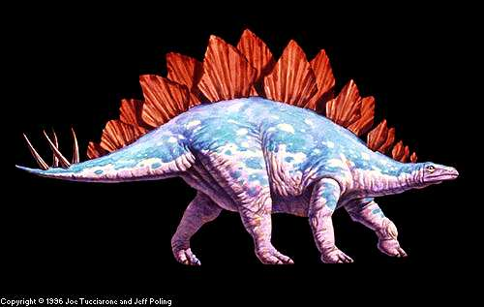

Slide 43
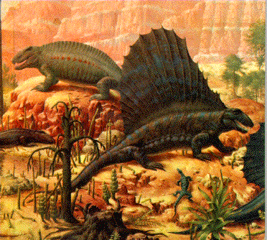

Slide 44
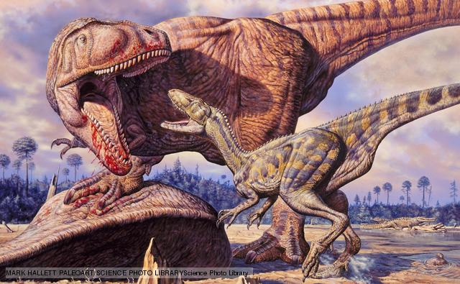

Slide 45
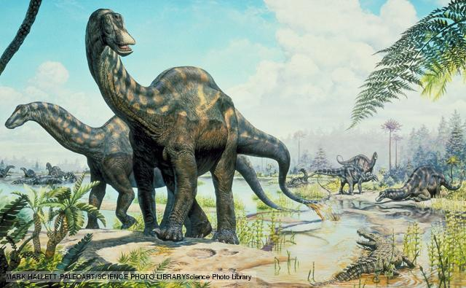

Slide 46
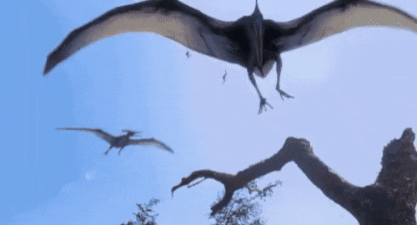
Some dinosaurs can fly.

Slide 47
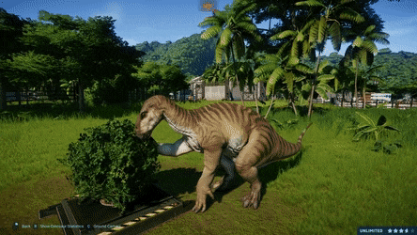
Most dinosaurs ate plants!

Slide 49
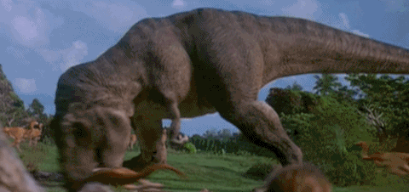
But some ate other dinosaurs.

Slide 50
Goodbye! See you next time :)

