Slide 1
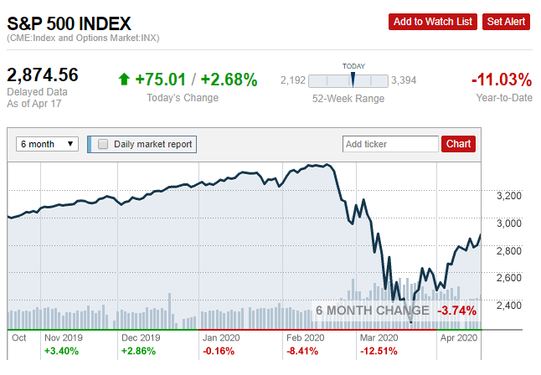
HOW & WHEN TO BUY STOCKS IN A VOLATILE MARKET
By Sven Carlin Ph.D. – Independent investor and stock market researcher
www.svencarlin.com
?
?

Slide 2
HOW & WHEN TO BUY STOCKS IN A VOLATILE MARKET
You have some cash:
you’ve been waiting in cash for a crash
You just got your stimulus
You just sold something
PUT IT ALL IN, OR PUT LITTLE BY LITTLE!
1) HISTORICAL RETURNS RELATED TO STRATEGY
LUMP SUM (ALL IN ONE)
DOLLAR COST AVERAGING
2) INVESTING VS. SPECULATING
3) THE IMPORTANCE OF BUYING AT THE RIGHT TIME – PERFECT MARKET TIMING
4) MY STRATEGY THAT WORKED THE BEST OVER THE LAST 20 YEARS

Slide 3
HOW & WHEN TO BUY STOCKS IN A VOLATILE MARKET
LET’s SAY YOU GOT $100,000
LUMP SUM – YOU PUT IT ALL IN THE MARKET IN ONE GO
DOLLAR COST AVERAGING – SYSTEMATIC – OVER 12 MONTHS
1) HISTORICAL RETURNS RELATED TO STRATEGY
LUMP SUM (ALL IN ONE)
DOLLAR COST AVERAGING
2) INVESTING VS. SPECULATING
3) THE IMPORTANCE OF BUYING AT THE RIGHT TIME – PERFECT MARKET TIMING
4) MY STRATEGY THAT WORKED THE BEST OVER THE LAST 20 YEARS

Slide 4
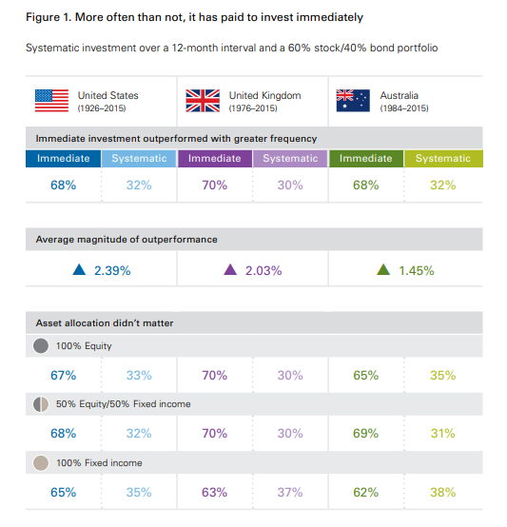
HOW & WHEN TO BUY STOCKS IN A VOLATILE MARKET
70% of situations – LUMP SUM IS BETTER
30% of situations – DOLLAR COST AVERAGING IS BETTER
1) HISTORICAL RETURNS RELATED TO STRATEGY
LUMP SUM (ALL IN ONE)
DOLLAR COST AVERAGING
2) INVESTING VS. SPECULATING
3) THE IMPORTANCE OF BUYING AT THE RIGHT TIME – PERFECT MARKET TIMING
4) MY STRATEGY THAT WORKED THE BEST OVER THE LAST 20 YEARS

Slide 5
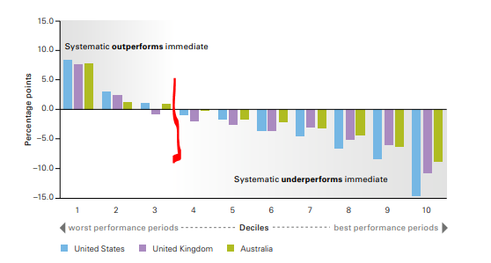
HOW & WHEN TO BUY STOCKS IN A VOLATILE MARKET
WHY DOES LUMP SUM OUTPERFORM?
IT ALWAYS BOILS DOWN TO INVESTING vs. SPECULATION
INVESTING IS A POSITIVE SUM GAME – when you DCA a LUMP SUM, YOU TIME THE MARKETS
IT IS ABOUT TIME IN THE MARKET, NOT TIMING THE MARKETS
1) HISTORICAL RETURNS RELATED TO STRATEGY
LUMP SUM (ALL IN ONE)
DOLLAR COST AVERAGING
2) INVESTING VS. SPECULATING
3) THE IMPORTANCE OF BUYING AT THE RIGHT TIME – PERFECT MARKET TIMING
4) MY STRATEGY THAT WORKED THE BEST OVER THE LAST 20 YEARS

Slide 6
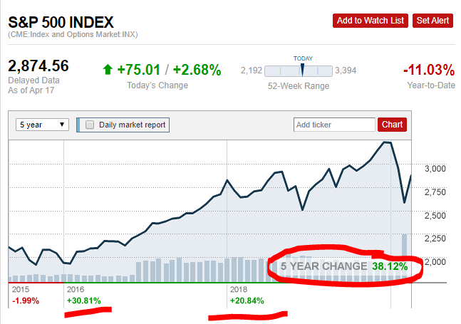
HOW & WHEN TO BUY STOCKS IN A VOLATILE MARKET
WHY DOES LUMP SUM OUTPERFORM?
IT ALWAYS BOILS DOWN TO INVESTING vs. SPECULATION
INVESTING IS A POSITIVE SUM GAME – when you DCA a LUMP SUM, YOU TIME THE MARKETS
I have started with social media financial writing in 2015 – constant emails of people waiting for a crash!
1) HISTORICAL RETURNS RELATED TO STRATEGY
LUMP SUM (ALL IN ONE)
DOLLAR COST AVERAGING
2) INVESTING VS. SPECULATING
3) THE IMPORTANCE OF BUYING AT THE RIGHT TIME – PERFECT MARKET TIMING
4) MY STRATEGY THAT WORKED THE BEST OVER THE LAST 20 YEARS

Slide 7
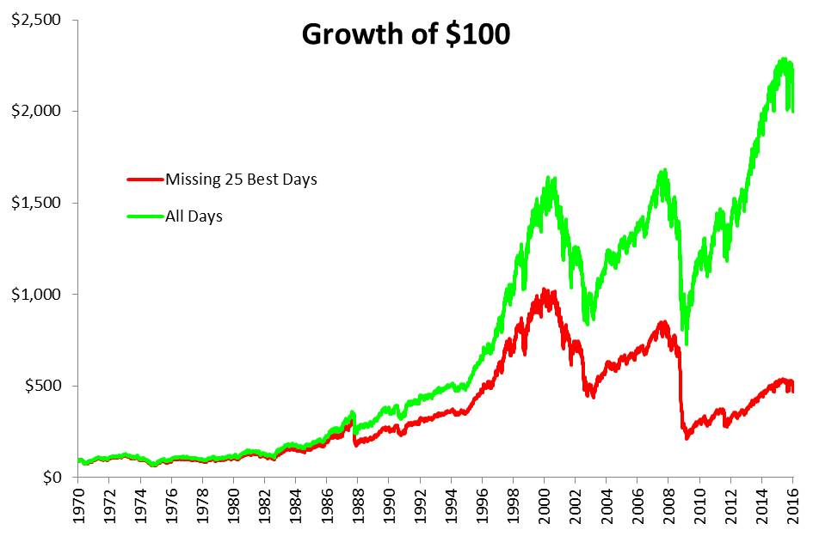
HOW & WHEN TO BUY STOCKS IN A VOLATILE MARKET
WHY DOES LUMP SUM OUTPERFORM?
INVESTING IS A POSITIVE SUM GAME – DON’T MISS THE BEST DAYS
INVESTING IS ABOUT OWNING BUSINESSES, DIVIDENDS, BUSINESS GROWTH, VALUE AND WEALTH ACCUMULATION
1) HISTORICAL RETURNS RELATED TO STRATEGY
LUMP SUM (ALL IN ONE)
DOLLAR COST AVERAGING
2) INVESTING VS. SPECULATING
3) THE IMPORTANCE OF BUYING AT THE RIGHT TIME – PERFECT MARKET TIMING
4) MY STRATEGY THAT WORKED THE BEST OVER THE LAST 20 YEARS

Slide 8
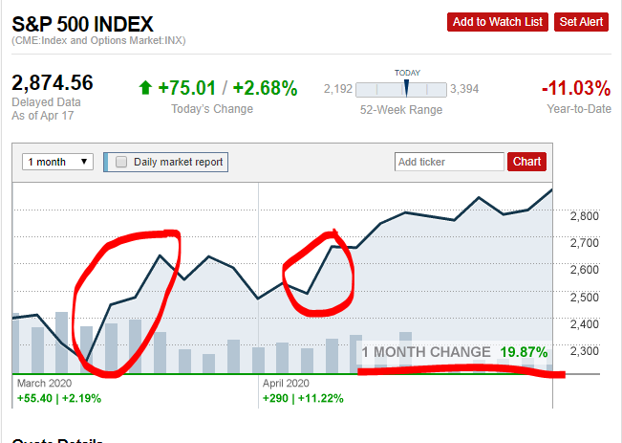
HOW & WHEN TO BUY STOCKS IN A VOLATILE MARKET
WHY DOES LUMP SUM OUTPERFORM?
INVESTING IS A POSITIVE SUM GAME
INVESTING IS ABOUT OWNING BUSINESSES, DIVIDENDS, BUSINESS GROWTH, VALUE AND WEALTH ACCUMULATION
1) HISTORICAL RETURNS RELATED TO STRATEGY
LUMP SUM (ALL IN ONE)
DOLLAR COST AVERAGING
2) INVESTING VS. SPECULATING
3) THE IMPORTANCE OF BUYING AT THE RIGHT TIME – PERFECT MARKET TIMING
4) MY STRATEGY THAT WORKED THE BEST OVER THE LAST 20 YEARS

Slide 9
HOW & WHEN TO BUY STOCKS IN A VOLATILE MARKET
WHY DOES LUMP SUM OUTPERFORM?
INVESTING IS A POSITIVE SUM GAME
INVESTING IS ABOUT OWNING BUSINESSES, DIVIDENDS, BUSINESS GROWTH, VALUE AND WEALTH ACCUMULATION
1) HISTORICAL RETURNS RELATED TO STRATEGY
LUMP SUM (ALL IN ONE)
DOLLAR COST AVERAGING
2) INVESTING VS. SPECULATING
3) THE IMPORTANCE OF BUYING AT THE RIGHT TIME – PERFECT MARKET TIMING
4) MY STRATEGY THAT WORKED THE BEST OVER THE LAST 20 YEARS
WHERE IS THE DIVERGENCE CREATED???

Slide 10
HOW & WHEN TO BUY STOCKS IN A VOLATILE MARKET
WHY DOES LUMP SUM OUTPERFORM?
INVESTING IS A POSITIVE SUM GAME
INVESTING IS ABOUT OWNING BUSINESSES, DIVIDENDS, BUSINESS GROWTH, VALUE AND WEALTH ACCUMULATION
1) HISTORICAL RETURNS RELATED TO STRATEGY
LUMP SUM (ALL IN ONE)
DOLLAR COST AVERAGING
2) INVESTING VS. SPECULATING
3) THE IMPORTANCE OF BUYING AT THE RIGHT TIME – PERFECT MARKET TIMING
4) MY STRATEGY THAT WORKED THE BEST OVER THE LAST 20 YEARS
GREAT RECESSION RECOVERY
WHERE IS THE DIVERGENCE CREATED???
BAD TIMES – BEAR MARKETS, CRASHES
2003 recovery
1987 crash
& recovery

Slide 11
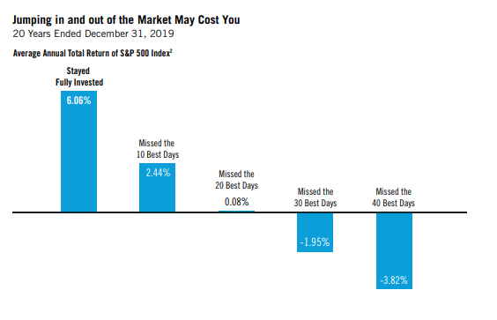
HOW & WHEN TO BUY STOCKS IN A VOLATILE MARKET
WHY DOES LUMP SUM OUTPERFORM?
INVESTING IS A POSITIVE SUM GAME
INVESTING IS ABOUT OWNING BUSINESSES, DIVIDENDS, BUSINESS GROWTH, VALUE AND WEALTH ACCUMULATION
1) HISTORICAL RETURNS RELATED TO STRATEGY
LUMP SUM (ALL IN ONE)
DOLLAR COST AVERAGING
2) INVESTING VS. SPECULATING
3) THE IMPORTANCE OF BUYING AT THE RIGHT TIME – PERFECT MARKET TIMING
4) MY STRATEGY THAT WORKED THE BEST OVER THE LAST 20 YEARS

Slide 12
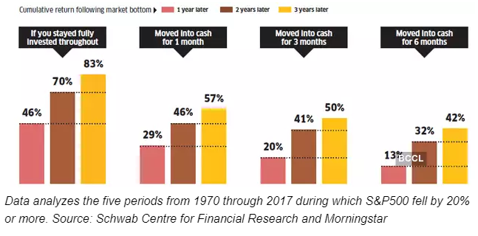
HOW & WHEN TO BUY STOCKS IN A VOLATILE MARKET
WHY DOES LUMP SUM OUTPERFORM?
INVESTING IS A POSITIVE SUM GAME
INVESTING IS ABOUT OWNING BUSINESSES, DIVIDENDS, BUSINESS GROWTH, VALUE AND WEALTH ACCUMULATION
1) HISTORICAL RETURNS RELATED TO STRATEGY
LUMP SUM (ALL IN ONE)
DOLLAR COST AVERAGING
2) INVESTING VS. SPECULATING
3) THE IMPORTANCE OF BUYING AT THE RIGHT TIME – PERFECT MARKET TIMING
4) MY STRATEGY THAT WORKED THE BEST OVER THE LAST 20 YEARS

Slide 13
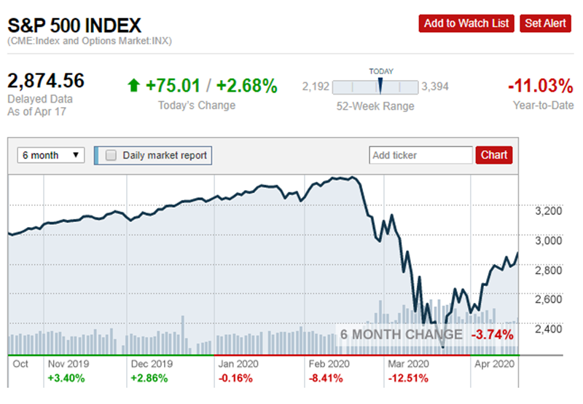
HOW & WHEN TO BUY STOCKS IN A VOLATILE MARKET
THE IMPORTANCE OF BUYING INTO THE CRASH AND RECOVERY
WOULD YOU BE HAPPIER TO BUY THE BOTTOM?
HOW IMPORTANT IT REALLY IS?
1) HISTORICAL RETURNS RELATED TO STRATEGY
LUMP SUM (ALL IN ONE)
DOLLAR COST AVERAGING
2) INVESTING VS. SPECULATING
3) THE IMPORTANCE OF BUYING AT THE RIGHT TIME – PERFECT MARKET TIMING
4) MY STRATEGY THAT WORKED THE BEST OVER THE LAST 20 YEARS

Slide 14
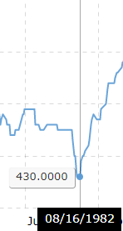
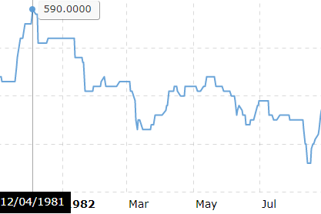
HOW & WHEN TO BUY STOCKS IN A VOLATILE MARKET
THE IMPORTANCE OF BUYING INTO THE CRASH AND RECOVERY – EXAMPLE!
1) HISTORICAL RETURNS RELATED TO STRATEGY
LUMP SUM (ALL IN ONE)
DOLLAR COST AVERAGING
2) INVESTING VS. SPECULATING
3) THE IMPORTANCE OF BUYING AT THE RIGHT TIME – PERFECT MARKET TIMING
4) MY STRATEGY THAT WORKED THE BEST OVER THE LAST 20 YEARS
DOWN 28% in 9 months

Slide 15
HOW & WHEN TO BUY STOCKS IN A VOLATILE MARKET
THE IMPORTANCE OF BUYING INTO THE CRASH AND RECOVERY WITH PERFECT TIMING
1) HISTORICAL RETURNS RELATED TO STRATEGY
LUMP SUM (ALL IN ONE)
DOLLAR COST AVERAGING
2) INVESTING VS. SPECULATING
3) THE IMPORTANCE OF BUYING AT THE RIGHT TIME – PERFECT MARKET TIMING
4) MY STRATEGY THAT WORKED THE BEST OVER THE LAST 20 YEARS
DOWN 28% in 14 months
YOU HAVE TO BE SMART AND
BUY AT THE BOTTOM???

Slide 16
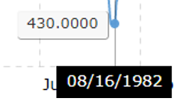
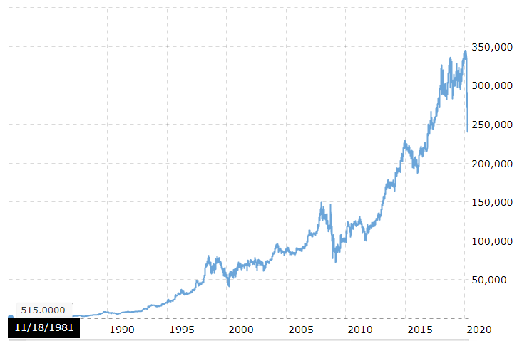
HOW & WHEN TO BUY STOCKS IN A VOLATILE MARKET
THE IMPORTANCE OF BUYING INTO THE CRASH AND RECOVERY WITH PERFECT TIMING
$284,400/$590=482 times your money
$284,400/$430=661 times your money
1) HISTORICAL RETURNS RELATED TO STRATEGY
LUMP SUM (ALL IN ONE)
DOLLAR COST AVERAGING
2) INVESTING VS. SPECULATING
3) THE IMPORTANCE OF BUYING AT THE RIGHT TIME – PERFECT MARKET TIMING
4) MY STRATEGY THAT WORKED THE BEST OVER THE LAST 20 YEARS

Slide 17
HOW & WHEN TO BUY STOCKS IN A VOLATILE MARKET
THE IMPORTANCE OF BUYING INTO THE CRASH AND RECOVERY WITH PERFECT TIMING
$284,400/$590=482X – annualized return 16.7%
$284,400/$430=661X – annualized return 17.6%
1) HISTORICAL RETURNS RELATED TO STRATEGY
LUMP SUM (ALL IN ONE)
DOLLAR COST AVERAGING
2) INVESTING VS. SPECULATING
3) THE IMPORTANCE OF BUYING AT THE RIGHT TIME – PERFECT MARKET TIMING
4) MY STRATEGY THAT WORKED THE BEST OVER THE LAST 20 YEARS

Slide 18
HOW & WHEN TO BUY STOCKS IN A VOLATILE MARKET
THE IMPORTANCE OF BUYING INTO THE CRASH AND RECOVERY WITH PERFECT TIMING
$284,400/$590=482X – annualized return 16.7%
$284,400/$430=661X – annualized return 17.6%
SO, WANT TO TIME THE MARKET ?
YOU BETTER FOCUS ON THE BUSINESS YOU ARE BUYING – NOT AT TIMING STOCKS!
THE DIFFERENCES ARE SO SMALL LONG-TERM!!!
1) HISTORICAL RETURNS RELATED TO STRATEGY
LUMP SUM (ALL IN ONE)
DOLLAR COST AVERAGING
2) INVESTING VS. SPECULATING
3) THE IMPORTANCE OF BUYING AT THE RIGHT TIME – PERFECT MARKET TIMING
4) MY STRATEGY THAT WORKED THE BEST OVER THE LAST 20 YEARS

Slide 19
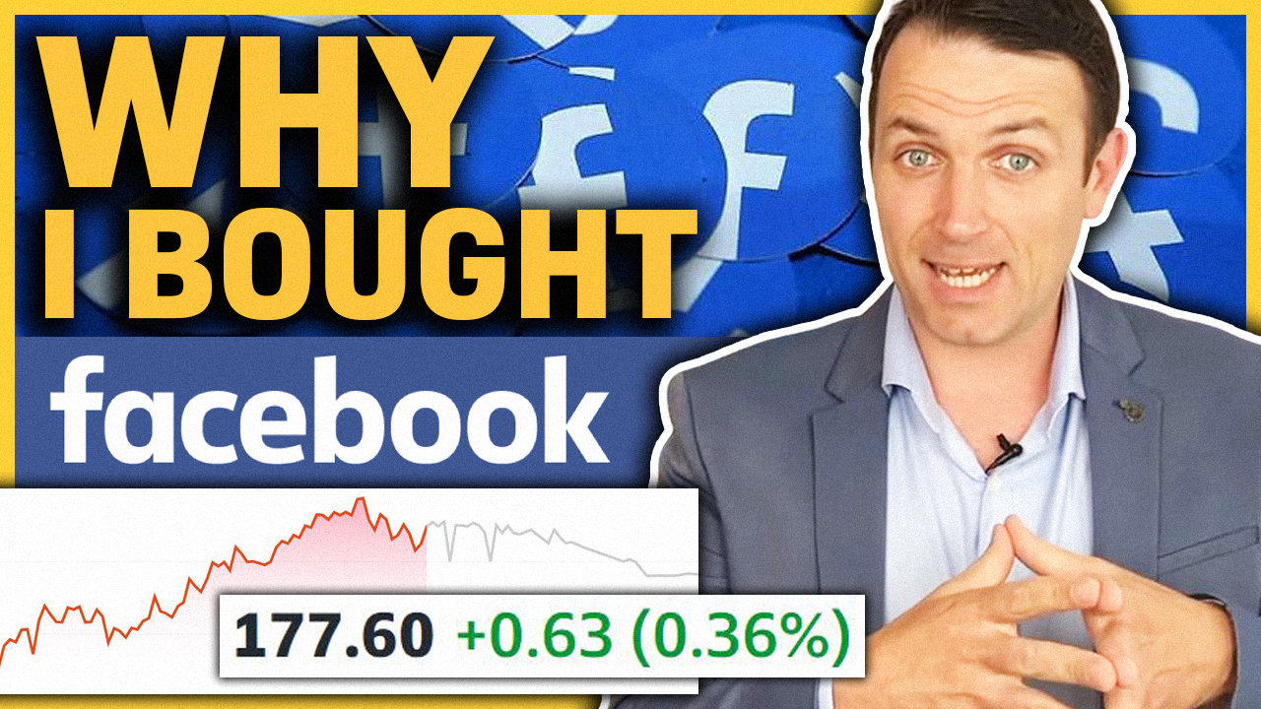
HOW & WHEN TO BUY STOCKS IN A VOLATILE MARKET
COMPOUNDING – RETURN ON CAPITAL – FB STOCK
BOOK VALUE GROWTH 20%
1) HISTORICAL RETURNS RELATED TO STRATEGY
LUMP SUM (ALL IN ONE)
DOLLAR COST AVERAGING
2) INVESTING VS. SPECULATING
3) THE IMPORTANCE OF BUYING AT THE RIGHT TIME – PERFECT MARKET TIMING
4) MY STRATEGY THAT WORKED THE BEST OVER THE LAST 20 YEARS

Slide 20
HOW & WHEN TO BUY STOCKS IN A VOLATILE MARKET
COMPOUNDING – RETURN ON CAPITAL
BOOK VALUE GROWTH 20%
KEEP COMPOUNDING AT 20% for 20 years
BOOK VALUE PER SHARE $1,358 in 20 years
WITH EARNINGS PER SHARE OF $226 in year 20 (change in book value are usually the earnigns)
1) HISTORICAL RETURNS RELATED TO STRATEGY
LUMP SUM (ALL IN ONE)
DOLLAR COST AVERAGING
2) INVESTING VS. SPECULATING
3) THE IMPORTANCE OF BUYING AT THE RIGHT TIME – PERFECT MARKET TIMING
4) MY STRATEGY THAT WORKED THE BEST OVER THE LAST 20 YEARS

Slide 21
HOW & WHEN TO BUY STOCKS IN A VOLATILE MARKET
COMPOUNDING – RETURN ON CAPITAL
BOOK VALUE GROWTH 20%
KEEP COMPOUNDING AT 20% for 20 years
BOOK VALUE PER SHARE $1,358
WITH EARNINGS OF $226 PER SHARE in year 20
ADD A PE RATIO OF 15 - $3,390
1) HISTORICAL RETURNS RELATED TO STRATEGY
LUMP SUM (ALL IN ONE)
DOLLAR COST AVERAGING
2) INVESTING VS. SPECULATING
3) THE IMPORTANCE OF BUYING AT THE RIGHT TIME – PERFECT MARKET TIMING
4) MY STRATEGY THAT WORKED THE BEST OVER THE LAST 20 YEARS

Slide 22
HOW & WHEN TO BUY STOCKS IN A VOLATILE MARKET
COMPOUNDING – RETURN ON CAPITAL
BOOK VALUE GROWTH 20%
KEEP COMPOUNDING AT 20% for 20 years
BOOK VALUE PER SHARE $1,358
WITH EARNINGS OF $226 in year 20
ADD A PE RATIO OF 15 - $3,390
ANNUAL RETURN - $3,390/$120 = 28.25^0.05=18.1%
ANNUAL RETURN - $3,390/$174 = 19.48^0.05=16%
It is just $54 bucks compared to $3,390 that get out or
1.5% of the sum!!!!
1) HISTORICAL RETURNS RELATED TO STRATEGY
LUMP SUM (ALL IN ONE)
DOLLAR COST AVERAGING
2) INVESTING VS. SPECULATING
3) THE IMPORTANCE OF BUYING AT THE RIGHT TIME – PERFECT MARKET TIMING
4) MY STRATEGY THAT WORKED THE BEST OVER THE LAST 20 YEARS

Slide 23
HOW & WHEN TO BUY STOCKS IN A VOLATILE MARKET
MY STRATEGY BASED ON A PH.D., 20 years of experience, accounting professorship, working as a researcher at Bloomberg, and on what my grandma told me!
IT IS 95% about what my GRANDMA TOLD ME!
Ph.D. for investing is worth like toilet paper, probably even less these days!
I BUY WHEN I HAVE MONEY AND WHEN I LIKE THE INVESTMENT I AM BUYING!
1) HISTORICAL RETURNS RELATED TO STRATEGY
LUMP SUM (ALL IN ONE)
DOLLAR COST AVERAGING
2) INVESTING VS. SPECULATING
3) THE IMPORTANCE OF BUYING AT THE RIGHT TIME – PERFECT MARKET TIMING
4) MY STRATEGY THAT WORKED THE BEST OVER THE LAST 20 YEARS

Slide 24
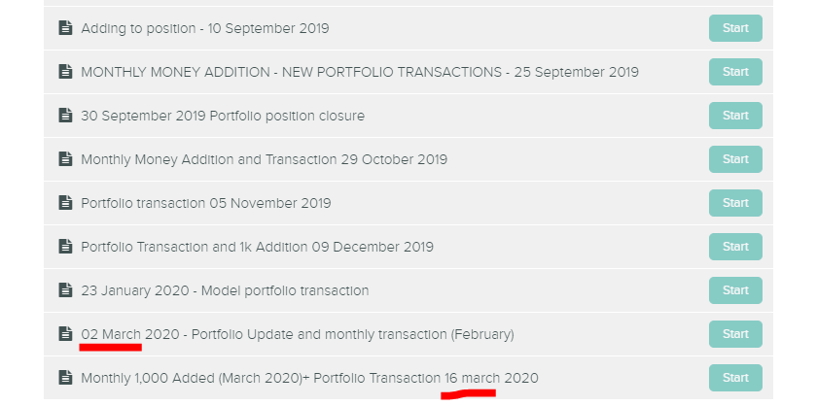
HOW & WHEN TO BUY STOCKS IN A VOLATILE MARKET
MY STRATEGY BASED ON A PH.D., 20 years of experience, accounting professorship and on what my grandma told me!
I BUY WHEN I HAVE MONEY AND WHEN I LIKE THE INVESTMENT I AM BUYING!
1) HISTORICAL RETURNS RELATED TO STRATEGY
LUMP SUM (ALL IN ONE)
DOLLAR COST AVERAGING
2) INVESTING VS. SPECULATING
3) THE IMPORTANCE OF BUYING AT THE RIGHT TIME – PERFECT MARKET TIMING
4) MY STRATEGY THAT WORKED THE BEST OVER THE LAST 20 YEARS

Slide 25
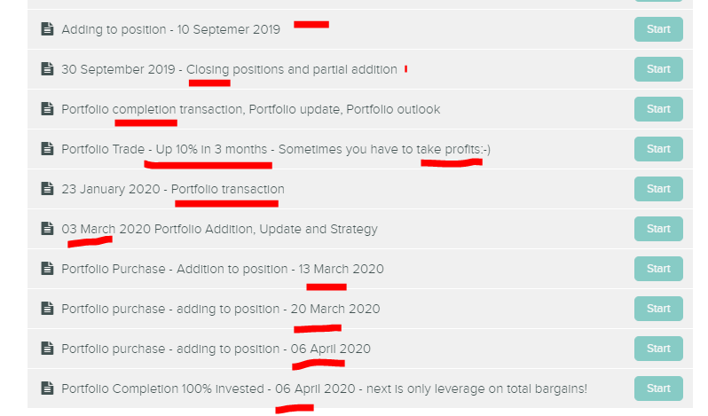
HOW & WHEN TO BUY STOCKS IN A VOLATILE MARKET
MY STRATEGY BASED ON A PH.D., 20 years of experience, accounting professorship and on what my grandma told me!
I BUY WHEN I HAVE MONEY AND WHEN I LIKE THE INVESTMENT I AM BUYING!
1) HISTORICAL RETURNS RELATED TO STRATEGY
LUMP SUM (ALL IN ONE)
DOLLAR COST AVERAGING
2) INVESTING VS. SPECULATING
3) THE IMPORTANCE OF BUYING AT THE RIGHT TIME – PERFECT MARKET TIMING
4) MY STRATEGY THAT WORKED THE BEST OVER THE LAST 20 YEARS

Slide 26
HOW & WHEN TO BUY STOCKS IN A VOLATILE MARKET
SO, MY MESSAGE IS:
DON’T TRY TO TIME THE MARKET
FOCUS ON OWNING BUSINESSES AT A FAIR PRICE
COMPARE RETURNS ON INVESTMENT
1) HISTORICAL RETURNS RELATED TO STRATEGY
LUMP SUM (ALL IN ONE)
DOLLAR COST AVERAGING
2) INVESTING VS. SPECULATING
3) THE IMPORTANCE OF BUYING AT THE RIGHT TIME – PERFECT MARKET TIMING
4) MY STRATEGY THAT WORKED THE BEST OVER THE LAST 20 YEARS

Slide 27
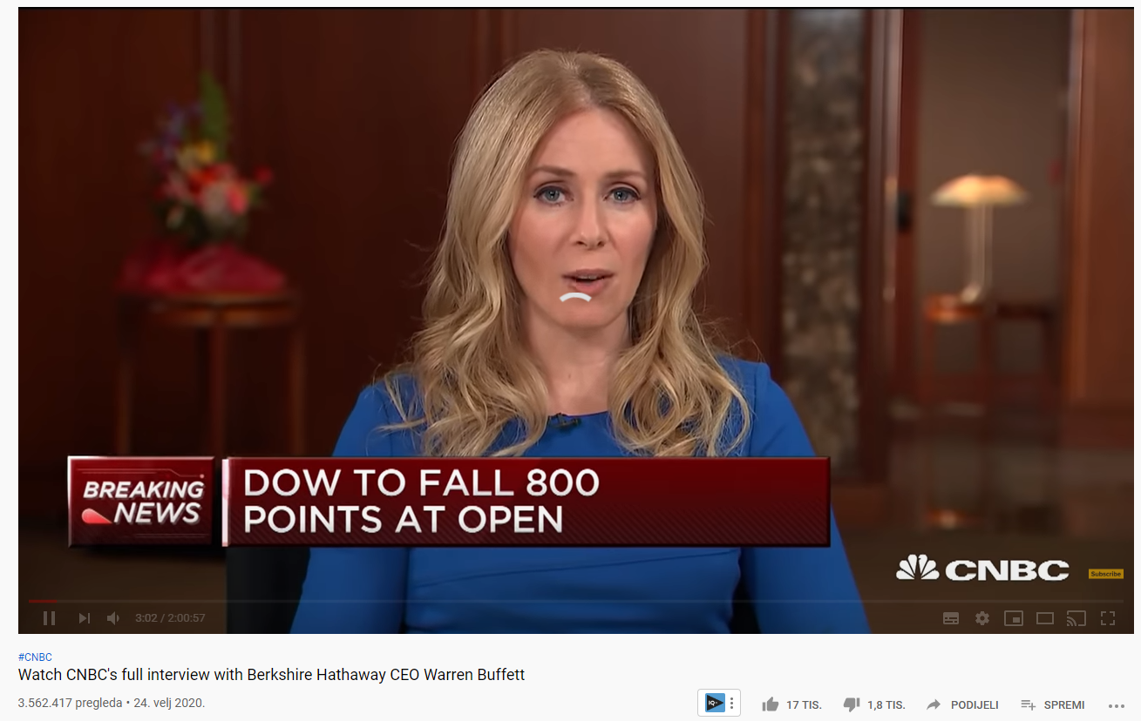
HOW & WHEN TO BUY STOCKS IN A VOLATILE MARKET
SO, MY MESSAGE IS:
DON’T TRY TO TIME THE MARKET
FOCUS ON OWNING BUSINESSES AT A FAIR PRICE
Don't GET FOOLED BY THE MEDIA ALWAYS DISCUSSING SHORT TERM PRICE MOVES!!!!!
1) HISTORICAL RETURNS RELATED TO STRATEGY
LUMP SUM (ALL IN ONE)
DOLLAR COST AVERAGING
2) INVESTING VS. SPECULATING
3) THE IMPORTANCE OF BUYING AT THE RIGHT TIME – PERFECT MARKET TIMING
4) MY STRATEGY THAT WORKED THE BEST OVER THE LAST 20 YEARS

Slide 28
HOW & WHEN TO BUY STOCKS IN A VOLATILE MARKET
SO, MY MESSAGE IS:
DON’T TRY TO TIME THE MARKET
FOCUS ON OWNING BUSINESSES AT A FAIR PRICE
Don't GET FOOLED BY THE MEDIA ALWAYS DISCUSSING SHORT TERM PRICE MOVES!!!!!
EVEN WHEN INTERVIEWING WARREN BUFFETT!!! CRAZYYYYYYYYY
1) HISTORICAL RETURNS RELATED TO STRATEGY
LUMP SUM (ALL IN ONE)
DOLLAR COST AVERAGING
2) INVESTING VS. SPECULATING
3) THE IMPORTANCE OF BUYING AT THE RIGHT TIME – PERFECT MARKET TIMING
4) MY STRATEGY THAT WORKED THE BEST OVER THE LAST 20 YEARS

