Slide 1
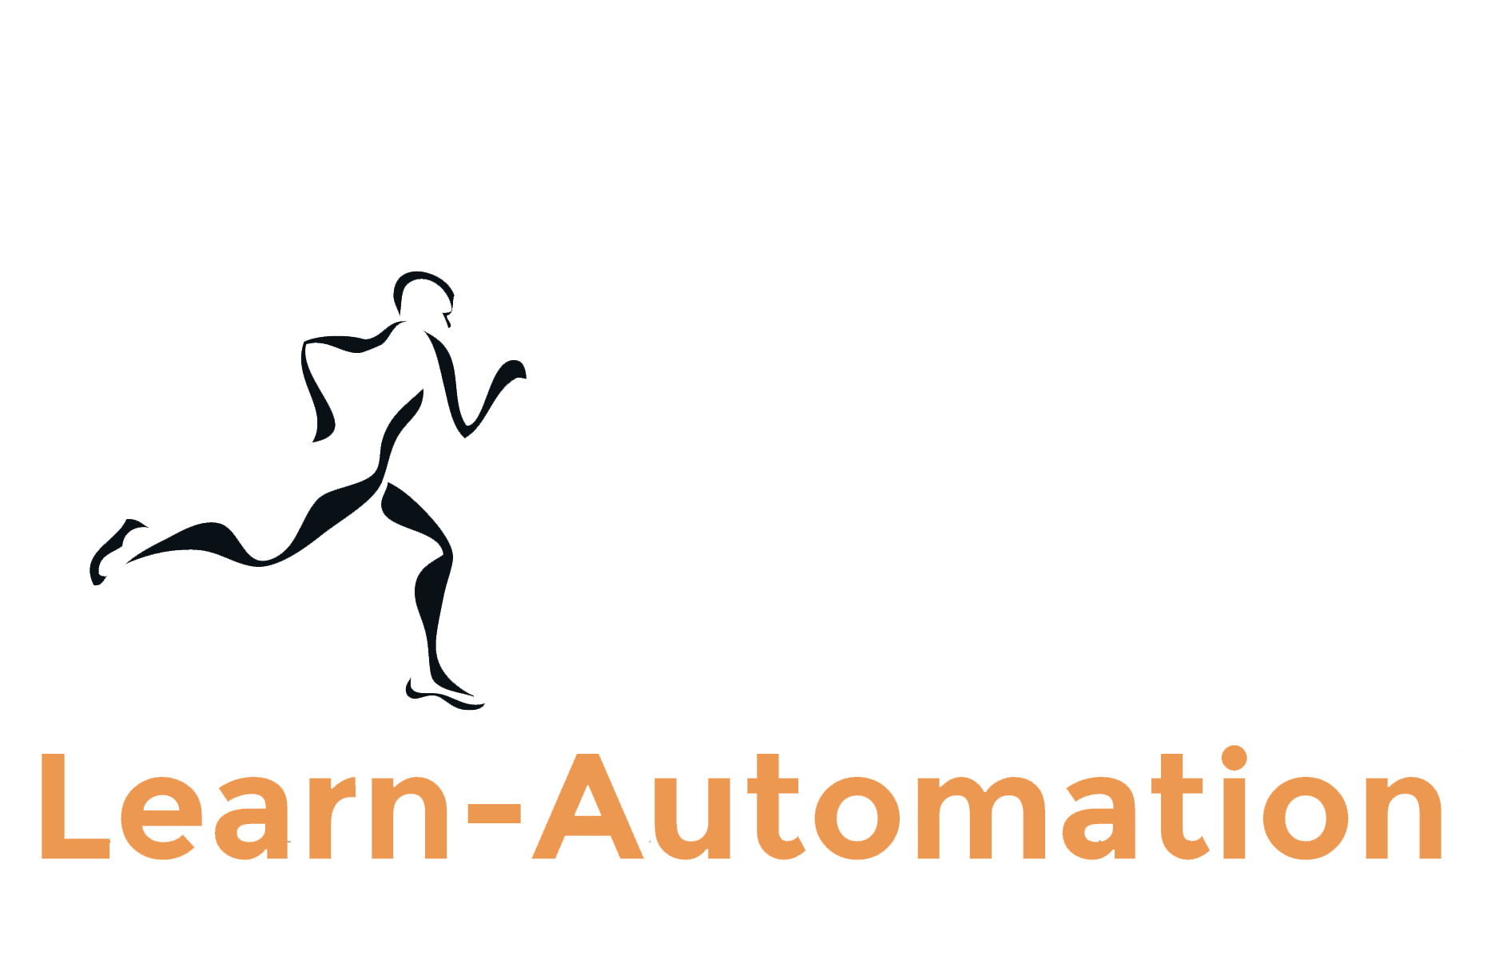
Selenium Webdriver Interview Questions Part 10
Mukesh Otwani
www.learn-automation.com

Slide 2
Question 91-What is framework.
Ans-
A framework is set of rule and guidelines which will help us to write test case in more efficient way.
Framework should have below features.
1- All test cases in proper structure.
2-Less code writing and no code duplication.
3-Easy to maintain the script.
4-Code reuse
5- Test data and config file should be separate from code.
6-Proper log should be maintained
7- Good reporting with screenshot attached.

Slide 3
Question 92- Type of automation framework.
Ans-
1- Data driven framework
2- Modular driven framework
3- Keyword driven framework
4- Hybrid framework

Slide 4
Question 93- How to explain framework in Interview
Ans-
1-Explain which framework you have used.
2- Explain Architecture and if possible draw the complete diagram.
3-Explain the component you have used and explain each module in detail.
4-What tools you have used and how you integrated.
5-What reporting and log features you have added.
6-What process you have followed.
7- What is end point of framework (How you are executing your test using framework)

Slide 5
Question 94- When you have used DDF
Ans
Explain in very clear way that you have only used for some scenario.
Example- Test application with multiple user and so on.

Slide 6
Question 95- How you are handling the test cases?
Ans
You can trigger the test from your end and send the report.
OR
You can handover the script to manual tester and let them run. They will update the status.

Slide 7
Question 96- Have you ever used any online repository to store the test.
Ans
Option 1- You can have all test with framework in machine and execute locally.
Option 2- You can update all test with framework on Server (github.com) and execute the Jenkins job which will take the data from Github directly and it will execute the test.

Slide 8
Question 97- Have you have integrated Selenium with Cucumber or any other BDD framework.
Ans
Try to cover this topic because now a days BDD is in demand.
Tell them direct answer that you have tried from your side for knowledge but practically not implemented for all test.
If you have really worked on BDD then no issue ☺

Slide 9
Question 98- How to import and export framework
Ans
In eclipse you have default feature to import and export the file in different format.
http://learn-automation.com/eclipse-tips-and-tricks/

Slide 10
Question 99- Database testing using Selenium
Ans
We don’t have any library in Selenium which will help you to connect with Database.
But yes we can use JDBC to connect with DB and get the content and verify the same.

Slide 11
Question 100- Keep exploring
Ans
I am done with the question but if you have any question in mind which you want me to add then please let me know.
I will cover in next videos.

Slide 12
Drop me an email- mukeshotwani@learn-automation.com
Visit http://www.learn-automation.com
Connect with us on Facebook, Google +,Twitter

