Slide 1
Room Setup 101: Making Your Space Work for You and Your Students

Slide 2
Why is the room setup so important?
Your classroom is where magic happens! Learning, growing, and having fun should be the focus of your room. It should feel like a safe and inviting space that you and your students want to come to everyday.

Slide 3
1. Where to Begin?
Let’s start with the most important: make your classroom a warm, welcoming, and inviting space. It should be clean, look nice, and smell good.

Slide 4
School, District, & Classroom Expectations
What do you need to have posted in your room?
Are there any guidelines your school has for your room set up?
How will you post and communicate student expectations?

Slide 5
Student Seating & Work Areas
Seats
Student seats should be organized in a way that you can easily see all students from any location that you will be at all times. Leave space for you to walk around the room and for students to line up.
Schedule
A student friendly schedule should be posted somewhere in your room that students can easily see.
Supplies
Determine how and where student supplies will go. Designate where you will store extra supplies so they are easily accessible throughout the year.

Slide 6
Cabinet & Storage Organization
Take time before the year starts to organize and know where materials will go so you can be set for the rest of the year.
Have a plan for how you will organize back to school supplies as students bring them.
You will also want to be sure you know how you (or students) will get supplies as needed.

Slide 7
Teacher Work Areas
Desk
Organize your desk for your own supplies. Have a system for keeping up with paperwork that you need. Create a filing system in a drawer with a file for each student. KEEP YOUR DESK FREE OF CLUTTER!
Small Group Table
Keep supplies you and your students will need close by. Have some type of cart or shelving system close by to organize and plan ahead. KEEP YOUR TABLE FREE OF CLUTTER!

Slide 8
Keep your classroom clean. Use Clorox wipes, disinfectant spray, and dust often. A clean space is essential for a successful classroom.

Slide 9
Hot Tips!

Slide 10
Less Can Be More
Not every space of your classroom needs to be filled up. Space is good. Students will fill up more space than you may think and they need an open environment to learn.

Slide 11
Classroom Inspo
Take ideas from social media sources (Pinterest, Instagram, etc.) if you like, but remember to make it your own. What works for one classroom or teacher may not work for you.
Your co-workers and other teachers in your building may have even better ideas that could help you more.

Slide 12
$$$$$$
Do NOT go out and spend your money on items you THINK you may need. Wait to see what your classroom looks like and get advice from other teachers on your campus. Spend your money on items that are functional as well as cute.

Slide 13
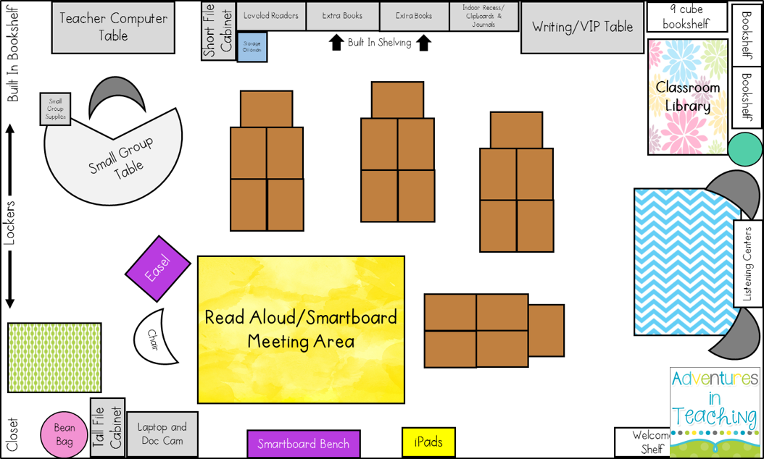
A picture is worth a thousand words
A complex idea can be conveyed with just a single still image, namely making it possible to absorb large amounts of data quickly.

Slide 14
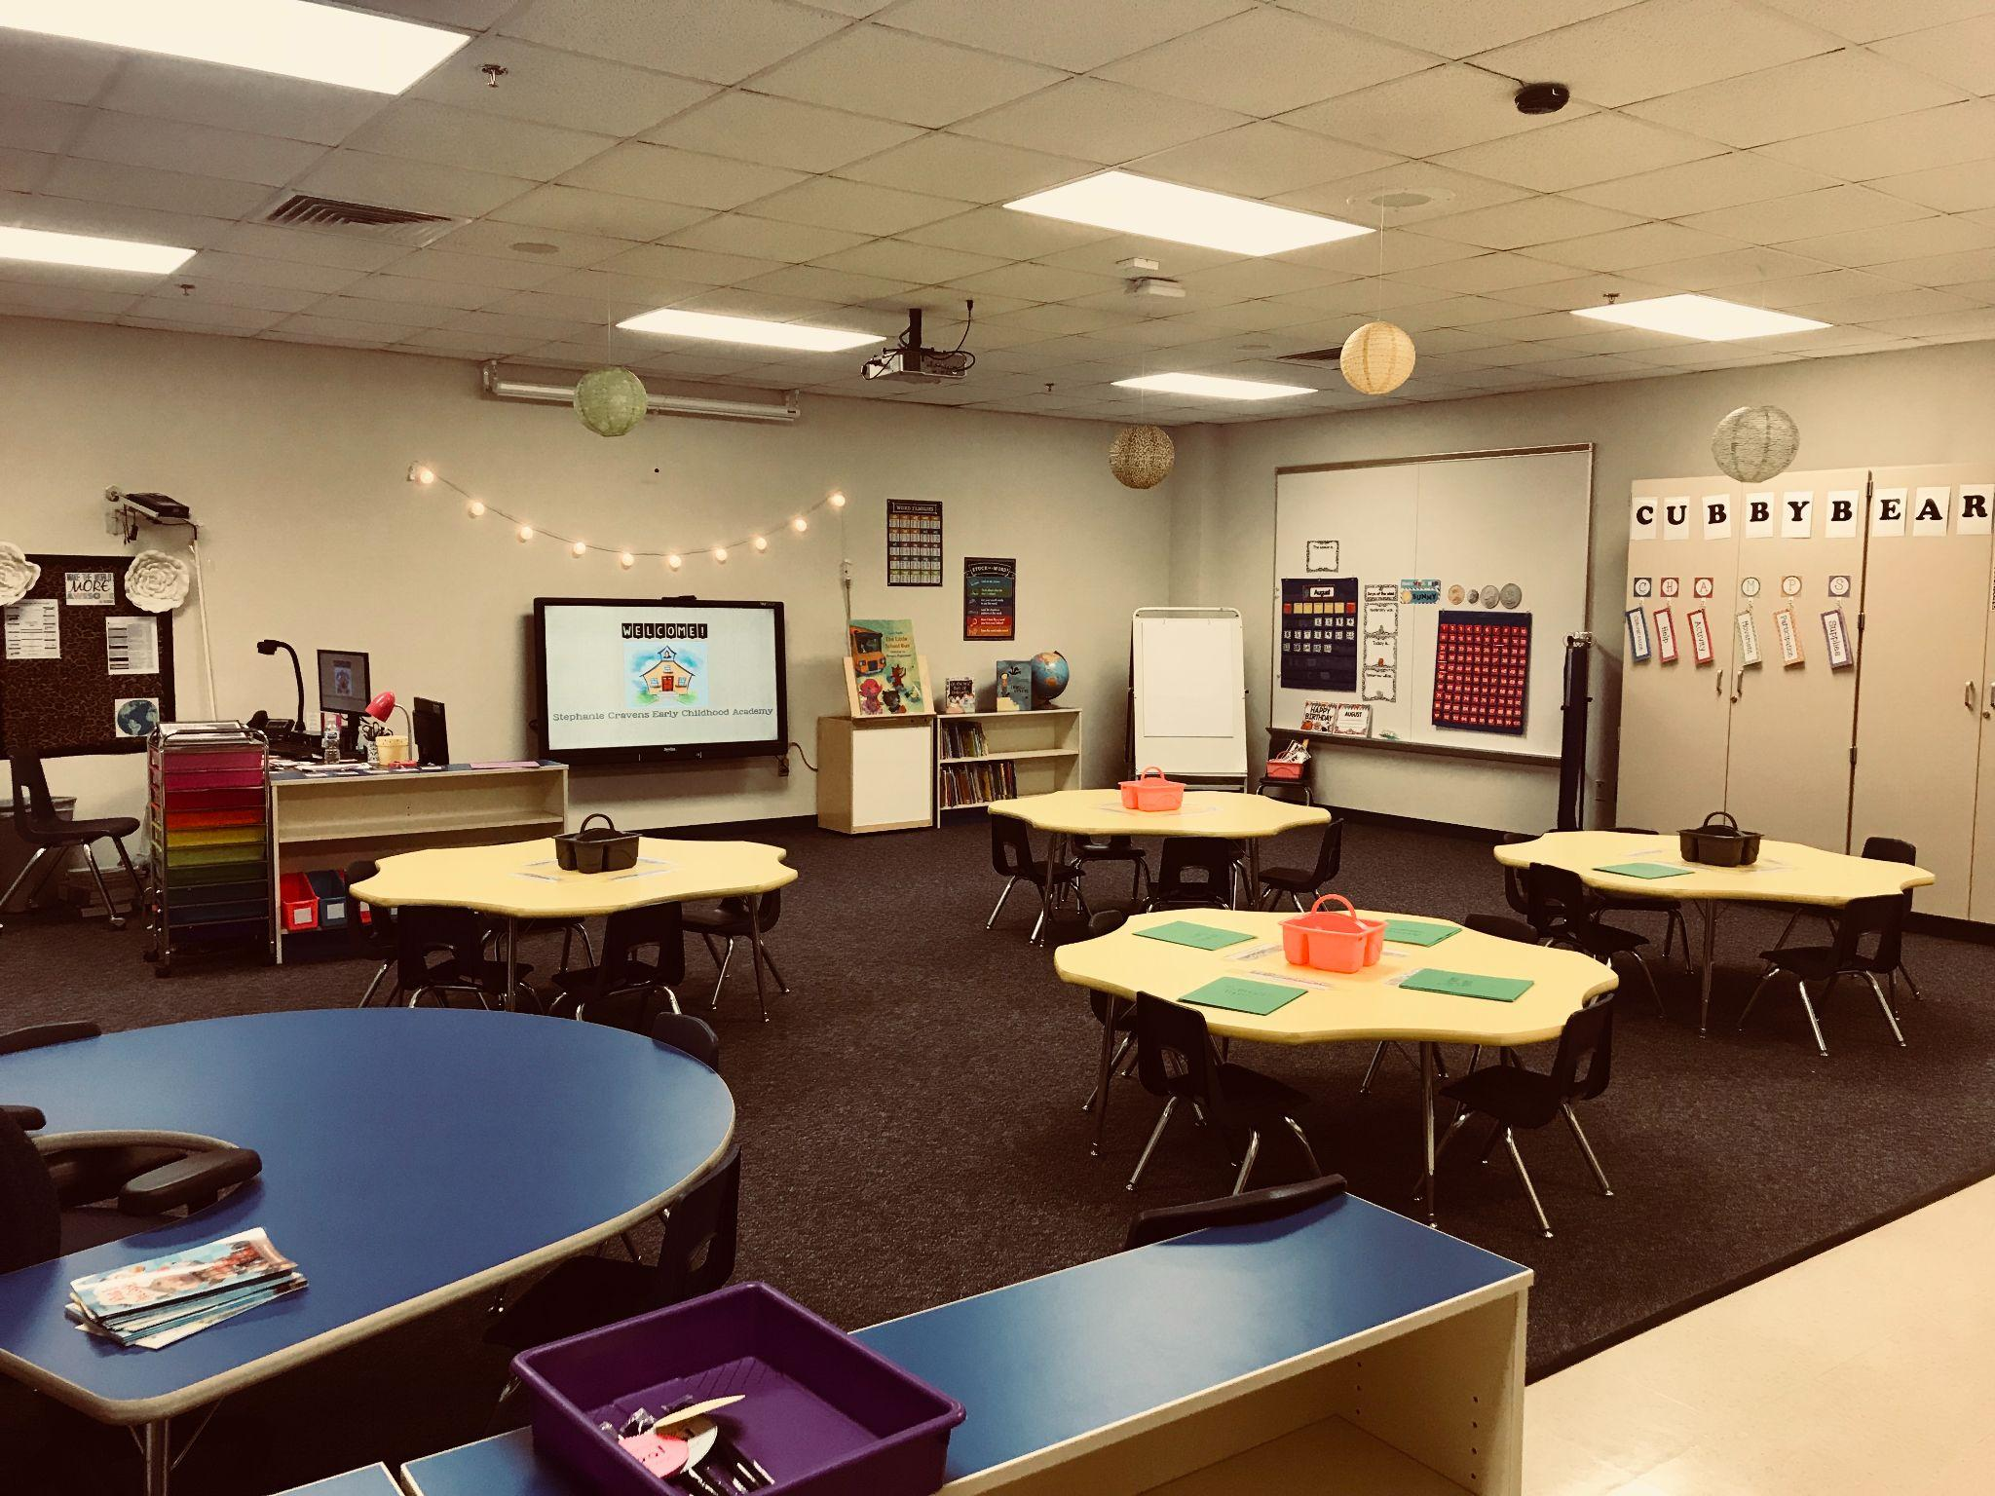
Want big impact?
Use big image.

Slide 15
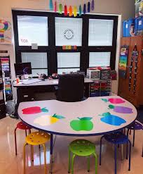

Slide 16
