Slide 1
Management Kits Leadership Development Kit Kit Board Quick Guide
© 2018 Management Innovation Services GmbH

Slide 2
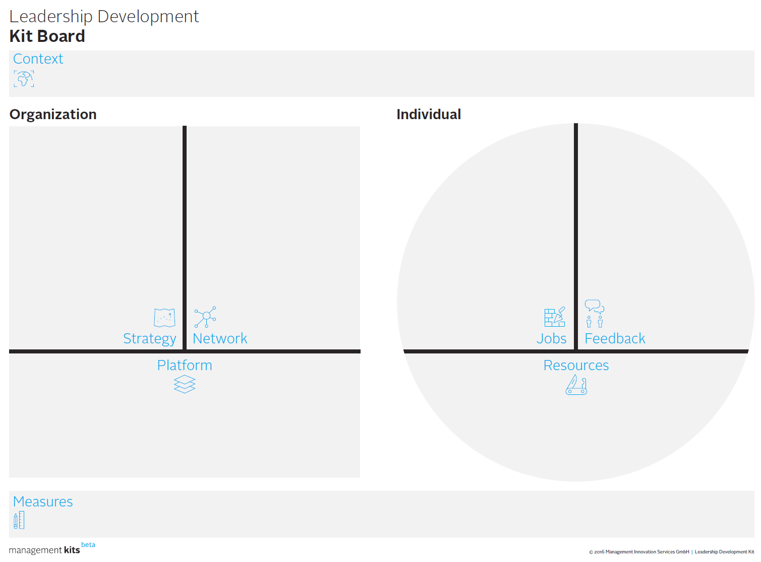
Leadership Development Kit – the Kit Board Canvas is a practical tool to map out an LD model …

Slide 3
… covering key elements of developing leadership capabilities in an organization
What are crucial context factors (like business cycle, industry trends, leader population) for our LD approach?
Which leader-follower relationships are crucial for our LD efforts?
How do we integrate job assignments and leadership learning?
How do we provide feedback to our leaders to reflect on their performance and develop?
What are priorities of our LD efforts, and how do they support strategic objectives?
How do we shape the structure of our LD initiatives and how can we leverage existing platforms?
Which resources (trainings, tools, and support) do our leaders need to strengthen their leadership capacity?
How does success look like and how do we monitor impact?

Slide 4
Driving effective LD efforts starts with establishing an organization’s specific context
Lead Questions
How does an organization’s leadership demography look like?
What is seen and understood as ‘good leadership’ today?
Where does the company stand in terms of competition and business cycle (high growth, turn-around, etc.)?
What type of culture does the company have? What are key cultural norms and behaviors people adhere to?
What are new upcoming leadership challenges in the current context?

Slide 5
On the organizational level, strategy, network and platform are key elements to build LD capabilities
Lead Questions
Strategy: What are key leadership challenges implied in our strategy? How does our enterprise strategy inform our LD strategy?
Network: What are formal and informal networks existing today in our organization – both within and to the outside? Which networks could be strengthened to support leader-follower relationships?
Platform: How do we structure our approach towards leadership development? How can we leverage existing platforms?

Slide 6
Individuals learn leadership on jobs, through reflection and feedback, leveraging resources
Lead Questions
Jobs: What are key jobs that drive the strategy and provide opportunities for LD?
Feedback: What are opportunities for individuals to solicit or give feedback? How can individual ‘feedback agency’ be built and developed?
Resources: what are key resources individuals need to have or employ in their jobs (trainings, skills, knowledge, ‘how-to’ guidance)

Slide 7
Define measures that capture outcomes of your LD work – how would success look like?
Lead Questions
How would success look like for your LD efforts?
What would be measurable indicators of this success that (directly or indirectly) reflect an increase in leadership capabilities in your organization?
Are there measurement systems in place that could be leveraged for LD purposes?

Slide 8
Leadership capabilities have to be built in the interplay of organization and individual
An organization’s strategy gives rise to jobs that need to be done and in which leadership can be experienced and learned – and that drive the strategy
The social network provides primary opportunities to receive feedback and reflect on leadership – and directs network building efforts and engage in leader-follower relationships
An organization’s platforms provide resources to individual leaders – and resources can be leveraged to use existing platforms for leadership development purposes

