Slide 1
Stages of reducing costs in your restaurant’s kitchen
1. Identify
cost
Factors
2. Confront
3. Control

Slide 2
Accomplishments in previous postings
Casa del Rio, Melaka
Reduced food cost from 47% to 30% within 1st month of starting on the job
Reduced cost of fuel by 30%
Swissbelhotel Golden Sand resort and spa, Hoi An
Reduced food cost from 41% to 30% after 1 month of starting work
Sokha beach resort, Sihanoukville
Changed menu to highlight local seafood. Did away with expensive imported meats
Sedona hotel Yangon
Maintained food cost at 25% vs. budget of 32%
Sourced for local farmers who were able to give us quality products at local prices
Made use of such products to substitute ingredients required in original recipes

Slide 3
Day 1 schedule:
Identify main cost factors
Confront identified cost factors

Slide 4
https://youtu.be/eSMxbWUkTwA

Slide 5
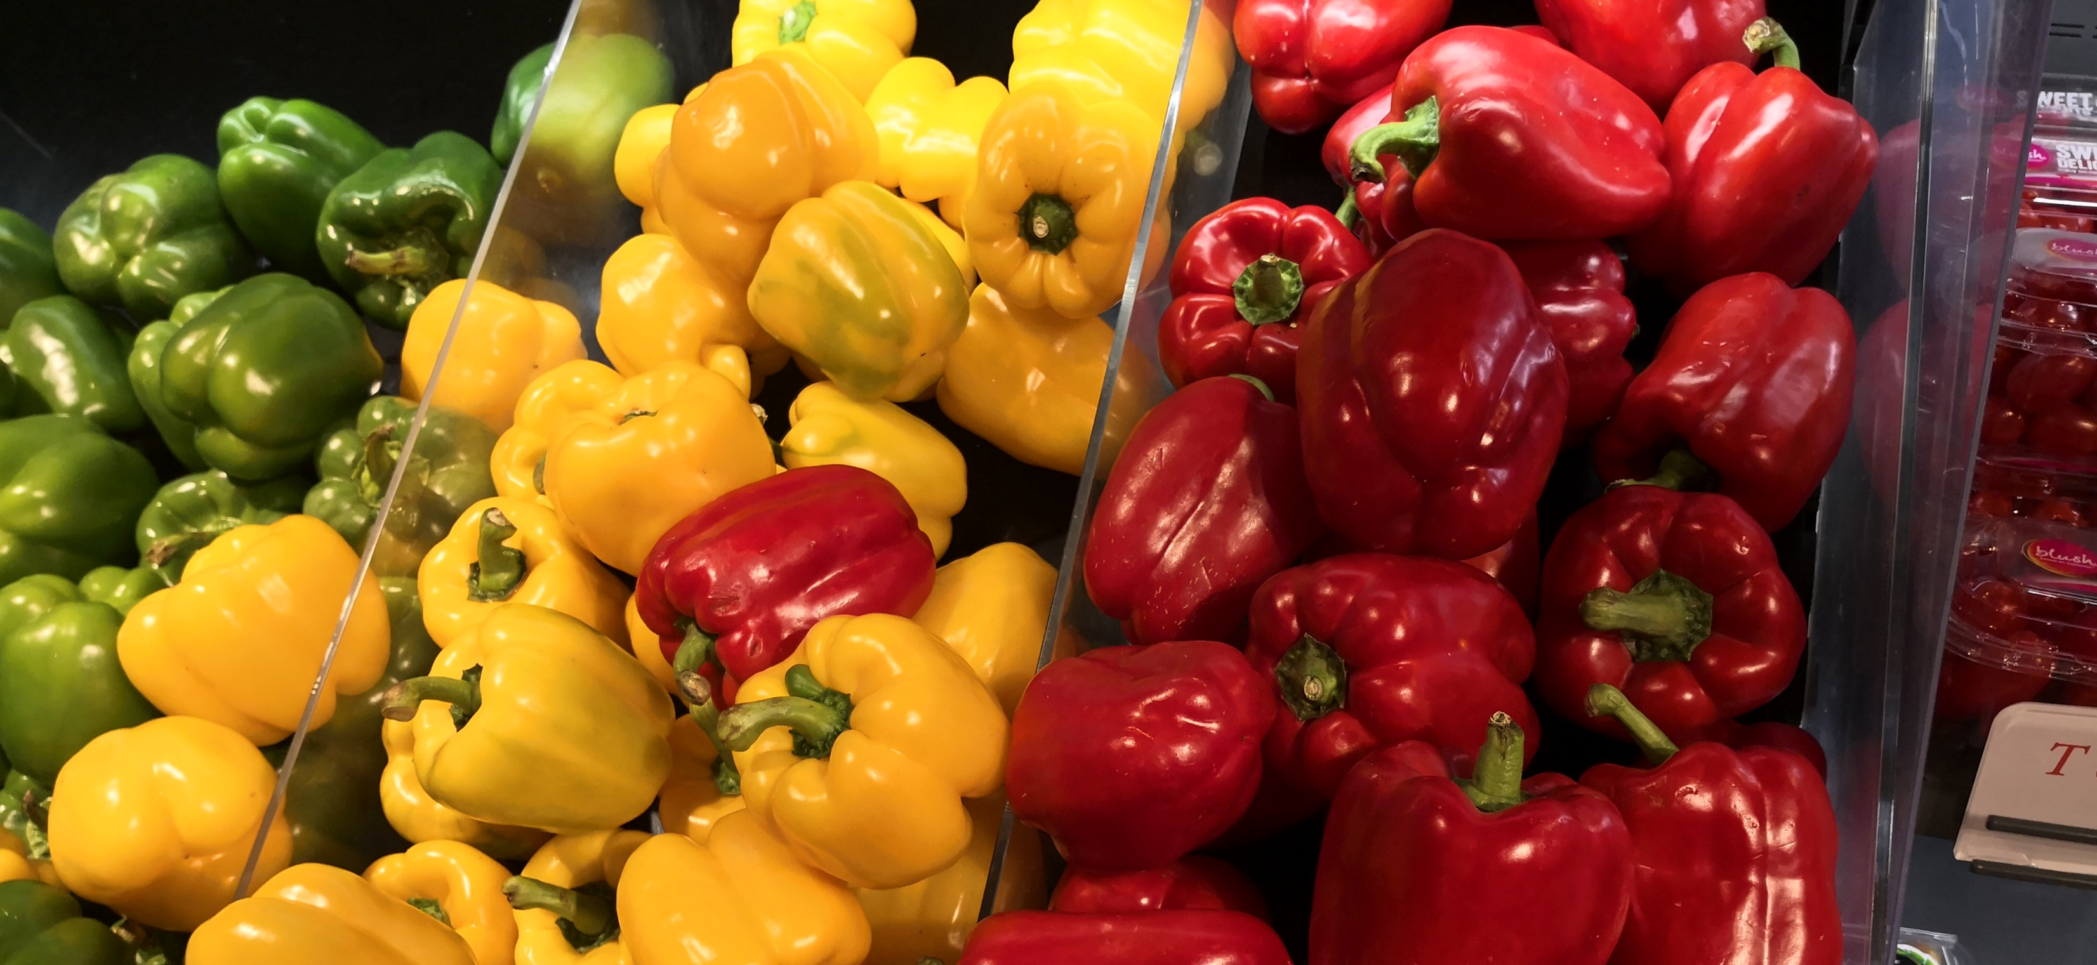
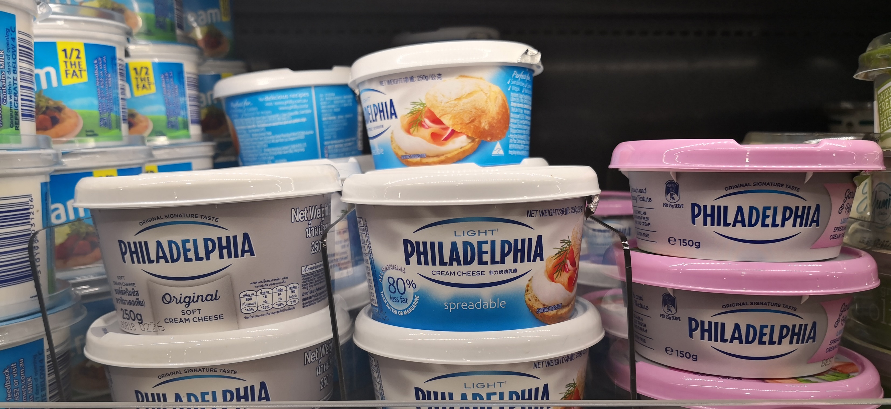
Identify main cost factors
Menu selection
Recipes,
Choice of ingredients
used
4. Suppliers,
5. Inventory,
6. Wastage.
7. Food safety,

Slide 6
Identify main cost factors:
1 .Menu selection
In line with your business concept
Too many dishes, too much garnish
Stands out from your competition
2. Recipes
Recipe costing,
Portion size
Help you to forecast purchases to meet demand

Slide 7
Identify main cost factors
3. Choice of ingredients used
For production of menu items sold to your guests
Include expense of meats, dairy, vegetables etc.
State of process of ingredient, fresh, dried, canned or frozen
Packaging state of ingredient, individually or bulk packed

Slide 8
Identify main cost factors:
4. Suppliers
Able and willing to advise you, for products they sell,
Types of items processing
Packaging alternatives available
5. Inventory
Effective purchasing management
Have a minimum par stock
Have a maximum par stock

Slide 9
Identify main cost factors:
6. Wastage
Order correct quantity of ingredients
Prepare according to forecast
Over portioning, overcooking
7. Food safety
Proper storage
Rotation of stock

