Slide 1
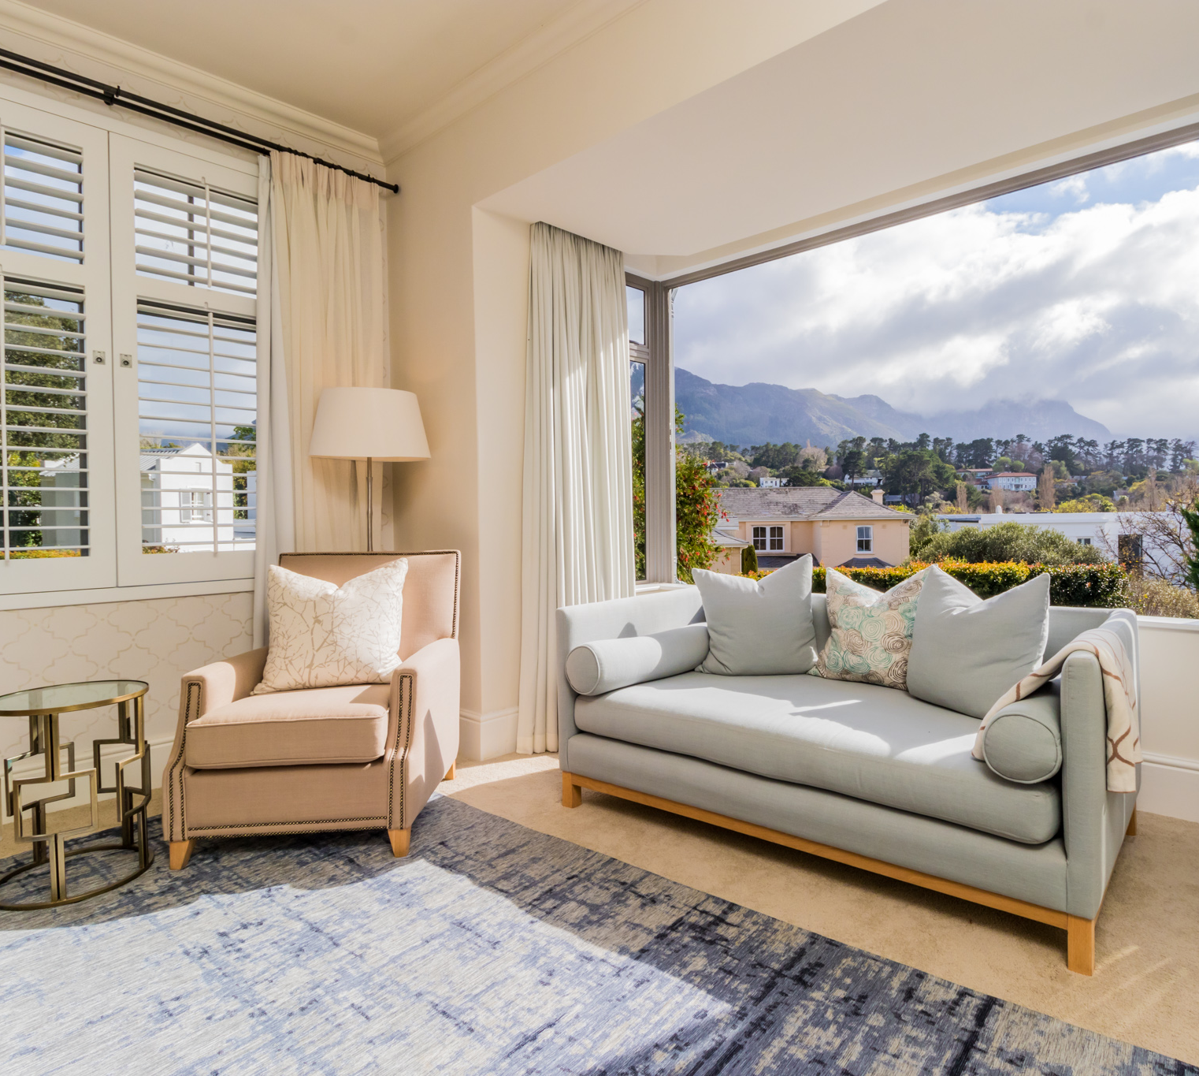
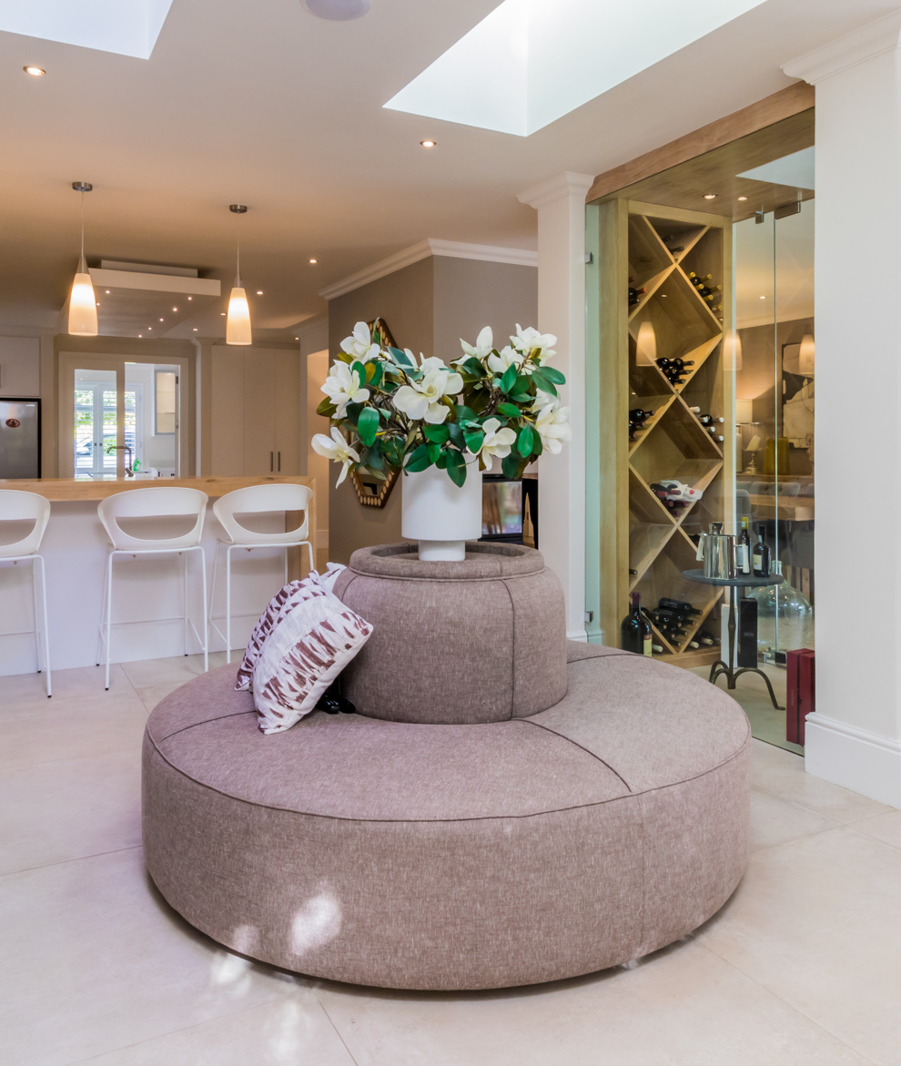
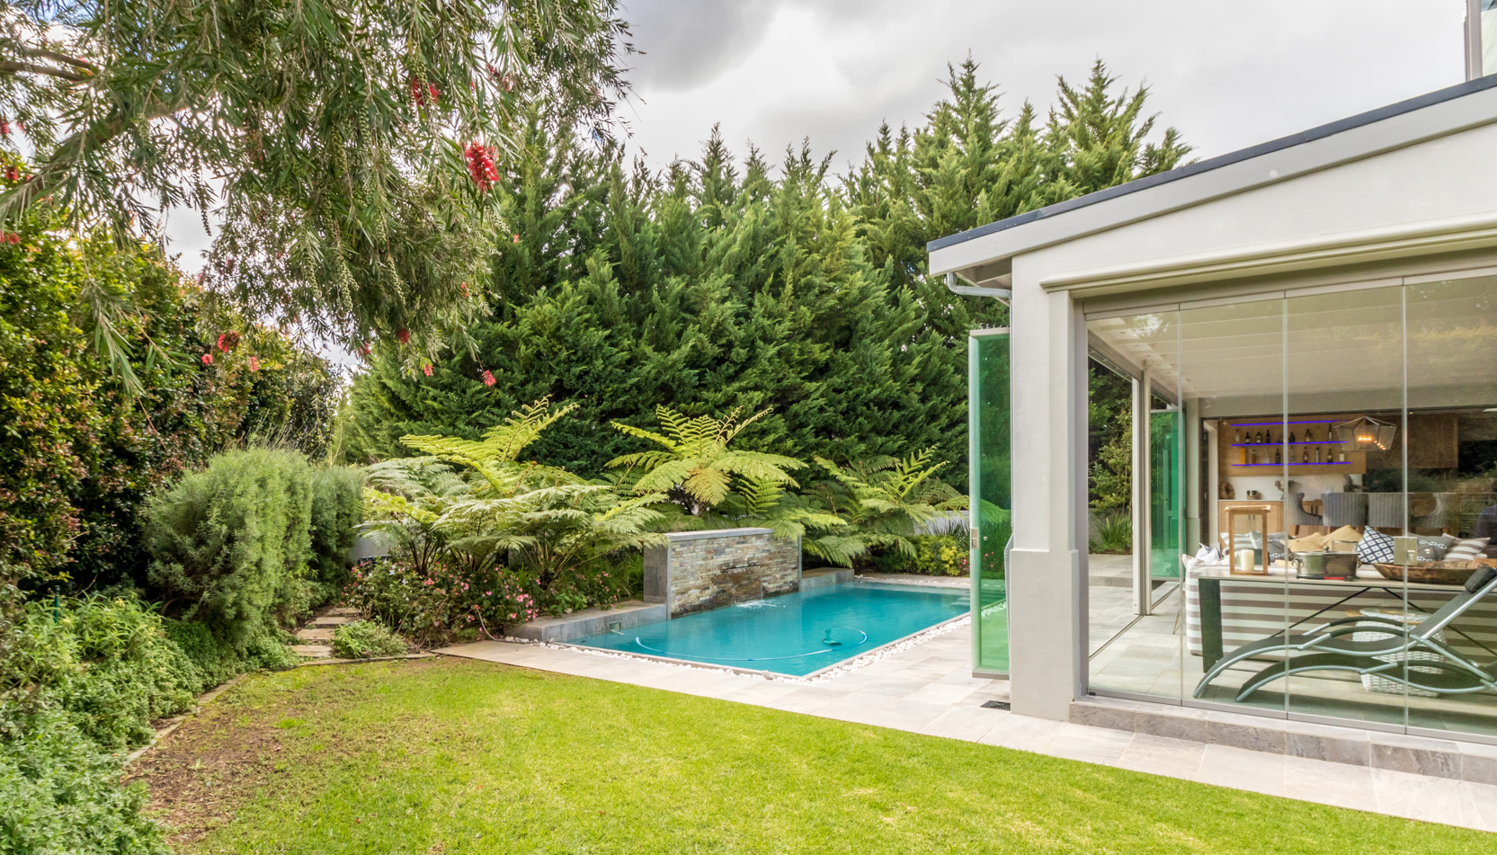
Show House
SUNDAY 14H00 – 17H00
Hyde Park
10 Main Street

Slide 2
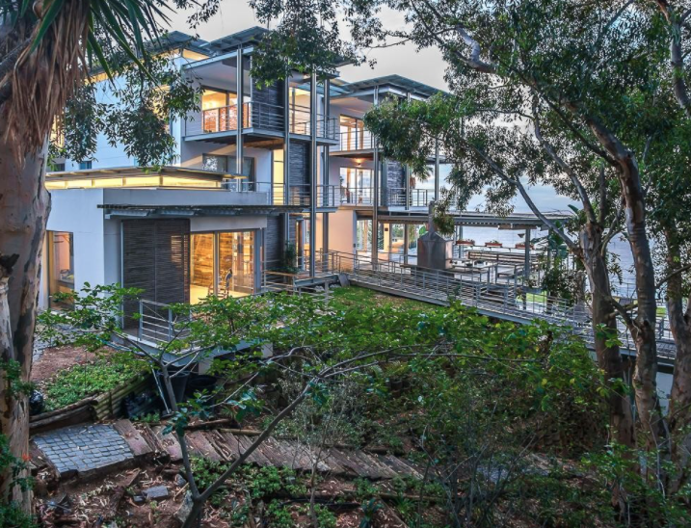
Show House
SUNDAY 2 – 5PM
Hyde Park
Johannesburg
NOTHING COMPARES.

