Slide 1
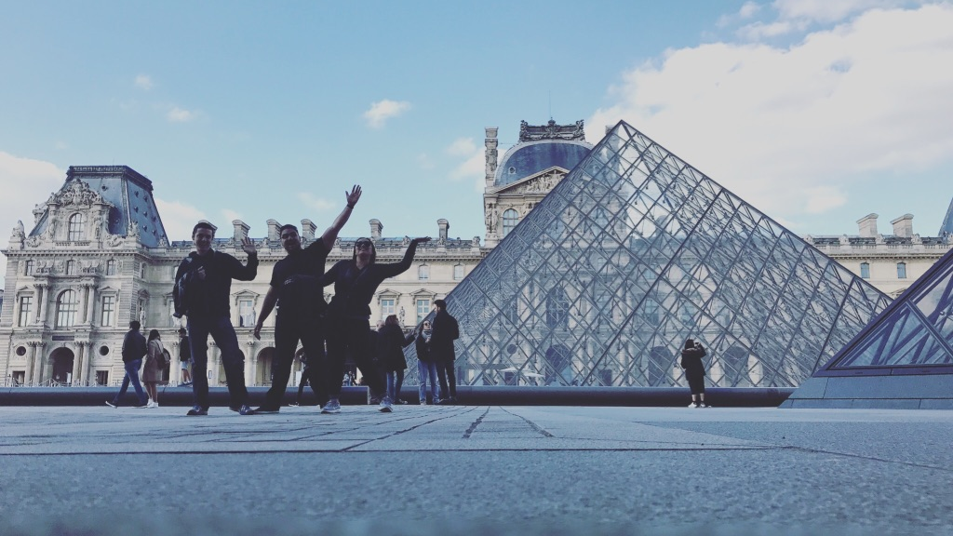
Introduction

Slide 2
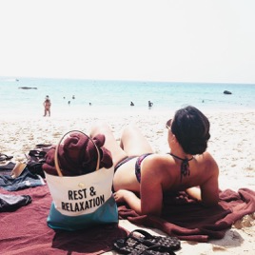
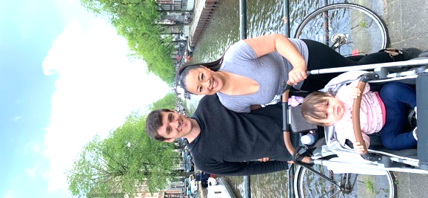
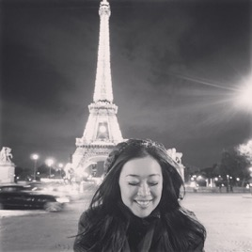
Introduction
Hi! I’m Ediza
Founder of HealthyGirlFashion.com, mother, wife, posher, and travel hacker. I’ve spent the majority of my married life, travel hacking my way around the globe all whilst running my small retail business on the side.
I started my online retail business by accident, selling my clothes on Poshmark, ThredUP, Facebook Marketplace, and others. My blog HealthyGirlFashion.com was a way to help other people gain success selling fashion from their own home and becoming successful. It’s still going strong with over 10k organic views a week and growing.
I’ve been to over 20 countries, 4 continents, and traveled around the world 4 times. I’ve hacked my way into numerous airport lounges, first class flights, and hotel suites for not only myself but for my whole family. Travel, exploration, and curiosity is embedded into my blood. I can’t help but to seek out the next destination.

Slide 3
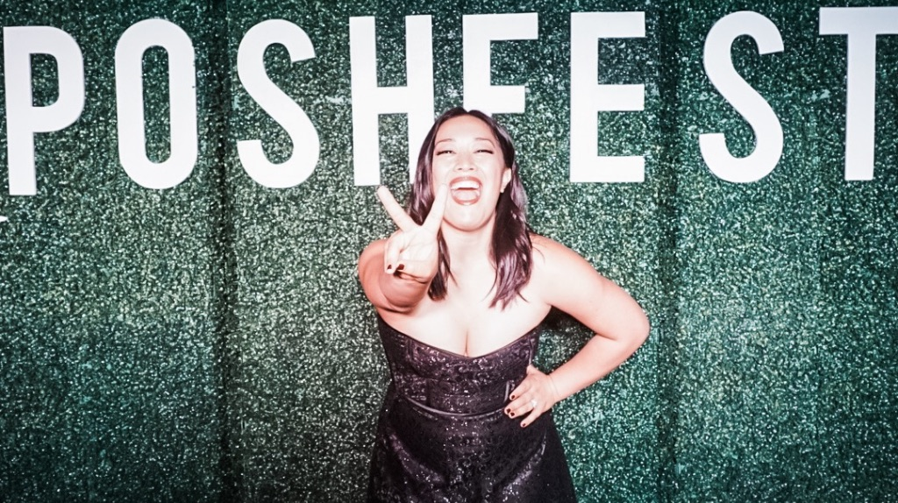

First
and foremost
I am a small business owner
Currently since I am a SAHM I take my resell business very seriously since it’s my only souce of income that I contribute for my family.
Second
I am a travel hacker
I cannot stop travelling
When I first got married I realized quite quickly that I wanted to explore the world, as much as I could.

Slide 4
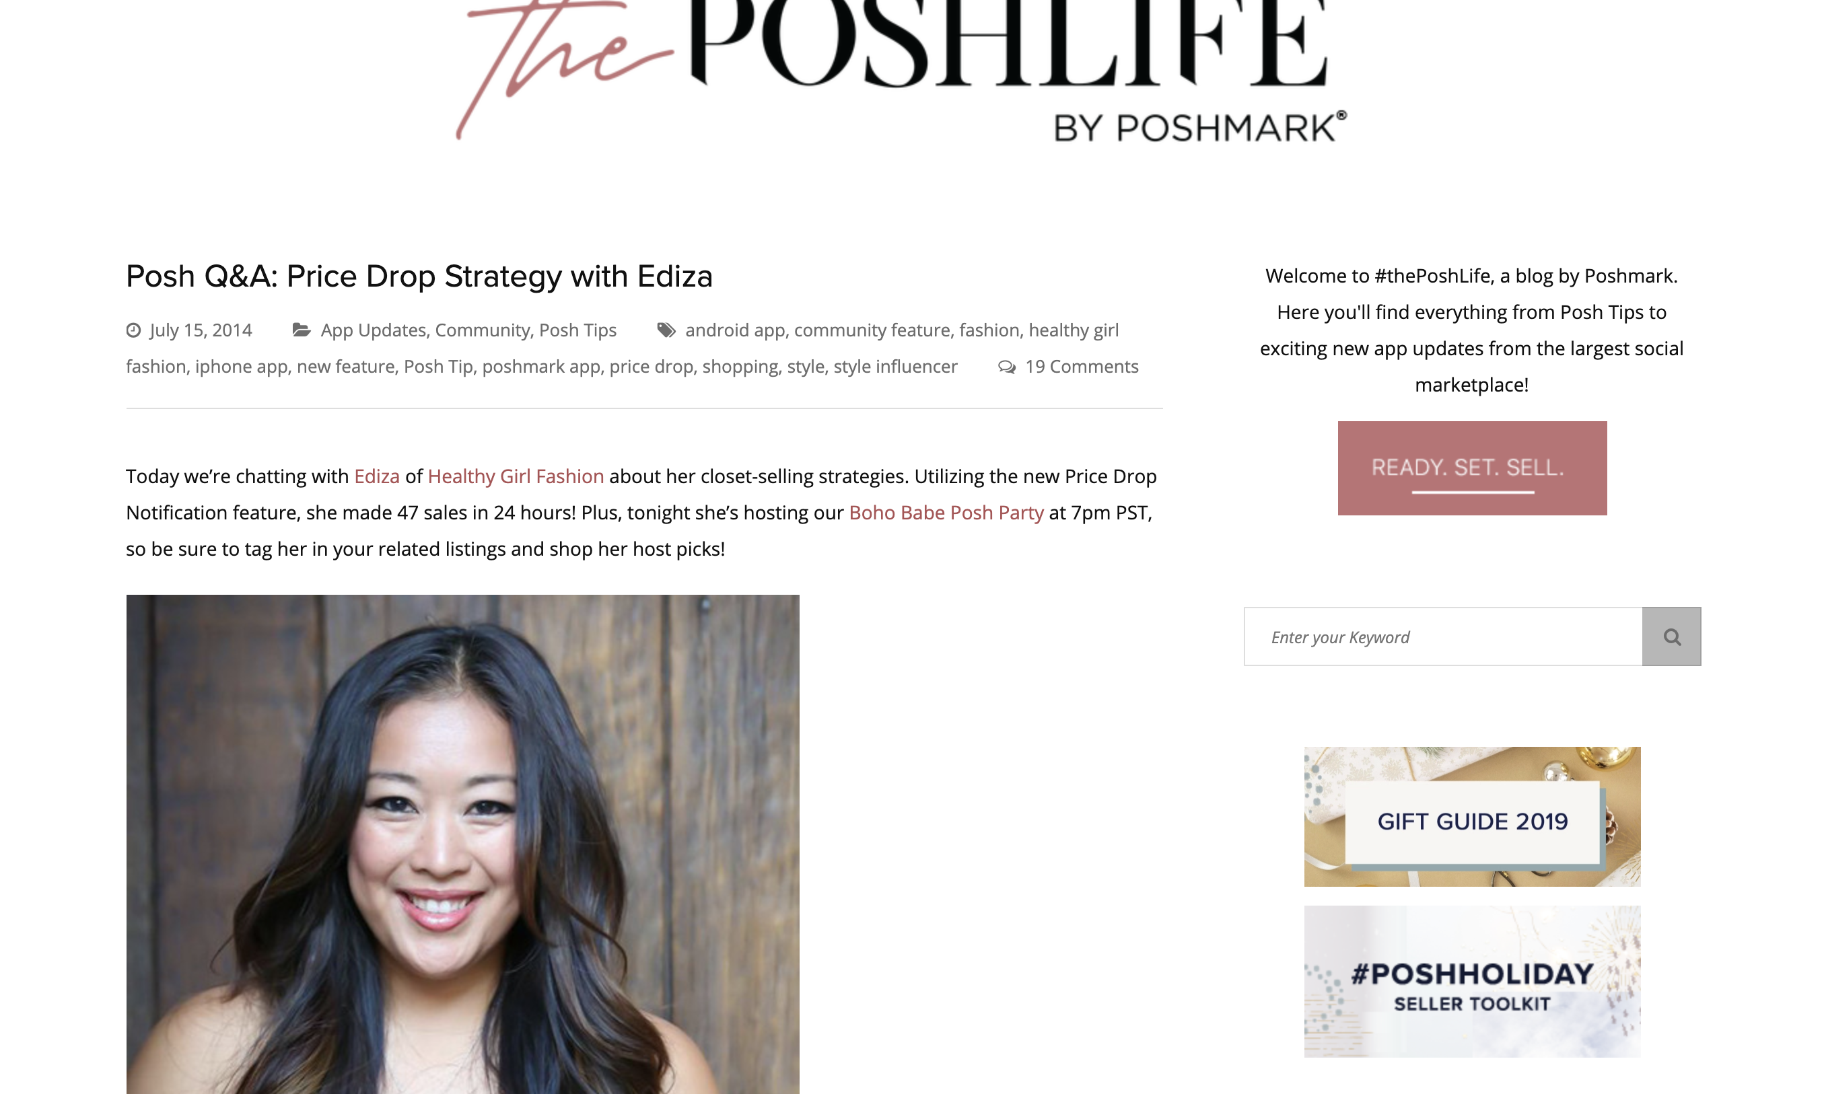
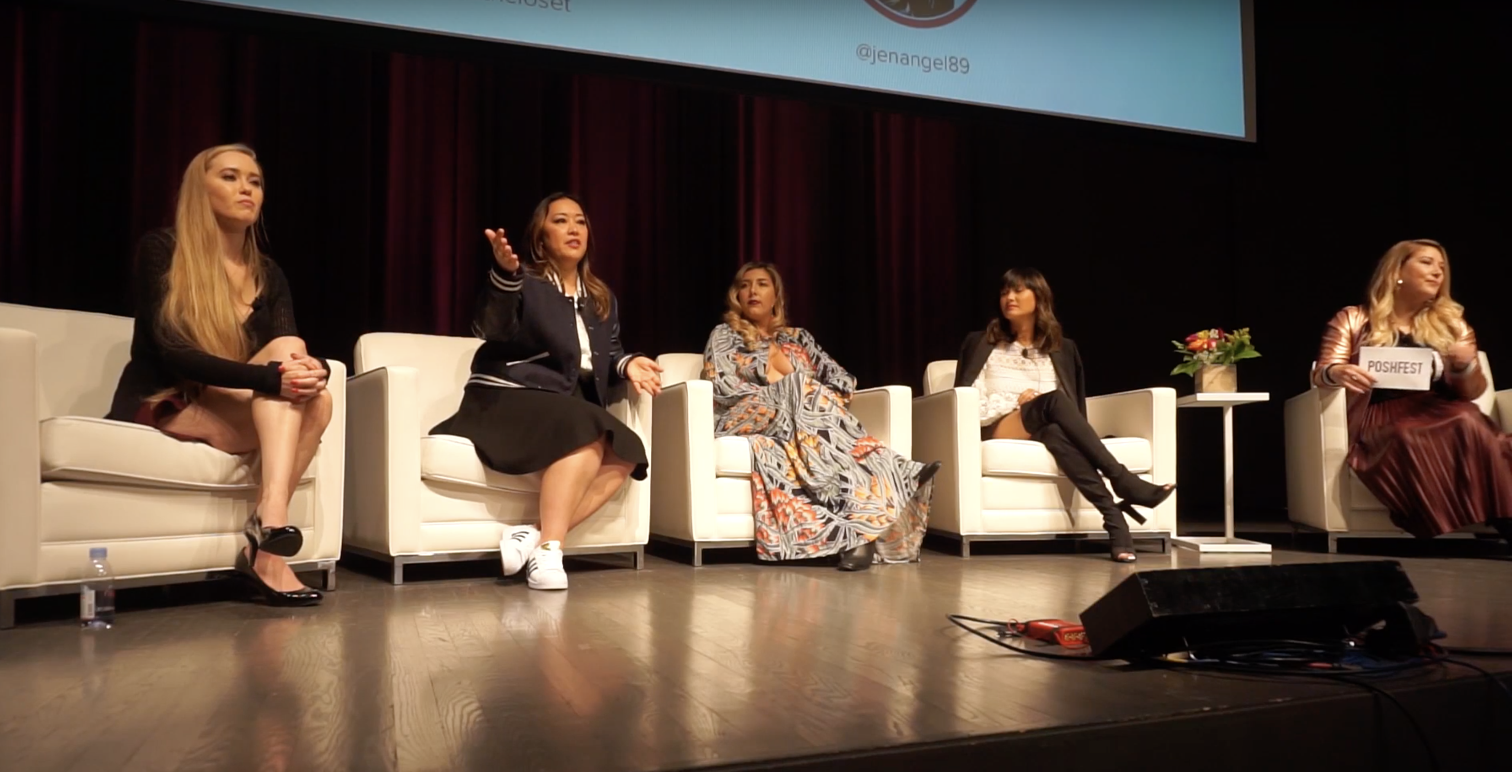
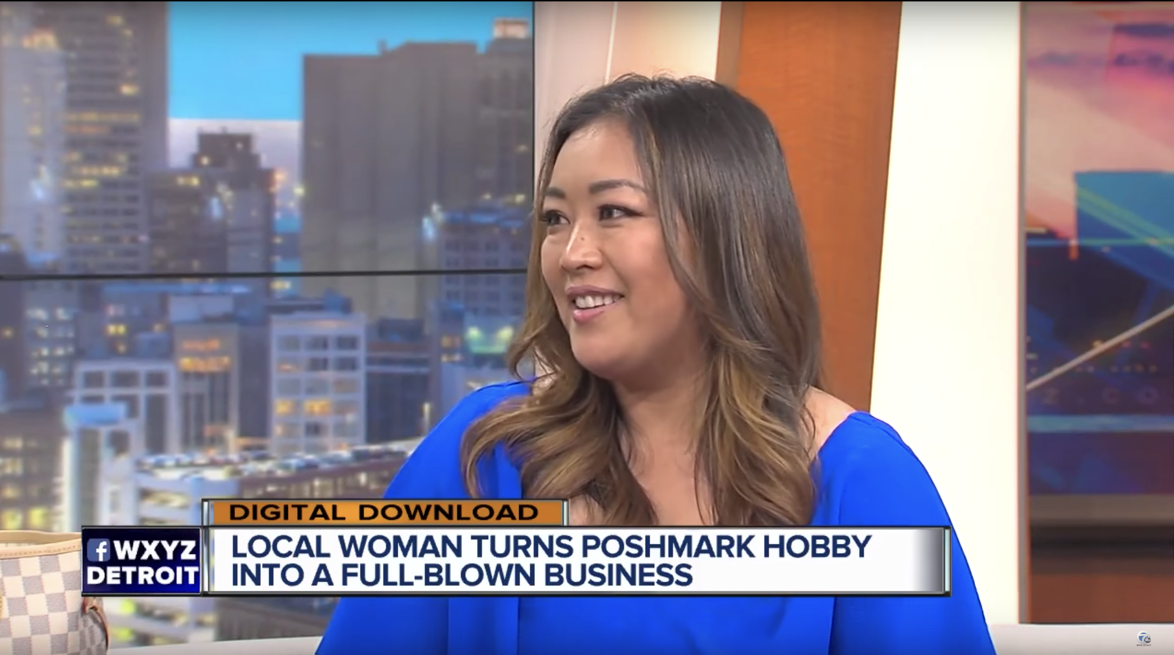
Reselling
all the time
Here are some of my milestones reselling
2014
2017
2017
Featured on Poshmar’s Blog for my Price Drop Strategy. How I sold 42 items in 24 hours.
Panelist at Poshmark’s Poshfest
Also featured on the local news sharing Poshmark tips.

Slide 5
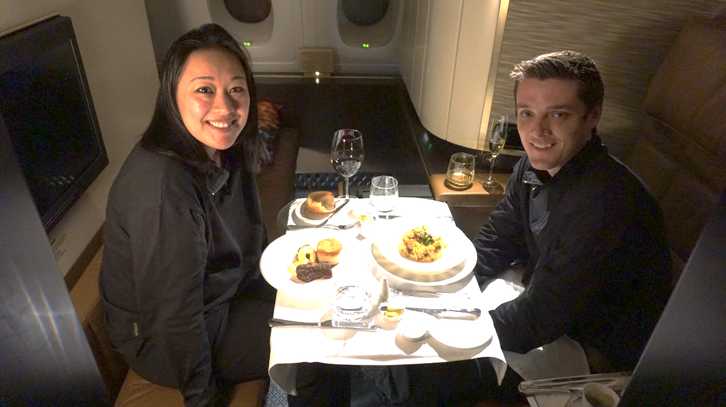
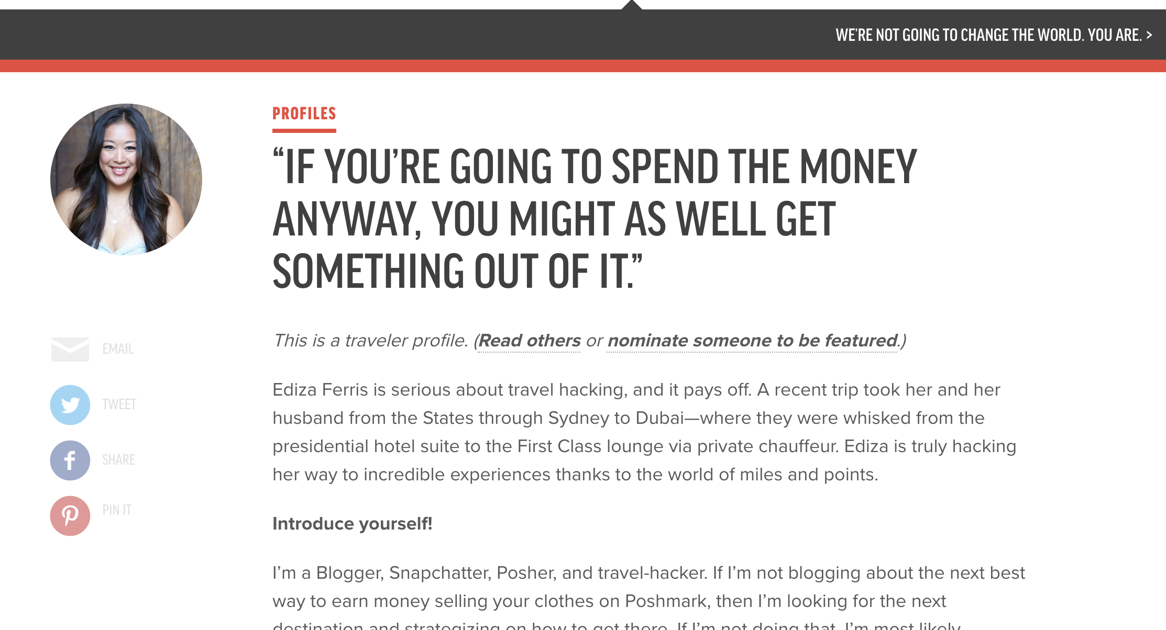
Travelling
all around the world
Here are some features and highlights from our time travel hacking.
2016
2017
2018
Made my first trip around the world in first/ business class, which included the Etihad First Class Apartments
Featured on Chrisguillebreau.com
Also featured in the book The Honeymoon Hack by Stephanie Zito

Slide 6
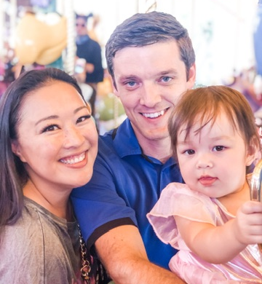
My Story
Focusing on the more in depth details about me
I’m just a regular person who learned from another person and tweaked it to fit my lifestyle.
Let’s just get this out of the way, we are NOT rich. Rich in points, for sure, but not in wealth. I would like to say that my resell business has catapulted me into super stardom and made me millions, alas it has not. I am still paying off my house and hoping to get the house painted. I still like to extreme coupon, and dig at the bins. I still send offers and buy things on clearance. I love to get a great deal and by travel hacking, I am still able to buy that CHANEL bag, or Disney Annual Pass that I saved up for instead of spending that on travel.

