Slide 1
Your Mind Is Everything
Perhaps it’s the only thing

Slide 2
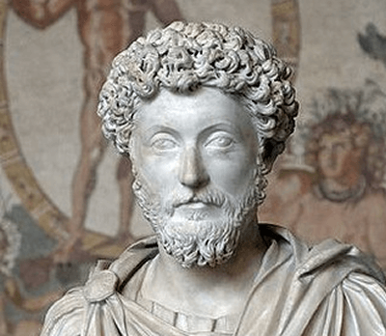
“Everything we hear is an opinion, not a fact. Everything we see is a perspective, not the truth.”
-Marcus Aurelius

Slide 3
Thoughts are energy and energy is interchangeable with mass
Every thought, feeling, and emotion you have you let into your consciousness and it is going to affect your life… because you ALLOW it to.
Principle number one is taking responsibility for your thoughts.

Slide 4
Are you responsible for your thoughts?
Who is?
How are they?

Slide 5
You can be “right” or you can be EFFECTIVE.
What is the most effective way to get what you want in life?
Being right or being effective?

Slide 6
EVERYTHING IS OPINION

Slide 7
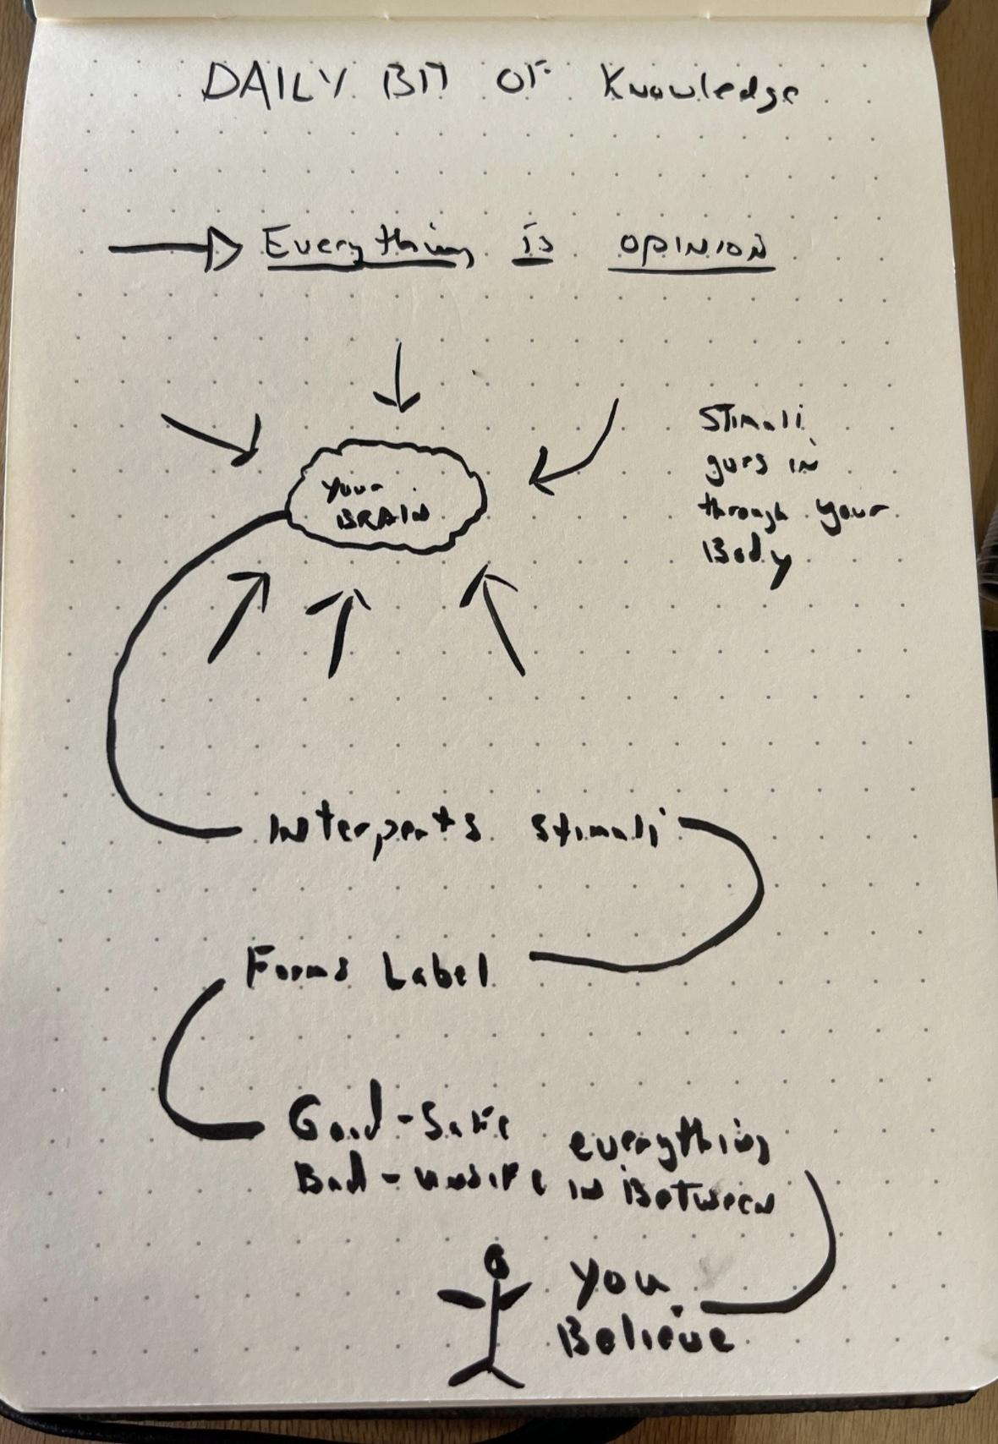
Your happiness, sadness, or averageness is
an opinion, a judgement, of your life.

Slide 8
Are you happy or unhappy with your finances?
That’s because you are better off than before or worse off than you think you should be.
Thus you are happy or unhappy based on the comparison to an ideal in your head.

Slide 9
Are you unhappy with your partner?
Think back to when you were happy; what changed?
Did you change?
Did your opinions change?
Did your values change?

Slide 10
Are you happy with your partner?
Do you think you can maintain your happiness when things change in future?
What ways can you combat the inevitable creep or time and adaptation?

Slide 11
Are you unhappy with your work?
List out the benefits of your work.
Think back to other crappy jobs you had. Imagine going back there.
Perhaps all you need is a perspective shift.

Slide 12
ALL OPINION
The thing about opinions is they are 100% your responsibility.
If you don’t like something, it is still your responsibility.
The Hard Truth: you are choosing to like or not like something.
If you really wanted to, you could appreciate anything and you could condemn anything. That’s how powerful your mind is.
And you should be in the driver seat.

Slide 13
There is no moral obligation to you
Most people fall victim to the ideal of right and wrong.
So when things aren’t going their way, they expect the Universe to “right itself.”
This leads to victim mentally and other mentally destructive thought patterns that keep people stuck.
The reality is, life is 100% your responsibility.
Your thoughts are 100% your responsibility.
Your results in life are 100% your responsibility.

Slide 14
NO ONE IS GOING TO LIVE YOUR LIFE FOR YOU
Mother Nature holds no court. She has no policy enforcers.
She doesn’t care if someone wrongs you.
Guess what? Most of the 6 billion other humans don’t care either.
Accept this, you must.

Slide 15
HOW THOUGHTS ARE FORMED

Slide 16
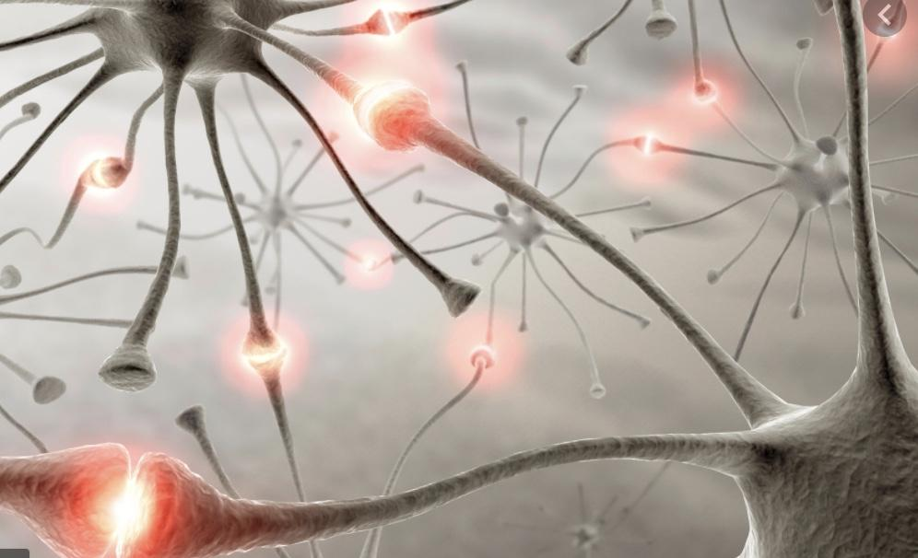
When a single neuron fires, it is an isolated chemical blip. When many fire together, they form a thought.

Slide 17
“Unconscious processes seem largely responsible for much of what we do habitually in daily life, and conscious processes seem largely responsible for making sense of what we do so that we can explain it to ourselves and others.”
Book: Mindwise

Slide 18
The estimated amount of behavior (and thought) that is automatic:
95%

Slide 19
What do we do with the 5% that’s conscious?
Find reasons to justify the 95%

Slide 21
When did you last form a thought?

Slide 22
When was the last time you
destroyed a bad thought pattern?

Slide 23
Our mental world is formed for us and without us.

Slide 24
And most people end up accepting whatever they become.

Slide 25
How To Change this

Slide 26
How you think determines everything
You are happy or unhappy or neutral with everything in your life based on your thoughts.
If you’re like most people, your brain has been doing this without your input for your entire life.
And it will keep on doing it if you don’t take proactive action.

Slide 27
Your goal now is to…
Stop labeling
Stop having any opinion at all (many things don’t deserve the attention)
Stop storytelling
Stop responding to the outside world

Slide 28
This process is called “becoming self-aware”

Slide 29
Become aware
By removing yourself from this automatic process, you give yourself the ability to change it. Until you can break the automatic spell, you will not be able to control it.
This is why step one is focused on becoming aware of these automatic thoughts, labels, stories, that run rampant in your mind.
The more awareness you cultivate, the more control you get.
Over time, you will prevent that inner voice from doing whatever it wants.
From there, you can build a new mental framework.

Slide 30
The 5 Step process

Slide 31
5 Steps
Accept reality - That you are in control of your mind and you alone. No one is responsible for what you think or how you feel.
Understand your mind - How it works, your mental defects, your bad thought patterns, your past, so you can wrangle it under control faster.
Become aware - Start noticing your thoughts so you can stop letting them run rampant. This process includes killing off and/or correcting bad thought patterns any chance you get.
Install new mental models - You will learn what mental software to install in this course.
Constantly question yourself and get feedback elsewhere. Remain hyper vigilant of your Ego as it will keep clawing back for control

Slide 32
Your thoughts affect your life

Slide 33
How they affect your life is up to you.

Slide 34
No one is going to control your thoughts for you...

Slide 35
In fact, the world will constantly challenge you and your thinking

Slide 36
The only way to control your destiny is to take complete control over your thoughts, and life

Slide 37
To start taking back control, start with awareness.

Slide 38
Focus on observing your thoughts. The mere act of watching your thoughts will reduce the frequency and severity of negative thoughts.

Slide 39
As you get better at observing and suppressing negative thought patterns, you can start adding new, better ways of thinking.

Slide 40
“Everything we hear is an opinion, not a fact. Everything we see is a perspective, not the truth.”
-Marcus Aurelius

Slide 41
Moving forward, every negative thought, feeling, or emotion is an opportunity to learn and grow.

Slide 42
Different modalities will bring you different results, but the constant is developing the HABIT OF BEING AWARE of your thoughts. This is the foundation of personal growth and development and why we put it at the top the list.

Slide 43
Bonus section

Slide 44
Awaken The Giant Within
Breeze-Through
Read the book + Read Nat’s book notes linked in lesson area

Slide 45
“Any time you sincerely want to make a change, the first thing you must do is to raise your standards. When people ask me what really changed my life eight years ago, I tell them that absolutely the most important thing was changing what I demanded of myself. I wrote down all the things I would no longer accept in my life, all the things I would no longer tolerate, and all the things that I aspired to becoming.”

Slide 46
How to create lasting change:
1. Raise your standards
2. Change your limiting beliefs
3. Change your strategy

Slide 47
“…I call “The Ultimate Success Formula,” which is an elementary process for getting you where you want to go:
1) Decide what you want,
2) Take action,
3) Notice what’s working or not, and
4) Change your approach until you achieve what you want.”

Slide 48
Three decisions that control your destiny:
1. What to focus on
2. What things mean to you
3. What to do to create the results you desire

Slide 49
“The truth of the matter is that there’s nothing you can’t accomplish if: 1) You clearly decide what it is that you’re absolutely committed to achieving, 2) You are willing to take massive action, 3) You notice what’s working or not, and 4) You continue to change your approach until you achieve what you want, using whatever life gives you along the way.”

Slide 50
Harness the Power of Decisions:
1. Remember the true power of making decisions
2. Realize that the hardest step in achieving anything is making a true commitment, a true decision
3. Make decisions often
4. Learn from your decisions
5. Stay committed to your decisions, but stay flexible in your approach
6. Enjoy making decisions

Slide 51
“One decision that has made a tremendous difference in the quality of my life is that at an early age I began to link incredible pleasure to learning.”
“Simply by linking pain to the behaviors we want to stop at such a high level of emotional intensity that we won’t even consider those behaviors any longer… Then, simply link pleasure to the new behavior you desire for yourself.”

Slide 52
Make Some Changes:
1. Write down 4 things that you’ve been putting off
2. Under each thing, write down “Why haven’t I taken action on this? In the past, what pain have I linked to taking action on this?”
3. Write down all the pleasure you’ve experienced in the past by indulging in this negative pattern. Why does it feel good to put these things off? What short term pleasures are motivating you to ignore the long term pains?
4. What will it cost you if you don’t change now? Be honest with yourself, what will it cost over the next month, year, decade if you don’t change this pattern.
5. Write down all the pleasure you’ll receive by taking action on these right now.

Slide 53
“We need to remember that most of our beliefs are generalizations about our past, based on our interpretations of painful and pleasurable experiences.”
“With enough emotional intensity and repetition, our nervous systems experience something as real, even if it hasn’t occurred yet.”
“If you’re going to make an error in life, err on the side of overestimating your capabilities”
“Achievers rarely, if ever, see a problem as permanent, while those who fail see even the smallest problems as permanent.”

Slide 54
“The only true security in life comes from knowing that every single day you are improving yourself in some way, that you are increasing the caliber of who you are and that you are valuable to your company, your friends, and your family.”

Slide 55
Changing in an Instant
“Why is it that most people think change takes so long? One reason, obviously, is that most people have tried again and again through willpower to make changes, and failed. The assumption that they then make is that important changes must take a long time and be very difficult to make. In reality, it’s only difficult because most of us don’t know how to change! We don’t have an effective strategy. Willpower by itself is not enough— not if we want to achieve lasting change.”

Slide 56
“Once we effect a change, we should reinforce it immediately. Then, we have to condition our nervous systems to succeed not just once, but consistently.”
“What are the two changes everyone wants in life? Isn’t it true that we all want to change either 1) how we feel about things or 2) our behaviors?”

Slide 57
“The first belief we must have if we’re going to create change quickly is that we can change now… You and I both know that when people finally do change, they do it in a moment, don’t they? There’s an instant when the change occurs. Why not make that instant now? Usually it’s the getting ready to change that takes people time.”
“The second belief that you and I must have if we’re going to create long-term change is that we’re responsible for our own change, not anyone else.

Slide 58
First, we must believe, “Something must change”— not that it should change, not that it could or ought to, but that it absolutely must.
Second, we must not only believe that things must change, but we must believe, “I must change it.”
Third, we have to believe, “I can change it.” Without believing that it’s possible for us to change, as we’ve already discussed in the last chapter, we stand no chance of carrying through on our desires.”

