Slide 1

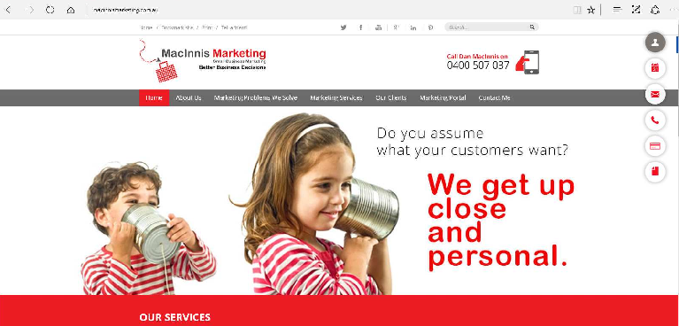
Attracting your ideal buyer
DECEMBER
 |  |  |  | 31

Slide 2
RReeaaddyy ttoo mmaakkee 22002109 the year that you’ll truly tackle marketing for your small business?
There’s no better time to start planning for the nneeww yyeeaarr tthhaann nnooww.. IInn oouurr 22001290 Marketing Planner, we’ll tackle a plan for deﬁning your target buyer, attracting the right type of prospect, converting more prospects into customers, and turning your customers into raving fans of your business.

Slide 3
CONTENTS
Step 1: Deﬁne Who You’d Like to Attract
Step 2: Attract Your Target Buyer
Step 3: Convert More Leads into Customers
Step 4: Turn Customers into Loyal, Raving Fans

Slide 4

STEP 1:
DEFINE WHO YOU’D LIKE TO ATTRACT

Slide 5
The ﬁrst step to a successful marketing plan is to set your sights on the type of customer you’d like to attract for your business.
Yes, there are bad customers...you know the ones. They require excessive time and resources to keep happy, but never seem satisﬁed.
On the ﬂip side, your ideal buyer is the perfect customer - the one that loves your products and services just as they are and is a champion of your small business. They are repeat buyers and tend to refer new customers your way.
Effective marketing begins by appealing to more of those perfect customers, and avoiding the detractors who suck the life out of your business.

Slide 6


IDENTIFY YOUR IDEAL BUYER
Creating a persona for your ideal customer helps you to attract the right type of buyer to your business.
To build an effective persona:
Create an identity.
Understand their day-to-day challenges.
Uncover the problems that your business can help them solve.
Continue to research and learn more.
Personas help you to address the challenges your ideal buyer faces and understand
what motivates them to act, whether you are creating an email marketing campaign,
sending out a direct mail piece, speaking at an event, or updating your website content.

Slide 7


IDENTIFY YOUR IDEAL BUYER
1. CRAFT AN IDENTITY
Find out who your persona is and give them a backstory. Ask:
What is their name?
What generation are they from?
What is their home life like?
What is their level of education?
Joe the single twenty-something is going to have different motivations than Mary the 40-something divorcée with 2.5 kids.

Slide 8
IDENTIFY YOUR IDEAL BUYER
2. CONSTRUCT A DAY-IN-THE-LIFE
How do they work? Are they managing a team? Do they work independently?
What is the best way to reach them? Are they tech-savvy? Are they technically challenged?
What personality characteristics do they possess? Are they goal oriented? Do they tend to be complacent?
What is their environment like? Are they suburbanites? City folk?
Think about the routines and processes your persona embarks upon every day. Ask questions like:
Where do they go every day? Do they wake up and head to the office each day? Are they the jet-setting type?
How do they communicate? Do they pick up the phone and dial? Do they send out a Tweet?
What is their role? Do they wear many hats each day? Are they in a stringent role?
Use insights about the daily achievements, struggles, and processes of your personas to uncover what motivates them to take action.

Slide 9
IDENTIFY YOUR IDEAL BUYER
3. UNCOVER PAIN-POINTS
Develop value-added content that solves a problem for your customers, keeping your business top-of-mind.
Position your products and services in a way that addresses their challenges.
Create new programs, products, and service offerings that meet their needs.
Think about the biggest challenges your persona might face.
What problems does your persona have?
Where do their obstacles intersect with your expertise?
What speciﬁc challenges can you help
them overcome?
Once you’ve tapped into your customers’ challenges you can:
GET STARTED

Slide 10
IDENTIFY YOUR IDEAL BUYER
4. CONTINUE PERSONA RESEARCH
Meet with customers in person, create places for feedback at your brick and mortar location, or send out quarterly surveys with tools like Surveygizmo or Survey Monkey.
The ﬁrst version of your persona might be built on educated guesses and hypothesis. That’s a great start, since you innately know things about your customer base.
However, continue to reach out to the customers and prospects in your target market to learn more about their identity, motivations and challenges.
Ready to create your own ideal buyer persona? Try it on the next page >

Slide 11
MY IDEAL BUYER PERSONA
MY PERSONA’S NAME
IDENTITY & DEMOGRAPHICS
A DAY IN THE LIFE
BIGGEST CHALLENGES
MOTIVATIONS

Slide 12
When you’re a small business with limited time and limited budget, you want to do everything you can to get the greatest impact from the least amount of resources. Identifying the right buyer for your product can help you make a big splash and get your small business noticed in a sea of multiple marketing channels and distractions.

Slide 13






STEP 2:
ATTRACT YOUR TARGET BUYER

Slide 14
Once you deﬁne who you’re trying to attract, it’s much easier to ﬁgure out how to attract them. Now, instead of wasting marketing dollars on broad programs that may or may not work, you can be much more strategic in where you spend your budget.

Slide 15
ATTRACTING CUSTOMERS
EVENTS
EEVVEENNTTSSTTOOAATTTTEENNDD IN 2019
Where is your ideal buyer hanging out? Trade shows, happy hours, a local conference?
Now that you know who your buyer is, you can more easily pin-point which events they attending.
So, if there are two major trade shows in your industry every year, but your ideal buyer tends to go to one over the other, you know which show to invest more in to make a bigger impact. You can invest in things like buying a list of attendees, leveraging a bigger booth, or running a contest on social media during the event.

Slide 16
ATTRACTING CUSTOMERS
KEYWORD STRATEGY AND SEO
Search engine optimization, or SEO, is all about creating quality content that is highly relevant to your target audience.
These terms can be directly related to your business. Or, they can be an area where your ideal buyer’s problem and your expertise intersect.
Think about your ideal buyer and the keywords they might be searching for, then create content on your website for each keyword on your list.

Slide 17



ATTRACTING CUSTOMERS
For example, let’s say you run a landscaping business, and your ideal buyer persona is “Becky, the Stay-at-Home Soccer Mom.”
Targeting keywords for every stage of the buying process, from “Just browsing” to “shopping around,” to “ready to buy” can help you connect with and convert more customers.
Becky might search, “Landscapers near me,” when she’s ready to re-do the landscaping in front of her home. However, you can connect with Becky much earlier in the sales process. She might be searching for things like:
Pet-friendly turf
Modern landscaping trends
Maintaining trees and shrubs

Slide 18
ATTRACTING CUSTOMERS
KKEEYYWWOORRDDSS TTOO TTAARRGGEETTIINN22002109

Slide 19
ATTRACTING CUSTOMERS
CONTENT STRATEGY
Content topics might include:
Now that you’ve outlined the keywords you want to target, you can map out a content strategy to match. Each keyword on your list can be broken down into several content topics.
How often to water my trees
A guide to pruning shrubs
When to mulch around trees and shrubs
Creating quality, in-depth content for each of the keywords on your list will help your bbuussiinneessss ggeett ffoouunndd oonnlliinnee iinn 2200210.9.
Back to our landscaping example, think about
the keyword phrase, “Maintaining Trees and Shrubs.”

Slide 20
ATTRACTING CUSTOMERS
CCOONNTTEENNTT TTOOPPIICCSS FOR 2019
Our Content Strategy Playbook is a great rreessoouurrccee ffoorr ddeevveellooppiinngg yyoouurr 22001290 content strategy, but you can start here by listing out the content topics that relate to your keyword strategy.

Slide 21
ATTRACTING CUSTOMERS
CONTENT TOPICS (CONT.)

Slide 22
ATTRACTING CUSTOMERS
SOCIAL MEDIA STRATEGY
One social media pitfall for small businesses is spreading themselves too thin. That’s why know your ideal buyer is so key. Instead of tackling every new social media channel, you can focus on the top one or two channels they engage with.
Targeting the right keywords and creating valuable content for your audience will attract your ideal buyer as they search online.
Another way to engage with your audience is through social media:
So, back to our landscaping business, Becky the stay-at-home soccer mom might be on Facebook and Instagram all day posting pics of the kids, but is less likely to be hanging out on LinkedIn.
Share the content you’re creating for your website.
Have a two-way conversation with prospects and customers.
Listen in on what customers and prospects are saying.
If you need more help with your social media strategy, check out our social media series.

Slide 23








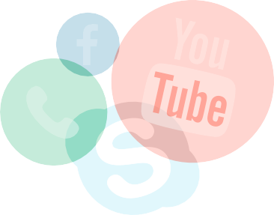


ATTRACTING CUSTOMERS
SOCIAL MEDIA CHANNELS TO TARGET
POSTS/WEEK
WHO WILL MANAGE

Slide 24
ATTRACTING CUSTOMERS
DIGITAL ADVERTISING STRATEGY
Search Engine Ads: You can advertise with search engines like Google or Bing on the keywords you are already targeting. That way, when potential customers search for your keywords, your ads will appear at the top of the search results, boosting your exposure.
You own your content marketing and social media collateral, earning your business exposure through search engines and social channels.
But to augment the number of ideal buyers you can attract, consider investing in a paid channel or two as well. If you’re a newbie when it comes to online ads, or want some help, consider outsourcing your ad campaigns.
Social Advertising: Social media channels like Facebook, Twitter, and Pinterest let you run ads to promote your brand to your ideal buyer. Test running ads on the same social channels you’re investing time in to boost your reach.

Slide 25
ATTRACTING CUSTOMERS
AD CHANNELS TO TEST
WHO WILL MANAGE

Slide 26
Attracting the right buyer is simple when you have a plan. Target relevant keywords,
build content that correlates to your keyword strategy, and distribute content through marketing channels like social media and
ddiiggiittaall aaddvveerrttiissiinngg ttoo ggrrooww yyoouurr rreeaacchh itnhi2s0y1e9a.r

Slide 27

STEP 3:
CONVERT LEADS INTO CUSTOMERS
LEADS (Awareness Stage):
Anyone in your market. At this stage, your goal is to get your brand on their radar, bumping them into the prospect stage.
PROSPECTS (Interest Stage):
Those who know of your brand and have a pain-point you can solve. Your goal is to provide value and educate them on how the types of products and services you deliver can alleviate their challenges.
OPPORTUNITIES (Consideration Stage):
Those who are actively evaluating your business against other solutions. Your goal here is to provide all of the resources opportunities need to decide to buy.
CUSTOMERS (Closed Stage):
Those opportunities you have won and want to stay engaged with. Your goal is to keep them engaged so they become repeat customers.

Slide 28
Now that you’ve planned out how you’ll engage more people that ﬁt your ideal buyer persona, the next step is to convert those leads into customers.
As a small business, every opportunity counts. Email nurturing, partnerships and referrals ensure that you can take advantage of your business relationships and turn connections into customers.

Slide 29
IINNCCRREEAASSEECCOONNVVEERRSSIOIONNSSININ22002109
EMAIL NURTURING CAMPAIGNS
move from learning about your business, to exploring your solutions to making a purchase.
You have a lot of information you’d like to share with your prospects, but you don’t want to overwhelm them. Email nurturing campaigns help you to break down big ideas into digestible chunks delivered over time, until a prospect is ready to buy.
Create a 6-step email campaign for new leads iinn 22002109. Start by introducing yourself and your business, then stay in touch with helpful content - like interesting articles or how-to tips. Finally, help your leads to learn about your products and services through a case study and a call-to-action to speak with a sales rep or make a purchase.
Email campaigns educate prospects and help them down a path to conversion. So instead of sitting stagnant in your database, leads

Slide 30
IINNCCRREEAASSEECCOONNVVEERRSSIOIONNSSININ22002109
E2M01A6ILEMNUAIRLTNUURRINTGURCIANMGPCAAIGMNPAIGN
Subject Line 1: Introduction
Subject Line 4: Helpful Hint or Resource
Subject Line 2: Interesting Article
Subject Line 5: Customer Case Study
Subject Line 3: How-To Article or Guide
Subject Line 6: Call to Action

Slide 31

IINNCCRREEAASSEECCOONNVVEERRSSIOIONNSS IN 2019
INCENTIVES
Think about the incentives you can offer potential customers this year, like:
Everyone loves to feel like they’ve gotten a bargain, and offering up an incentive each month can be a great way to get prospects who are on the fence about buying to pull the trigger.
Product discount
Free trial
Free consultation
Free upgrade
Bonus add-on

Slide 32
IINNCCRREEAASSEECCOONNVVEERRSSIOIONNSS IN 2019
IINNCCEENNTTIIVVEESSTTOOOOFFFFEERR IN 2019
June Incentive
January Incentive
July Incentive
February Incentive
August Incentive
March Incentive
September Incentive
April Incentive
October Incentive
May Incentive
November Incentive
December Incentive

Slide 33
IINNCCRREEAASSEECCOONNVVEERRSSIOIONNSS IN 2019
PARTNERSHIPS
PARTNERS TO CONNECT WITH IN 2019
Partnerships are relationships you can build with other organizations to help open new avenues to more customers.
Back to our landscaping business example, you could partner with a lawn care service to reach their list of customers - after all, if they are enlisting a service to maintain their lawn, they may enlist your landscaping business to replace or revamp trees, shrubs and ﬂowers.
Leverage partnerships to quickly scale your customer base.

Slide 34
IINNCCRREEAASSEECCOONNVVEERRSSIOIONNSS IN 2019
REFERRALS
referral partners with. For instance, if it cost your business an average of $125 to acquire a new customer, it may be well worth it to offer a $100 gift card or give a $100 discount to anyone who sends a new customer your way.
According to Nielsen, people are 4 times more likely to buy when referred by a friend.
YYoouu ccaann bboooosstt ccoonnvveerrssiioonnss biny2o0ff1e9rinbgy offering incentives to your network to refer business your way. Find out how much it costs your business to acquire a new customer by adding uupp ssaalleess aanndd mmaarrkkeettiinngg eexxppeennsseess iinn 22002105 aanndd dividing by the number of customers you acquired.
Need help managing a customer referral program? There are many B2C and B2B apps that can help you organize and track customer referrals. You should also track who is referring customers and who has been referred to you in your CRM so you can pinpoint where your best referrals are coming from.
This number will give you a good idea of how much you can afford to incentivize your

Slide 35
IINNCCRREEAASSEECCOONNVVEERRSSIOIONNSS IN 2019
R20E1F6ERRREAFLERPRROALGRPARMOGRAM
Last Year’s Sales and Marketing Expenses
Incentives We Can Offer Referral Partners
Number of Customers Acquired Last Year
Average Cost to Acquire a New Customer
Target Referral Incentive Value

Slide 36
If you’ve ever heard the phrase that “there’s money in the list,” it’s true. There is a ton of opportunity for your business when you tap into your network. Stay relevant with helpful email nurturing campaigns, help prospects make the decision to convert by reaching out with a promotion, and leverage partnerships to ﬁnd burstable channels of new customers.

Slide 37
STEP 4:
TURN CUSTOMERS INTO LOYAL, RAVING FANS

Slide 38
Sales and marketing is hard work, and in the midst of it all, it’s easy to forget about the customers you’ve worked hard to win.
But taking care of your customers after the sale pays off. According to SumAll, returning customers spend, on average, 20% more that ﬁrst time buyers.
In addition, happy customers will send more customers your way through word-of-mouth and social referrals.
Nurture your customers with email campaigns, thank them for their business with perks, and tap into them for reviews and referrals to boost your sales while getting the most out of your marketing budget.

Slide 39
TURN CUSTOMERS INTO FANS
EVENT CAMPAIGNS
Let your customers know you’re thinking about them on those milestone days, like their birthday, a renewal date, or the day they became a customer. Thank them for their business with a special coupon, exclusive discount, or fun freebie.
List out the events that you want to highlight for your customers, and build an email around each one.
A few examples of event campaigns you
mmiigghhtt wwaanntt ttoo iimmpplleemmeenntt ffoorr 22002109 are:
With a CRM and marketing automation, you can track milestones for each customer and automatically send a personalized email
to your customers on those special days, reminding them how much you value their business.
New customer welcome email
Birthday email
Anniversary email
Renewal reminder email
30-day, 60-day or 90-day check-in email

Slide 40






TURN CUSTOMERS INTO FANS
EEVVEENNTTSSTTOOHHIIGGHHLLIGIGHHTT IN 2019

Slide 41
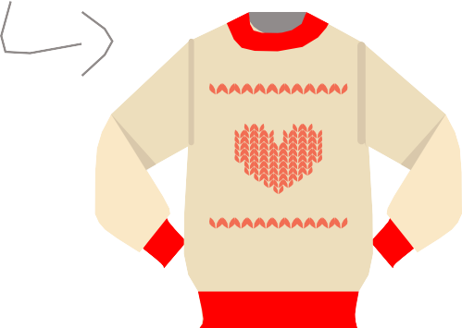
TURN CUSTOMERS INTO FANS
CROSS-SELL & UPSELL CAMPAIGNS
If you’re like most small businesses, you know that your sales are built on repeat customers. But, you don’t have to wait for your customers to come back to you. Instead, reach out with an upsell or cross-sell campaign.
If they like these, they’ll love this
You can track and note the type of purchases your customers make in your CRM, then use your customer’s purchase history to determine what other products and services they might be interested in.

Slide 42
TURN CUSTOMERS INTO FANS
MY PRODUCTS
COMPATIBLE PRODUCT TO UPSELL OR CROSS-SELL

Slide 43
TURN CUSTOMERS INTO FANS
REVIEW CAMPAIGNS
For best results:
Offer an incentive (hey, a $5 gift card is a small price to pay for a testimonial)
Ask for one review on one review site at a time (make it as simple as possible for your customers to participate)
Have you ever googled your business? If you have, you may be surprised to ﬁnd that after your website, review sites are often next in line at the top of the search results.
Reviews can be the ﬁrst impression of your business, and potential customers will take reviews into account as they research your business online. To make sure your reputation remains sparkling clean, periodically ask your happiest customers to leave a glowing review.
Review sites to target:
Industry review sites
Better Business Bureau
Your Google page
Your Facebook page

Slide 44

TURN CUSTOMERS INTO FANS
REVIEW SITES TO TARGET IN 2019

Slide 45
You’ve invested many marketing dollars into attracting and converting customers for your business. But the payoff doesn’t have to end there. Keeping your customers happy long after the sale is key to scaling your revenue in 22002109.
Stay in touch with your customers through event-based campaigns, offer compatible products and services they might like, and tap into your happiest customers for reviews.
You’ll be rewarded with repeat business in addition to harnessing the power of word-of- mouth referrals and positive reviews to attract new customers.

Slide 46
You’ve identiﬁed your ideal customer, are set to attract your target buyer, have a game plan for converting more prospects into customers, and are prepped to nurture customers long
after you’ve made a sale.
Congrats, the stage is set for a remarkable 22002109!

Slide 47

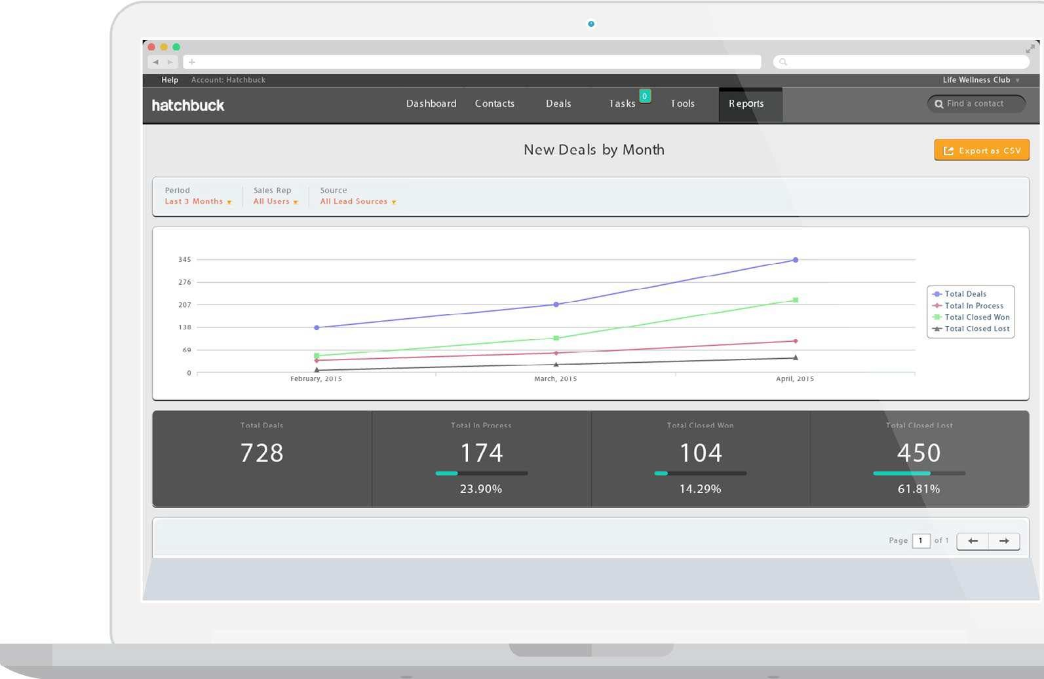
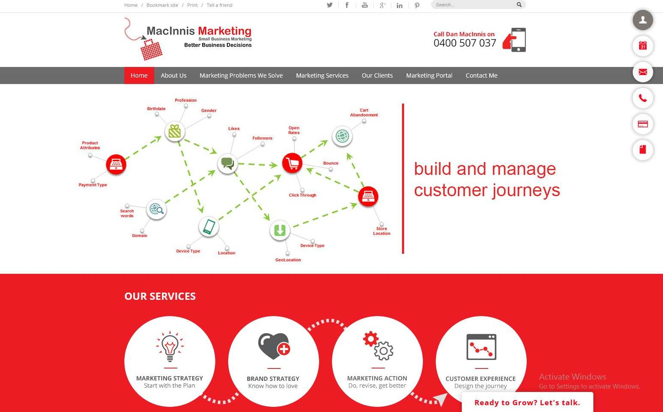
ABOUT MACINNIS MARKETING
Meet Dan - the leading authority on customer-centric marketing
Dan's superpowers are...insight and empathy!
Dan has the ability to understand your customers and provide solutions to their problems, so you can provide real value. Insight is a superpower that helps you empathize with customers, identify their struggles, and help them succeed. Creating a compelling value proposition is the key to a great business and makes marketing easy and this starts with understanding customer needs. Dan has just been engaged a second time to present for the Dept of Industry and Science a roadshow around Australia around how to create a compelling value proposition, so she knows her stuff.
Call Danielle MacInnis 0400 507 037

