Slide 1
Session 1: Real Estate Business
Aprendiendo Real Estate School

Slide 2
Congratulations for starting a new profession.
This will give you freedom to budget your time and to increase your income.
In this introduction we will teach you why you should have a Real Estate license.
With the license in your hands your dreams will come true, so we invite you to read the book in order to achieve your aims as soon as possible.
Aprendiendo Real Estate School

Slide 3
Learning Objectives
Describe the various activities of real estate brokerage
Distinguish among the five major sales specialties
Identify the role of property managers
Explain the appraisal process and the role of appraiser
Understand the mortgage process and the role of the mortgage loan originator
Explain the three phases of development and construction
Distinguish among the three categories of residential construction
Aprendiendo Real Estate School

Slide 4
Vocabulary List
absentee owner
appraisal
business opportunity
BPO
comparative market analysis (CMA)
dedication
farm area
follow-up
MLS
property management
real estate brokerage
subdivision plat map
USPAP
Aprendiendo Real Estate School

Slide 5
Definitions
In the State of Florida, any person representing the buyer, seller, landlord or tenant for a compensation must have a Real Estate License under Chapter 475 FS.
Compensation is the direct or indirect payment (money, assets and services) and also the promise of payment.
For example, a retired person has many lots and asks her daughter to sell one of them promising to give her one in the future. This is clearly understood as compensation, that is to say, a promise to pay in the future for providing a Real Estate service. For the promise, the daughter must have an active Real Estate license.
Remember that compensation is a synonym of commission.
Aprendiendo Real Estate School

Slide 6
Florida’s Licensees usually work with other States’ Real Estate Licensees. When we say other States we mean everything outside Florida, and that includes in the same category the State of Georgia and Spain. Those licensees, even if they do not have a Florida license, can get a commission from a Florida Real Estate company when they send a referred customer (finder-fee).
For example, company A from Atlanta, Georgia, sends a customer to the Real Estate Company B of Florida. If this customer closes the transaction in Florida, the Atlanta broker can receive a commission for that referred customer.
It is important to point out that one licensee from another State is “sending” the referred customer and not “going with him/her”. If a licensee from another State goes with the referred customer to Florida (and stays with him/her during the transaction), he is considered a person without a license for the State of Florida, therefore he cannot get a commission.
Aprendiendo Real Estate School

Slide 7
Any other person (a lawyer, accountant, dealer, baker) from this State or from any other cannot get a commission unless he has a Real Estate License.
Commissions are shared by Real Estate companies. This means that a sales associate cannot pay a commission to another Sales Associate; this can only be made by one broker to another broker.
In Florida, the regulations for Real Estate activities are established in Chapter 475 FS (based on the principle Caveat Emptor “Buyer’s protection”). In Chapter 61J2 rules and regulations for the Real Estate practice are established.
There is also another Chapter, 455 FS, regulated by DBPR (Department of Business and Professional Regulations) that establishes rules for all professions in Florida, within which we find the Real Estate one, under the Real Estate Department’s supervision (DRE).
Can a person who does not have a Real Estate license get some part of a commission? NO, unless he/she is part of the transaction (buyer or seller)
Aprendiendo Real Estate School

Slide 8
Your license’s working field
After establishing the legal framework for the Real Estate profession, let’s turn to the license’s working field.
A licensee can get commissions from any these two areas (but not simultaneously): he can work with a Real Estate Company or with a Developer. An owner-developer is an unlicensed entity that sells, exchange, or leases its own property. A developer's sales staff must hold active real estate licenses in order to be paid a commission (is exempt from real estate licensure if paid strictly on a salaried basis).
Your license’s working field
Real Estate Company
Developer
Sales and Leasing
Property Management
Appraisal
Financing
Counselor
Lands Acquisition
Subdivision and Development
Construction
Aprendiendo Real Estate School

Slide 9
Real Estate Company
Sales and Leasing
Real Estate activity is mainly related to selling and leasing properties.
These properties are divided according to different characteristics. Depending on the type of the transactions, different disclosures are needed.
Residential: sale or leasing of up to 4 units, vacant lot for 4 or less units and agricultural properties of up to 10 acres.
Commercial: properties of more than 4 units, business premises, office buildings.
Industrial: properties located in industrial parks, lots in industrial areas.
Agricultural: properties of more than 10 acres.
Businesses: purchase/sale of stores (bakeries, laundries, computer’s stores).
Aprendiendo Real Estate School

Slide 10
It is advisable for licensees to work on a determined
area, in that way he can acquire knowledge and
become an expert in zoning, construction rules,
etc. That is called Farming.
Follow-up: Monitoring the customer after the transaction is closed.
Property Management
This type of activity may occur when an owner will not administer his property (absentee owner) and gives it to a Real Estate company. For example, charging the leasing of a property, pay the taxes, control the maintenance.
Appraisal
The licensee can establish the approximate value of a property through a CMA (Comparative Market Analysis) using the properties on sale on the market, the ones which were sold and those which were not (within the last 12 months), the licensee can charge for this service.
Real estate broker or sales associate can, in the ordinary course of business, performs a comparative market analysis, gives a broker price opinion, or gives an opinion of value of real estate. However, in no event may this comparative market analysis, broker price opinion, or opinion of value of real estate be referred to as an appraisal, as defined in s. 475.611.
Aprendiendo Real Estate School

Slide 11
You surely know the term Appraisal. This term refers to determining the value of the property based on established methods following the USPAP’s procedures (Uniform Standards of Professional Appraisal Practices).
Appraiser:Are paid a fee, not a commission.
The Appraisal service is considered an art, not a science.
The licensee Appraiser cannot charge a commission on the value of the property, he must charge a fee.
All federally related transaction MUST have an appraisal.
475.611 (L) say: "Federally related transaction" means any real estate-related financial transaction which a federal financial institutions regulatory agency or the Resolution Trust Corporation engages in, contracts for, or regulates, and which requires the services of a state-licensed or state-certified appraiser.
Note: any person pointed by a Court can make an Appraisal, even if he does not have a license (a Real Estate or Appraiser license).
Aprendiendo Real Estate School

Slide 12
BPO (Broker’s Price Opinion)
A BPO is the process used by a real estate agent to determine the potential selling price or estimated value of a real estate property. A BPO is popularly used in situations where a financial institution believes the expense and delay of an appraisal is unnecessary.
Broker's price opinions are initiated by financial institutions: banks, mortgage companies, and loss mitigation companies.
The BPO is performed by a real estate professional who is acting on behalf of the financial institution. Such a professional could be a real estate agent, a real estate broker, or an appraiser.

Slide 13
Financing
It is not the Real Estate licensee’s job to get mortgage loans, but he must know the credit facilities (qualification procedures, interest rates, type of loans).
494.001 F.S. say:
Loan Officer : the person licensed under Chapter 494 FS who is entitled to charge a commission for getting the loan to purchase a property.
“Act as a loan officer” means, for compensation or gain, or in the expectation of compensation or gain, either directly o indirectly, accepting or offering to accept an application for a mortgage loan, soliciting or offering to solicit a mortgage loan on behalf of a borrower, negotiation or offering to negotiate the terms or conditions of a mortgage loan on behalf of a lender, or negotiating or offering to negotiate the sale of an existing mortgage loan to a non-institutional investor.
Counselor
The Real Estate licensee who has a lot of experience and knowledge in Real Estate procedures, investments, market’s activity and advises his customer on the best decision to make.
Aprendiendo Real Estate School

Slide 14
Developer
A licensee can work as a Developer for a company. There are three stages in this process.
1.- Lands Acquisition
The developer acquires a tract for future projects. The licensee must be careful and study how to use the land and the kind of property established by the local government.
2.-Subdivision and development
Local Governments demand development companies to handle a Subdivision plat map in which individual lots, streets, water connections and sewer services are present. This plat map is recorded in Court.
The developer must build the streets and then give them to the city for their care and maintenance (the government imposes taxes to the property’s owner for this service). That gift is called Dedication.
To maintain the value of the properties in the future, the developer can make use of uses’ limitations known as restrictive covenants.
These limitations can have different characteristics, for example, properties have to be painted with some specific colors, or you cannot park a lorry outside the property.
All these limitations must be recorded in Court.
That means that every person who buys a property in that subdivision receives the rights with the established limitations.
Aprendiendo Real Estate School

Slide 15
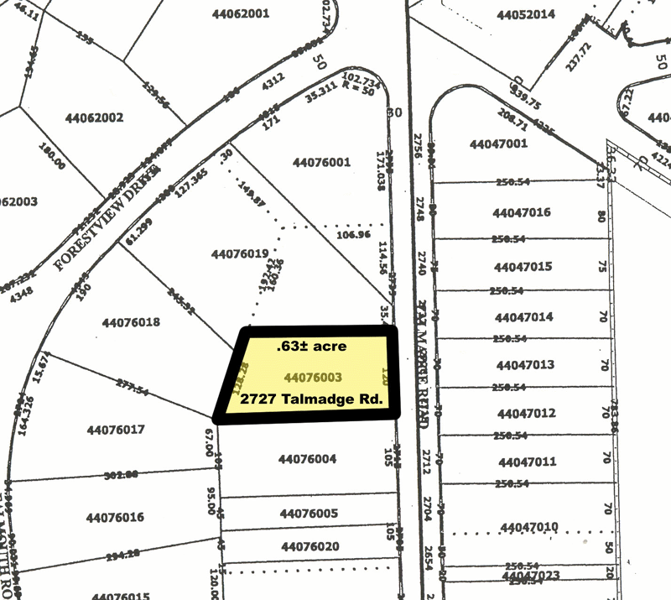
Plat Map
Aprendiendo Real Estate School

Slide 16
3.- Constructions There are three categories or market types.
Spec homes: the developer builds the units and then he sells them, speculating with price increase. He does not sell until the subdivision is ready. The increase on the value of the properties from the beginning of the building work is in the power of the developer.
Custom homes: the developer sells a lot to the customer and starts building it according to the buyer’s style. The buyer facilitates the building’s plans.
Tract homes: the developer provides the buyer with different property models. the buyer chooses the model and the lot to build it.
Aprendiendo Real Estate School

Slide 17
Government influence on Real Estate
A Real Estate licensee must know that the Government in its different levels influences Real Estate activities:
Local government: does it through zoning, charging taxes to the property, giving building permits.
State government: does it through charging taxes on the sale and appraisal (Stamp tax on the Deed, on the Note and Intangible).
Federal government: through monetary and tax policies, the creation of Departments as HUD (Department of Housing and Urban Development), EPA (Environmental Protection Agency) and through IRS and Federal Reserve policies.
Aprendiendo Real Estate School

Slide 18
Professional Real Estate Boards
It is necessary to clarify a concept which is sometimes confusing for many people.
What is the difference between a Real Estate licensee and a Realtor?
Real estate licensee: Anyone who earns a real estate license can be called a real estate agent, whether that license is as a sales professional, an associate broker or a broker.
REALTOR®: A real estate agent who is a member of the National Association of REALTORS®, which means that he or she must uphold the standards of the association and its code of ethics.
In summary, Licensee is the person who has a Real Estate license, Realtor® is a licensee who is member of the board of Real Estate licensees.
There are three boards of Realtors®:
NAR (National Association of REALTORS®)
FAR (Florida Association of REALTORS®)
Local board of Realtors®.
Aprendiendo Real Estate School

Slide 19
Ethics
NAR promotes ethics and education in the real estate industry. Many of the state laws designed to promote professionalism and improve ethical standards begin in NAR’s REALTORS® Code of Ethics and Standards of Practice.
Ethics is not in conflict with enterprise or profit. Time and time again, ethical performance has proved to be good business. The most important factor influencing real estate agents to operate ethically is their personal code of behavior. The most important factor influencing real estate agents to operate unethically is the behavior of their employers and, then, other real estate agents.
Most professional and trade organizations have requirements designed to raise the professional and ethical standards of their members. The National Association of REALTORS® (NAR) adopted its Code of Ethics in 1913. The Code emphasizes fair dealings in three major areas: (1) with clients, (2) with other real estate brokers, and (3) with the general public.
Today, to maintain membership in NAR, REALTOR® members must complete three hours of ethics training every four years.
Aprendiendo Real Estate School

Slide 20
MLS (Multiple Listing Services)
An important service created by NAR is the Multiple Listing Service (MLS). The MLS is a database that allows real estate brokers representing sellers under a listing contract to share information about properties with real estate brokers who may represent potential buyers. The MLS compiles the listings of all member brokers, making the property information available to all brokers and their associates.
To participate in an MLS, brokers agree to cooperate with each other in a sharing of the commission between the listing broker and the selling broker. The terms for division of commission can vary from broker to broker. Depending on the population of an area, a broker may be a member of more than one MLS. The MLS is not a copyrighted trademark of NAR. Anyone can create an MLS.
Aprendiendo Real Estate School

Slide 21
Summarizing:
What are the functions of a Real Estate License?
A real estate licensee is allowed to earn commissions or fees for the following reasons: purchase and sale, rents, appraisers, property administration or property management, for auctions and for given advice.
Real Estate Licenses can be use for: residential (up to 4 units and lots for up to 10 acres), commercial (more than 4 units and commercial businesses), industrial, agriculture and business opportunities.
Compensation: is the payment in the form of money, goods and services.
Compensation: is also the PROMISE of a future payment.
Aprendiendo Real Estate School

Slide 22
Summarizing:
What is a Property Manager?
The property manager or property administrator is a real estate licensee that manages a property when the owner is absentee.
Property Managers are responsible for improving good relations with the tenants, collect rents and manage the properties.
The increase of absentee owners increased the demand for property management.
Property management does NOT include the owner’s representation.
Aprendiendo Real Estate School

Slide 23
Summarizing:
What are the duties of an appraiser?
An appraiser, evaluator or assessors are in charge of establishing the value of a real estate property. Appraisers are paid a fee NOT a commission.
The property appraisal is considered an Art.
A real estate licensee CANNOT present an appraisal to a federal institution if the licensee does not have an appraiser license UNLESS IS REQUESTED TO THE LICENSEE BY A COURT.
FIRREA is the law enacted to ensure that appraisals are performed up to standards. FIRREA regulates the financial transactions in Real Estate that involve a federal financial institution.
A real estate licensee generally presents his/her clients with a CMA (Comparative Market Analysis). A real estate licensee can charge for that.
Even though the law establishes that an appraisal can only be done by a person who is licensed as an appraiser, we have to clarify that when the court appoints a person to conduct an appraisal, this person DOES NOT need to be licensed and can earn a fee for the service provided.
Aprendiendo Real Estate School

Slide 24
Summarizing:
Can a sales associate open a Real Estate office?
A sales associate CANNOT open a real estate office, is forbidden by the law.
What happens with referral fees?
A real estate broker from New York sends a client to Florida, can the Florida broker share the commission with the NY broker? The answer is YES, if there was a mutual agreement previous to sending the client.
A broker from New York travels with his client to Florida and shows the client many properties and then looks for a Florida broker to close the deal. Can the New York broker receive a commission? The answer is NO because the New York broker acted in Florida as a real estate agent without being licensed in Florida.
Aprendiendo Real Estate School

Slide 25
Summarizing:
A New York broker travels with his client to Florida, he introduces the client at a Florida Broker and goes to spend the day at the beach. In the afternoon, after his referred client and the FL broker signed a sale contract for a property, the NY broker passed by the office to pick up his client. Can the New York broker receive a commission? YES because he did not participate in the negotiation.
A New York lawyer sends a client to Florida to invest on some properties. Can the lawyer claim a commission? The lawyer can ONLY claim a commission if he has a real estate license.
Aprendiendo Real Estate School

Slide 26
Summarizing:
Who pays a sales associate the earned commission?
Only a broker or developer can give a sales associate his/her commission, never the property owner or the buyer.
If a licensee works and receives a commission from a broker and a developer at the same time, the licensee cannot work with a broker and a developer at the same time.
A licensee CAN work with a broker and developer at the same time if the licensee gets pay a salary with one of them.
Aprendiendo Real Estate School

Slide 27
Summarizing:
How do the governments influence in the real estate market?
The state government influences in the real estate market when it charges taxes related with the sale or financing of a property.
The local government affects the real estate market when it modifies Property Taxes.
The federal government influences the market when it establishes new rules, when the Federal Reserve acts by regulating the market.
Aprendiendo Real Estate School

Slide 28
Summarizing:
What are the different ways that Developers use to sell their properties?
Spec homes: the developer builds the land, creates the development and then sells the properties.
Custom Homes: the developer sells the lot and builds accordingly with the floor plans presented by the buyer.
Tract Homes or pre-construction: the developer provides the buyers with different model homes, the buyer chooses the model homes and the lot where he/she wants to build it.
Aprendiendo Real Estate School

Slide 29
Summarizing:
REMINDER NOTES
One of the functions in real estate is the auction.
Survey: is NOT one of the duties that can be done by a real estate licensee without having the proper license.
Dedication: is the gift of common land (streets, parks, etc.) from a developer to the local state.
Restrictive Covenant: are the restrictions determined for the whole community.
The National Association of Realtors (NAR) is in charge of promoting education and ethics in the real estate industry.
Ethics does not produce conflict with the performance of a business.
The ethics is a good business.
Aprendiendo Real Estate School

