Slide 1
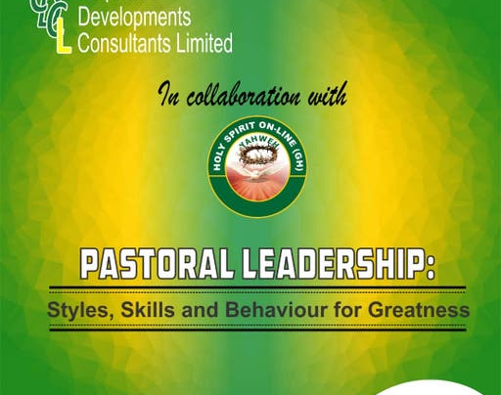
Message From the Professor
Prof John Martey FCG
4 October 2021

Slide 2
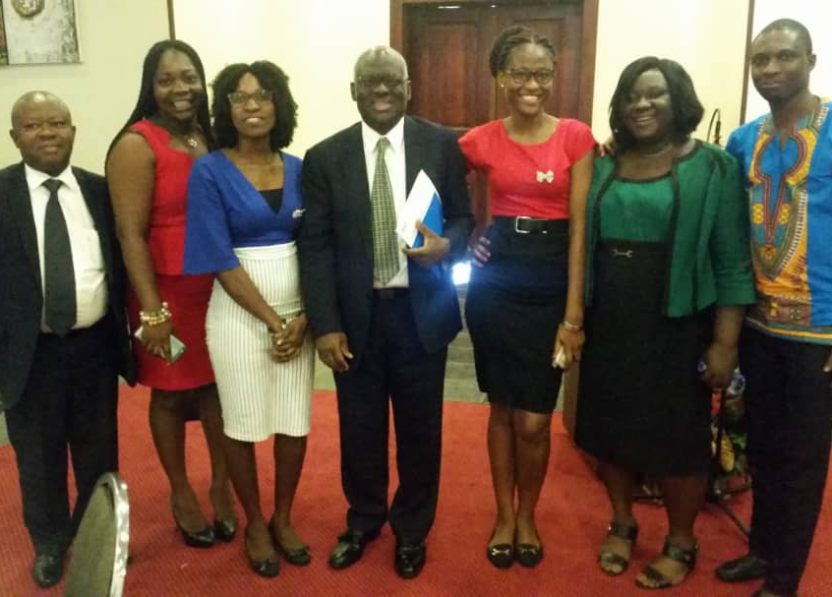
Welcome
Thanks for your interest in studying this course.
You will be taken through very exciting and interesting topics that will build your capacity as a pastor.

Slide 3
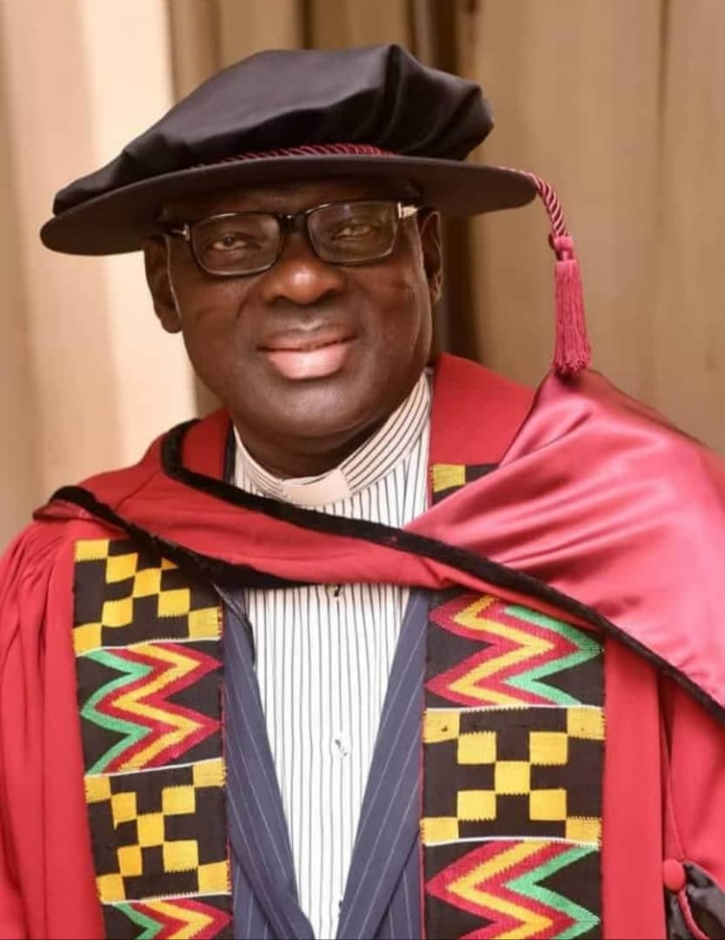
Prof John Martey FCG
Rev Canon Professor John J M Martey FCG
is a Professor of Management,
Fellow, Chartered Governance Institute,
Consultant and
Priest.

Slide 4

My Story
Leading is influencing people towards the achievement of goals.

Slide 5
Influence and Questions
Influence | Question | Question | Answers | Style
A good pastor must be able to influence others to understand and agree about what needs to be done | What accounts for the fact that some leaders rise to positions of great power. | Why do some followers remain so loyal. | Answers to these questions will be found from the knowledge that you will gain in studying this course | His or her style must result in influencing people.

Slide 6

The pastor must have the capacity to enable him or her apply appropriate leadership style, skills and behaviour

Slide 7
Style, Skills and Behaviour
The pastor’s style and skills must enable him or her touch more lives.
The way he or she behaves must result in influencing people.
The leader’s behaviour must help change lives and achieve greatness.
Your successful completion of the module on Pastoral Leadership Styles, Skills and Behaviour will equip you with the skills needed for greatness.

Slide 8

Register Now
Click
holy-spirit-on-line.teachable.com/p/pastoral-leadership-styles-skills-and-behaviour-for-greatness

Slide 9
Thank You
L(9) Prof John Martey FCG | LinkedIn
Email
corpdevconsult@yahoo.co.uk
Phone
(+233) 500077596
Twitter(1) Corporate Developments Consultants Limited (@CorporateDeve11)

