Slide 1
Quality checks
A mandatory process to be followed while filling the flat file

Slide 2
Title
A customer should be able to make the purchase based on information in the title alone. Clear and concise titles will improve search results and catch the customer’s attention. Title should be formatted as follows:
Brand name first, then product line, then description, then quantity/colour preceded by a comma
Include model number when necessary (small appliances, vacuums, some personal care items)
Capitalize the first letter of each word
Spell out quantities such as Quart and Inch
Avoid dashes, use commas
The basic format for the title is:
[Brand]+[Product Title]+[Colour_name]+[Size_name]
Good Title: Samsung S5570 Galaxy Pop GSM Cell Phone
Bad Title: S5570
Note: Amazon uses the words in product titles to display your products in search results and a product with bad title might be suppressed from search results and the customer might never view your products.

Slide 3
Title formats
Baby product: [Brand]+[Product Line]+[Color]+[Size]
Example: Philips AVENT Natural Feeding Bottle, 11 Ounce
Clothing: [Brand]+[Product Name/Style]+[Color]+[Size]
Example: Lee Men's Regular Fit Straight Leg Jean, Size: 34
Electronics: Brand + Series Name + Model Name + Form Factor + “with” Unique Thing* [if applicable] + (color, packaging* [if applicable])
Example: Canon EOS Rebel XTi 10.1MP Digital SLR Camera with 2.5-Inch LCD (Black, Body Only)
Eyewear: [Brand]+[Gender*]+[Style Name]+[Frame Color]+[Lens Color]+[Glasses Type]+[Sunglasses OR Glasses]+[Strength]
Example: Ray-Ban RB2140 Wayfarer Black Plastic Sunglasses – 55 mm
HPC: [Brand] + [Feature] + [Product Type] + [Model Number ] + [Size] + [package count] + [Color]+ [Scent]+[Flavor]
Example: Biofreeze Pain Relieving Roll On, 3-Ounce

Slide 4
Product description
Elaborate on the features and uses of your product.
As you describe your product, you might want to include some key features listed in your bullet points. However, go beyond a simple to-the-point description. Well-written product descriptions help the customer imagine the experience of owning or handling your product. Put yourself in your customers' shoes: what would they want to feel, touch, understand? Incorporating information about the feel, usage and benefits of your product can fire the customer's imagination. This is as close as you can come to creating an in-store experience. Product Descriptions are limited to 2000 characters.
Clean the descriptions and remove the special characters like: €“ ® â © * ˜ ° ™ Ã ¢ ~ and html tags except (<li> <p> and <br>)
Remove seller oriented words/phrases like "gift" "contact-9898****" "free shipping" "website links" "promotions" * * * NEW! * * *

Slide 5
Product Description
Good Product Description:
This Casio Sea analog illuminator watch offers all the convenience and durability of a sports watch, with an adaptable style well suited for a work day. The large round dial is black with white and luminous indexes, two luminous hands, and a red arrow-tipped seconds hand. The black stainless steel bezel offers additional Arabic numeral and dot indexes and a one-way rotation to make timing easy. The bezel's distinctive cog-like edge also gives the watch a stylishly industrial edge. The date displays subtly at four o'clock, and a super illuminator light makes the watch easy to read at any time. The band is made out of rugged black resin with a buckle clasp. This analog quartz powered timepiece is water resistant up to 660 feet (200 meters) and offers a battery life of approximately three years. It is backed by a 1-year limited manufacturer's warranty.

Slide 6
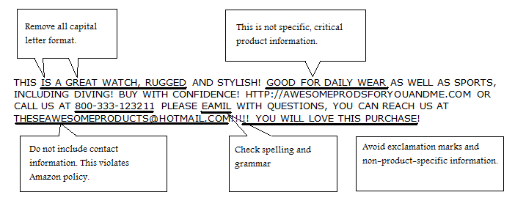
Product Description
Bad Product Description:

Slide 7
Product Description Guidelines
DO’s | DO NOT
Describe the major product features and list product information including size, used-for and style. Keep it short, but include critical information Include accurate dimensions, care instructions and warranty information Please use correct grammar and complete sentences | Do not include your merchant name, e-mail address, website, or any company-specific information Do not write about anything but the product for sale; this is your opportunity to tell the customer what they are buying Do not include promotional language such as "sale" or "free ship" (use the Manage Promotions tool

