Slide 1
How to think like a business owner and not an employee
By
Dr Boyce Watkins
The Black Business School

Slide 2
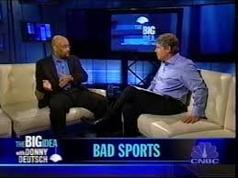
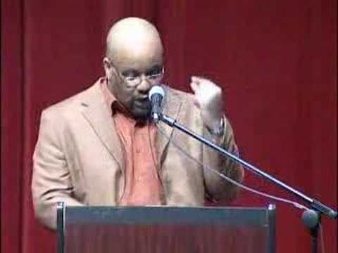
When I quit my job
I didn’t quite know what I was doing
I didn’t know if I was going to be successful
I didn’t have enough money to do the things I wanted to do
I was scared to death

Slide 3
#1: Protect your time like you’re President Obama
Notes:
No phone calls. No social media. Tell friends you have appointments. Who does she think she is?

Slide 4
#2: Learn the art of structured commitments

Slide 5
#3: Avoid the slave thinking – don’t try to work 80 hours a week, work 800

Slide 6
#4: Learn to manage people and processes
Notes:
Read books like Traction – check BlackMoney103.com for more information on the reading list

Slide 7
#5: Cut all distractions – learn to work in silos

Slide 8
Listen to warren buffett

Slide 9
#6: Risk and self-sacrifice are on the menu, and they must be your friend
No bougie entrepreneurs
No more paychecks

Slide 10
#7: Till death do you part, stop waffling
Notes:
Are you married to the game or just playing around?

Slide 11
#8: The difference between being a good king and a good man

Slide 12
#9: Managing the financial leeches and emotional drains of your life
Notes:
Loaning money to relatives – a no-no
Don’t try to save everybody because your business is making money
Don’t tell anybody how much money you make

Slide 13
#10: Remember why you get paid – million dollar mindset vs minimum wage mentality
Notes:
You get paid because you are productive, efficient and smart. There is always more money out there for you, but you have to go find it. This is the challenge and excitement of being an entrepreneur. Think small and win small.

Slide 14
Follow up on your learning
BlackMoney103.com
TheBlackLegalProgram.com
TheBlackStockMarketProgram.com
BlackMillionairesOfTomorrow.com
BlackDragonDiscount.com

Slide 15
The black business school

