Slide 1
Disaster Management: Vulnerability and Resilience in Disaster Recovery in Thailand
Pattamaporn Busapathumrong
Faculty of Liberal Arts,
Asian University, Thailand

Slide 2
Outline of Presentation
1. Background on the research
2. Disaster management in Thailand
3. Vulnerability and Resilience: Concepts and Models
4. Resilience (Women, Children, Elderly and People with Disabilities)
5. Discussions and Recommendations
6. Conclusion

Slide 3
1. Background on the research
Objectives
(a) to explore models of disaster management in Thailand; and
(b) to explore building resilience for social recovery for women, children, and the elderly and disabled population. This project discusses five models of disaster management:

Slide 4
Background of the research
This project discusses five models of disaster management:
(a) royal projects on disaster preparedness and the Red Cross;
(b) the Association of Southeast Asian Nations (ASEAN) Socio-Cultural (SCC) Blueprint;
(c) the rights-based approach;
(d) the welfare mix model on state, private and family, and community sectors; and
(e) knowledge management.

Slide 5
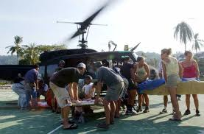
2. Disaster management in Thailand
Public relief in Thailand
Karn-bantao-sataranapai (การบรรเทาสาธารณภัย)

Slide 6
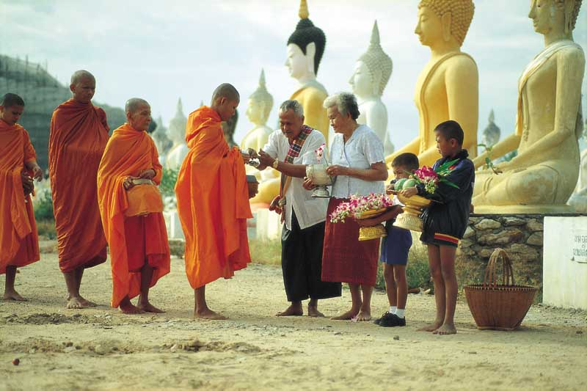
Merit making in Thai Buddhist Society
Meritorious accumulation
Tam-bun (ทำบุญ)
Philanthropic giving
Individual, group, community giving for disaster survivors

Slide 7
3. Vulnerability and Resilience: Concepts and Models
Vulnerability and resilience
Vulnerability refers to susceptibility to physical or emotional injury.
Building resilience of communities

Slide 8
3. Vulnerability and Resilience: Concepts and Models
Models
1) Royal activities on disaster preparedness and the Red Cross
2) ASEAN Model focusing on SCC Blueprint
3) Rights-based Approach
Strength perspective and integration with community
4) Knowledge Management for resilience in disaster management
5) Welfare Mix Model on state/private and family/community

Slide 9
4. Resilience (Women, Children, Elderly and People with Disabilities)
Women
Children
Elderly
People with Disabilities

Slide 10
5. Discussions and Recommendations
Discussing five models of disaster management: 1) royal projects and the Red Cross, 2) the ASEAN SCC Blueprint, 3) the rights-based approach, 4) the welfare mix model and 5) knowledge management.
1. Respond to the needs and urgent needs of the population by applying these five models of disaster management in Thailand to build resilience.
2. Plan and implement for short-, medium-, and long-term development for quality of life and social quality in Thailand to cover subpopulations of marginalized people and those in need.
3. A rights-based approach and paradigm shift on human rights as discussed earlier are essential components to build resilience.
4. The ASEAN SCC Blueprint as a model enables the regional communities to cooperate and yield fruitful participation.

Slide 11
6. Conclusion
This research explores the current models that contribute to disaster management in Thailand.
To conclude, this research explores the current models that contribute to disaster management in Thailand. Among these five models, applications are varied and further research can be designed and conducted in the future. Vulnerability and resilience concepts, when applied to the case of Thailand, have been reflected in the National Economic and Social Development’s latest plan and the participation of several organizations. As disasters have become globalized, urgent needs and responses are required by all involved parties.

