Slide 1
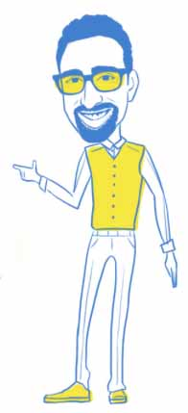
Part 1: The Driving Forces

Slide 2
Alignment
+
Satisfaction
=
TWINS SEPARATED AT BIRTH

Slide 3
The goal in understanding our Driving Forces
“The decision for transition is brave but the path to true and lasting success requires a great deal of vigilance, patience, and belief.”

Slide 4
What are your Driving Forces for Transition?
These are drivers of why you want to transition
Emotions
Examples:
Unfulfillment, Sadness, Dissatisfaction, Perseverance for More
Realities in your life
Examples:
Marriage/Divorce, M&A gone sour, Laid Off, New Management, Children
What are your driving forces for transition?

Slide 5
Understanding your Driving Forces
When do these triggers occur?
How frequent do these triggers take place?
Where are you when these triggers happen?
Examples:
Time, Day, Event, Conversation, Visual Reminder

Slide 6
Reverse Engineering your Driving Forces
When do the more positive feelings of fulfillment and alignment occur?
If some take place at work, during which activities/functions?
If others take places outside of work, which activities/functions are you partaking in?
Examples:
At work: Project Management Activities
Outside of work: Volunteer work with rescue animals

Slide 7
Think about what values you hold to be self-evident?
What are some of your core values? (e.g. Trust, Integrity, Teamwork, Leadership)
What are some of your values that you would like to see as part of your next transition?

Slide 8
Are they aligned to your values?
Are your driving forces a part of a wider net of values you hold?
What are some of your values that you would like to see as part of your next transition?
What happens when your core values and your driving forces come together?

Slide 9
Why they are important
Why are they important to you?
What meaning do they bring to your life?
…Most importantly, are they powerful enough to generate actionable change?!

Slide 10
“It is the mark of an intelligent mind to entertain an idea without ever accepting it.”
Aristotle

Slide 11
Please Complete Exercises

