Slide 1
Vision Launch Party 2019
Presented by Lynita Mitchell-Blackwell, Esq., CPA, CCLC
Leading Through Living Community, LLC

Slide 2
What is a Vision Board & why do we party?
“Where” are you going in life?
Who’s guiding you “there”?
Why do you need to know?

Slide 3
Historical background for Vision Planning
Habbakuk 2:1-3 King James Version
1I will stand upon my watch, and set me upon the tower, and will watch to see what he will say unto me, and what I shall answer when I am reproved. 2And the LORD answered me, and said, Write the vision, and make it plain upon tables, that he may run that readeth it. 3For the vision is yet for an appointed time, but at the end it shall speak, and not lie: though it tarry, wait for it; because it will surely come, it will not tarry.

Slide 4
Habbakuk 2:1-3 New International Version
1I will stand at my watch and station myself on the ramparts; I will look to see what he will say to me, and what answer I am to give to this complaint. 2Then the Lord replied: “Write down the revelation and make it plain on tablets so that a herald b may run with it. 3For the revelation awaits an appointed time; it speaks of the end and will not prove false. Though it linger, wait for it; it will certainly come and will not delay.

Slide 5
Habbakuk 2:1-3 Living Translation Version
1I will climb up to my watchtower and stand at my guardpost. There I will wait to see what the LORD says and how he will answer my complaint. 2Then the LORD said to me, “Write my answer plainly on tablets, so that a runner can carry the correct message to others. 3This vision is for a future time. It describes the end, and it will be fulfilled. If it seems slow in coming, wait patiently, for it will surely take place. It will not be delayed.

Slide 6
Habbakuk 2:1-3 English standard Version
1I will take my stand at my watchpost and station myself on the tower, and look out to see what he will say to me, and what I will answer concerning my complaint. The Righteous Shall Live by His Faith 2And the LORD answered me: “Write the vision; make it plain on tablets, so he may run who reads it. 3For still the vision awaits its appointed time; it hastens to the end—it will not lie. If it seems slow, wait for it; it will surely come; it will not delay.

Slide 7
15 Steps to successful vision launching
Stop running!
Step 1 – take a stand - right where you are
Step 2 – select a position of strength
Step 3 – survey and scout the surroundings
Step 4 – stop and listen

Slide 8
15 Steps to successful vision launching
Ask for what you want!
Step 5 – respond honestly
Step 6 – accept the “yes”
Step 7 – listen for direction
Step 8 – do as instructed

Slide 9
15 Steps to Successful Vision Launching
Embrace help!
Step 9 – make it easy to understand
“make it plain” Habbakuk 2:2
Step 10 – use a medium it may be shared
“on tablets so a runner may carry the correct message” Habbakuk 2:2
Step 11 – make your mind & heart receptive to support
“to others” Habbakuk 2:2
Step 12 – be patient
“the vision awaits the appointed time” Habbakuk 2:3

Slide 10
Steps to Successful Vision Launching
Labor in Love!
Step 13 – work through the healing
Step 14 – use this time of preparation wisely
Step 15 – think, act, and grow in what you already know

Slide 11
Let’s Take 10 Minutes
Be silent.
BREATHE.
Relax.

Slide 12
NOW You’re Ready to Fancy Up Your Board
Grab your
Markers
Magazines
Scissors
Tape and/or glue
Select pictures that depict the result of the things you’ve asked for
Place them on your board with a Power Caption
My New Home
Bestselling Book
Top Sales Award

Slide 13
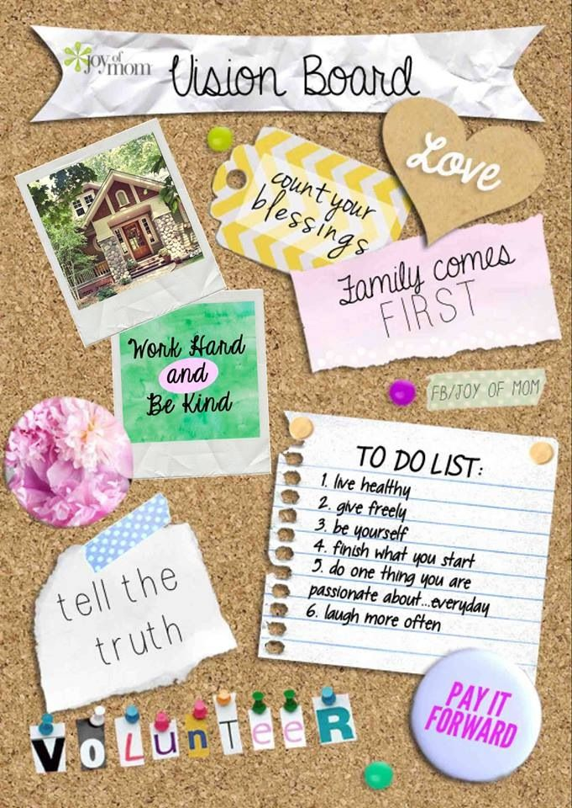
Let’s transform it into a digital board you may take with you!
Take a picture
And graphic designer Briana Jazmin will do the rest!
Your poster board transformed to a screen saver, desktop image, and/or a JPEG file you may refer back to often so you may stay on track!
Only $47!
Purchase now: www.PayPal.me/leadingthroughliving/47

Slide 14
And for our current or aspiring business owners and entrepreneurs…
Register for Business Class, our 12 month program, packed with 17 courses designed to help you start, run, and grow your business into a profitable endeavor!
13 women, all experts in their fields, teaching one hour each on every area you need to run a successful business.
Goals setting
Strategic planning
Funding – for-profit and non-profits
Marketing
Branding
Public Relations
Social Media
Self-care and fitness
And more!
FREE 101 page ebook!
Only $97 per month for 12 months!
Register now: businessclass.teachable.com

Slide 15
Contact Info
“Abundance is an action word. In-brace the awe-mazing!”
--Lynita Mitchell-Blackwell
Lynita Mitchell-Blackwell, Esq. CPA, CCLC
The Leadership Champion
(770) 766-3152
info@leadingthroughliving.com
www.LivingtheLifestyle.live

