Slide 1
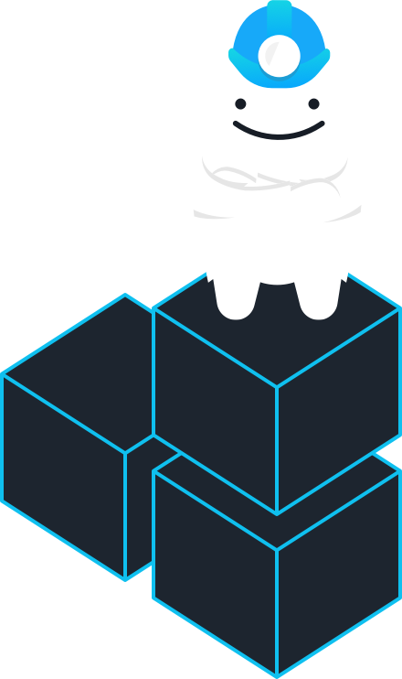
Gruntwork
Reference Architecture Walkthrough

Slide 2
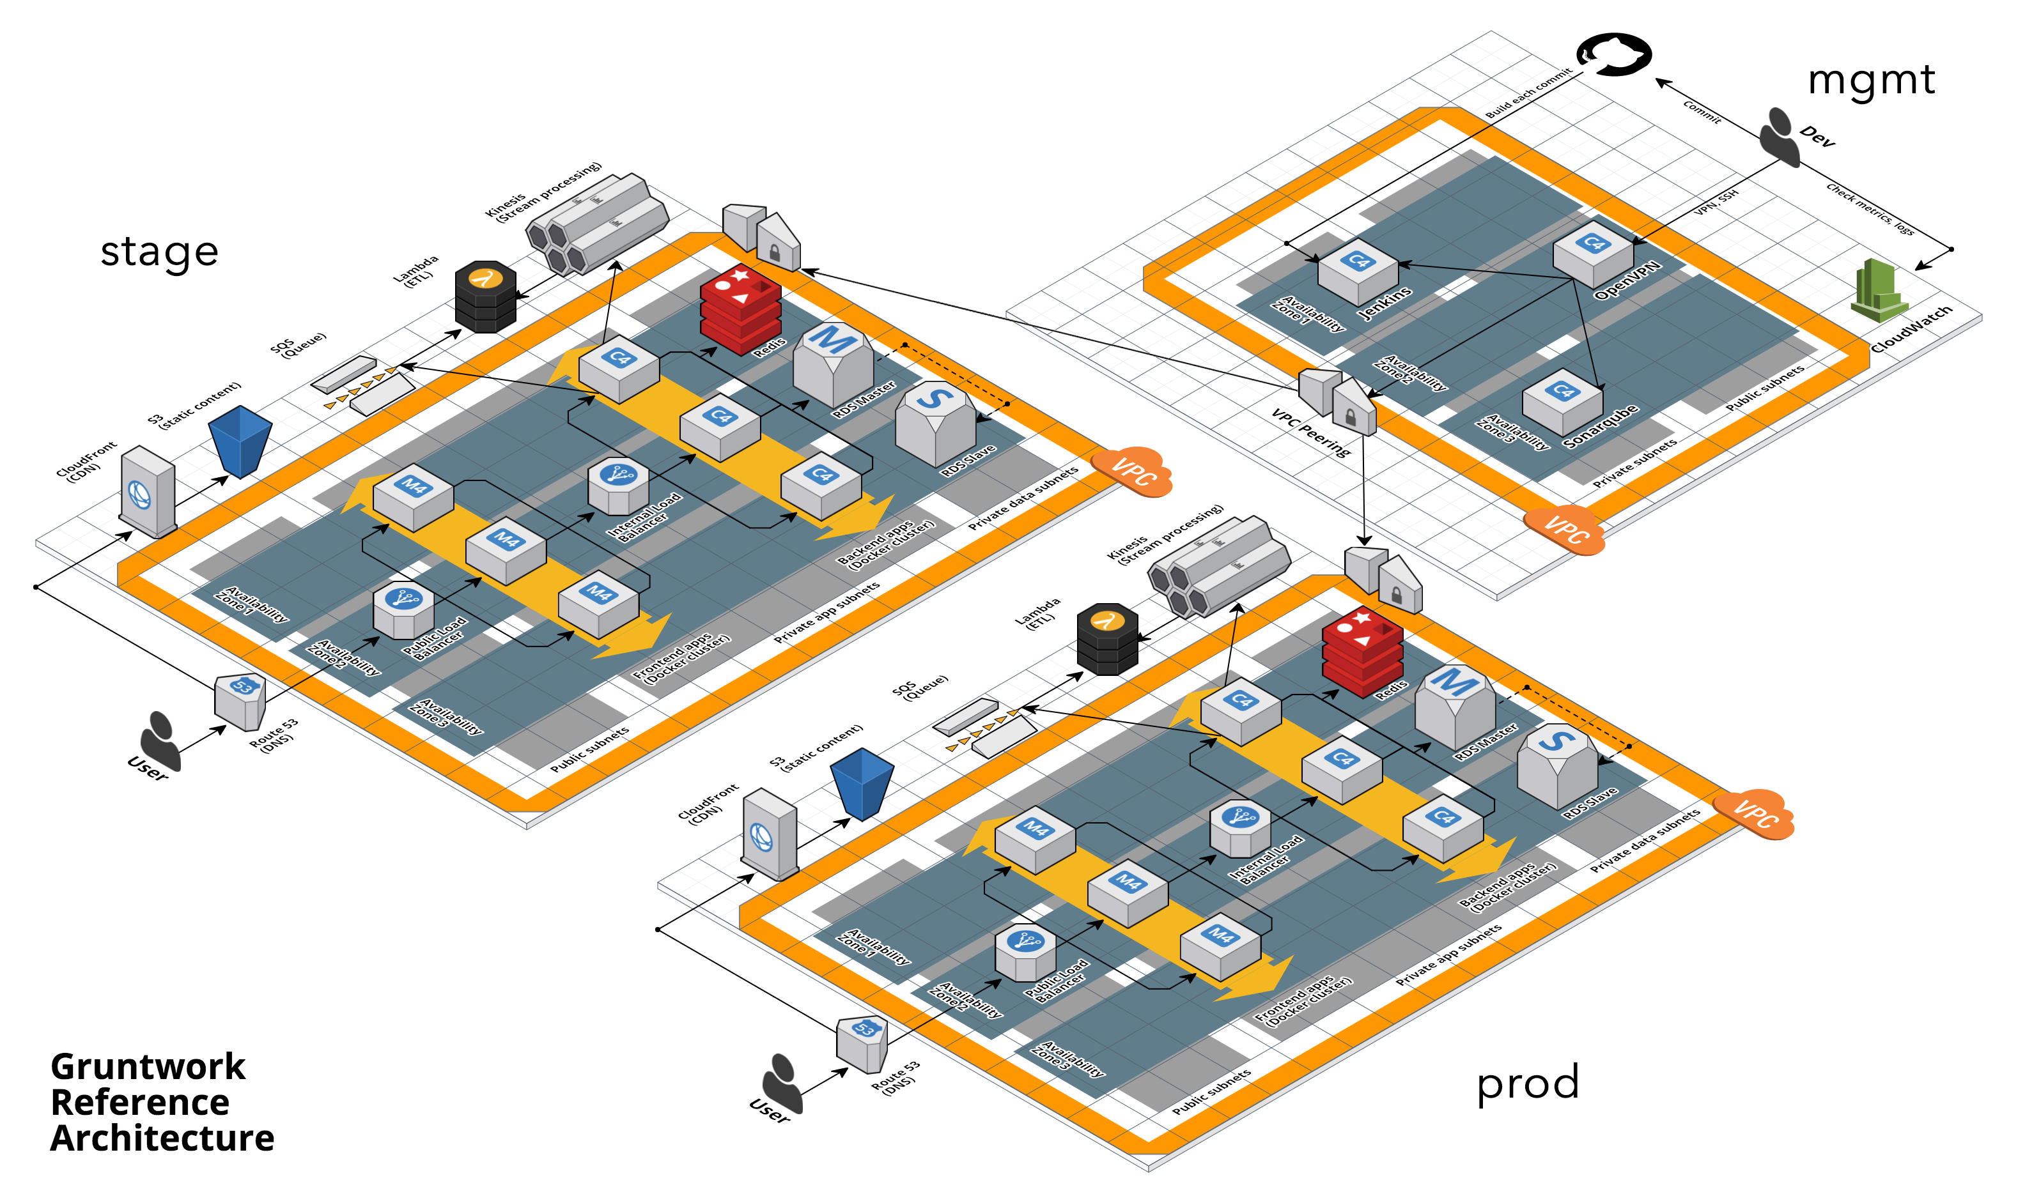
The Reference Architecture is a battle-tested, production-ready, end-to-end tech stack

Slide 3
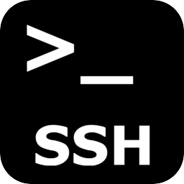
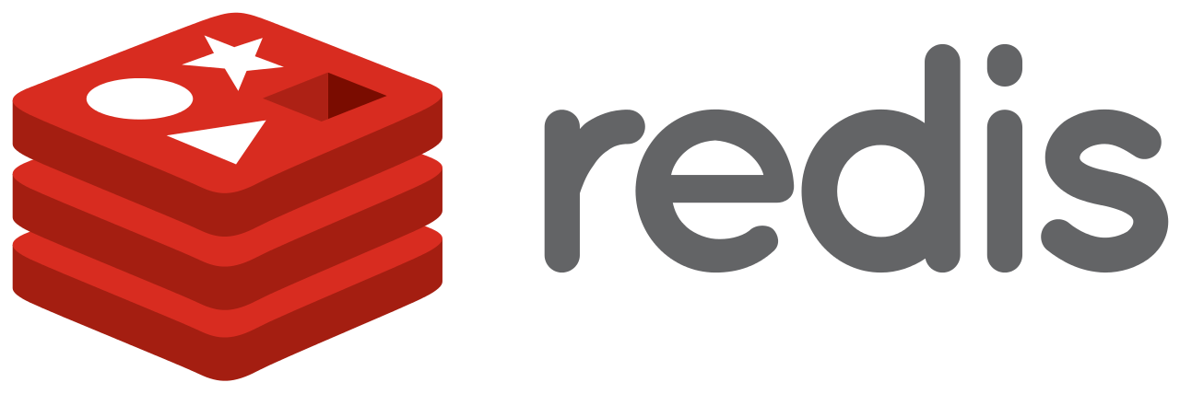
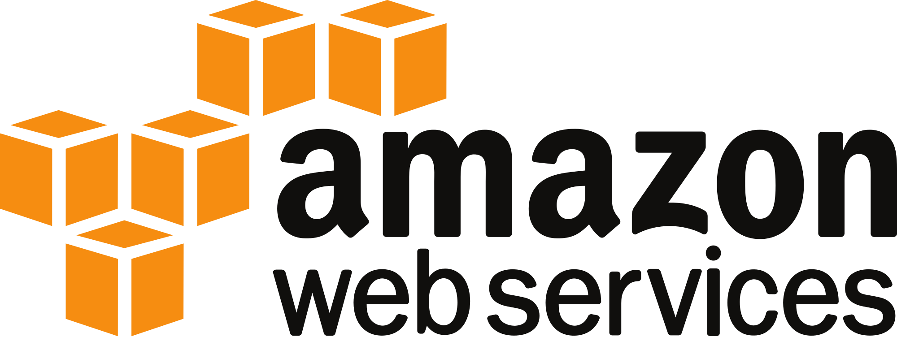
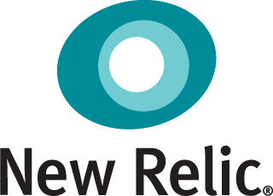
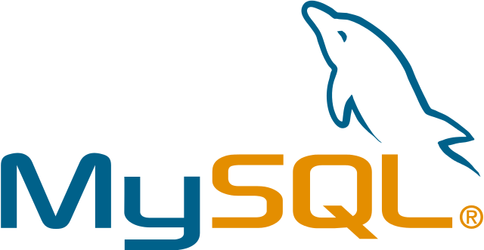
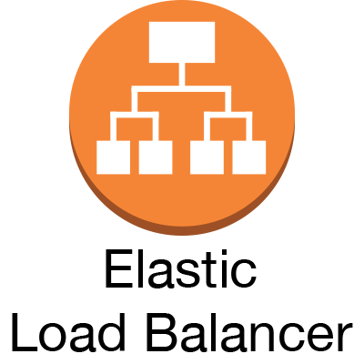
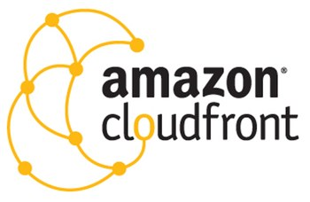
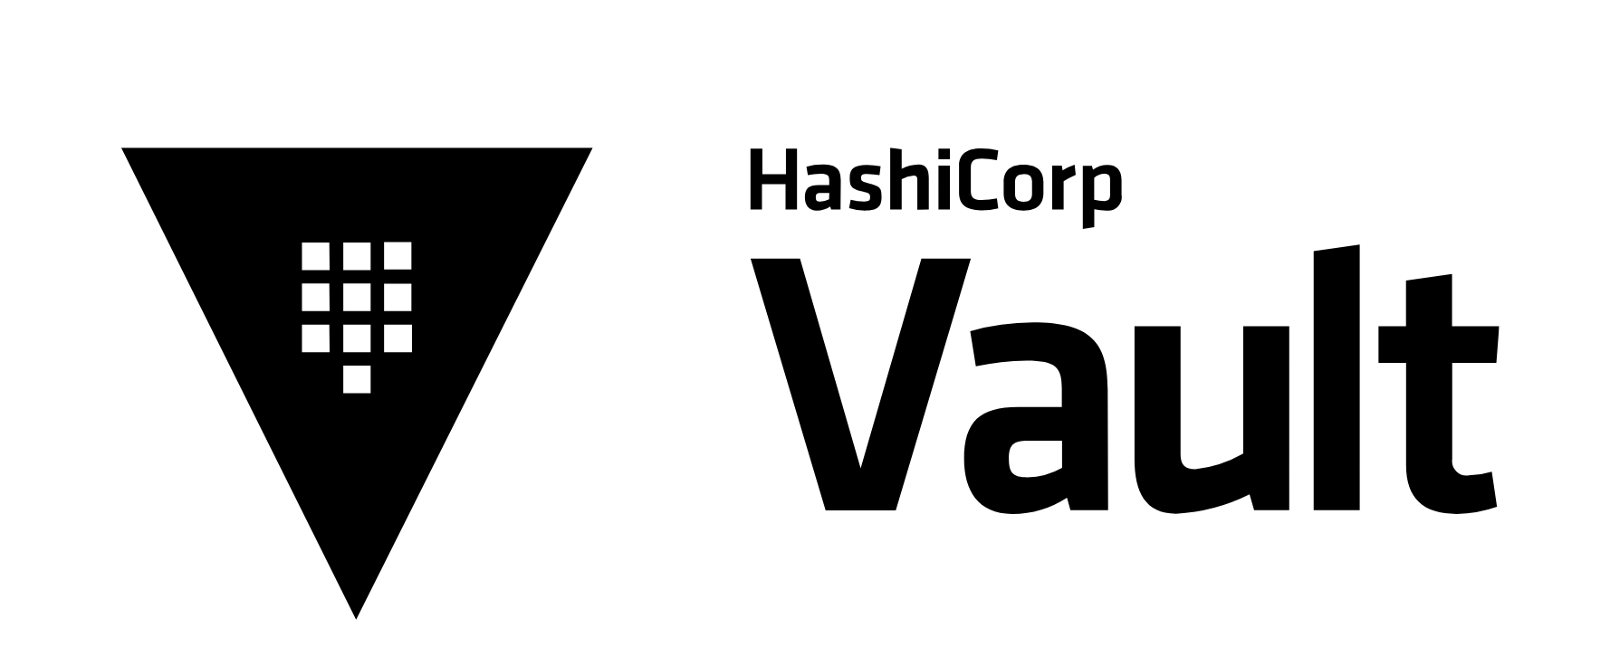
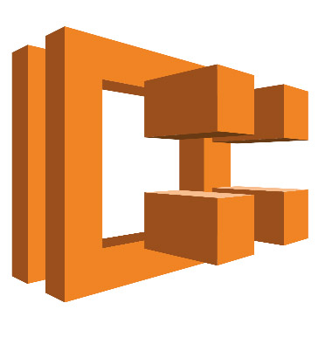
It includes everything the typical company needs

Slide 4
We deploy it in your AWS account(s)

Slide 5
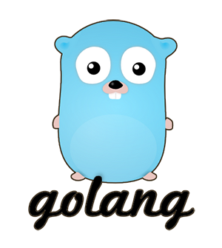
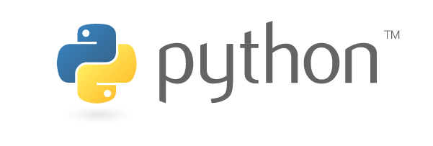
And give you 100% of the code: Terraform, Go, Python, and Bash

Slide 6
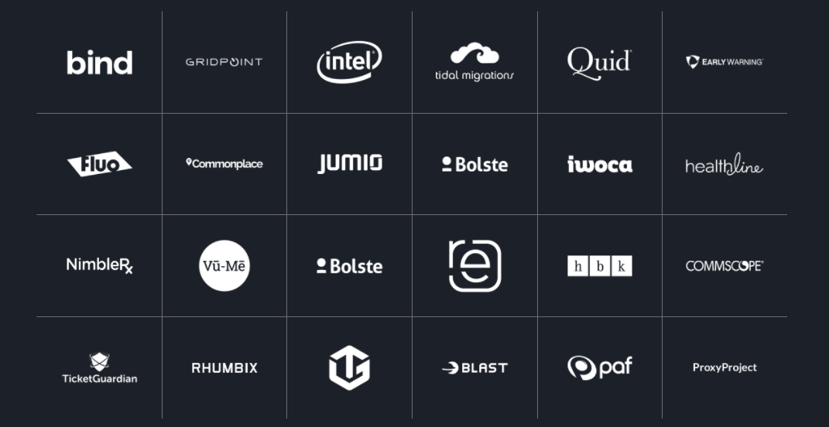
The code is used in production by dozens of customers

Slide 7
This training will show you how the Reference Architecture works

Slide 8
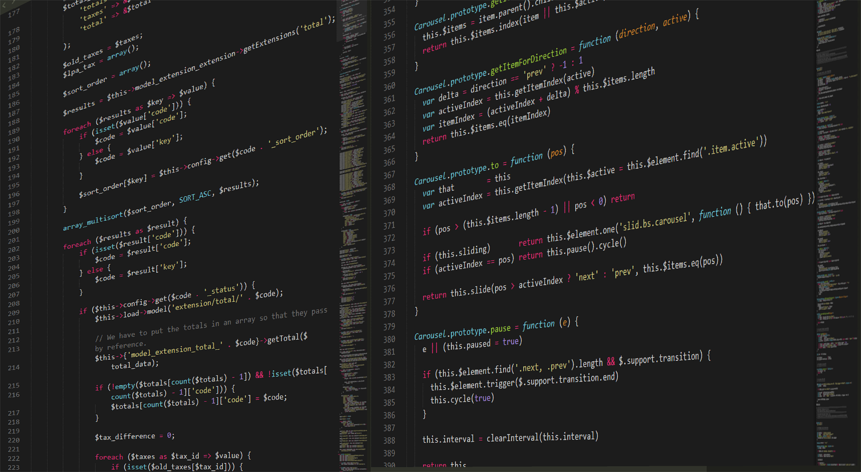
And how to make changes

Slide 9
I’m Yevgeniy
Brikman
ybrikman.com

Slide 10
Co-founder of
Gruntwork
gruntwork.io

Slide 11
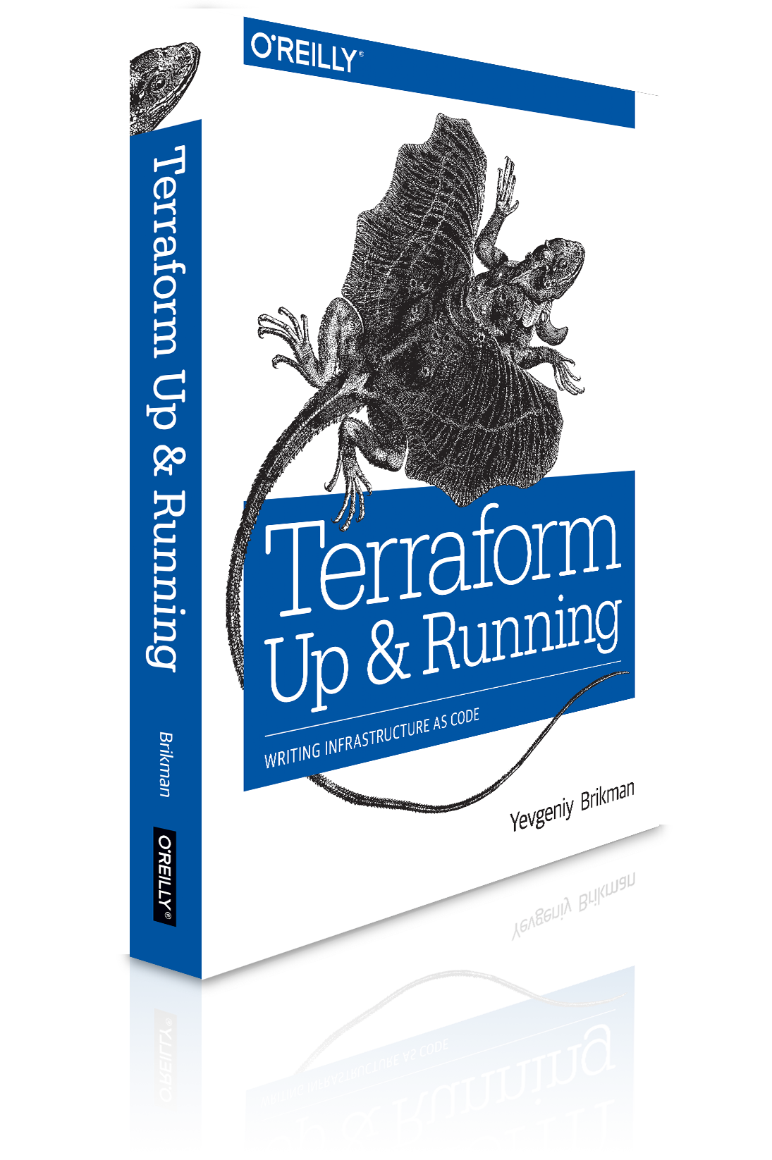
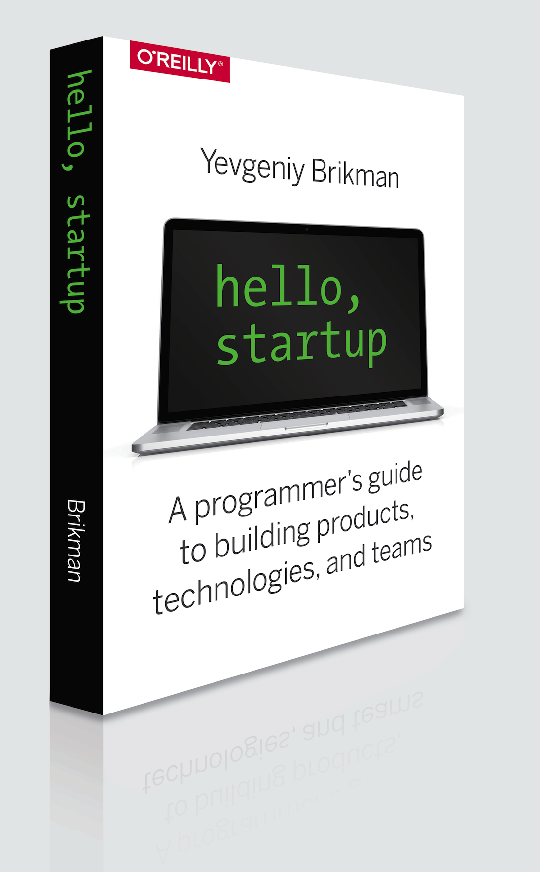
Author

Slide 12
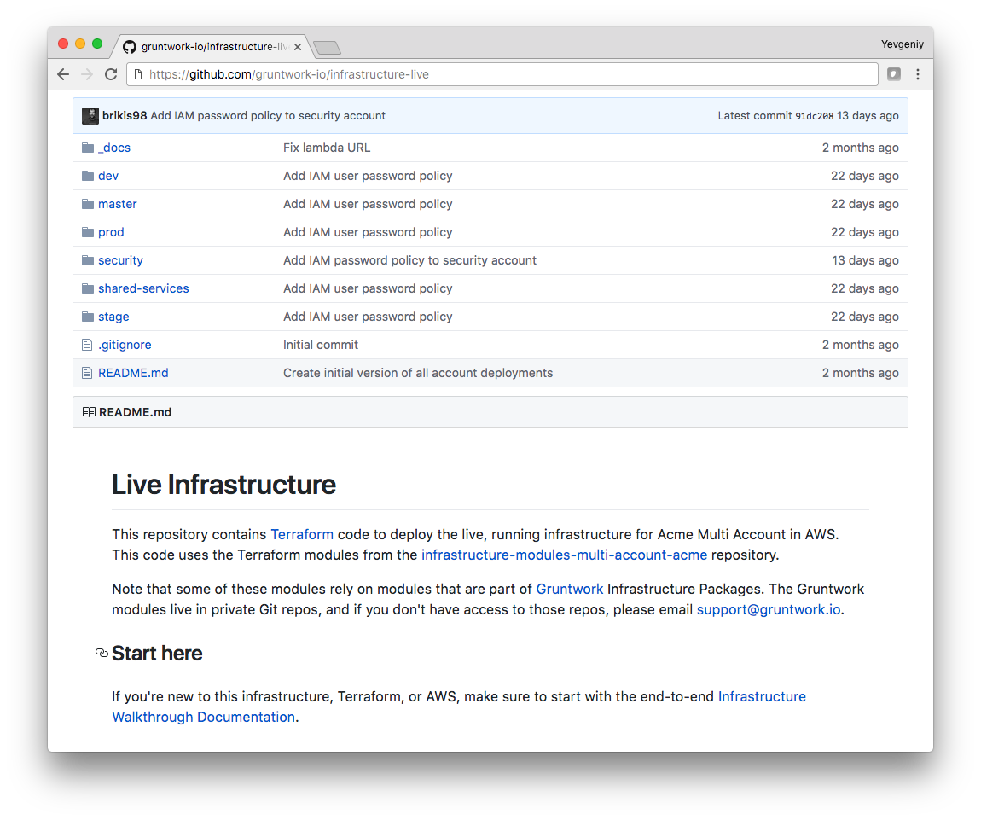
We’ll start the walkthrough in the infrastructure-live repo

Slide 13
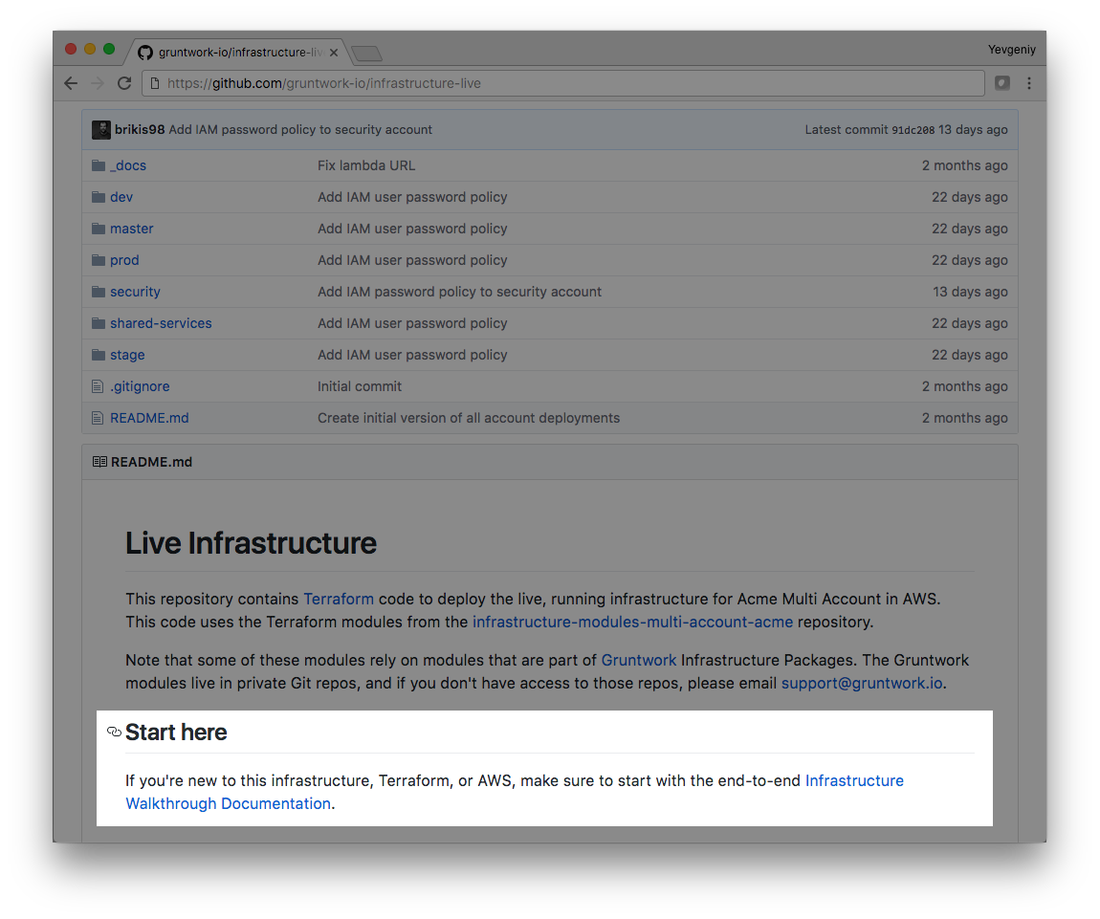
Click on the walkthrough docs link (which goes to the _docs folder)

Slide 14
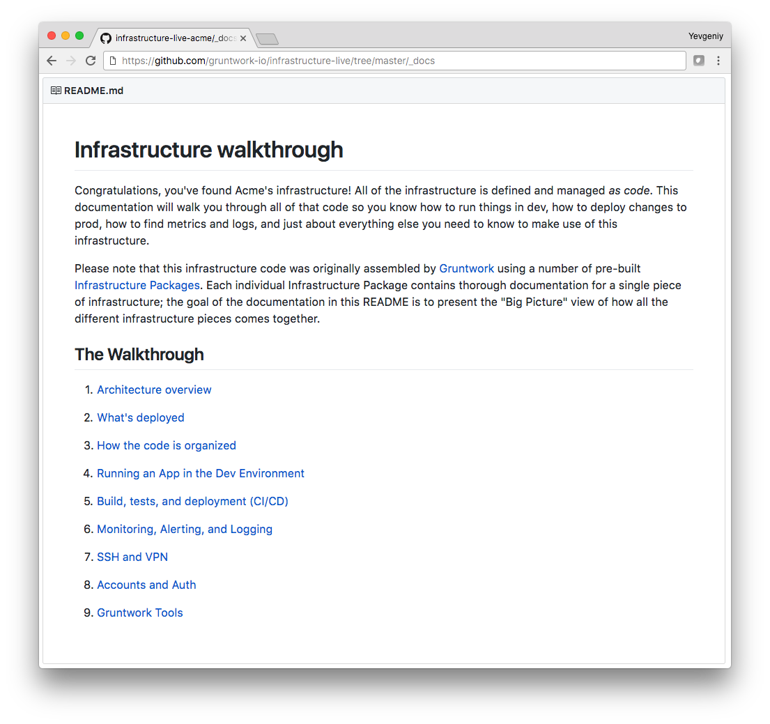
This takes you to the written version of this walkthrough

Slide 15
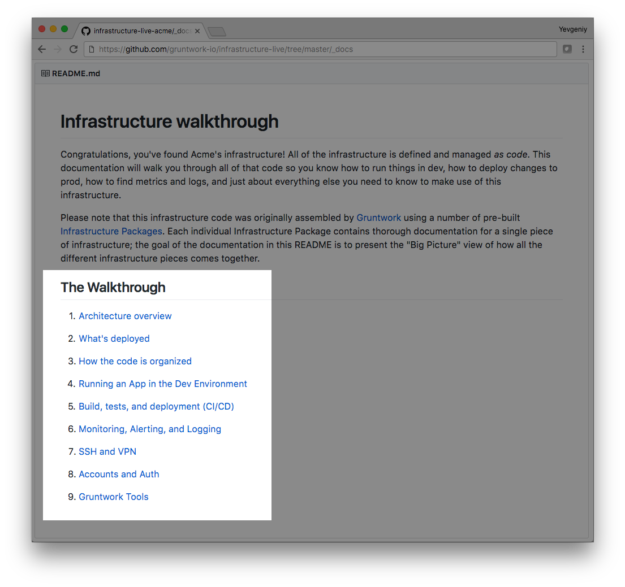
We’ll follow a similar outline

Slide 16
Outline
Architecture overview
How the code is organized
Accounts and Auth
Running an app
Build, tests, and deployment
Monitoring, alerting, logging
VPN and SSH

