Slide 1
Funding the Good
Three Effective Ways Nonprofits May Approach Fundraising From Government, Foundations, and Community Organizations
Candace Bazemore
President, J. Lane Media

Slide 2
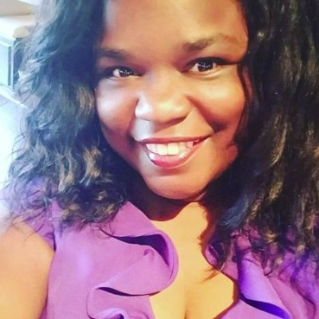
Candace Bazemore
20+ Years Non Profit Leadership Experience
15+ Years in Digital Marketing
Specialty Areas: Board Leadership, Non Profit Fundraising, Digital & Social Media Marketing, Partnership Development
Virginia Native who loves Cosplay and Dr. Pepper

Slide 3
By the end of this session I hope you will go from this...

Slide 4
…to this.

Slide 5
AGENDA
Tell Your Impact Story
Build Partnerships
Embrace Technology
Resources
Questions & Answers

Slide 6
Tell Your Impact Story

Slide 7
Build Partnerships

Slide 8
Embrace Tech!

Slide 9
Helpful Resources
Foundation Center
YouTube
Google Grant
Top People/Influencers in Your Industry
Me!

Slide 11
THANK YOU
Candace Bazemore
J. Lane Media
Email: cbazemore@jlanemedia.com | Phone: 404-931-4702
IG & TW: @TheCandaceB | LI: Candace Bazemore

