Slide 1
Child Sex Abuse, Religious Institutions,
and the First Amendment
The Ministerial Exception
CLE, Nov. 17, 2020
Leslie Griffin
Boyd Professor of Law, UNLV
November 17, 2020
leslie.griffin@unlv.edu

Slide 2
What IS the
Ministerial Exception?
It is an affirmative defense.

Slide 3
The Case of Minister Madeline Weishuhn
Weishuhn v. Catholic Diocese of Lansing, 287 Mich. App. 211, 787 N.W.2d 513 (2010)
review denied, Weishuhn v. Catholic Diocese of Lansing, 488 Mich. 852, 787 N.W.2d 507 (2010)
cert. denied, Weishuhn v. Catholic Diocese of Lansing, 565 U.S. 1155, 132 S. Ct. 1088, 181 L. Ed. 2d 976 (2012)

Slide 4
The Supreme Court’s first minex: Hosanna-Tabor (2012)
https://www.oyez.org/cases/2011/10-553

Slide 5
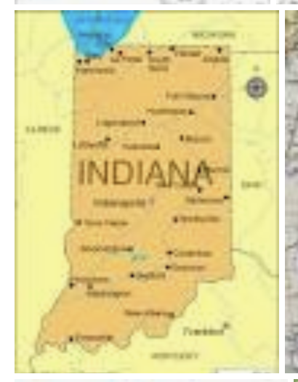
Ballaban v. Bloomington Jewish Cmty., Inc.,
982 N.E.2d 329 (Ind. Ct. App. 2013)

Slide 6
Teachers:
Fratello v. Roman Catholic Archdiocese of New York, 175 F. Supp. 3d 152 (S.D.N.Y. 2016), aff'd sub nom. Fratello v. Archdiocese of New York, 863 F.3d 190 (2d Cir. 2017)
Grussgott v. Milwaukee Jewish Day Sch., Inc., 882 F.3d 655 (7th Cir.), cert. denied, 139 S. Ct. 456, 202 L. Ed. 2d 348 (2018) (Per Curiam opinion with Judge Barrett)
Ninth Circuit: Biel and Morrissey-Berru are teachers, not ministers

Slide 7
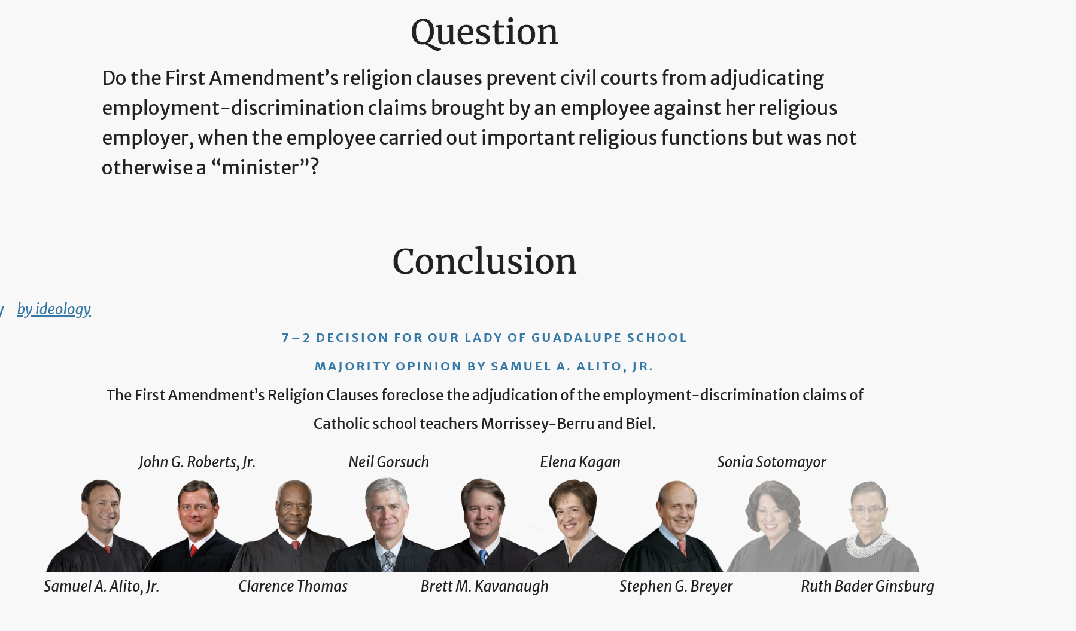
The Supreme Court (2)
Morrissey-Berru (2020)

Slide 8
Racial Discrimination:
Ross v. Metro. Church of God, 471 F. Supp. 2d 1306 (N.D. Ga. 2007)
Rweyemamu v. Cote, 520 F.3d 198 (2d Cir. 2008)
Alicea-Hernandez v. Catholic Bishop of Chicago, 320 F.3d 698 (7th Cir. 2003)

Slide 9
Gender Discrimination:
McClure v. Salvation Army, 460 F.2d 553 (5th Cir. 1972)
Petruska v. Gannon University, 462 F.3d 294 (3d Cir. 2006)
Combs v. Central Texas Annual Conference of United Methodist Church, 173 F.3d 343 (5th Cir. 1999)
Dias v. Archdiocese of Cincinnati, No. 1:11-CV-00251, 2012 WL 1068165 (S.D. Ohio Mar. 29, 2012)

Slide 10
Sexual Orientation Discrimination:
Bollard (9th Cir. 1999)
McKelvey v. Pierce (NJ 2002)
Matthew Barrett (Mass. Super. 2015)
Demkovich (7th Cir. 2020)

Slide 11
Hospitals:
Shaliehsabou v. Hebrew Home of Greater Washington, Inc., 363 F.3d 299 (4th Cir. 2004)
Penn v. New York Methodist Hosp., 884 F.3d 416 (2d Cir.), cert. denied, 139 S. Ct. 424, 202 L. Ed. 2d 317 (2018)

Slide 12
Going Forward?
Contracts??
Morrissey-Berru (2020)
Demkovich, 2-1 (7th Cir. 2020)
Look at the Facts--More Protection Against Child Abuse!

Slide 13
Thank You!
Questions?

